Slide 1
Kick Out Cervical Cancer from Nigeria: A Need to Implement the Global Strategy
Cyril C. DIM
Professor/Consultant Obstetrician & Gynaecologist
College of Medicine UNN/UNTH, Ituku-Ozalla
Presentation to Nigeria Health Commissioner Forum
3rd September 2021

Slide 2
Declaration
None
Except
Member, WHO DG’s Expert Group for the Elimination of Cervical Cancer Initiative
A volunteer committee → developed the Global Cervical Cancer Elimination Strategy, & is advocating for its implementation

Slide 3
Objectives
Cause, course,& burden of cervical cancer locally & globally
Global elimination strategy interventions/targets
Emphasize that Nigeria can effectively implement a nationwide HPV vaccination of eligible girls
Introduce Resolutions of WHO Africa’s Regional Committee for Africa (71st Session, August 2021)
Request NCHF to kickstart the introduction of HPV vaccination in the National Immunization schedule
Request HPV vaccination awareness & implementation at State level

Slide 4
Burden of Cervical Cancer (Ca Cx)
Globally → one of the most common causes of cancer deaths
Within ages 15 – 59 yrs:
2nd most common cancer/cause of cancer deaths in Nigeria, Africa, & worldwide
½ million new cases & 300,000/yr
90% occur in less developed Nations
By 2030 → ↑ 700,000 new cases & 400,000 deaths, if nothing is done!

Slide 5
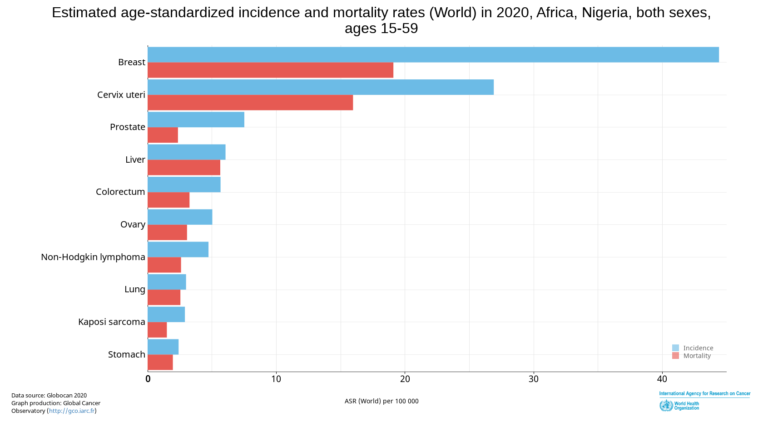

Slide 6
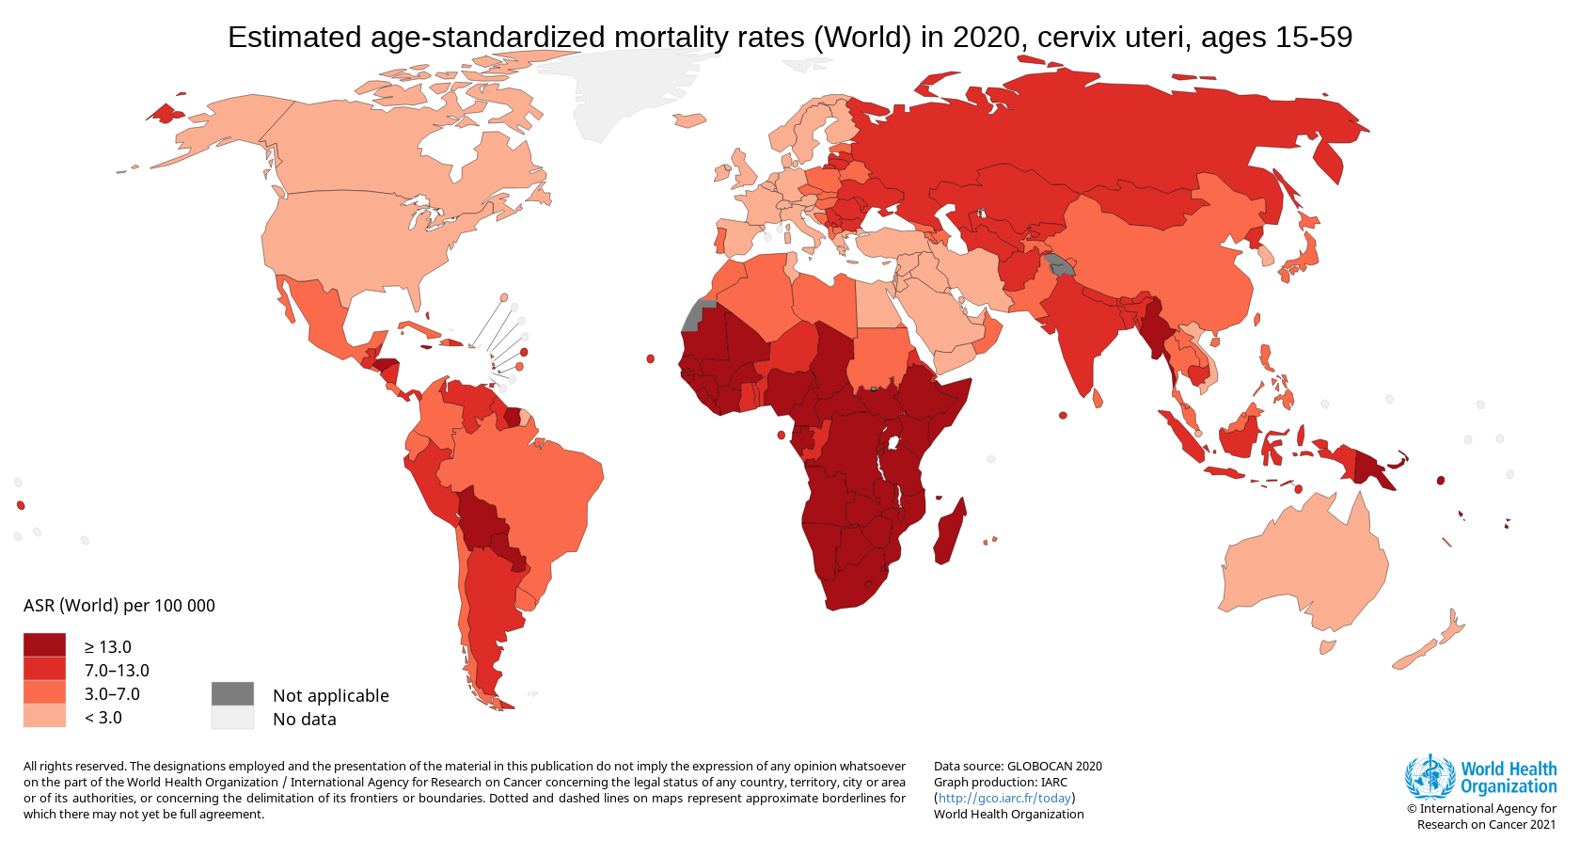
Nigeria

Slide 7
Cause & Course of cervical cancer
Peculiar Disease Course
Prolonged precancer stage = cervical intraepithelial lesion
Detectable by routine screening & treatable
Screening = HPV-based screening methods, not accessible in Nigeria
Ca cx → Early & Late stages
Early-stage → curable
Late-stage → No cure (palliative treatment only!)
Cause of Ca Cx
Persistent infx by high-risk human papillomavirus (HPV) types
About 14 HPV types → associated with Ca Cx
Types 16 & 18 → over 70% of the disease
Included in approved HPV vaccines

Slide 8
But, there is ‘Good News’ About Ca Cx
Ca Cx → Vaccine preventable
Because of the established viral (HPV) cause
The precancer stages last long
Identifiable through screening, &
Effectively treated
Based on the “good news”,
WHO → Global Ca Cx Elimination Strategy
Ambitious, all-inclusive, and evidence-based strategy
Launched by member nations in November 2021 – including Nigeria

Slide 9
Global Ca Cx Elimination Strategy (90-70-90)
Target year of the global Strategy → 2030
Prescribed 3 interventions → achievable by every Nation if there is enough political will
My team’s mission → to mobilize credible stakeholders to encourage Govt political will, etc

Slide 10
Projected Ca Cx Incidence if Developing Nations achieve the 2030 target & sustain it?

Slide 11
Cervical Cancer Elimination: Nigerian status
All 3 interventions →
Simultaneous implementation nationwide to achieve goal of Ca Cx elimination (< 4 cases/100,000 women-yrs) by end of century
Simultaneous implementation of 3 interventions →
? realistic in Nigeria for now!
Where do we start?
Nationwide implementation of HPV vaccination for eligible young girls!
How do we achieve this?
Inclusion of HPV vaccination in the National Immunization Schedule
Any global challenge
Yes → Inequity in HPV vaccine distribution b/w rich Vs poor countries

Slide 12
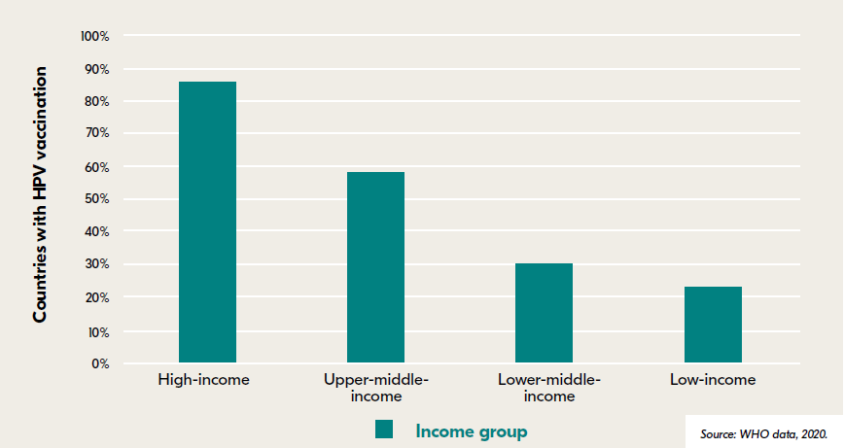
Nations with HPV vaccine in national immunization schedule by World Bank income Grp

Slide 13
Vision: An African Region free of Ca Cx a public health problem
Goal: To ultimately eliminate Ca Cx as a public health problem in the African Region

Slide 14
Their Objectives
introduce and scale up HPV vaccine in routine national immunization programmes
increase coverage of, and access to screening and appropriate management of precancerous lesions
increase coverage of, and access to diagnosis and management of cervical cancer and palliative care as needed
strengthen capacity for monitoring and evaluation of cervical cancer prevention and control for performance tracking

Slide 15
Summary Objectives, milestones, etc

Slide 16
So, what have I been saying?
Ca Cx → caused by HPV & has a favourable disease course
Ca Cx → preventable; & curable (if identified early)
Ca Cx burden (new cases & deaths) → very high in Nigeria
HPV vaccination of girls (9-14 years) prevents Ca Cx
It is one of the 3 interventions in Global Ca Cx Elimination Strategy
Nigeria may not be able to implement 3 interventions now but,
We should start immediately by including HPV vaccination of girls in National immunization schedule & meet the 90% target by 2030
While scaling up the other interventions

Slide 17
Action Sought - 1
Implement Ca Cx elimination strategy in Nigeria jointly/individually
Fed. Govt. level:
Advocate for implementation of WHO 90-70-90 Ca Cx elimination strategy in Nigeria, starting with the most feasible intervention, i.e.,
inclusion of HPV vaccination into routine national immunization schedule
Includes mobilizing global linkages → counter the HPV vaccine distribution inequity
Notes:
although the above interventions (Government and Diocesan) are not all-inclusive as would have been preferred by WHO maximum results, they will serve as a good starting point to join the global community in achieving Universal heath in the area of cervical cancer elimination.

Slide 18
Action Sought - 2
State level:
Educate State Exco on WHO 90-70-90 global strategy, & WHO African Regions milestones for achieving the Global target
Develop State-level budgeted Ca Cx control plan & encourage your State to make a specific budgetary allocation for the plan
Use existing programs in your State (e.g., Immunization program) to create Ca Cx prevention awareness
Include HPV vaccination into routine immunization schedule of the State
Work with the State Ministry of Education to initiate school-based HPV education & vaccination of eligible girls
Join global celebration of 1 yr anniversary of Global Strategy launch (17th Nov.)
Notes:
although the above interventions (Government and Diocesan) are not all-inclusive as would have been preferred by WHO maximum results, they will serve as a good starting point to join the global community in achieving Universal heath in the area of cervical cancer elimination.

Slide 19
You can illuminate a public place in your state capital-
color = teal with hexadecimal color code #008080

Slide 20
Please,
Let’s Join hands & eliminate this PREVENTABLE Cancer from Nigeria & the world
We can do it
May God bless us as we do so

Slide 21
Acknowledgments
Dr Vincent Okpala, Commissioner for Health, Anambra State → facilitated this presentation
Hon. Minister of Health / Commissioners – good efforts at improving health care delivery & promotion in Nigeria
God bless Nigeria
Notes:
Episcopal Chairman of CBCN Health Committee: Most Rev. Stephen Mamza (Bishop of Yola) → facilitated this presentation & for his unusual simplicity

Slide 22
Pls, Continue Encouraging Nigerians to Keep Safe from COVID-19
Failure to do that is nothing but,
“Not-My-Portion Syndrome” (Dim CC, 2019)
Thank you

Slide 23
References
International Agency for Research on Cancer / WHO. Global Cancer Observatory: Cancer Today. Lyon, France: International Agency for Research on Cancer. 2020. https://gco.iarc.fr/today
WHO. Global strategy to accelerate the elimination of cervical cancer as a public health problem. Geneva: WHO 2020. https://www.who.int/publications/i/item/9789240014107
Dim CC. “Not My Portion” Syndrome: The Bane of Cervical Cancer Prevention and Women’s Health Promotion in Nigeria. 152nd Inaugural Lecture: University of Nigeria; lecture given 2019 June 20. https://drive.google.com/file/d/16x6gpaxPNEm7_2b57m_FWZJ_4z-MtMah/view

