Slide 1
LEVERAGING ON PPP WITH THE LOCAL PHARMA MANUFACTURING GROUP:
AN OPPORTUNITY FOR STATES TO STRENGTHEN THEIR DRUG SUPPLY CHAIN AND INCREASE ACCESS TO MEDICINE.
FRANK MUONEMEH
Executive Secretary PMG-MAN

Slide 2
OUTLINE
PMG-MAN Overview
Our Success Story
- WHO CGMP certification
- 5TH Nigeria Pharma Manufacturers Expo
Our ambitious goals
Partnership that works
What we expect from State actors.

Slide 3
PMG-MAN OVERVIEW
BY THE NUMBERS
SINCE 1983

Slide 4
120+
MEMBERS
PMG-MAN is an umbrella body of over one hundred and twenty (120+) active members.
We collectively play key roles in ensuring that Nigerians have timely access to affordable, safe and high-quality medicines.
We contribute largely to National Development.

Slide 5
60%
VOLUME
OF HEALTH PRODUCTS
Nigeria accounts for over 60% of pharmaceutical manufacturing in West Africa.
Nigeria remains one of the most vibrant and fastest growing pharmaceutical market in West Africa.
Nine(9) of the PMG-MAN member companies are listed on the Nigerian Stock Exchange. (Frost & Sullivan 2013)

Slide 6
N500BILLION
IN NATION BUILDING,
TAXES AND TARRIFS
Estimated value as at 2018 that the sector contributes to nation building, paying taxes and other tariffs.

Slide 7
2,000,000
EMPLOYEMENT
(DIRECT & INDIRECT)
Number of persons that are employed directly or indirectly by the Industry.

Slide 8
30%:70%
RATIO
(LOCALLY MANUFACTURED/IMPORT)
The approximated ratio of local manufacturing to imported medicine in Nigeria.
We are changing the narrative to 70% locally manufactured medicines.

Slide 9
70%
LOCAL
The National Drug Policy demands that at least this percentage of medicine be procured from local manufacturers.
This is in line with Executive Order 003 of the Federal Government of Nigeria.

Slide 10
OUR SUCCESS STORY

Slide 11
WHO cGMP
CERTIFICATION
Four (4) PMG-MAN member companies in Nigeria are WHO cGMP certified. Their facilities have been certified for global and local manufacturing.
Swiss Pharmaceutical
Chi Pharmaceutical
Evans Medical Plc.
May & Baker Plc.

Slide 12
PARTNERSHIP FOR
CAPACITY DEVELOPMENT
WEST AFRICAN HEALTH ORGANIZATION(WAHO)
UNITED NATIONS INDUSTRIAL DEVELOPMENT ORGANIZATION(UNIDO)
UNITED STATES PHARMACOPIA(USP)
AFRICAN RESOURCE CENTER /PRIVATE SECTOR HEALTH ALLIANCE(ARC/PHA)
NATIONAL AGENCY FOR FOOD AND DRUG ADMINISTRATION(NAFDAC)
FEDERAL MINISTRY OF INDUSTRY TRADE AND INVESTMENT(FMITI)
GIZ Nigeria.
PPP WITH YOBE STATE GOVERNMENT.

Slide 13
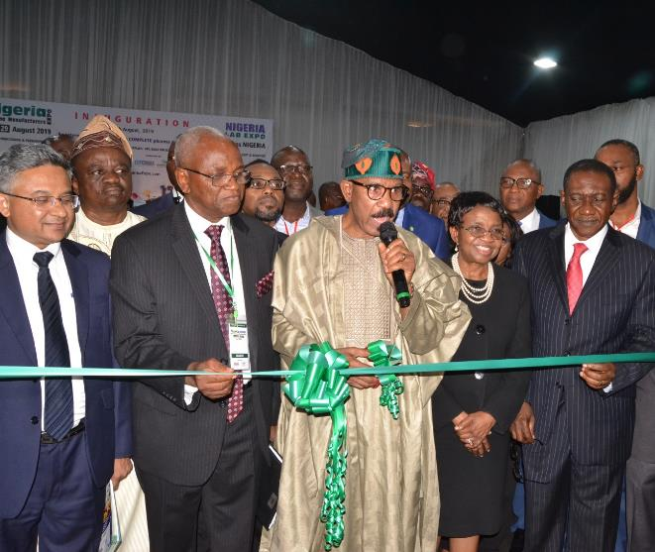
2019
A traditional event that holds biennially to showcase a wide range of pharma equipment and inputs which cover the entire pharma manufacturing industry and locally finished pharmaceutical products.
It encourages further development of local manufacturing capacity and production of high quality, safe and affordable medicines

Slide 14
OUR AMBITIOUS
GOALS

Slide 15
GOAL 1
INTERVENTION FUND
We seek for Intervention fund for sustainable export and expansion, to update, upgrade and scale up our facilities.

Slide 16
GOAL 2
CHANGING THE NARRATIVE & FOCUSING BEYOND
DONOR AID
To reverse our over dependence on imported medicine.
We are changing the narrative, we have sowed the seed towards Self Reliance and looking beyond Donor Aid.

Slide 17
GOAL 3
ENSURE ATTAINMENT OF MEDICINE SECURITY
To Prepare to attain Medicine Security and National Self sufficiency within the context which government policies allows.

Slide 18
WHY PPP WITH
LOCAL PHARMA
MANUFACTURING SECTOR

Slide 19
…Partnership that works
WE ARE NOT RE-INVENTING THE WHEELS.
PETROLEUM TRUST FUND OF 1994-1999.
YOBE STATE DRUG MANAGEMENT AGENCY-ARC PPP
WE HAVE DONE IT BEFORE

Slide 20
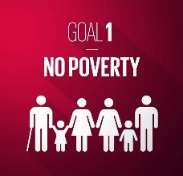
THE NEXUS BETWEEN SDG,
MEDICINE SECURITY &
UNIVERSAL COVERAGE
There are strong linkages between Medicine Security, Universal Health Coverage, and attaining the Sustainable Development Goals(1,3,8,9)
Achievement of Medicine Security and UHC is fundamentally dependent on increasing production, improving quality of Medicines produced, ensuring access to this quality medicines to the last mile.

Slide 21
POPULATION BOOM
The UN report predicts that by 2050,more than half the worlds population will be concentrated in NIGERIA and Nine other countries.
Nigeria is to be the 3RD LARGEST POPULATION IN THE WORLD.
Nigeria occupies a dominant position in Africa as the most populous country.
With this population, comes high incidence of diseases that puts the country at high Medicine Security risk, if we don’t manufacture our own medicine.

Slide 22
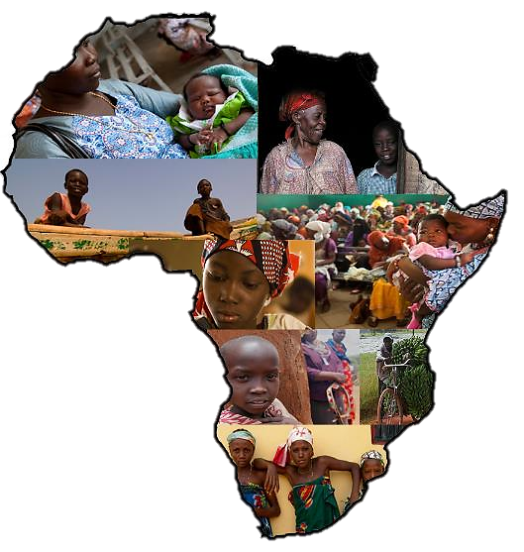
NATIONAL DEVELOPMENT
AND SOCIAL ECONOMIC
PERSPECTIVE
Evidence suggests that the local pharma manufacturing has contributed immensely by not only satisfying the nations medicine needs but also in the boost of the nations economy.
The industry creates jobs in millions.
The industry helps to reduce pressure on our foreign reserves.
It attracts Forex and Foreign Direct Investment.

Slide 23
AfCFTA REGIME
Africa Continental Free Trade Agreement regime just started. We all have to key into the benefits of the regime.
The partnership will be a win-win in Access to Medicine.

Slide 24
WHAT THE INDUSTRY
EXPECTS OF THE
STATE ACTORS

Slide 25
TRUST IS A BURDEN

Slide 26
INSTITUTIONALISED
SYSTEMS
DEVOID OF POLITICAL INTERFERENCE

Slide 27
ENGAGING THE THIRD PARTY FOR EFFECTIVE QUANTIFICATION AND FORECASTING AND BUILDING TRUST

Slide 28
THANK YOU !

