Slide 1
Sustaining Action: Nigeria’s state-level COVID-19 response
Nigeria Health Commissioners’ Forum Meeting
Dr Chikwe Ihekweazu
Director General
3rd September 2021

Slide 2
The first fundamental question is how do we strengthen and sustain our response to the COVID-19 pandemic and other disease outbreaks

Slide 3
Current situation

Slide 4
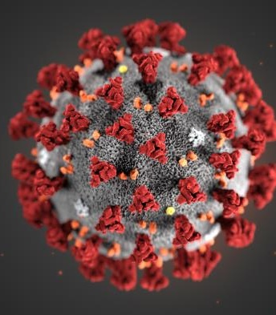
COVID-19 in Nigeria
AS AT 3RD SEPTEMBER 2021
193,644
2,488
Confirmed cases
Deaths
36 + 1
States

Slide 5
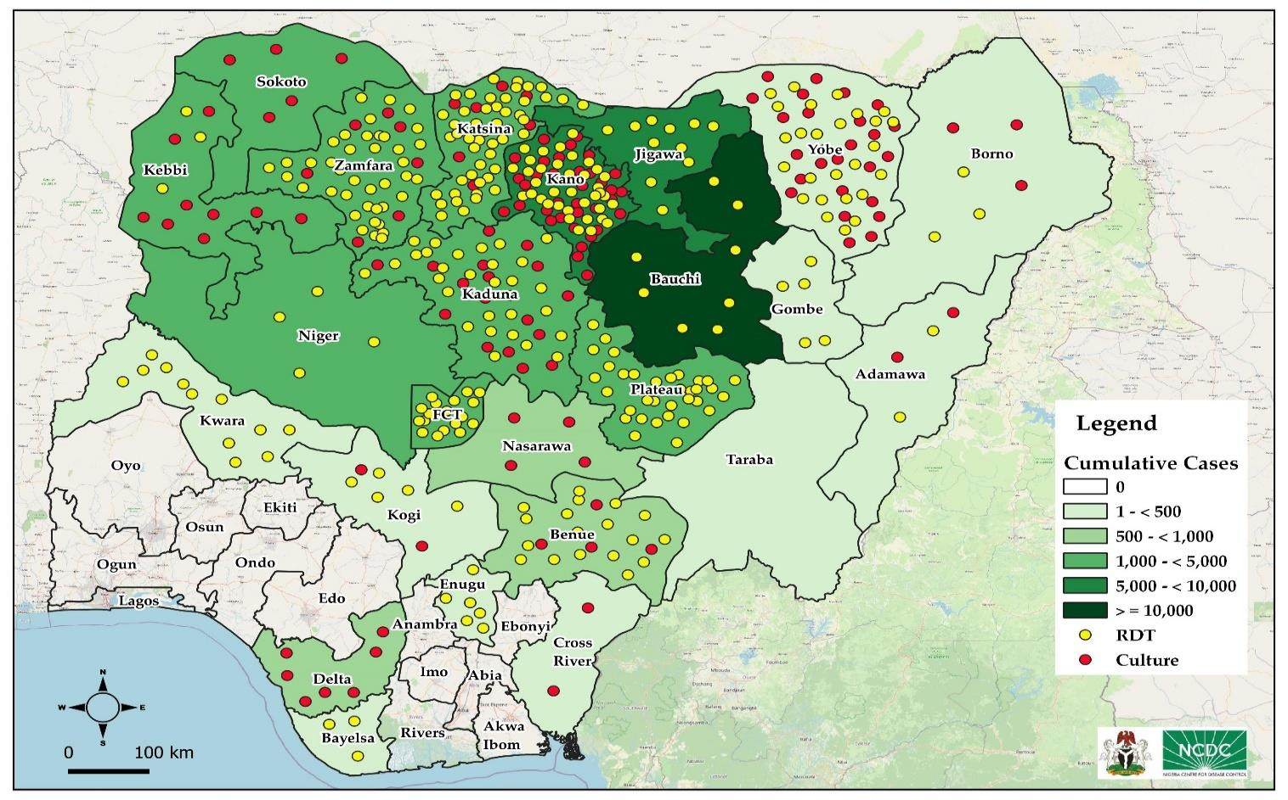
Cholera in Nigeria (Week 1-33)
AS AT WEEK 33
58,698
2,035
Suspected cases
Deaths
23 + FCT
States

Slide 6
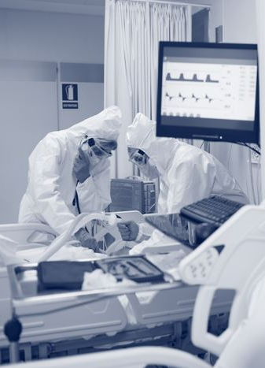
Continued health security threats
Global shortage of vaccine supply
Inequity in vaccine access
Reports of breakthrough infections
Delta variant and increased transmissibility
Other outbreaks – Ebola, Marburg, cholera

Slide 7
The second fundamental question is how do we strengthen and sustain our response to the COVID-19 pandemic and other disease outbreaks, in the context of ongoing threats?

Slide 8
NCDC’s support to states

Slide 9
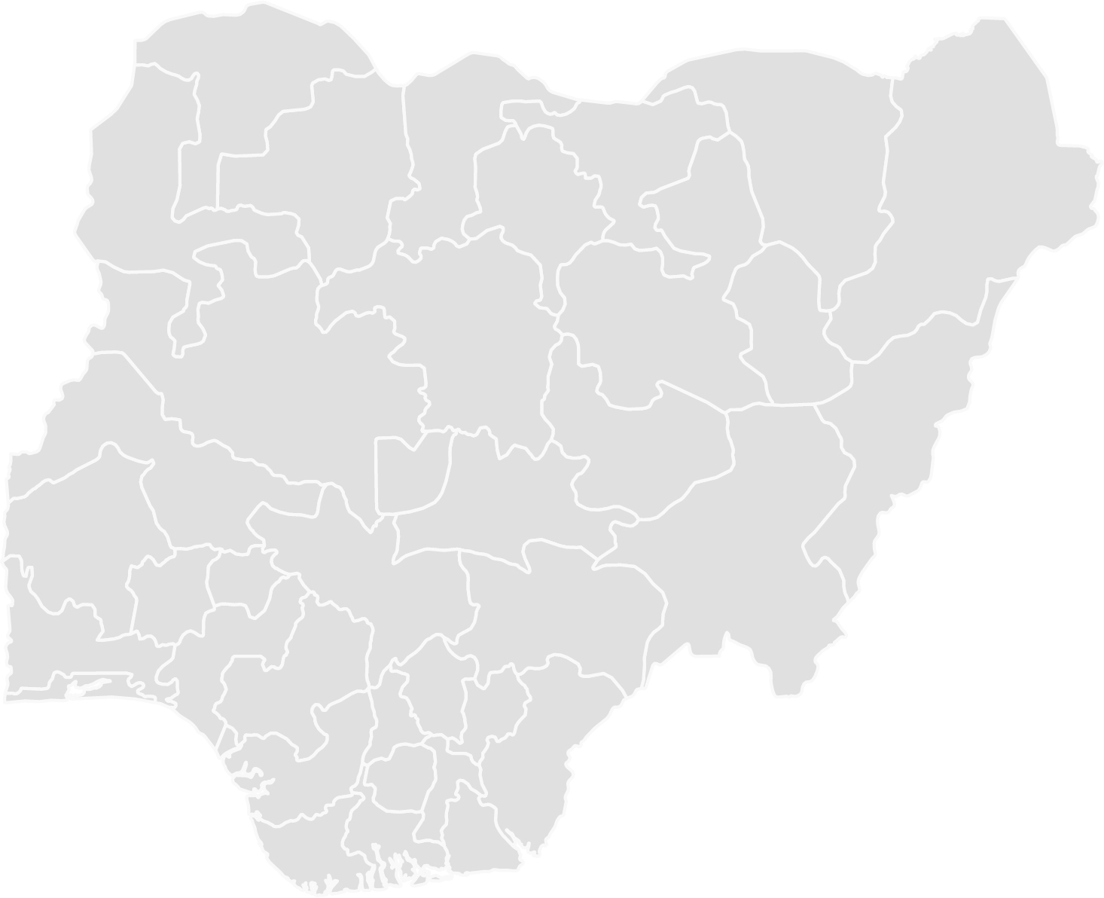
NCDC’s Role
Article N Part II of the NCDC Act (2018) mandates the agency to provide guidance, technical and logistic support to the States and Local Governments for the planning, implementation and management of diseases of public health importance and on activities to reduce health risk and impact from public health events.
The Nigeria Centre for Disease Control is the country’s national public health institute with the mandate to lead the prevention, preparedness for, detection and response to infectious disease outbreaks.

Slide 10
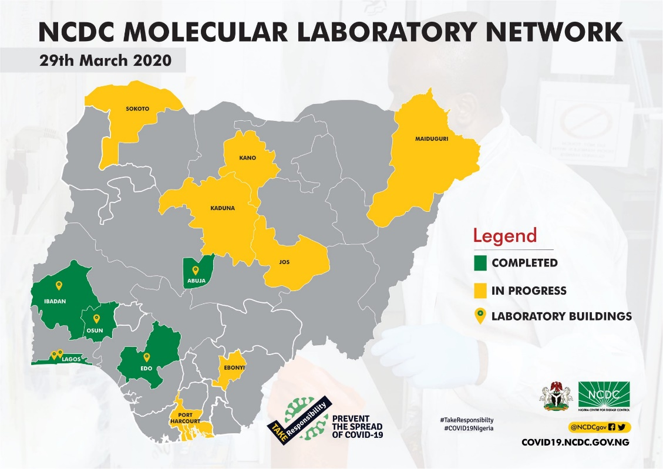
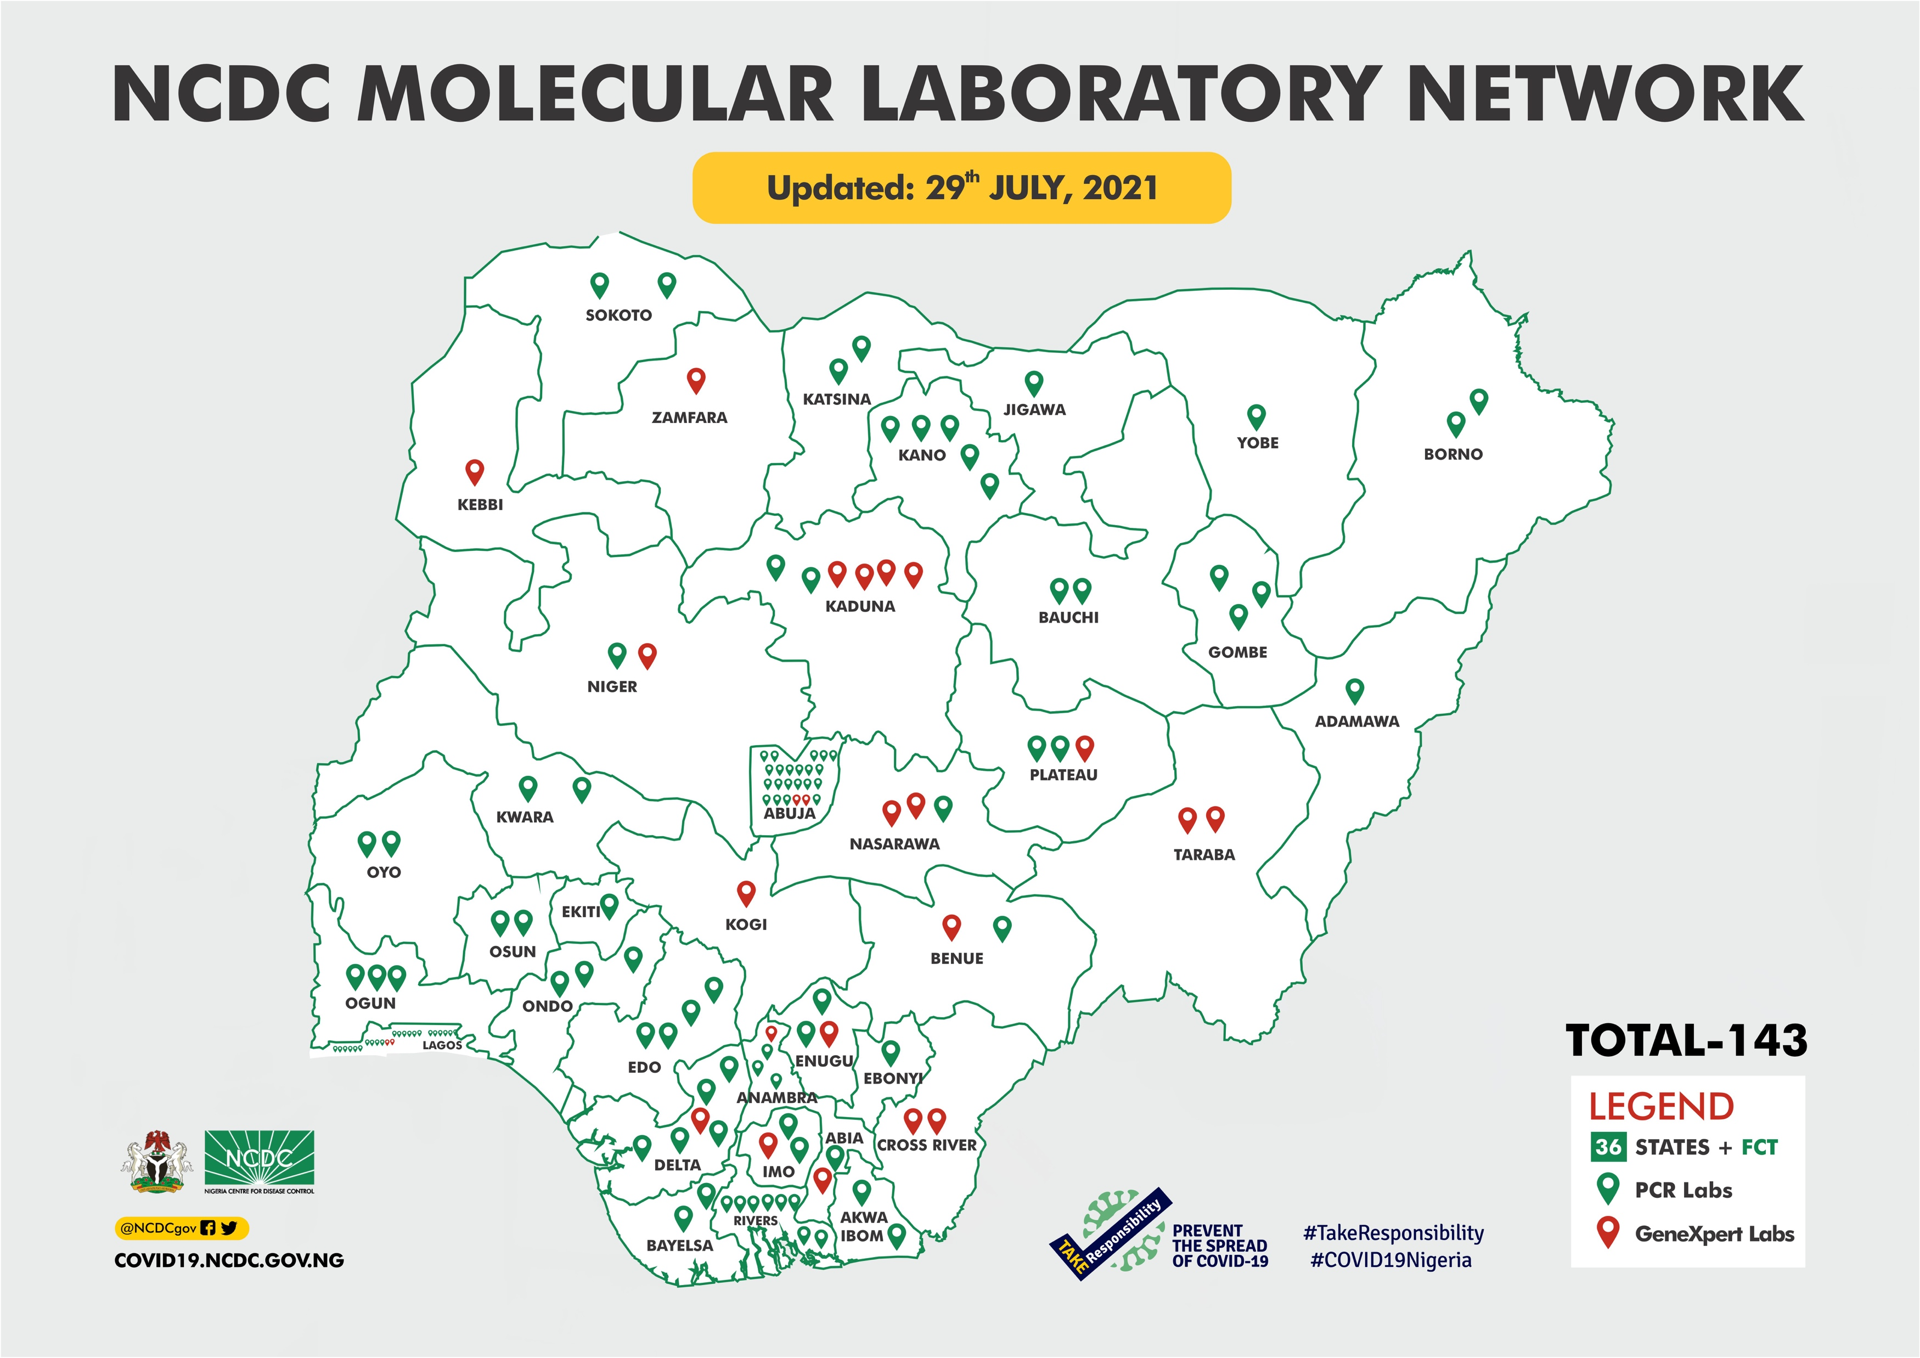
Establishing labs in states
2020
Currently
By July 2021 > 140 government PCR labs have been activated in Nigeria’s COVID-19 Laboratory Network.

Slide 11
New standard molecular labs in states
Federal Capital Territory - University of Abuja Teaching Hospital, Gwagwalada | Complete and functional
Anambra State - Chukwuemeka Odumegwu Ojukwu Teaching Hospital, Awka | Complete and functional
Ebonyi State - Alex Ekwueme Federal University Teaching Hospital, Abakaliki | Complete and functional
Edo State - Irrua Specialist Teaching Hospital, Irrua | Complete and functional
Delta State - Federal Medical Centre, Asaba, Delta | Complete and functional
Kwara State - University of Ilorin Teaching Hospital | Complete and functional
Imo State - Federal Medical Centre, Owerri | Complete and functional
Kaduna State - Infectious Disease Centre Mando | Ongoing
Ekiti State. - Ekiti State University Teaching Hospital | Ongoing
Enugu State - University of Nigeria Teaching Hospital, Nsukka | Ongoing
Ogun State - Federal Medical Centre, Abeokuta | Ongoing
Federal Capital Territory - State House Clinic Laboratory, Abuja | Complete
12 standard molecular labs with capacity beyond COVID-19

Slide 12
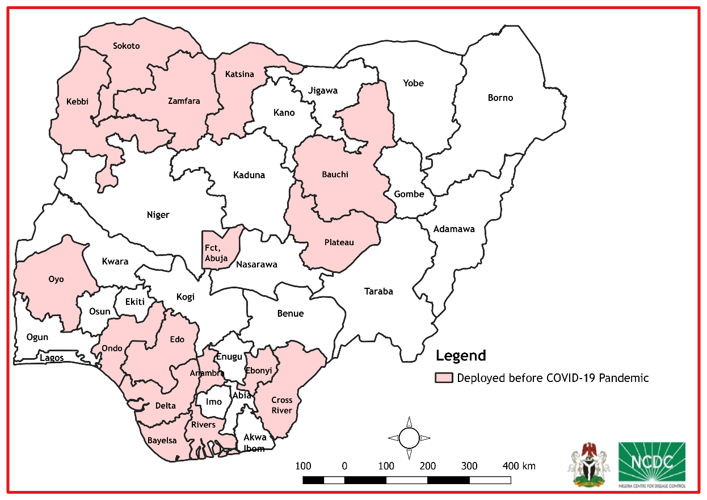
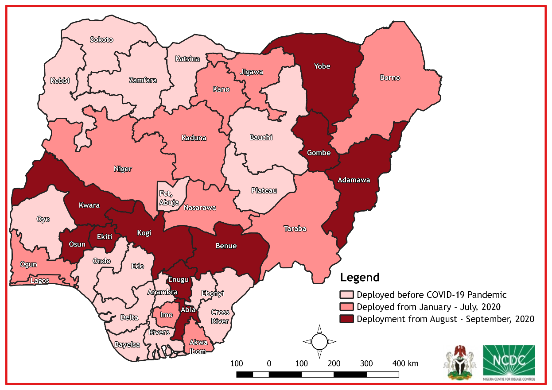
SORMAS for Case-Based Digital Surveillance
Pre-2020
Currently
17/37 states with SORMAS deployed
37/37 states and 774 LGAs with SORMAS deployed

Slide 13
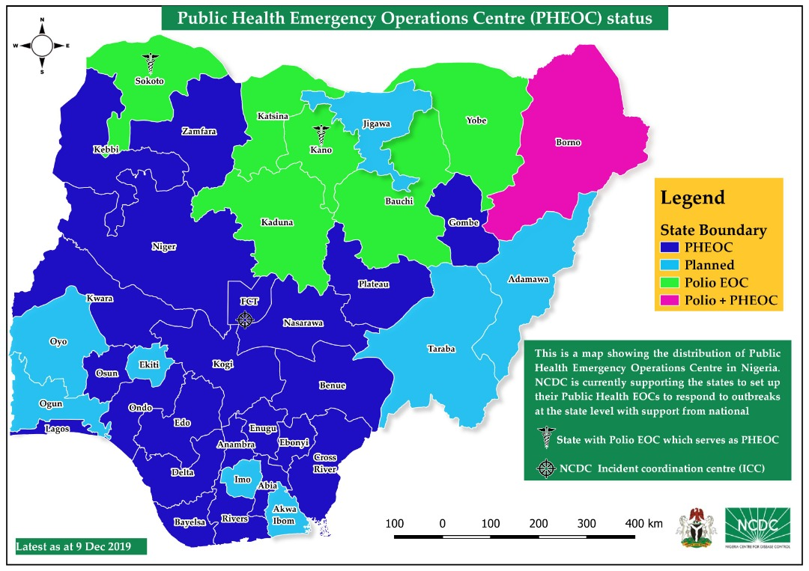
Public Health Emergency Operations Centres
Pre-2020
Currently
29/37 states with EOCs
36/37 states with EOCs
Target: 37/37 EOCs by December 2021

Slide 14
Training and Protecting Health Workers
Notes:
Established database of IPC trainers across all States in the country

Slide 15
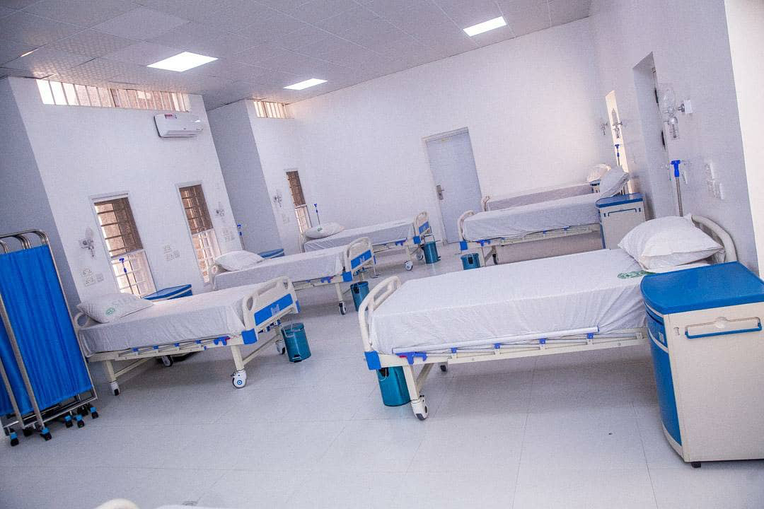
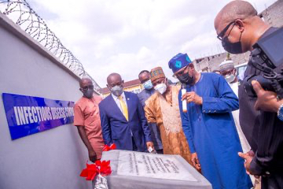
New standard treatment centres in states
University of Abuja Teaching Hospital, Gwagwalada, FCT | Complete and commissioned
Bingham University Teaching Hospital, Jos, Plateau | Complete and commissioned
Federal Medical Centre, Keffi, Nasarawa | Complete and commissioned
Federal Medical Centre, Jalingo, Taraba | Complete and commissioned
Federal Medical Centre, Owerri, Imo | Complete and commissioned
Federal Medical Centre, Kebbi | Complete and commissioned
Federal Medical Centre, Katsina | Complete and commissioned
Nnamdi Azikiwe University Teaching Hospital, Nnewi, Anambra | Ongoing
Abubakar Tafawa Balewa University Teaching Hospital Bauchi. | Ongoing
University of Calabar Teaching Hospital, Cross-River | Ongoing
Federal Medical Centre, Yola, Adamawa | Ongoing
Lagos University Teaching Hospital, Lagos | WB/REDISSE funded – Planning phase
University of Port-Harcourt Teaching Hospital, Rivers | Ongoing
University of Nigeria Teaching Hospital Enugu | Ongoing
Aminu Kano Teaching Hospital, Kano | Ongoing
University of Ilorin Teaching Hospital, Kwara | Ongoing

Slide 16
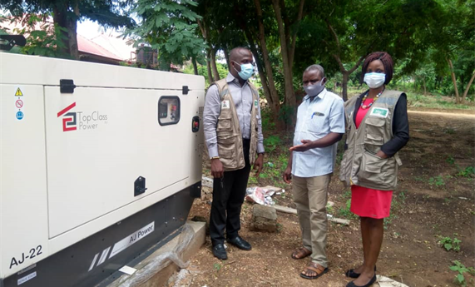
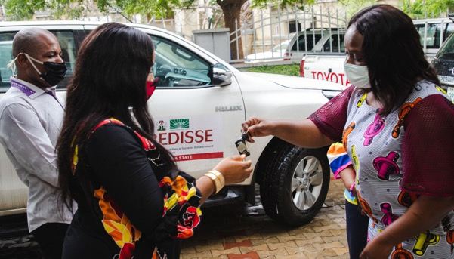
Funding through World Bank/REDISSE
Selected major activities
100M naira funding provided to 36 states in 2020
Funding for establishment of five treatment centres
Procured generators for 27 State EOCs
Procured vehicles for State EOCs and treatment centres
Technical support to states

Slide 17


Research and Development
National COVID-19 Research Consortium established
Seroprevalence survey conduced in eight states
Over 25 manuscripts in development. Six published in collaboration with states
Critically documenting lessons learned and using science to guide response

Slide 18
The third fundamental question is how can states strengthen and sustain the response to the COVID-19 pandemic and other disease outbreaks, in the context of ongoing threats and building on gains so far?

Slide 19
State’s Role
NIGERIAN GOVERNMENT TIERS
States have responsibility for health, including preparedness for and response to disease outbreaks within their boundaries.
FEDERAL
STATES (36 + 1)
LOCAL

Slide 20
Ownership for stronger health security
Provide funding
Set up governance
Run Operations
1
2
3
  Secure funding for health security in budgetary allocation
  Ensure timely release of funds for outbreak preparedness and response
  Ensure judicious use of resources
  Ensure accountability for outbreak preparedness and response
  Create regular platform for collaboration with treatment centres
  Strengthen collaboration with other MDAs- environment, agric etc.
  Ensure adequate human resource in Public Health Departments, labs etc
  Scale up sample collection and testing
  Scale up risk communications
  Contribute to public health research – samples for genomic sequencing
Activities
  State government funding
  World Bank REDISSE and CoPREP
  State Health Partners
  Existing State PHEOCs for multi-sectoral collaboration
  New laboratories and treatment centres
  Increasing focus on WaSH
  Increasing training opportunities by NCDC, partners
  Availability of RDTs commercially
  Increase in availability of scientific evidence
Opportunities

Slide 21
The answer is States have the resources, expertise and experience to strengthen the response to the COVID-19 pandemic and other disease outbreaks. We need stronger political commitment, leadership and funding to sustain this

Slide 22
THANK YOU

