Slide 1
Jeremie Zoungrana M.Phil, MSc, PhD.
Director, Nigeria Country Office
Notes:
At the Bill & Melinda Gates Foundation, we believe that all lives have equal value. Our purpose is to ensure that all children, no matter where they are born, can lead a healthy, productive life. We’re a large organization working on many different causes, but our belief captures why we do what we do.
The foundation has been a partner to Nigeria since 2010, working across health, agriculture, financial services, nutrition, and more recently gender, all with the overarching goal of supporting the country to advance its progress in achieving the Sustainable Development Goals (SDG) and ensuring healthy and productive lives for all Nigerians.
. . . . . . . . . . . . . . . . . . . . . . . . . . . .
Photo caption: Children running in Mwea Village, Kenya. [Image #XX136650]

Slide 2
What we do
The Gates Foundation doesn’t make a product or provide a service. We don’t do work in the field.
Instead “what we do” is deploy our four assets.
By deploying our money, voice, convening power and expertise, combined, we hope it will act as a catalyst, and spur positive action and change in big, systemic ways

Slide 3
How we do what we do
Grantees and partners are at the center of our work
Together, we take risks, push for new solutions and harness the power of science and technology
This work requires support from governments, the private sector, communities, nonprofits, and individuals
Notes:
. . . . . . . . . . . . . . . . . . . . . . . . . . . .
Photo captions:
Left image: Anganwadi worker Manju Kumari with Chandrika Devi and her 15-day old child during a home visit in Samda village, Saharsa district, Bihar, India. March 21, 2013. Photo by Prashant Panjiar. [Image #PP334892]
Middle image: Lucy Kananu Murungi and a coworker study plant parasite nematodes at the International Center for Insect Physiology and Ecology (ICIPE) in Nairobi, Kenya. [Image #FC426519]
Right image: Students and teachers in action at the White Center Heights Elementary School in Seattle, WA on January 5, 2015. Photo by Michael Hanson [Image #MH439347]

Slide 4
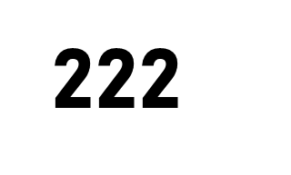
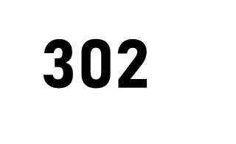
THE SCOPE OF OUR WORK
We work with partner organizations around the world to reduce inequity
Foundation-Wide
Nigeria
For the Year ended December 31, 2020.
Notes:
We work across a broad range of issues, but all of them focus on removing the barriers that prevent people from living healthy, productive lives.
For more than 20 years we have learned several valuable lessons about how to tackle inequity as a foundation, and our approach continues to evolve, based on new evidence and changing circumstances facing the world.
For the year ended December 31, 2020 (left to right, top to bottom):
Program Strategies = 41 The current number of co-chair approved strategies as of 12/31 that the foundation is pursuing (Source: Foundation Strategy Office) In 2020: Institute for Disease Modeling (IDM) and USP Data were added.
Direct Grantee Support= $5.8 billion The value of grant payments made in the fiscal year (Source: 2020 Annual Report)
Countries served = 134 Number of countries we have awarded grants to by Location of Work or Geography Served in the fiscal year (Source: Investments By Geography Tool – Committed Investment Detail) 9 New in 2020 (compared to 2019): Djibouti, Seychelles, Timor-Leste, Puerto Rico, Iceland, Kazakhstan, Maldives, Tajikistan, Tunisia. 10 Countries in 2019 and not in 2020: Bahrain, Cuba, Fiji, Greece, Paraguay, Qatar, Russian Federation, Samoa, Trinidad and Tobago, Venezuela, Bolivarian Republic of.
Number of full-time employees worldwide = 1,763 Active headcount as of 12/31
Number of grantees = 1,357 The count of grantees awarded to in the fiscal year (Source: Data & Reporting)
Number of grants awarded = 2,136 Total number of new grants awarded in the fiscal year (Source: Data & Reporting)
U.S. states served = 49 Number of states in the US we have awarded grants to by Location of Work or Geography Served in the fiscal year (Source: Data & Reporting) No specific grants were awarded for work to performed directly in or to serve the people of Maine in 2020.
Number of employee alumni = 1,814 Alumni Network as of 12/31 (Source: Alumni Network/Andrea Voytko)

Slide 5
How we operate globally and in Nigeria
UN Systems
4Gs
Global Levers
WB
WHO
GFF
GPEI
GAVI
GFATM
UNPFA
UNICEF
UN Women
WFP
FAO
COVAX
Regional Levers
Africa CDC
ECOWAS
African Union (AU)
Federal Level
FMOH
FMOF
BNP
NPHCDA
NCDC
NGF

Slide 6
Nigeria: STATE engagement
SOKOTO
KATSINA
Deep Engagement
Kano – Health MOU Kaduna – Integrated PHC MOU
Moderate Engagement
Borno Sokoto, Yobe, Bauchi – PHC MOU addendum Niger – Integrated PHC MOU (to be extended) Lagos – PHC grant
Light Engagement
Gombe – MNCH MOU (ended 2019) Nasarawa – PHC Grant (ended 2019)
States tracked by Polio team
Kebbi, Zamfara, Katsina, Jigawa, Adamawa
Strategic Engagement States
Ekiki – support to State Development Partnerships & SDG office; and strengthening data quality for RI & PHC
AgDev
Direct Engagement : Kaduna & Kano AGRA collaboration: Kaduna & Niger
JIGAWA
YOBE
ZAMFARA
KANO
BORNO
KEBBI
GOMBE
KADUNA
BAUCHI
NIGER
ADAMAWA
PLATEAU
KWARA
FCT
NASARAWA
OYO
TARABA
EKITI
KOGI
OSUN
OGUN
BENUE
LAGOS
ONDO
EDO
ENUGU
EBONYI
ANAMBRA
CROSS RIVER
DELTA
IMO
ABIA
RIVERS
AKWA IBOM
BAYELSA
*Engagement is defined in terms of interaction with state government and leadership.

Slide 7
Nigeria: Evolution of our work
Doubling-Down on BMGF Investment
2010 – 2013: Early Engagement
BMGF recognizes Nigeria as a priority country for impact, given its burden of disease and poverty index. Early focus on Polio eradication
Doubling Down on BMGF Investment
Push to eradicate polio and strengthen RI given the realization that eradication is within reach
Commitment of health via BMGF Abuja declaration to integrate and focus service delivery and systems strengthening investments from 35 states to 6-10 states
Nigeria Prioritization
Internal rationalization and restructuring of BMGF strategy for Nigeria
Post Prioritization
Increase in engagement driven by socio-political shifts, including Nigeria exiting from economic recession
Africa Transition
Appointment of Country Director and DD’s for Nigeria. Growth of country office
BMGF Nigeria Country Plan
WHO Certified Polio Eradication achieved
Focus on PHC as a pillar for achieving HCD/SDGs, Seattle Declarations
Prioritization
Post Prioritization
Africa Transition
BMGF-Nigeria Early engagement
VxDel
Polio
MNCH
IntDel
FP
Ag
Ag
PHCUOR approved by National Council of Health
Nigeria enters recession
COVID-19 Pandemic
Dangote Partnership in Kano and Bauchi
BHCPF Implemented
Governor’s visit to Seattle – Seattle Declarations for PHC
Dangote Partnership extends to Sokoto, Yobe, Kaduna, and Borno
Notes:
*This chart represents only paid and committed funding for active investments from 2010 - 2020.
The orange shading is illustrative of estimated future spend on investments from 2018 - 2020.

Slide 8
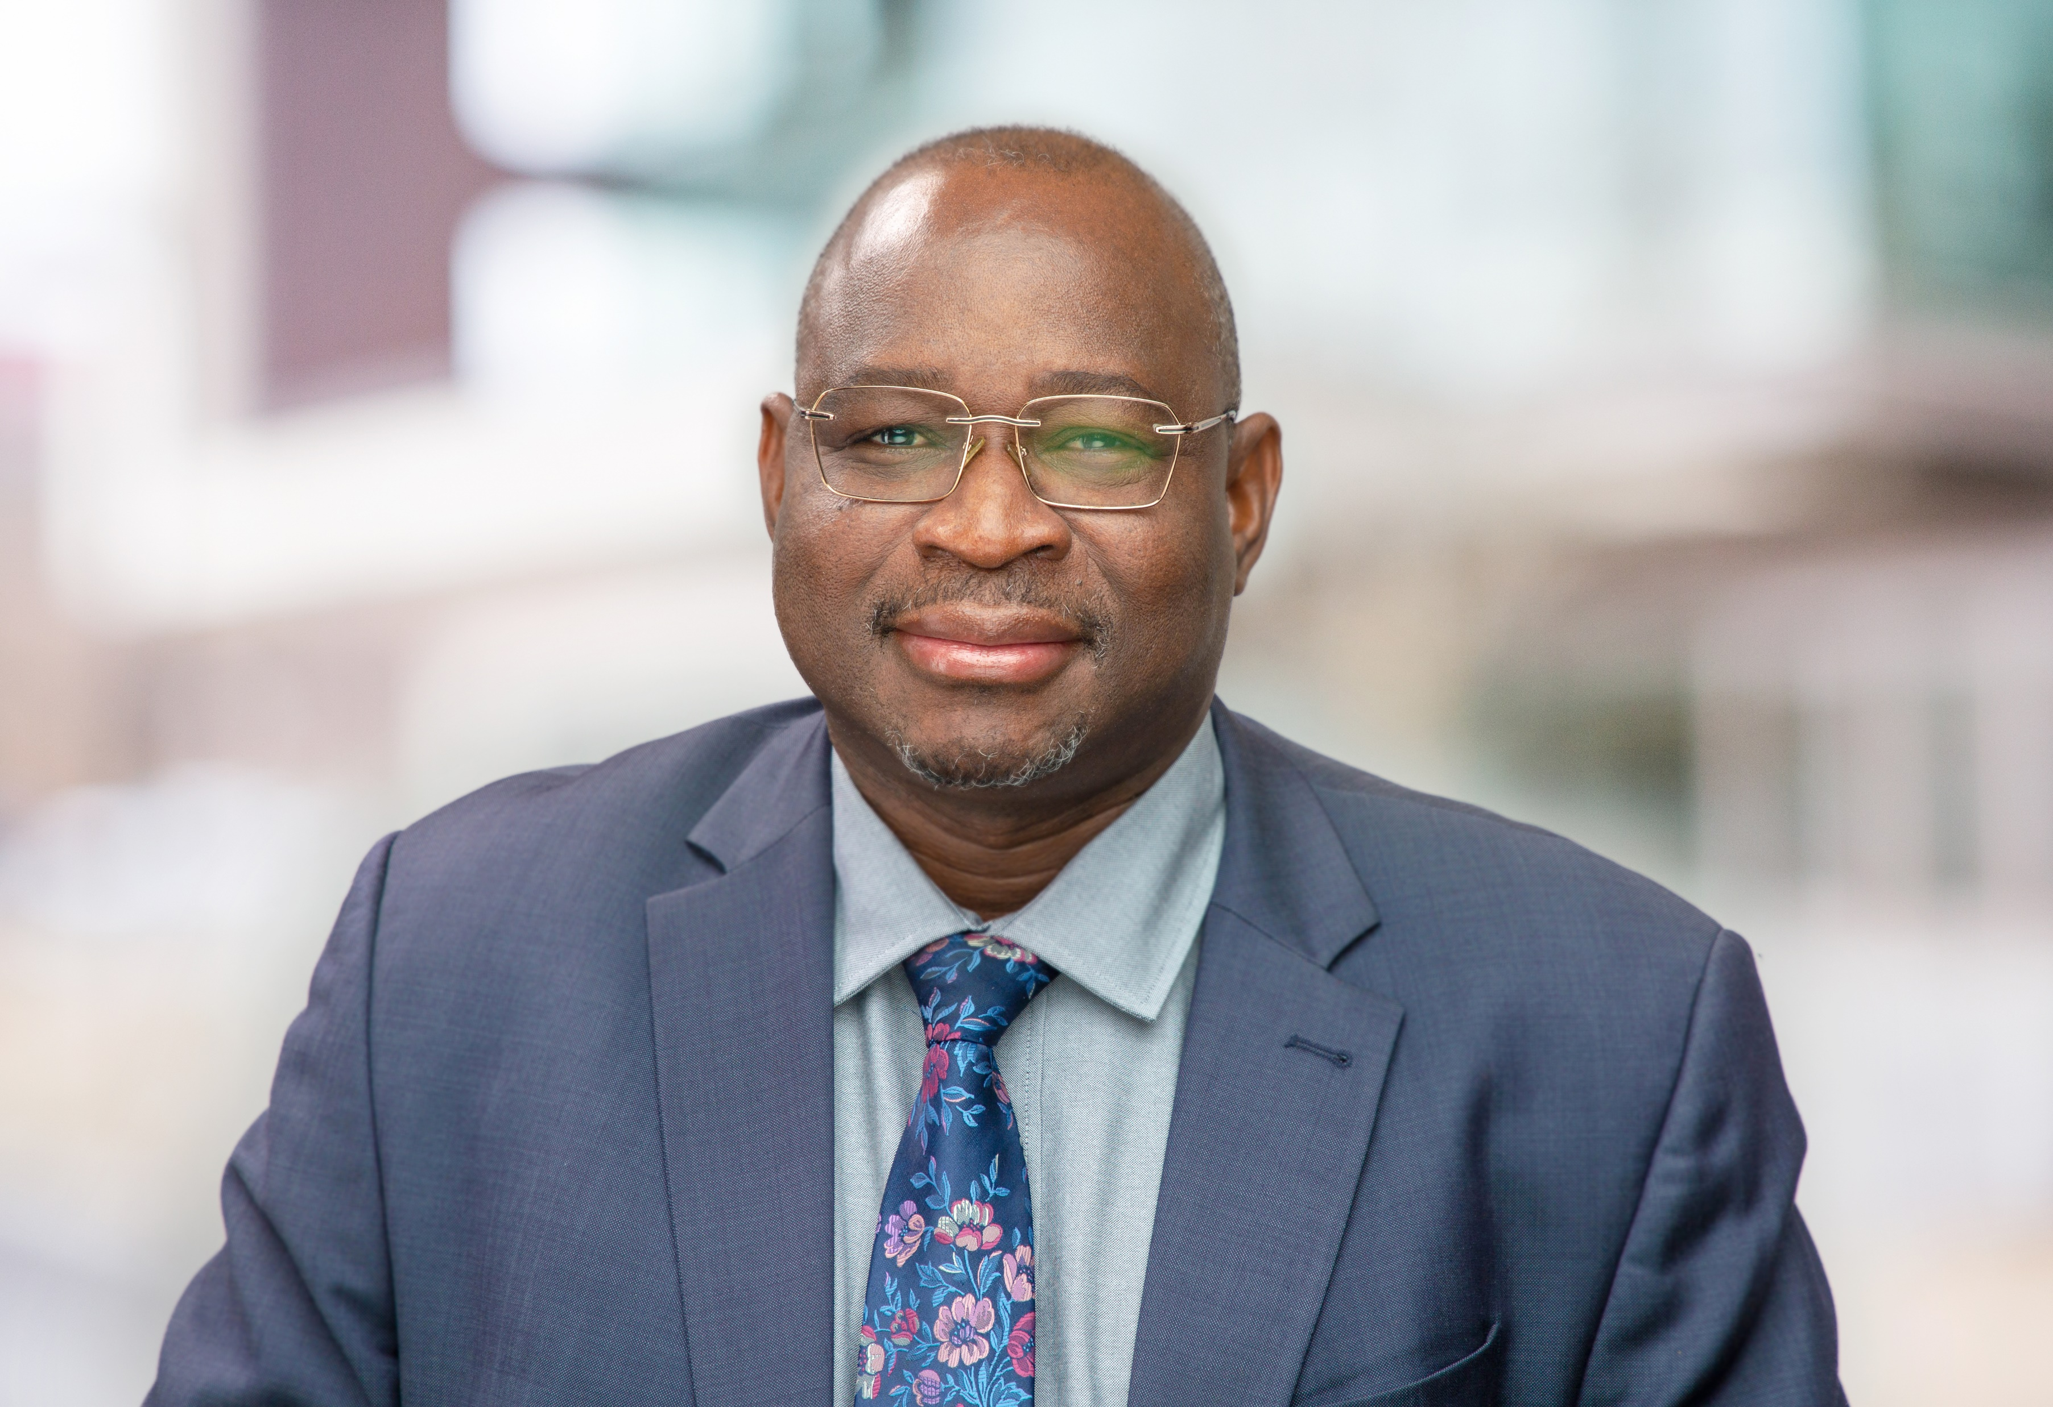
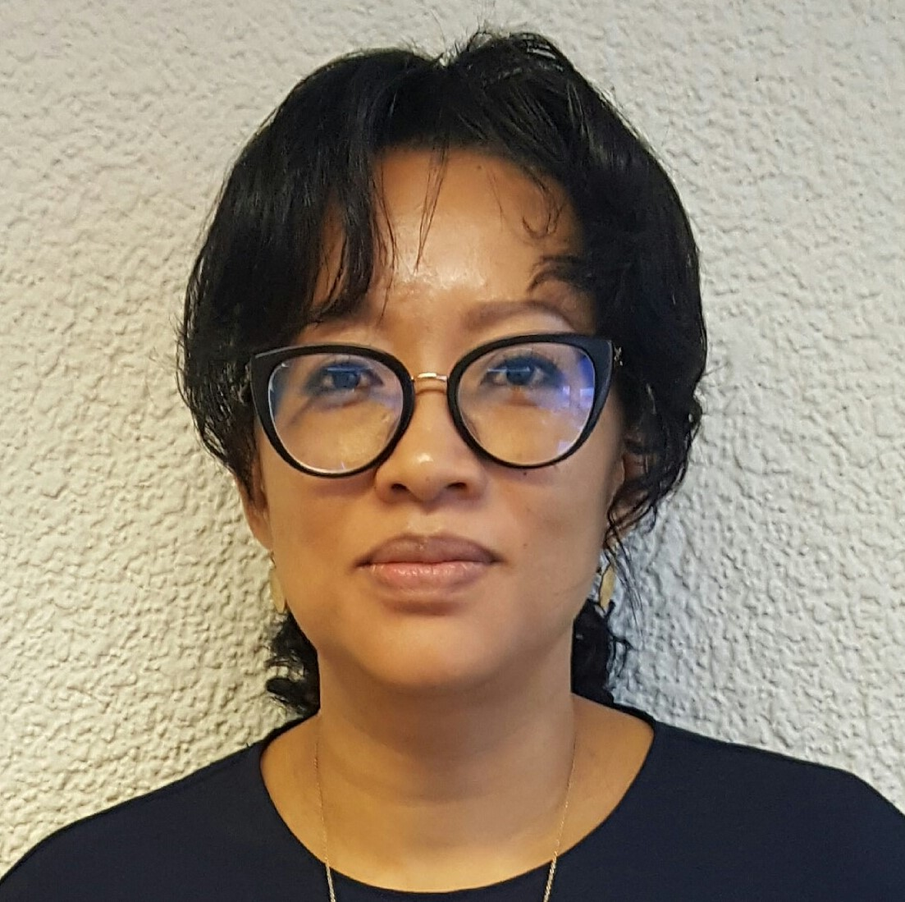
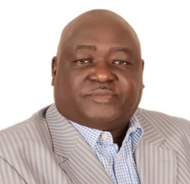
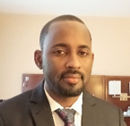
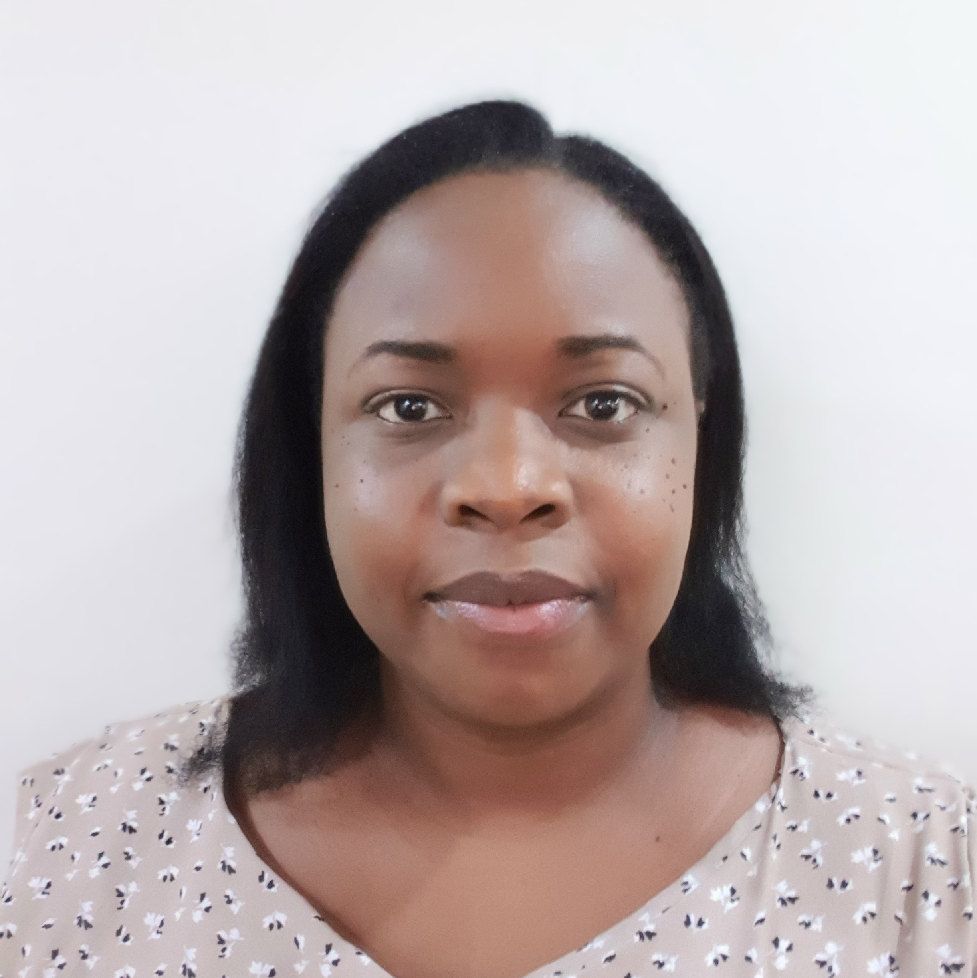
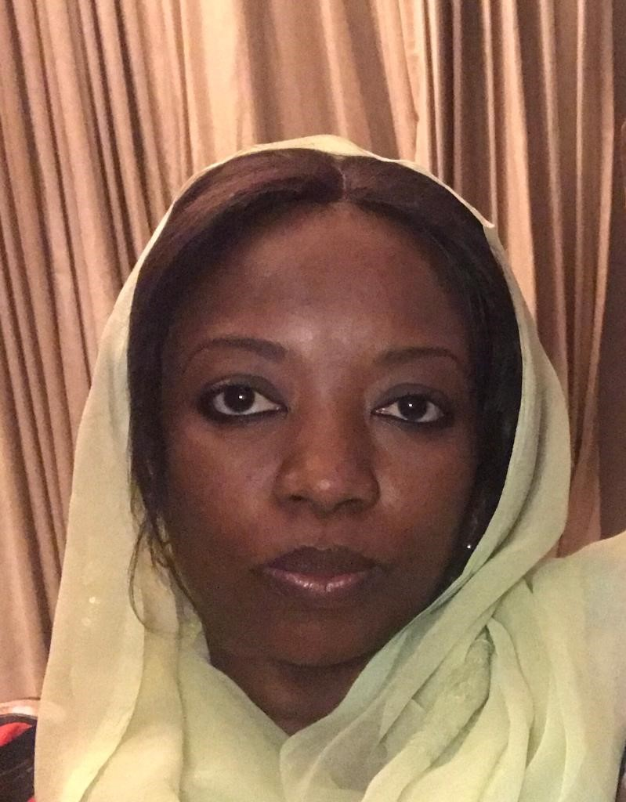
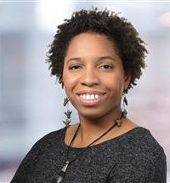
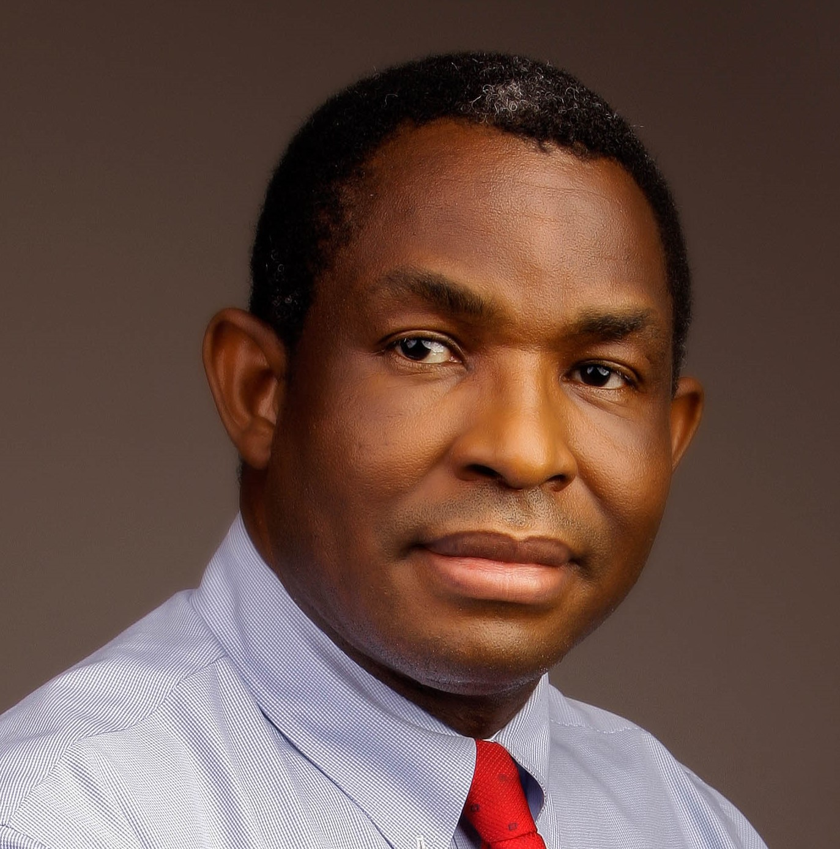
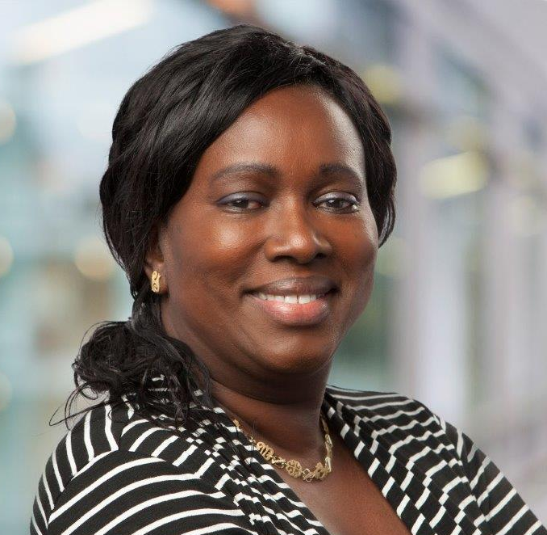
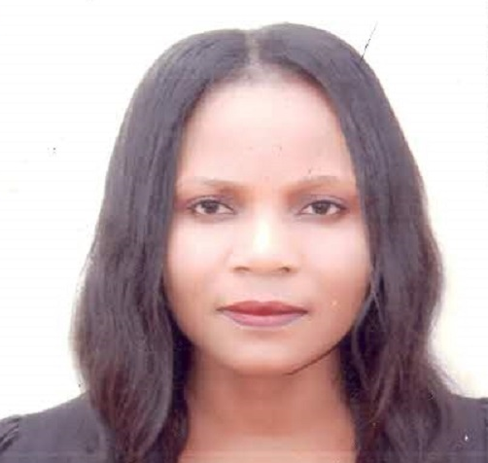
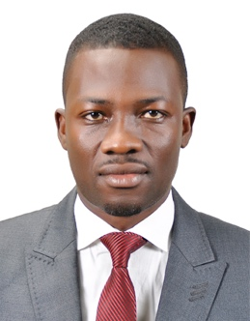
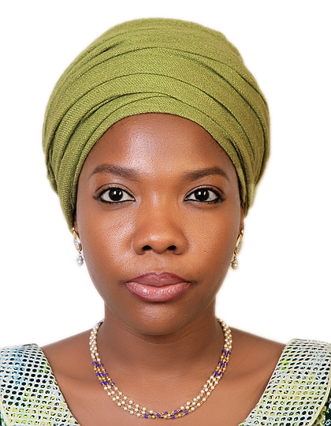
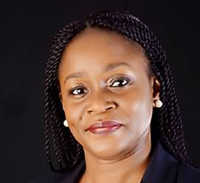
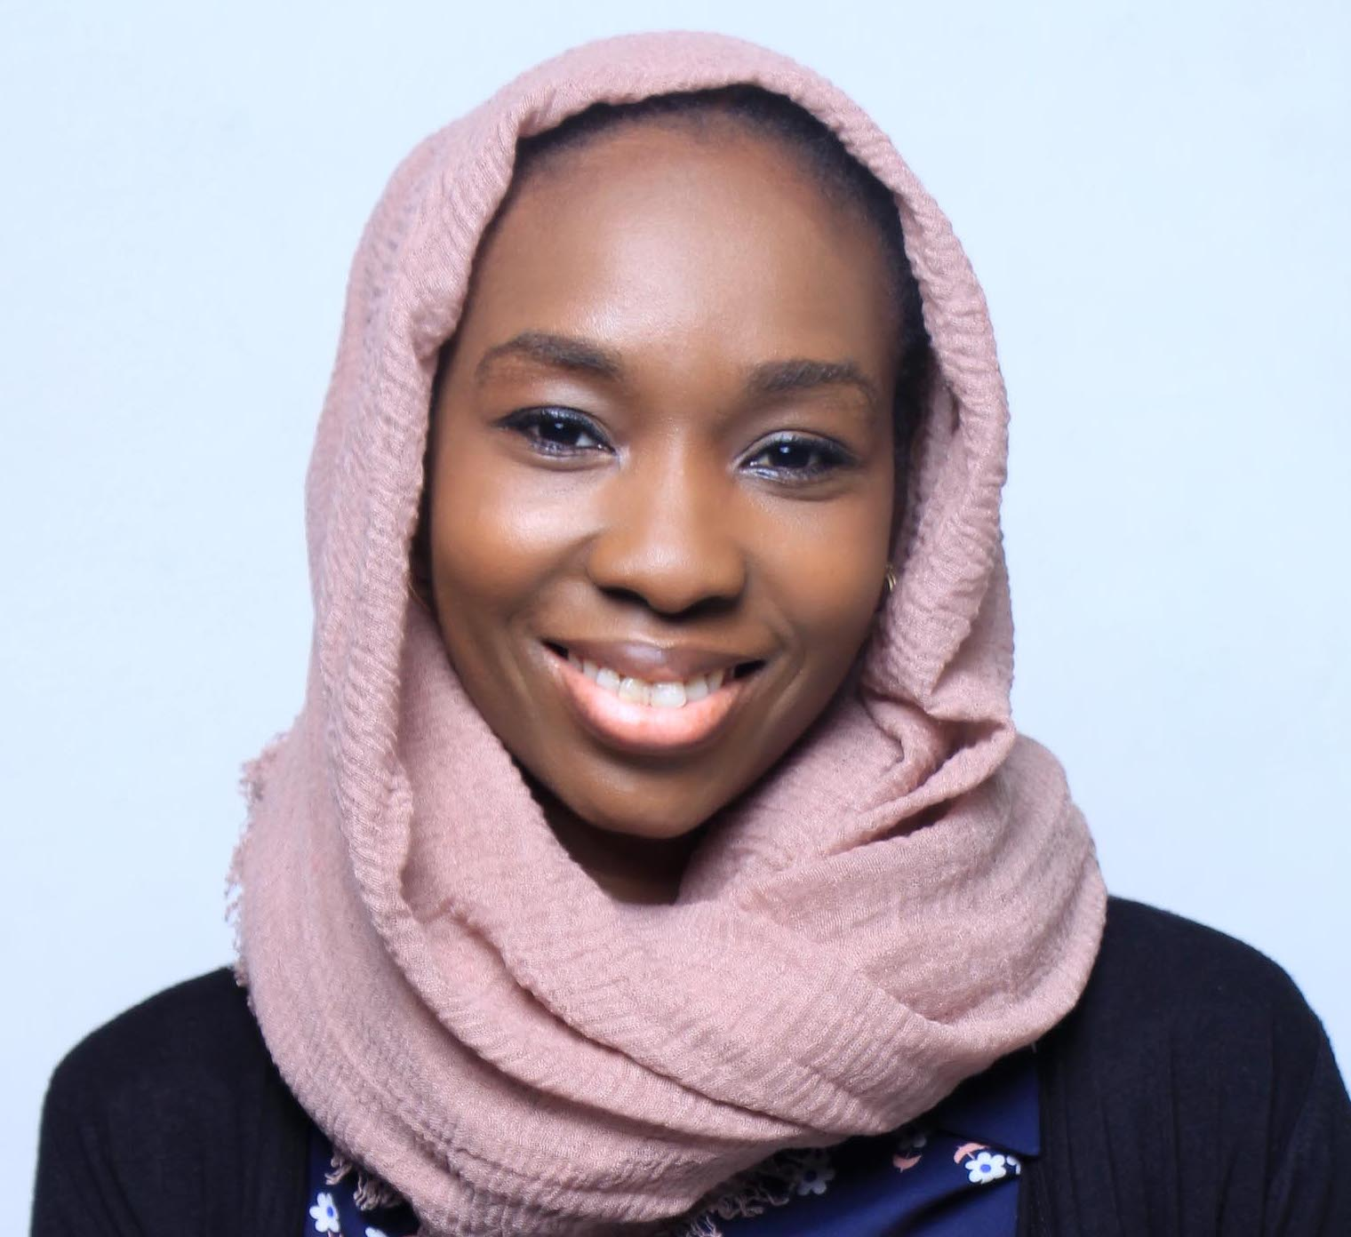
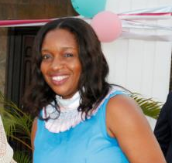
NIGERIA COUNTRY OFFICE
Jeremie Zoungrana Country Director
Tijjani Mohammed
DD Policy Advocacy & Communications
Caroline Jehu-Appiah
DD Health, Nutrition & Polio Eradication
Audu Grema
SPO, Agriculture
Masduk Abdulkarim
PO, Data, Analytical & MEL
Joy Udusegbe
Snr. Program Assistant
Onyeka Igwebuike
Program Manager
Katja Schiller Nwator
SPO, PAC
Fatimah Akali
SCO
Endurance Ajayi
Program Assistant
Jasmine Jones
APO, Health
Victor Ajieroh
SPO, Nutrition
Rodio Diallo
SPO, Family Planning
Yusuf Yusufari
SPO, Immunization
Olakunle Ajayi
Snr Program Coord.
Deborah Ishaya-Ndahi
Program Assistant
Shina Aladeshawe
SPO, Malaria
Charity Chenge
SPO, Health
Firdausi Sadiq
PO, Health Financing
Ese Olufemi
Program Assistant
Chiamaka Chinwendu
Project Manager

Slide 9
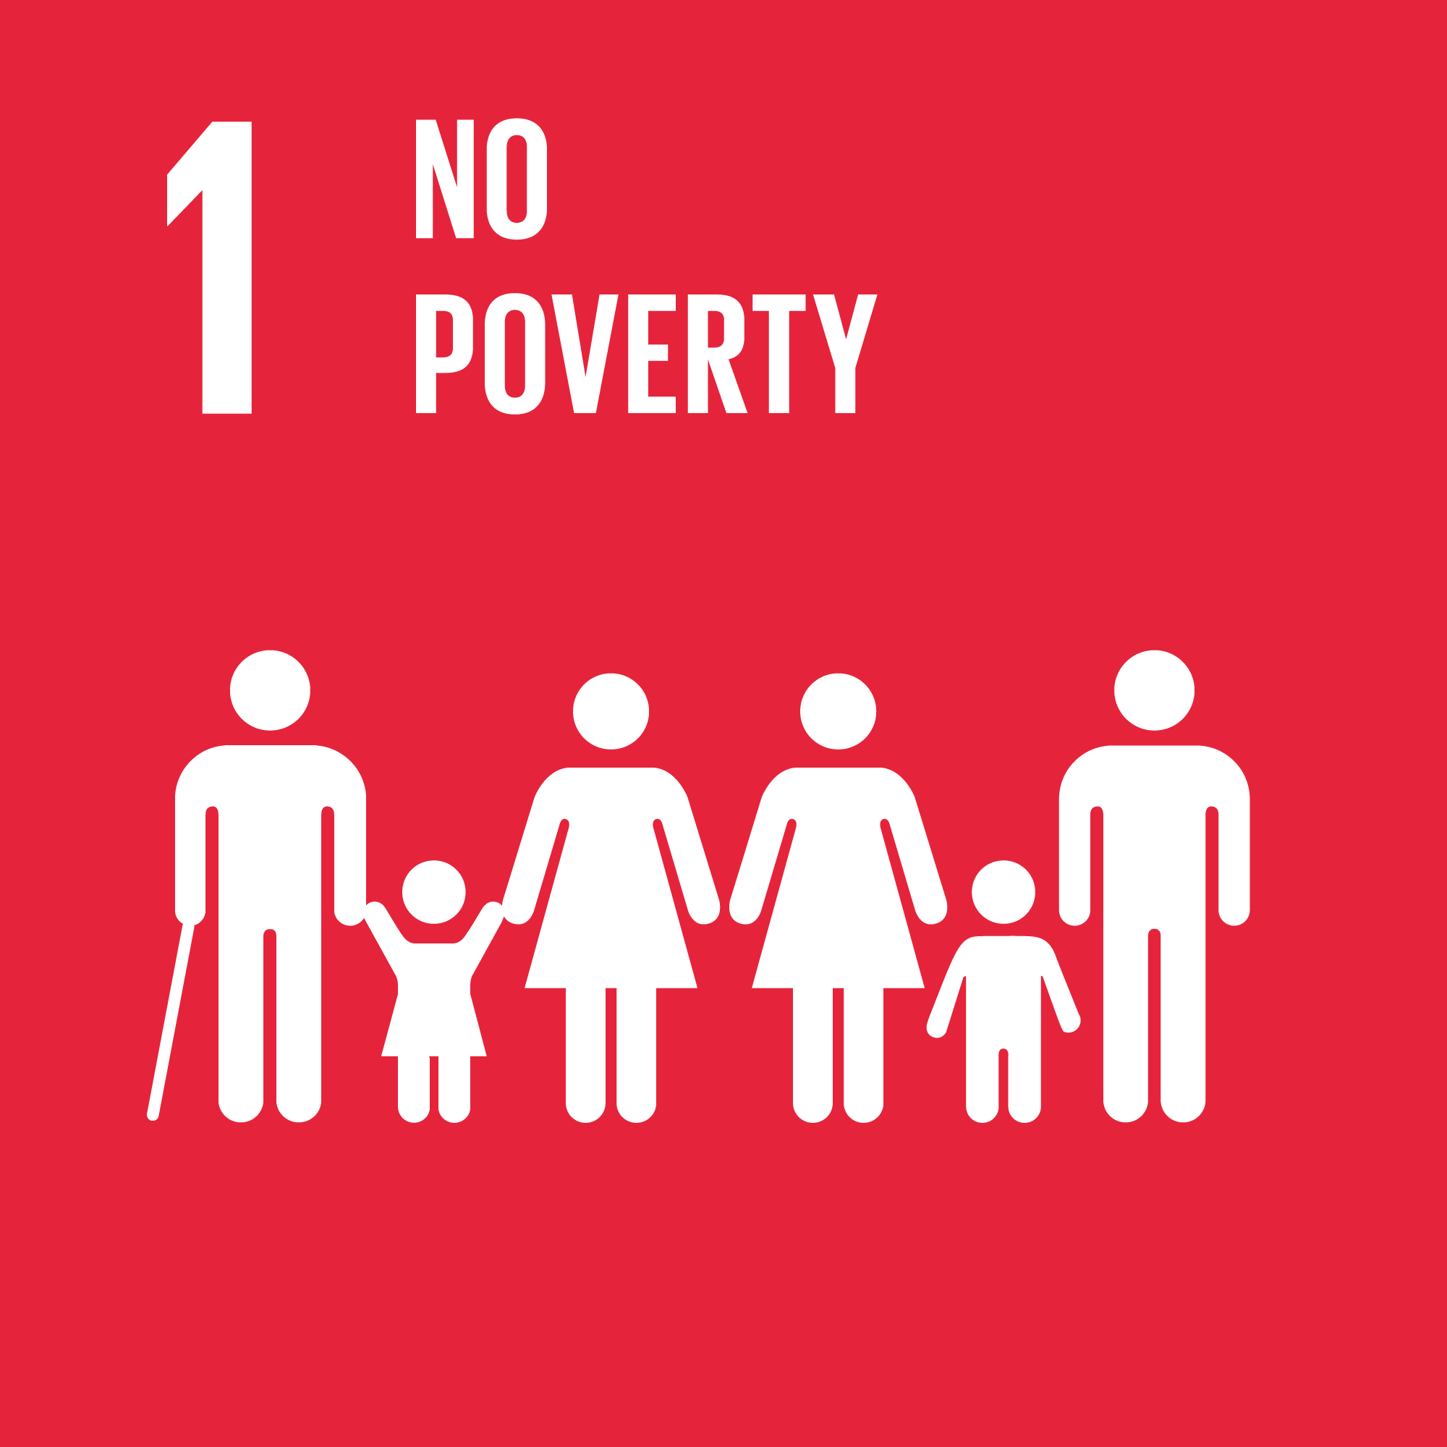
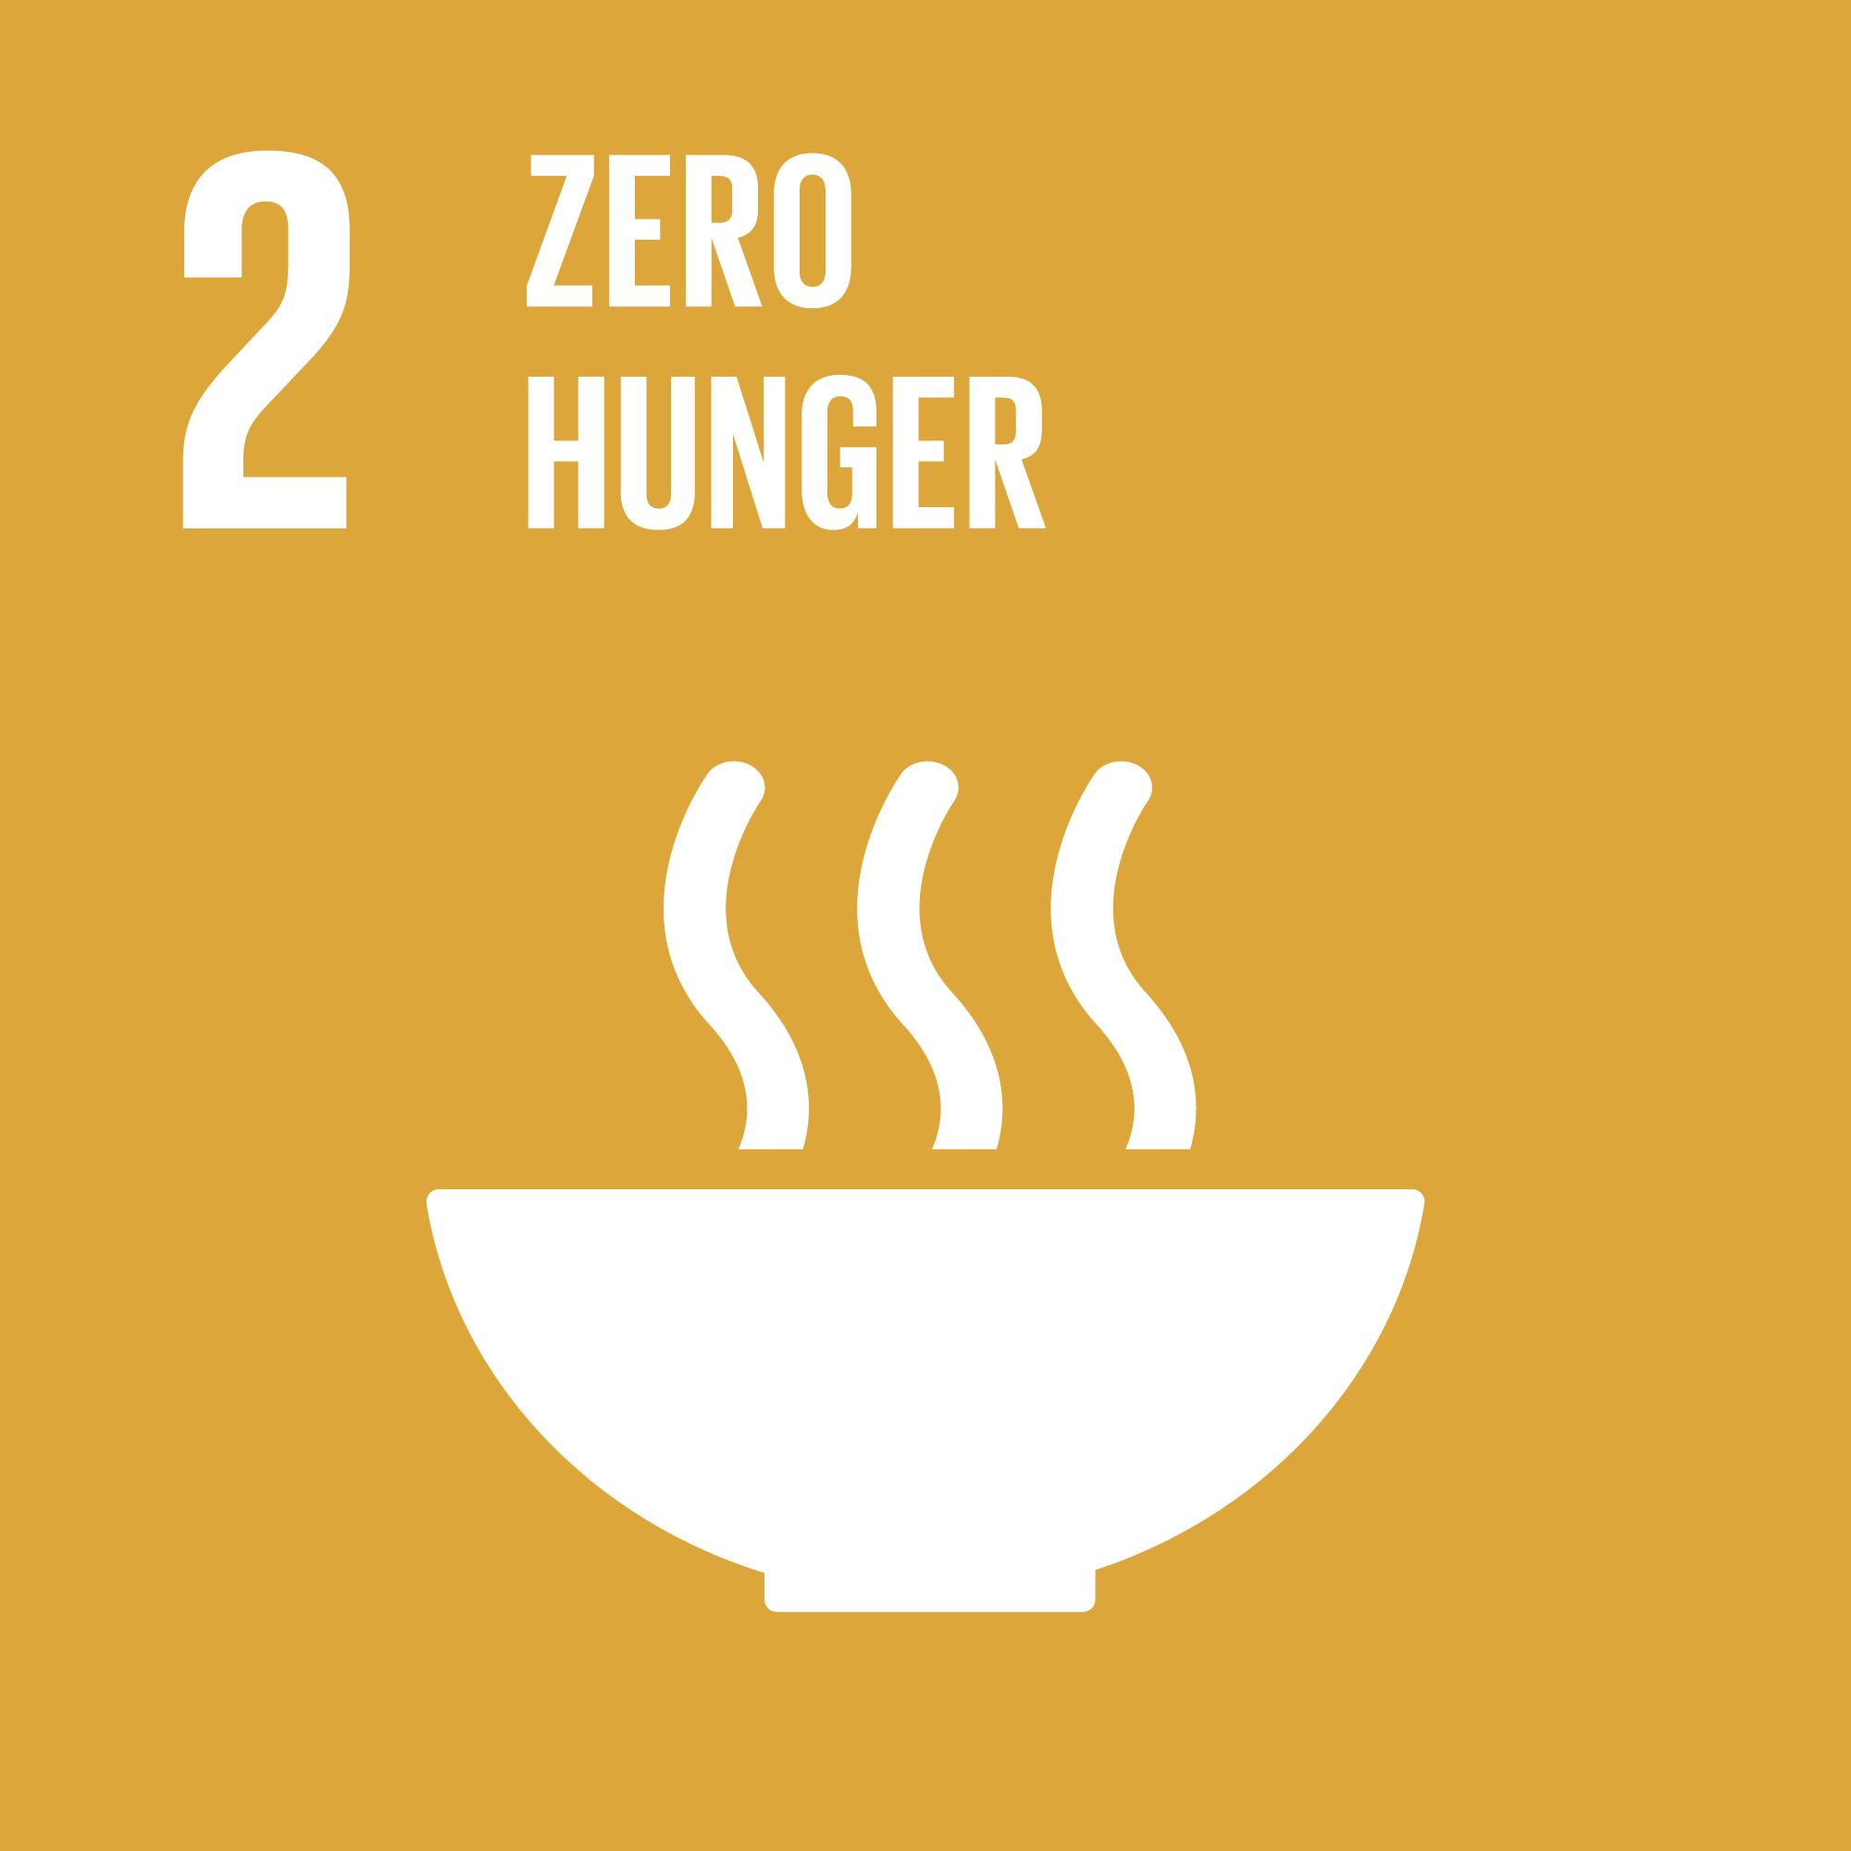
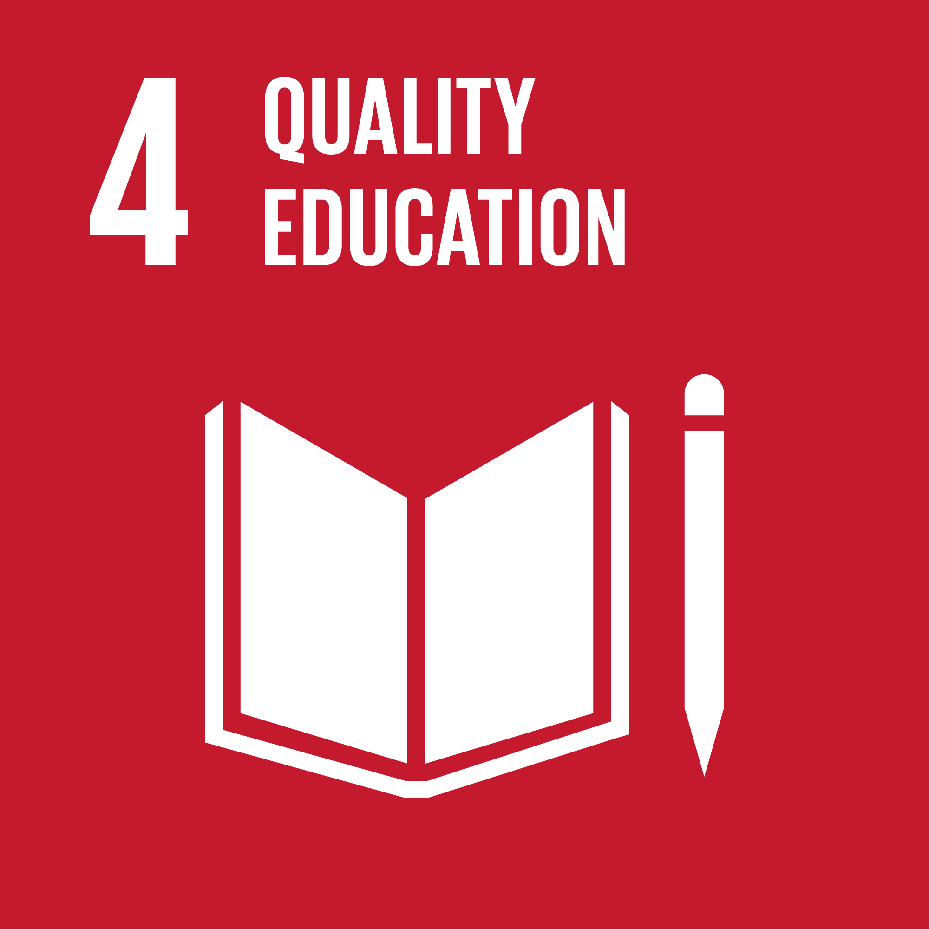
BMGF THEORY OF CHANGE FOR NIGERIA
The NCO works to advance BMGF priorities that will improve Nigeria’s human capital development and
accelerate progress towards reaching SDGs 2, 3, and 5.
NCP Strategic Priorities
BMGF Priorities
Global
Priorities
Increasing SHF productivity and household income, increasing equitable consumption of quality & nutritious diet year-round, increasing women’s empowerment
Nigeria will reach SDGs 2 (zero hunger) and SDG 3 (ensure health lives and promote well-being) and 5 (achieve gender equality).
Foster a committed policy environment that generates sufficient resources for HCD
Agricultural Development
Improve RMNCH+N outcomes, eradicate polio, and reduce morbidity and mortality
Health & Nutrition
HCD
Applying a gender lens
to all we do
Support a high-performing PHC system that delivers better RMNCAH-N outcomes
Gender Equality
Financial Inclusion
Build Nigeria’s institutions for the future
Increasing access to and use of digital financial services
Health as a pathfinder approach
Gender
Demand
Private Sector
Cross-cutting agendas
Notes:
We know that those closest to challenges are in the best position to solve them. Our investments focus on the
areas of overlap between our expertise and the post-ERGP National Development Plan (2021-2030), which
focuses on advancing the achievements of Nigeria’s SDG priorities. With our partners, the NCO strives to
achieve the following priorities:
• Ending polio and strengthening routine immunization systems
• Strengthening primary health care systems
• Reducing the burden of malaria
• Ensuring high quality care and equitable access across the RMNCAH continuum, including nutrition
• Improving the productivity and sustainability of smallholder farmers
• Increasing financial inclusion
• Improving gender equity and equality
• Strengthening local institutions and capacity, including civil society organizations
• Ensuring resilience and recovery post COVID-19
The NCO also has a cross-cutting advocacy role, cultivating and managing policy dialogue across the foundation’s priorities with federal and state
government, private sector, and civil society stakeholders, among others. Agricultural development, financial services and other foundation priority areas like gender are actively engaging in Nigeria; however, these activities are guided by global strategies designed at foundation headquarters.

Slide 10
Health Theory of Action: By 2025, Better and More Equitable Health Outcomes Will Be Achieved
Through Targeted Actions at the Federal and State Levels to Improve Primary Health Care Performance
Illustrative PHC Performance Outcomes (NCO)
Health Impact Outcomes (BMGF)
Gender
Demand Gen.
Private Sector
BOW
Approach
Key Investments
SP 1. Influencing policy and finance for health and development
Strengthen platforms to shape agendas
Influence and set a PHC forward agenda
NGF Platform
Subnational Fiscal Data & Investment in Human Capital Advocacy
DRPC
Sustained Secretariat Support for Human Capital
1. Federal budget for PHC increases by __% by 2025
Strengthen platforms for policy/regulation
Strengthen platforms for evidence-based policy and regulations
Strengthen fiscal ecosystem for development
2. Evidence-based allocation formulas developed and used
Improve financing for PHC reforms
Polio eradicated
3.Priority States routinely reporting PHC performance data to Federal level
Strengthen capacity for governance
6 PHC Domains
Basket Funding, MOUs
Wrap Around TAs
PHC Challenge Fund
ICS
TA Hub
Healthcare Financing TA
Supply Chain Transformation
PPMVs
Feedback Systems
SP 2. Strengthening capacity and enabling systems for delivery
Strengthen systems for service delivery
Institutional CB to FMOH and Health MDAs
RMNCH-N outcomes improved equitably
NCO’s Strategic Priorities
Integrated Service Delivery
4. BHCPF disbursing effectively
Catalyze platforms relating to demand
Support PST/FT delivery programs
Demand-sensitive PHC approaches
5. Costed plans developed and included in state budgets
Catalyze emergence of strong local institutions
Strategic partner selection and sustained technical assistance
SP 3. Building Nigeria's institutions for the future
6. PHC utilization increases among target populations in BMGF priority states
TA Hub
DRPC
CS SUNN
Strategic Org. Capacity Building through local expertise

Slide 11
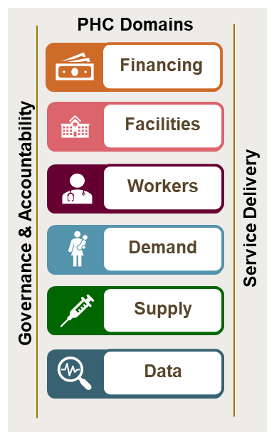
Phc strengthening is our key areas of focus at state level
PHC is the entry point for all
BMGF health priorities
PHC ‘domains’ as tactics for improving the system
Key PHC Investments
Nigeria’s PHC system is critical for delivering high quality, affordable, and accessible health services to communities. RI, FP, maternal and child health, first-line drugs for TB and HIV, malaria prevention and treatment, and nutrition may involve different levels of medical care but the performance of the PHC system impacts them all.
• State MOUs/PHC basket funds
• PHC Challenge Fund
• TA Connect
• BHCPF
• ARC ESM
• NPHCDA HRH/Quality of Care catalytic grant
• Strengthening Data Quality to Improve RI & PHC (AFENET)
• Strengthening PHC Demand in a COVID-impacted World (Busara)

Slide 12
Key Achievements and Impact so far
PHC Transformation:
Governance: Federal level agencies that support PHC related work have been strengthened in different areas of governance, use of data and performance management.
Health Financing: implementation of the BHCPF provided sustainable additional fiscal space for PHC.
Nutrition: Our partnership with Aliko Dangote Foundation has seen leaders in philanthropy, politics, and industry converging to improve public health and nutrition through the priority of improving the reach and quality of fortified foods in Nigeria. We have over 80% of the Nigerian population reached with adequately fortified foods with salt, sugar and wheat flour reaching or remaining sustained over the 90% compliance mark.
Family Planning: Several national strategy documents and policies were launched for an enabling family planning environment this year. Support to the national DMPA-SC rollout plan has seen a 10-fold increase in service uptake including Self-Injection this year, with a spike in self-injection during the peak of the COVID 19 pandemic.
Data: The KDBS Health Facility Census Analytics (HEFA) platform was launched as a one stop resource for health information analytics for the Kaduna State government. The state also launched the Data Science Fellowship Program to train young people and public sector workers on data management principles.
State Engagement/Partnership: deepened engagement and partnership with leadership at all level of government, including with Nigeria Governors Forum (NGF), extension of MOUs in 5 engagement States, and implementation of Seattle Declarations for PHC
Human Capital Development (HCD): Nigeria has prioritized the HCD agenda, developed a strategy vision that is focused on the three pillars of improving primary health care, basic education and labor force participation. A HCD multi-donor trust fund (MDTF) set-up collaboratively between the foundation and World Bank is set to catalyze development finance and spearhead mobilization of domestic resources.

Slide 13
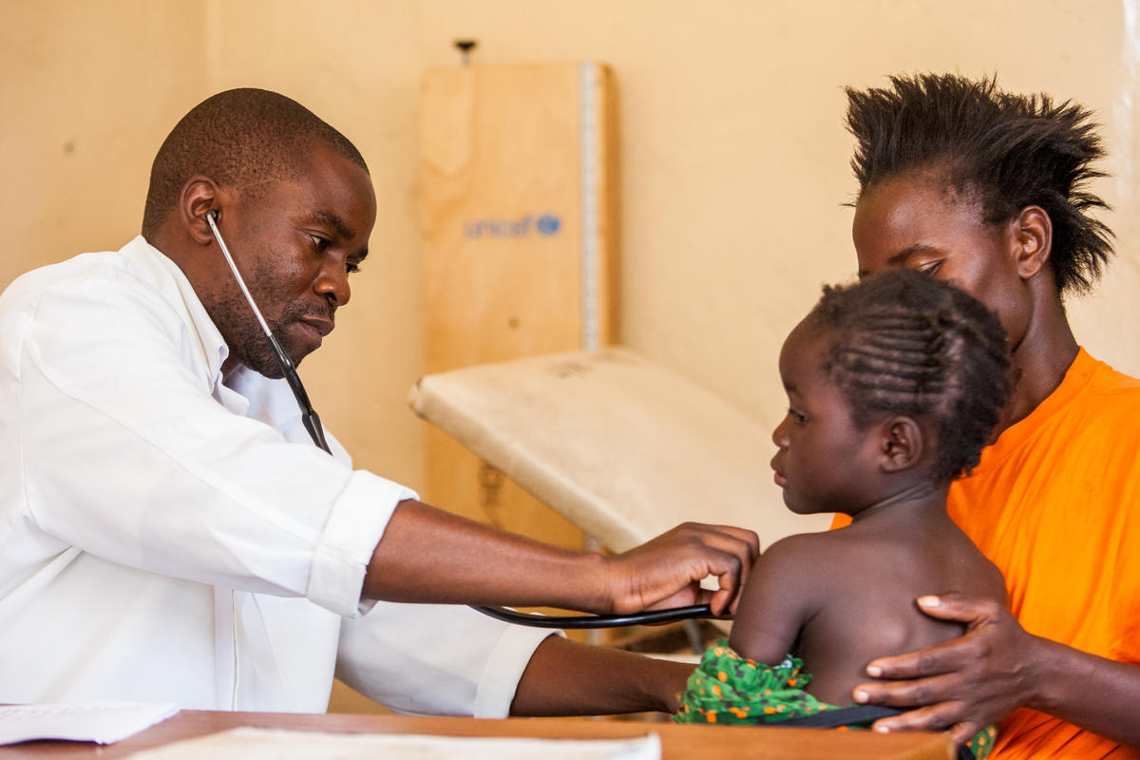
THANK YOU

