Slide 1
Nigeria Health
Commissioner’s Forum
Congress Hall, Transcorp Hilton, Abuja September 2 – 3, 2021

Slide 2
Outline
Introduction
Scope & Coverage
COVID-19 Support
Model Practices for Improving Partnership & Accountability
USAID’s Asks to Government Leadership

Slide 3
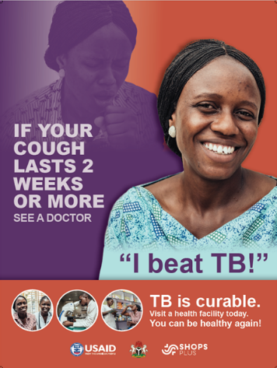
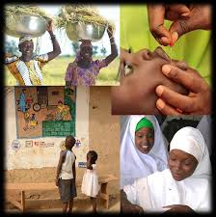
Assistance to Nigeria dates to 1960
From 2016 to 2020, USAID has contributed over $1.01 billion dollars to support the Government of Nigeria's health initiatives
Notes:
Notes:
USAID has a long and proud history of assistance to Nigeria that dates back to 1960, the year that Nigeria became the 26th African nation to gain independence.
From 2016 to 2021, USAID has contributed over $1.01 billion dollars to support the Government of Nigeria to improve the health and lives of Nigerians. Our support to Nigeria includes multiple health program areas: maternal and child health, family planning, nutrition, malaria, global health security, and tuberculosis
USAID’s HIV programming has already been discussed in the presentation from the PEPFAR Coordinator so I will focus on the other components of our portfolio.

Slide 4
Health by the Numbers
Finance
Human Resources
Medicines and Technologies
Information
Service Delivery
Health Systems Strengthening

Slide 5
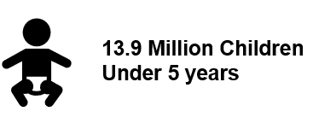
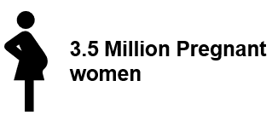
Beneficiaries With Access to USAID Interventions
Notes:
These numbers are inclusive of all USAID health/TB interventions

Slide 6
How We Work
Alignment with Government Priorities (PHCUOR)
Collaboration with other donors
Bilateral
Private Sector
Implementing Partners
Notes:
#1 Alignment with key priorities of the Government of Nigeria i.e. Primary Health Care Under One Roof (PHCUOR)
Collaboration and coordination with other donors
Bi-lateral
Private sector
Through Implementing partners

Slide 7
What Guides Us?
Productive and committed partnerships
Achieving high quality, evidence based results through our investments
Alignment with Nigeria policies and planning
Accountability, transparency and cost efficiency
Funding levels, earmarks and USG priorities
Defined key intervention areas: MCH, FP, Malaria, Nutrition, GHSA, TB and HIV
Notes:
Productive and committed partnerships
Achieving high quality results through our investments
Alignment with Nigeria policies and planning
Accountability, transparency and cost efficiency
Funding levels and earmarks and USG priorities
Defined Key intervention areas: MCH, FP, Malaria, Nutrition, TB and HIV

Slide 8
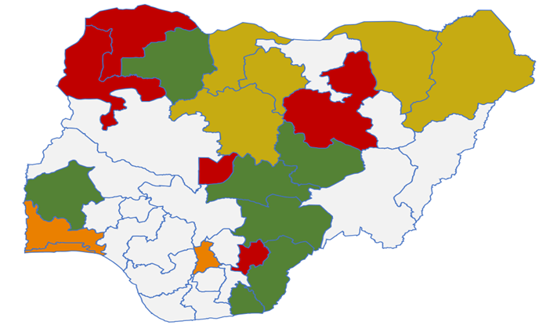
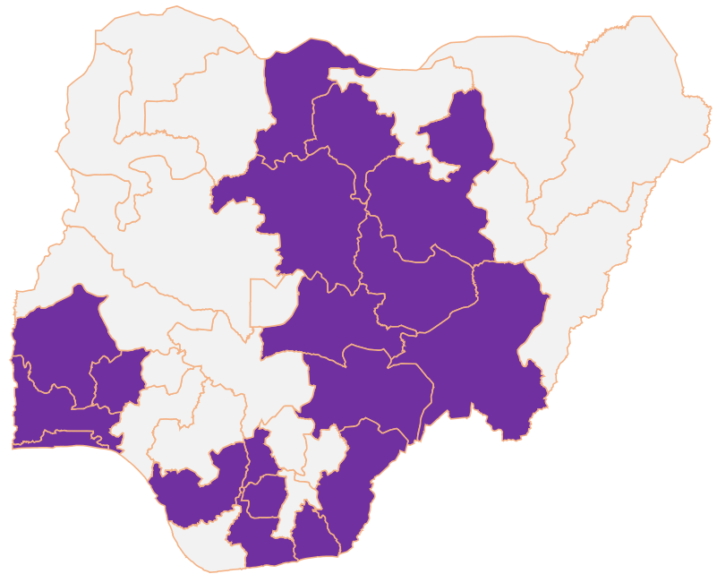
USAID Scope of Health
Interventions & Coverage
Notes:
USAID selection of states in which we work are determined through:1 coordinated donor coverage to avoid duplication, 2.operating environment i.e. security and Federal and State commitment, 3. Disease burden - unmet need, 4. USAID investment. And 5. Funding from Washington and other priorities i.e. earmarks for family planning, MCH etc.
Geographic selection is periodically reviewed through CDCS and activity planning

Slide 9
COVID-19 Support at the Sub-National Level
Bi-directional screening/ referrals
TB & COVID-19 integration across 18 TB states
Vaccine hesitancy
Vaccine safety
Combating misinformation
Digital messaging
Joint TB COVID awareness
Risk Communication & Community Engagement
Joint TB & COVID-19 Activities
COVID-19 planning
PPE & vaccinators training (on AEFI)
Logistics support (vaccines, lab samples, PPE)
Waste management
Data recording & monitoring
200 ventilators donated to 36 states
Emergency Operations Centers (8) at State level
Technical Assistance to PTF & NPHCDA
Health System Strengthening
USAID staff
Implementing partners & donor collaboration
*4M Doses of Moderna Vaccine

Slide 10
Model Practices
Integrated Health Programming
Multi Sectoral Nutrition Strategy and Approach
Innovation in Community Case Finding for TB
Drug Revolving Fund
Notes:
USAID has expanded TB services in the private health sector using network of providers including private health facilities, patent medicine vendors, pharmacists and laboratories. Geospatial technology is used to map communities with high burden of TB for active case finding interventions. Contact tracing of all index TB patients using a 2km radius around the patient.

Slide 11
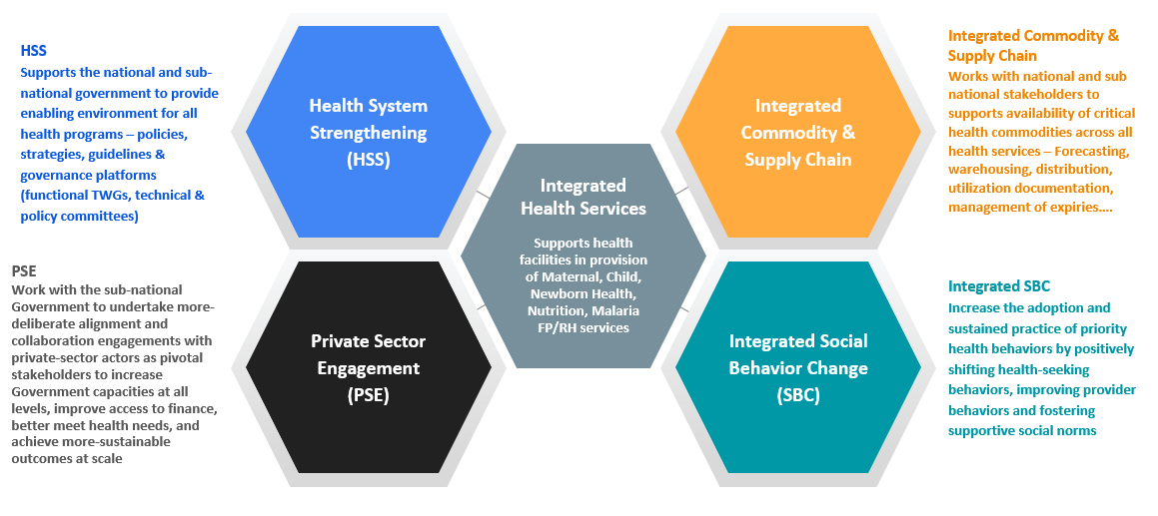
Integrated Health Programming
Notes:
1.Programs in the health portfolio are integrated and designed to complement each other.
2.Each component of the portfolio is further integrated for optimization

Slide 12
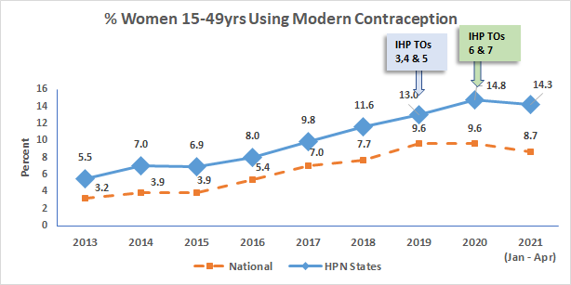
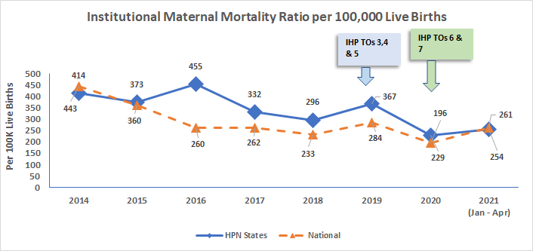
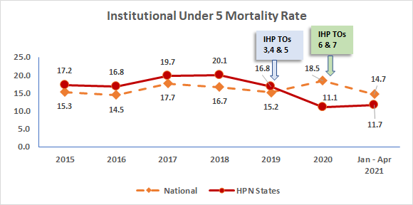
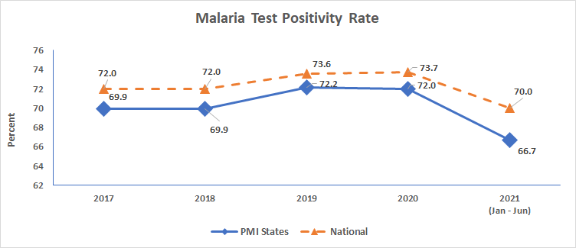
Health Investments = Positive Primary Health Care Outcomes
Increasing proportion of users of modern contraception
Decreasing maternal mortality
Decreasing infant mortality
Declining trend in malaria positivity

Slide 13
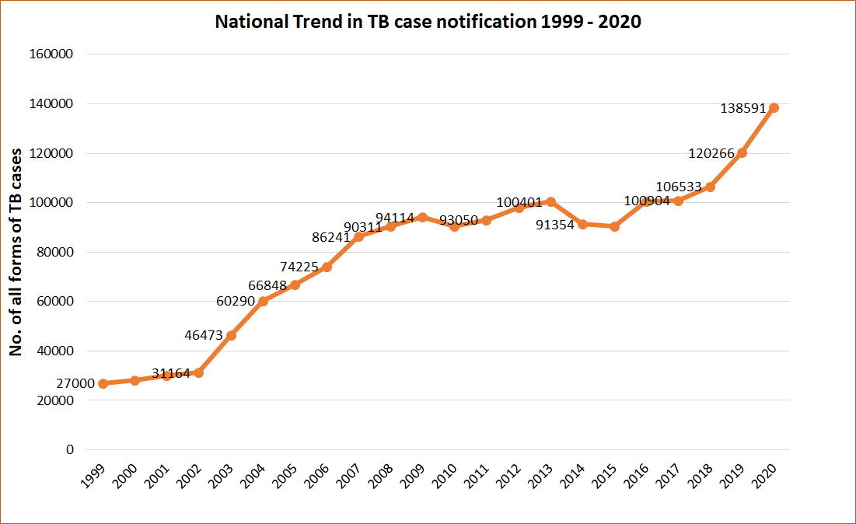
Increasing TB Case Detection and Treatment
Health Investments: Improving Tuberculosis Notification
Notes:
Nigeria has the 6th highest burden of TB Globally. Of the WHO estimated number of 440,000 TB patients only 138,571 have been diagnosed treated and reported. However through our partnership with each of the state commissioners, ministries of health we have shown commendable increase in case detection. In FY20, we had our largest increase in case detection, which is remarkable considering this occurred during the COVID pandemic. Nevertheless a significant gap remains to detect and treat TB in Nigeria.

Slide 14
Multi-Sectoral Nutrition Approach
USAID/Nigeria uses Multi-Sectoral Nutrition Strategy and Systems including Health, Food, Gender, WASH, and Humanitarian Assistance to address malnutrition in supported states
Reactivation and strengthening of State Food and Nutrition Committees (SFNC) and domestication of National Multi-Sectoral Nutrition Plan of Action in supported states of Bauchi, Ebonyi, Kebbi, Sokoto, and FCT
Scaling up innovative integrated maternal, infant and young child nutrition interventions including enhanced SBC; empower families and communities to improve access and uptake of safe nutritious food
Routinization of Micronutrients Supplementation as part of Primary Health Care services
Notes:
1.Programs in the health portfolio are integrated and designed to complement each other.
2.Each component of the portfolio is further integrated

Slide 15
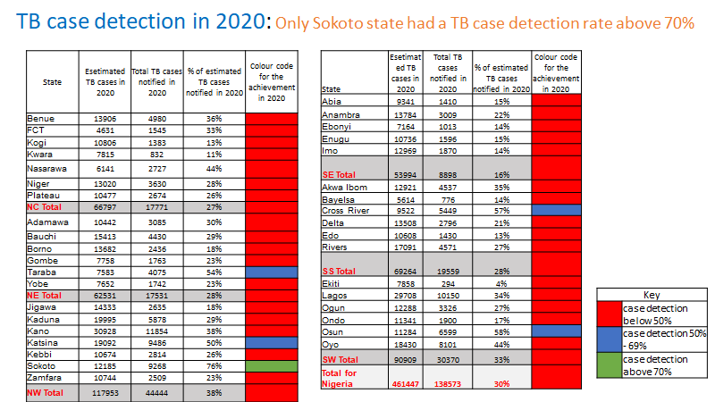
TB Case and Treatment Performance By States in 2020
Notes:
The recent increases of TB patients reported from 2017 are however commendable and should be sustained . This table compares the actual TB case notification by state in 2020 with the WHO estimated number of cases in each state. In 2020, only Sokoto state treated and reported up to 70% of WHO estimated TB cases . Taraba, Katsina, Cross River and Osun states reported 50% and over. All other states reported less than 50% of estimated WHO estimated TB cases in 2020. USAID is committed to working with states to further accelerate TB detection and treatment.
WHO 2020 annual report estimates there is a 70% funding gap in what is required to accelerate TB Case Finding with in Nigeria

Slide 16
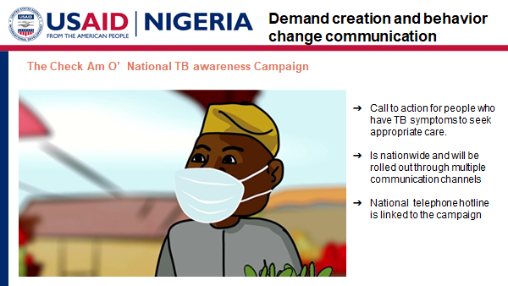
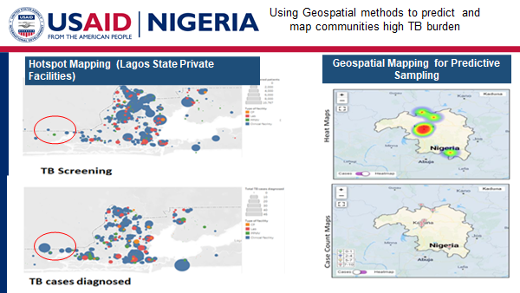
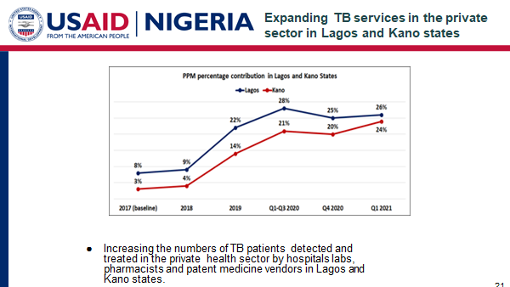
TB Case Finding Best Practices

Slide 17
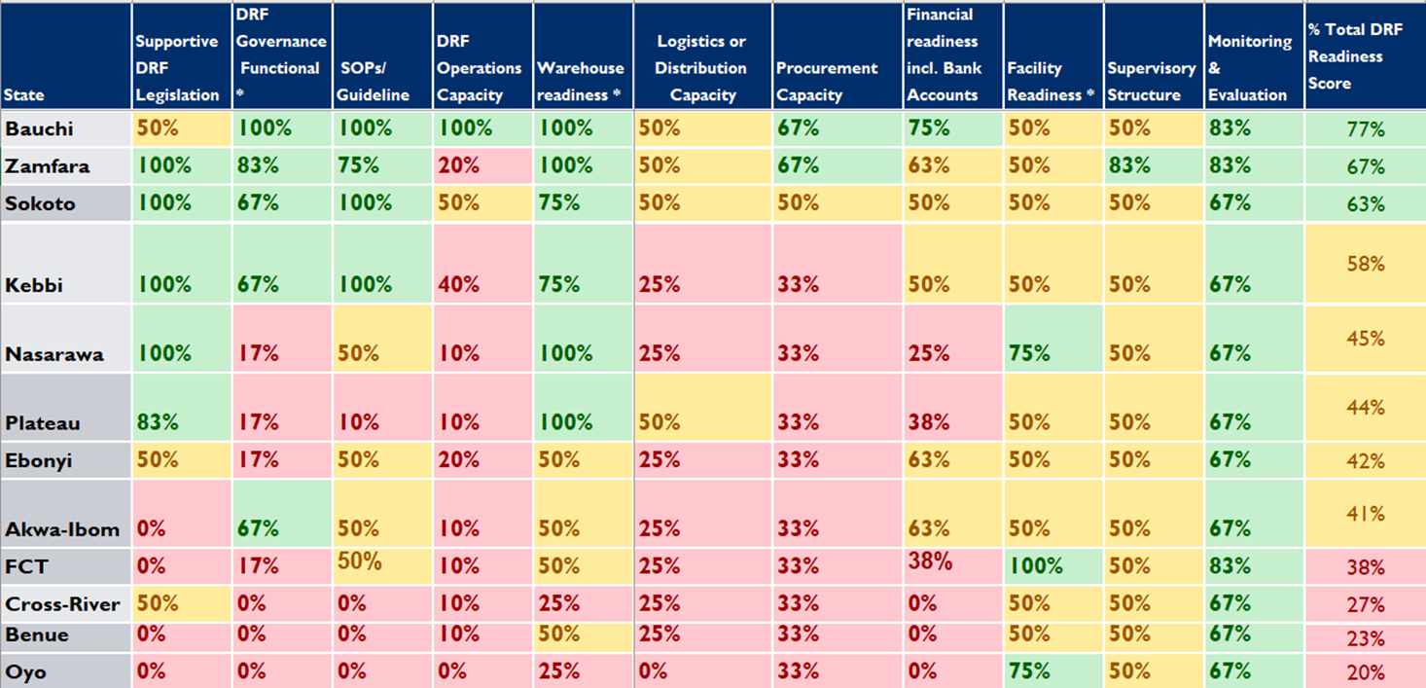
Drug Revolving Fund Readiness
Notes:
USAID is investing in the drug revolving fund (DRF) as a strategy to maintain a supply of essential medicines in the states.
Since 2018, USAID has supported these 12 states shown in various stages to establish a drug revolving fund in the states -
In Zamfara, Sokoto, Kebbi, Nasarawa, we have made significant progress in moving key legislation. With the DMMA, government, community and religious leaders, civil society organizations including women and youth groups are encouraged to take active roles in ensuring sustainability of the DRF scheme at all levels. This has been model practice in designing sustainable initiatives...

Slide 18
USAID’s Ask to States to Strengthen Partnerships Across the Health Portfolio
Funding
Basic Health Care Provision Fund
MOU Accountability
Operationalization of CHIPs Program
Drug Revolving Fund
Allocations for TB
State Procurement for TB diagnostics (Gene Xpert)
Human Resources for Health
Prioritization for Health
Domestic Resource Mobilization
Increased
Governance and Accountability
Notes:
USAID’s ask to you are two fold
Governance and Accountability
Funding
BHCPF
We want to see Each state with the a State Primary Healthcare Development Agency and State Social Health Insurance Agency and that PHCs not covered by the BHCPF need to be considered for expansion of services
Increase accountability in agreed upon memorandums of understanding
Operalization of CHIPs program
CHIPs (funding provisions and opportunities to operationalize the CHIPs program (recruit, train, equip) under the NHPCDA gateway)
Drug Revolving Fund
With regard to FUNDING
State budget allocations / release for TB
State procurement of GeneXpert machine for diagnosis of TB
Funding for HRH
With the Impact of COVID-19, seasonal outbreaks - a need to systemize operations to mitigate shocks and minimize resources from being diverted from PHC services and other infectious disease threats
Domestic Resources Mobilization

Slide 19
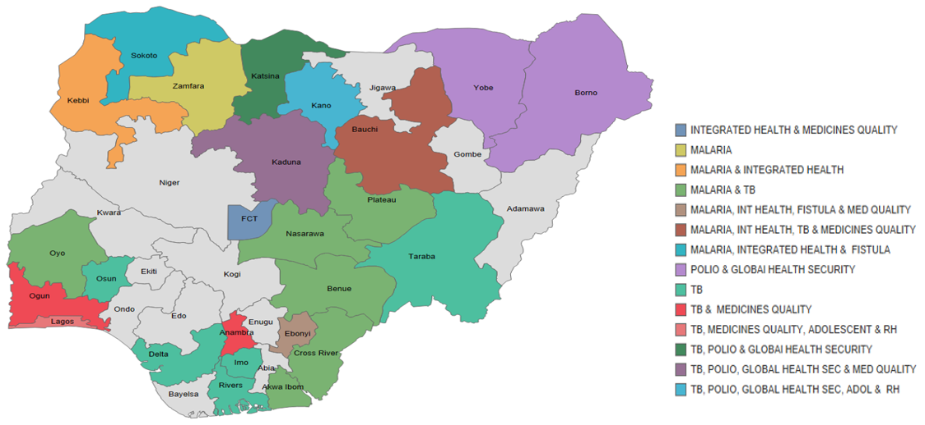
Scope of interventions and coverage
HPN and TB Support is in 25 States
Notes:
USAID selection of states in which we work are determined through:1 coordinated donor coverage to avoid duplication, 2.operating environment i.e. security and Federal and State commitment, 3. Disease burden - unmet need, 4. USAID investment. And 5. Funding from Washington and other priorities i.e. earmarks for family planning, MCH etc.
Geographic selection is periodically reviewed through CDCS and activity planning

