Slide 1

The Rural Electrification Agency
COLLABORATION WITH STATES FOR IMPACT:
Achieving Universal Electrification
Notes:
Collaboration for Impact showcases our readiness to work with the states collectively and individually to achieve universal electrification.
REA recognizes states as important stakeholders in rural electrification because rural communities are within state boaders.
There is a need to work together so that our projects will be complementary and beneficial to rural communities.

Slide 2



About
Vision
REA is the implementation Agency of the Federal Government of Nigeria under the Federal Ministry of Power, tasked with the electrification of unserved and underserved communities across the country
Nigeria achieving universal access to affordable and sustainable electricity, thus improving the quality of life and economic opportunities.
Mission
To provide access to reliable electric power supply for rural dwellers irrespective of where they live and what they do.
Mandate
Promote Rural Electrification in the country;
Co-ordinate Electrification Programs for unserved and underserved communities in the country;
Administer the Rural Electrification Fund (REF) to promote, support and provide rural electrification through Public and Private sector participation

Slide 3
REA Platforms
Private Sector Driven
FG Appropriation
1
6
Solar Power Naija
Capital Projects Appendix
2
7
Rural Electrification Fund
COVID-19 Support for States Appendix
3
Nigeria Electrification Project
Agriculture & Commerce
8
Education
Energizing Agriculture Programme Appendix
4
9
Energizing Education Programme
Energizing Economies Initiative Appendix
Sustainability
Gender Mainstreaming
5
10
Rural Electricity Users Cooperative Society
Gender Mainstreaming Programme Appendix
Notes:
Briefs on Programmes in Appendices:
Capital projects are funded through federal government appropriation capital budget which the REA is mandated by law to implement.
The core objective of the FGN’s Capital projects being implemented by the REA is to provide equitable access to energy across the 6 geo-political zones of the nation. Projects are in the form of grid extension, injection substation, solar streetlights, solar mini-grids and solar home systems
COVID-19: The Energy for ALL, a Mass Rural Electrification/Solar Power Strategy with a total funding of NGN 12,424,849,535 was appropriated by the national assembly as part of the response to COVID19 pandemic.
The 2 components are:
Deployment of Mini-grids to 200 PHCs and provision of Solar Streetlights to adjoining communities
Distribution of Solar Home Systems to 104 Unity Schools and provision of Solar Streetlights within the campuses
Energizing Agriculture Programme targets agriculture in rural communities through the provision of electricity and its services in the form of irrigation systems, processing equipment, cold storages and access to market to rural agrarian communities. State governments will play a big role in nominating agricultural clusters and the section of interest within the value chain.
The Energizing Economies Initiative (EEI) is an FGN sponsored programme targeting macro, small and medium enterprises (MSMEs) through increased energy access and economic growth by providing clean, reliable and affordable power to economic clusters across Nigeria; such as markets, shopping complexes and agricultural/industrial clusters.
Gender Mainstreaming Programme provides in-house gender inclusion trainings as well as networking opportunities for women within the REA and power sector at large, as a strategy to retain, empower and promote career advancement for the women. It also empowers women in rural communities powered by REA, encourage them to develop businesses through cooperatives and Ensuring sustainability of programme by training them towards maintaining and growing their businesses

Slide 4






States as Catalysts for Rural Development
Job Creation
Revenue Generation
Increase in revenue from partnership with private developers through REA programmes
Increase in jobs and local technical capacity/skills
Economic Development
Enhanced Security
Increase in commercial activities in rural communities through access to reliable power
Improving security through provision of electricity to homes & streets
Improved Health
Better Standard of Living
Reduction in pollution through use of clean energy sources
Better Education, Healthcare and Infrastructure

Slide 5




Solar Power Naija
Status in States as at 31st July 2021
Increase energy access through 5 million new solar connections
S/N | State | Developer | Engagement Status and Next Steps
1 | Adamawa | A4&T | Developer engaging with State and Banks for financing
2 | Akwa-Ibom | PRADO POWER | Developer and state have signed MOU Prado looking to identify banks
3 | Cross River | ASOLAR | State Government and company in discussions on MoU
4 | Delta | - | State requested to review the conditions to provide feedback
5 | Ekiti | SOLARPAWA | REA to hold virtual session with the state representatives
6 | Enugu | PRADO POWER | State planning on expanding the scope of work State and Prado power finalising on MoU
7 | Kano | EMEL | Kano Invest DG leading the state team on the Project MoU being reviewed by the state State seeking to do a higher transaction for ISPO
8 | Katsina | Privida | Meeting held with State Commissioner of Power
9 | Kwara | ASTEVENS | Indicated Astevens as the preferred developer
10 | Sokoto | Central Electrics & Utilities (CEU) | Engaged with Commissioner for Energy State about to commence engagement with CEU
Cover up to 5 million households
Serve about 25 million off-grid Nigerians
Increase local content in the off-grid solar value chain
To include the assembly or manufacturing of components of off-grid solutions
to facilitate growth of the local manufacturing industry
Create 250,000 new jobs in the energy sector
Incentivize solar equipment manufacturers
Offer additional job opportunities to Nigerians
5
Notes:
FGN has adopted a solar strategy for the electrification of 5 million households, serving about 25 million Nigerians and creating 250,000 jobs in the Economic Sustainability Plan
The eligible participants in the off-grid sector are Manufacturers/Assemblers on the upstream, and Distributors/Developers and Vertically Integrated Distributors on the downstream end.
HEVP launched the distribution of 100,000 units of SHS in Jigawa State earlier this year
Table shows the status of our engagement with states on the SPN. Discussion is ongoing with more states as we encourage the rest of the states to sit with us and benefit from the programme

Slide 6


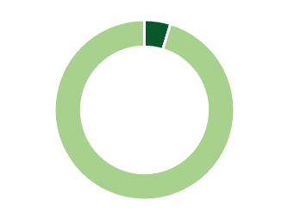
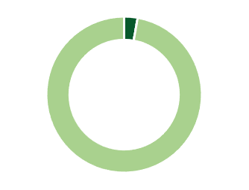
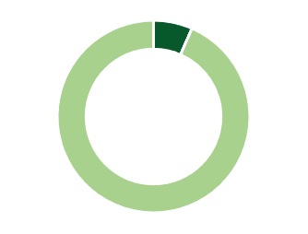
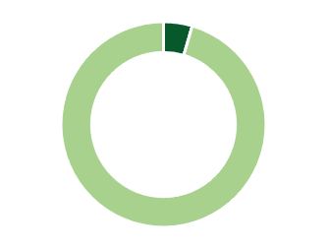

Rural Electrification Fund
Call 1 Status as at 31st July 2021
Katsina
12
Mini grid Projects Completed
Kebbi
Borno
24,402
Total Households Connected
Kaduna
Gombe
Niger
14
SHS Projects Completed
Plateau
19,030
SHS Units Deployed
FCT
Oyo
Taraba
Kogi
Benue
Ogun
Edo
+6000
Mini grids Connected
Ebonyi
1,364KWp
Total Deployed Capacity
Cross
River
Abia
Akwa Ibom
North-Central
North-West
North-East
South-West
South-East
South-South
Total
Akwa Ibom
34
22
62
44
42
60
Direct and Indirect jobs created under REF Call 1
725
788
948
971
1017
1087
5536
691
766
886
927
975
1027
Notes:
REF is a directorate in the REA that gets funding from:
donations, gifts, or loans made by international agencies, State Governments, the Federal Government, local communities, businesses
Monies appropriated by the National Assembly / Special Intervention fund
Any fines obtained by NERC pursuant to the EPSR Act
Percentage of the annual turnover of the licensee’s as may be determined by the NERC
REF aims to attract project developers with a track record of deploying rural electrification systems who can commit private capital to viable project sites.
The fund sets to:
Achieve more equitable regional access to electricity
Promote expansion of the grid and development of off-grid electrification
Maximize the economic, social and environmental benefits of Rural Electrification subsidies
Stimulate innovative approaches to rural electrification
Direct Jobs highlighted in dark green
Indirect jobs highlighted in light green
Total jobs in the middle
States energized are highlighted in green on the map

Slide 7





Rural Electrification Fund
Call 2
REF Call 2 will be carried out in two phases:
Phase 1 – Infrastructure projects (grid extension, Isolated mini grids and ICMG); and Non infrastructural projects ( SHS and SHS for productive use)
Phase 2 – Innovation (start ups, Innovation hubs, University research calls, Hackathons etc.); and State Government Matching fund (REUCS supports via promotions department)
NGN 3 billion total funds allocated
Phase 2
NGN 2.4 billion allocated for phase 1
NGN 300million to REF innovation hub
NGN 300million to State Gov Matching fund
Over 17,000
Households to be electrified
2,570 KW
capacity to be installed
29
Mini grids installed
Notes:
REF CALL 2 builds on the progress made in REF CALL 1 with more distribution of projects states across all zones.
States highlited in green and outlined at the bottom will benefit from the CALL

Slide 8









Nigeria Electrification Project
WB - $350 Million + AfDB $200 Million = $550 Million
SOLAR HYBRID MINI GRIDS | STANDALONE SOLAR HOME SYSTEMS | ENERGIZING EDUCATION PROGRAMME (Phases 2 & 3) | ENERGY EFFICIENT EQUIPMENT & PRODUCTIVE USE APPLIANCES | TECHNICAL ASSISTANCE
FUNDING
Performance Based Grant (PBG) $48 Million | Output Based Funds (OBF) $60 Million | $205 Million | $20 Million | $37 Million
Minimum Subsidy Tender (MST) $95 Million | Market Scale-up Fund (MSF) $15 Million
COVID 19 & Beyond $70 Million
PROJECTED IMPACT
403 MST sites, 405,000 Households 50,000 MSMEs, 100 Treatment/Isolation centers, 400 PHCs | 300,000 Households 40,000 MSMEs | 15 Federal Universities 2 Teaching Hospitals | 24,500 Productive Use Appliances across 36 states | Project Implementation and Capacity Building
8
Notes:
The NEP is an innovative initiative of the FGN, conceptualized to catalyze off-grid development in Nigeria through the provision of grant funding. The FGN has secured funding from both the World Bank ($350m) and the African Development Bank (AfDB) ($200m). The REA has been chosen as the implementing agency.
states

Slide 9






Energizing Education Programme
Phase I Status as at 31st July 2021
G
  153,239 Students
  Will have access to uninterrupted power supply
B
  180 Female Students
  Will gain hands-on practical training and experience in the design and construction of power systems
D
  21,166 Staff
  Will have access to uninterrupted power supply
  4,000+ Medical Staff
  Doctors and 1000+ other medical professionals will have access to uninterrupted power supply at work
H
C
  153,239 Students
  Will be trained on renewable energy courses at the projects’ Workshop/ Training Centers
I
E
F
A
  Streetlights
  ~76KM provided for improved safety and security within University campuses
A
B
C
D
E
F
G
H
I
AE-FUNAI
BUK
FUAM
ATBU
FUPRE
NAU
UDUS
OAU and OAU Teaching Hospital
UNILAG
Commissioned 2nd August 2019
Commissioned 3rd September 2019
Commissioned 4th December 2020
Commissioned 2nd February 2021
Commissioned 26th February 2021
Project completed - yet to be commissioned
Project completed and yet to be commissioned
Project 41% completed
Project 65% completed
Notes:
EEP is set to provide captive power to 37 federal universities and their associated teaching hospitals
Phase 1 funded by the FGN
9 universities and 1 teaching hospital
5 univeristies have been completed and duly commissioned
2 universities are completed but yet to be commissioned
2 universities and 1 teaching hospital are in the completion phases

Slide 10
Energizing Education Programme
Phase II and III Beneficiaries
Proposed Phase IV Beneficiaries
S/N | UNIVERSITIES | State
 | Phase II (World Bank-Funded)
1 | Federal University of Agriculture, Abeokuta | Ogun
2 | Michael Okpara University of Agriculture, Umudike | Abia
3 | University of Calabar and Teaching Hospital | Cross-River
4 | University of Maiduguri and Teaching Hospital | Borno
5 | University of Abuja | F.C.T
6 | Federal University, Gashua | Yobe
7 | Nigeria Defence Academy | Kaduna
 | Phase II (AfDB-Funded)
1 | Modibbo Adama University of Technology, Yola | Adamawa
2 | Federal University, Dutsin-Ma | Katsina
3 | University of Lafia | Nasarawa
4 | Federal University, Lokoja | Kogi
5 | Federal University of Technology, Owerri | Imo
6 | University of Port-Harcout | Rivers
7 | Federal University, Uyo | Akwa-Ibom
8 | Federal University, Akure | Ondo
S/N | UNIVERSITIES | State
 | No Funding yet
1 | University of Ilorin and Teaching Hospital | Kwara
2 | Federal University of Technology, Minna | Niger
3 | University of Jos | Plateau
4 | Federal University, Wukari | Taraba
5 | Federal University, Kashere | Gombe
6 | Ahmadu Bello University and the University Teaching Hospital, Zaria | Kaduna
7 | Federal University, Dutse | Jigawa
8 | Nigerian Police Academy, Wudil | Kano
9 | Federal University, Birnin-Kebbi | Kebbi
10 | Federal University, Gusau | Zamfara
11 | Federal University, Otuoke | Bayelsa
12 | University of Benin and University of Benin Teaching Hospital | Edo
13 | Federal University, Oye Ekiti | Ekiti
*REA is working to secure funding for implementing EEP Phase IV
10
Notes:
Phases 2 and 3 of the EEP is being funded by World Bank and AfDB
Phase 4 highlights the remaining 13 universities that will commence as soon as funding is secured
8 Universities highlighted in light green are part of the 9 new universities established in 2011. FUNAI (in phase 1) is the 9th

Slide 11
Rural Electricity Users Cooperative Society
Status as at 31st July 2021
A total of 761 communities and 126 have been sensitized and REUCS registered under capital projects and NEP (World Bank & AfDB) respectively.
NE
NW
NC
121
Sensitized
Communities
186
Sensitized
Communities
210
Sensitized
Communities
22
Registered
Cooperatives
37
Registered
Cooperatives
9
Registered
Cooperatives
SW
SE
SS
105
Sensitized
Communities
84
Sensitized
Communities
55
Sensitized
Communities
10
Registered
Cooperatives
12
Registered
Cooperatives
36
Registered
Cooperatives
Notes:
The Rural Electricity Users Cooperative Society (REUCS) is an initiative of the REA that is aimed at mobilizing benefiting communities to achieve sustainability of electrification projects. Role includes:
To promote community participation in rural electrification projects through training on ownership, operation, maintenance and safety of facility
Enable community members to learn about productive usage of electricity as well as educate members on energy conservation and efficiency
Ensure community members work together to protect electricity equipment against theft and vandalization
To partner with Electricity Distribution Companies and Independent Power Producers (IPPs) in their localities for the provision of electricity at an affordable price.
Ensure prompt payment of electricity bills by members and through the cooperative society
Encourage all relevant stakeholders to work together to solve community electricity related problems

Slide 12


General Prayers and Next Steps
Focal Person:
A Focal Person for the REA to be able to work with in coordinating activities and projects and generally creating an enabling environemnt for REA projects in states.
Suitability: A state official that has access to the Executive Governor, so that state policies and priorities are communicated in a timely manner.
General Stakeholder Workshop: All Focal Persons will be invited and sponsored by the REA to a stakeholder workshop to discuss States’ Priority Needs and the Way Forward
One-on-Ones: Meetings with Executive Governors and their respective Focal Persons to discuss peculiarities within the states and immediate Next Steps
Sustainability:
The need to support the deployment of COVID-19 intervention projects (Mini-grid, SHS and Solar Streetlights) and help in sustaining them *Letters have been sent to all states soliciting for support
Take ownership of FGN Capital Projects in states for sustainability *Kaduna has taken control of projects
Technical Assistance:
REA to provide States with access to capacity building training for staff in Rural Electrification Boards and energy-related ministries.
Access to strategy, plan and policies on Offgrid Solar Development through REA’s development partners. *Jigawa, Kaduna and Kano already in the pipeline, Lagos is almost complete.
Access to Energy Transition plan that helps states to utilize renewable and sustainable energy resources. *Pilot phase for some states in currently ongoing. Delta is almost complete.
Access to Offgrid Solar Development market assessment report which provide information on investors, developers and donors in the sector. *Engagement already ongoing with 10 states
Access to rooftop solar potential for cities through REA partners where state government will know the solar power capacity of public buildings, schools, markets and hospitals. *Jimeta, Kaduna and Sokoto cities already simulated and ready for usage.
12
12

Slide 13
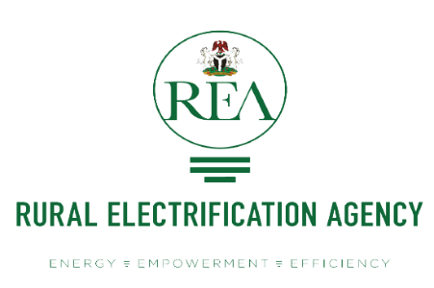
End
Website: www.rea.gov.ng
Email: info@rea.gov.ng
@REANigeria
@realREANigeria
@REANigeria
@realREANigeria
Notes:
END!

Slide 14
Appendices

Slide 15
The REA Strategy
Implement and Coordinate
Promote a Sustainable Market
Focus on the Unserved and Underserved
Excellence in Delivery and Talent
Increasing Sector Coordination
Support greater collective impact through increased coordination of rural electrification efforts throughout Nigeria
Enabling Electricity
Markets
Electricity markets for unserved and underserved users strengthened across the value chain by an effective enabling environment
Reaching Unserved & Underserved Communities
Improved quality of life through the electrification of unserved and underserved households & institutions (health, education, etc.) and economic sectors
Increasing Economic Opportunity
Increased economic opportunities in rural areas through electrification initiatives that reach SMEs, agriculture, healthcare sector, and other priority industry segments
Shaping REA into a Top-Tier Agency
Providing internal development programs, employee support initiatives, and transparent work practices to solidify REA as an agency that builds and maintains its institutional capacity
Notes:
There is a link that binds all our strategic points together
from our role as coordinators in the space,
to emphasising on sustainable market through public-private partnerships,
to going deep into identifying viable rural communities and creating a model and providing grants and subsidies that makes it attractive to private developers while also making it affordable to the communities,
to implementing complementary programmes that target MSMEs, Healthcare and Agriculture to increase economic opportunities in those communities,
And finally, by focusing on improving REA from within and equip it with the tools to be able to deliver on the objectives enshrined.

Slide 16





Capital Projects Status
Status as at 31st July 2021
457 Projects Completed
2017
182 Projects Completed
2018
440 Projects Completed
2019
379 Projects Completed / 49 Ongoing
2020
Connections
achieved in all
36 states
2
3
2
9
47
172
193
Notes:
Capital projects are funded through federal government appropriation capital budget which the REA is mandated by law to implement.
The core objective of the FGN’s Capital projects being implemented by the REA is to provide equitable access to energy across the 6 geo-political zones of the nation.
Projects are in the form of grid extension, injection substation, solar streetlights, solar mini-grids and solar home systems
The pictorial chart at the bottom shows the distribution for completed and ongoing 2020 projects

Slide 17
Capital Projects for 2021
New Projects
Ongoing Projects
208
207
17
42
NE
NW
73
New Projects
NC
76
New Projects
111
New Projects
6
Ongoing Projects
7
Ongoing Projects
7
Ongoing Projects
SW
SE
SS
63
New Projects
47
New Projects
59
New Projects
6
Ongoing Projects
5
Ongoing Projects
6
Ongoing Projects
Notes:
Capital project distribution across all geopolitical zones for 2021
Including ongoing projects from previos budget

Slide 18
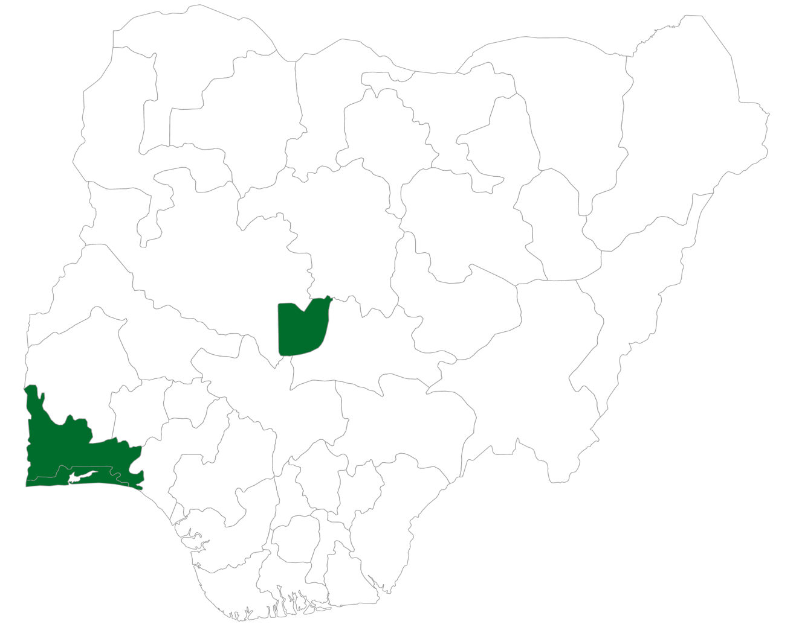


Powering Healthcare
Status as at 23rd April 2021
At the onset of the COVID-19 outbreak, President Muhammadu Buhari outlined the intervention and palliative measures of the FGN. The President also called for inter-agency collaboration on the fight against the pandemic. The REA has electrified four COVID-19 health facilities in three states, with solar hybrid mini grids
A
B
C
D
D
B
25kWp
20kWp
10kWp
53.1kWp
A
C
NCDC Public Health Laboratory, Lagos state
Ikenne Isolation Centre,
Ogun state
Iberekodo Isolation Centre, Ogun state
University of Abuja Teaching Hospital, FCT
108.1kWp
Total power deployed
Projected Impact of project:
200
Total number of PHCs to receive sustainable energy solutions across Nigeria in the next 12 months, currently being implemented by the REA as part of the “Energy for All – Mass Electrification” Programme
Powers critical loads such as ventilators and cooling systems
Enable frontline medical workers to function effectively
Serves as a source of clean, safe and reliable energy appropriate for a healthcare environment
Notes:
On the FGN directive, through the Ministry of Power, REA ventured into providing power to critical infrastructure in isolation centers in the hard hit states when COVID 19 was at its peak in second quarter of 2020.
There is also Energy for ALL, a Mass Rural Electrification/Solar Power Strategy with a total funding of NGN 12,424,849,535 was appropriated by the national assembly as part of the response to COVID19 pandemic.
The 2 components are:
Deployment of Mini-grids to 200 PHCs and provision of Solar Streetlights to adjoining communities
Distribution of Solar Home Systems to 104 Unity Schools and provision of Solar Streetlights within the campuses
Letters have been sent to states on the need to support the deployment of minigrids, SHS and solar streetlights, and to help in sustaining them

Slide 19
COVID-19 Projects for States
The Rural Electrification Agency, working with NPHCDA and the Federal Ministry of Health identified viable sites in all the 36 states of the country for the implementation of the COVID-19 response projects.
S/N | STATE | MINI-GRID | SHS (Unity Schools) | SOLAR STREET LIGHT
1 | ABIA | 6 | 60 | 121
2 | ADAMAWA | 8 | 40 | 145
3 | AKWA IBOM | 3 | 60 | 60
4 | ANAMABRA | 6 | 60 | 102
5 | BAUCHI | 4 | 40 | 60
6 | BAYELSA | 3 | 60 | 87
7 | BENUE | 7 | 80 | 110
8 | BORNO | 8 | 60 | 382
9 | CROSS-RIVER | 4 | 60 | 267
10 | DELTA | 3 | 40 | 50
11 | EBONYI | 3 | 40 | 50
12 | EDO | 4 | 60 | 70
13 | EKITI | 4 | 60 | 70
14 | ENUGU | 4 | 40 | 20
15 | GOMBE | 3 | 40 | 50
16 | IMO | 3 | 40 | 50
17 | JIGAWA | 6 | 40 | 209
18 | KADUNA | 4 | 60 | 70
19 | KANO | 15 | 40 | 170
S/N | STATE | MINI-GRID | SHS (Unity Schools) | SOLAR STREET LIGHT
20 | KASTINA | 5 | 60 | 80
21 | KEBBI | 6 | 60 | 90
22 | KOGI | 5 | 40 | 70
23 | KWARA | 5 | 40 | 97
24 | LAGOS | 4 | 80 | 80
25 | NASARAWA | 3 | 60 | 60
26 | NIGER | 15 | 100 | 200
27 | OGUN | 4 | 60 | 70
28 | ONDO | 4 | 60 | 115
29 | OSUN | 4 | 60 | 70
30 | OYO | 4 | 40 | 60
31 | PLATEAU | 5 | 40 | 110
32 | RIVERS | 3 | 60 | 87
33 | SOKOTO | 3 | 60 | 60
34 | TARABA | 12 | 60 | 790
35 | YOBE | 11 | 20 | 220
36 | ZAMFARA | 3 | 40 | 20
 | TOTAL | 98 | 1,920 | 4,422
*Each Mini-grid site has 10 SSL *Each school has 20 SHS and 10 SSL *400 Project for Phase II is underway *States will nominate sites
Notes:
The Energy for ALL, a Mass Rural Electrification/Solar Power Strategy with a total funding of NGN 12,424,849,535 was appropriated by the national assembly as part of the response to COVID19 pandemic.
The 2 components are:
Deployment of Mini-grids to 200 PHCs and provision of Solar Streetlights to adjoining communities
Distribution of Solar Home Systems to 104 Unity Schools and provision of Solar Streetlights within the campuses

Slide 20









Energizing Agriculture Programme
Identify Agricultural Clusters
Nomination from states, MDAs and other stakeholders
Identification through geospatial tool and existing REA database
Stakeholder workshops to validate viable sites
Lack of coordination and collaboration
Lack of awareness of best practices
Lack of vetted, high quality electric agricultural appliances
Assess Feasibility
Carry out energy audit and baseline surveys
Load analysis and technology solultion
Equipment audit
Barriers
Align stakeholders in the energy and
agriculture sector
Equip investors and practitioners with data
Provide electricity and productive use equipment
Identify Funding Opportunities
Explore co-funding opportunities with states
Secure funding from Development Partners
Objectives
Design Project Pipelines
Collaborate with states on ongoing ADP projects
Explore suitable delivery models and susbsidy design
Filter projects through a Productive Use Accelerator
Stakeholder Collaboration and Escalation
Non-Market Services
Productive Use Innovation Accelerator
Build Projects
Providing electricity for existing ADP projects
Provide the improved PUE for energized clusters
Private developers to Operate and Maintain
Components
Operate and Maintain
Private developers to operate and maintain
Beneficiaries to participate through cooperative societies
*Programme yet to commence
Notes:
Energizing Agriculture Programme targets agriculture in rural communities through the provision of electricity services such as irrigation systems, processing equipment, cold storages and access to market to rural agrarian communities.
This is done to ensure that the economic lives of rural dwellers is enhanced.
State governments will play a big role in nominating agricultural clusters within their enclave.
The slide hghlights the barriers to energy and agriculture nexus, the objectives of the programme and the components that will be implemented
The slide also shows the line of activities of the programme from identifying the clusters right down to where private developers will operate and maintain the projects
REA is currently in discussion with Farmers association and private developers to coordinate a commodity-for-service kind of projects.

Slide 21





Energizing Economies Initiative
Pilot Phase
Lagos
Abia
Kano
Lagos
Ogun
Ondo
Edo
Ondo
Commissioned
Markets
Sura Shopping Complex | Ariaria Market | Sabon Gari Market | Iponri Market | Ita Osun Market | Isinkan Market | Edaiken Market | NEPA 1&2 | Total
1,047 | 4,768 | 6,102 | 507 | 508 | 157 | 168 | 179 | 13,436
1,091 | 4,763 | 6,102 | 1,670 | 3,602 | 190 | 168 | 278 | 17,864
1,000 | 1,600 | 750.24 | 684 | 87.48 | 45.36 | 29.16 | 41.62 | 4,238
22,806,000 | 78,192,000 | 16,290,000 | 6,516,000 | 2,606,400 | 325,800 | 325,800 | 195,480 | 131,623,200
Connections &
Meters Installed
SMES Connected
(Estimated)
Installed
Capacity (kW)
x
CO2 Savings
(Annually)
Jobs
Created
28
90
84
32
25
12
15
24
310
*More than 130 markets are currently being audited across all 6 geopolital zones, covering all 36 states and the FCT
Notes:
The Energizing Economies Initiative (EEI) is an FGN sponsored programme targeting macro, small and medium enterprises (MSMEs) through increased energy access and economic growth by providing clean, reliable and affordable power to economic clusters across Nigeria; such as markets, shopping complexes and agricultural/industrial clusters.
Over 340 economic clusters have already been identified across the country
Over 200,000 MSMEs will be transformed
Over 2,500 direct jobs will be created
Over 18 million Nigerians will be served

Slide 22





Gender Mainstreaming
Professional Women
Community Women
Providing in-house gender inclusion trainings as well as networking opportunities for women within the REA and power sector at large, as a strategy to retain, empower and promote career advancement for the women.
This component aims to:
Empower women in rural communities powered by REA through economic integration.
Encourage women in communities to develop businesses through cooperatives.
Ensuring sustainability of programme by training women towards maintaining and growing their businesses.
Increased women’s awareness on career opportunities in the power sector
Platform to connect industry experts
to other women in the power who are seeking career opportunities/ guidance
Women taking on more active roles
and managerial positions in the power sector
30.000+
Women estimated to be empowered
300,000+
households to be potentially impacted directly
Standard of living
To be improved on across selected communities
Increased the number of women in management roles from 1 to 6;
Ensured that over 25 female project managers are working across the various REA initiatives;
Organized various gender-focused workshops and trainings, etc.
5,500+
Women sensitized and encouraged to be proactive by playing key roles and representing women in their communities

