Slide 1

Transforming end-to-end tax processes through technology
to improve the taxpayer experience
Titilayo Adewumi – SAP Sales Director – West Africa
April 2021
Notes:
In application business since 1972 : Developing Enterprise Application SW has been and still is SAP’s core business.
COTS vs customer build: Plus 10,000 software developers : SAP is further massively investing in product innovation and development, including Defense specific applications.
Complete application documentation : The documentation is including all industry solutions, business scenarios, components and interfaces.
High effort for best software quality : The SAP process for product launches ensures timely and high product quality.
In 2011 SAP spent 13% of it’s revenue in R&D expenses alone (2bn€)

Slide 2

Government has a timeless mission
Provide services
Protect the community
Help the economy prosper

Slide 3




Market Trends
The Nigeria Tax Administration and collection is being driven by four critical forces:
Governance & Compliance
Lack of institutional capacity to effect tax administration - Weak / Incapacitated tax administration
Inadequate coverage and capacity for effective tax registration and collection
Tax evasion and non remittance of collected VAT
Multiple taxation and leakages
Tax payers are not encouraged to pay taxes
Competition for Scarce Resources
Nigeria is a mono-economy with heavy dependence on crude sales
Poor taxation drive by all tiers of government due to overdependency on Federation Account Allocation Committee (FAAC)
COVID-19 pandemic and the devastating effects in the global crude price necessitate a rethink in alternative sources of revenue for all tiers of government
Dearth of capable human resources to administer the relevant taxes efficiently
Bridge the wide gap between national development needs and the funding required to meet these needs
Instability, Volatility, Uncertainty
Economic uncertainty – payment of salary to civil servants is now a big challenge
Political instability
Unforeseen events and unrest in some part of the country
Regulatory shifts
Enabling Technology Adoption
Enable taxpayer for self assessment
Significant growth in the rate of Internet adoption
Mobile technology adoption and use
Social networking
Interconnectivity

Slide 4
SAP in Tax and Revenue Management
Dedicated Business Unit for Tax and Revenue Management
From Market, Product and Partner Strategy to Field and Partner Enablement
Regional presence
Organization
SAP Tax and Revenue Management
SAP Taxpayer Online Services
SAP Behavioral Insights and Compliance Management
SAP Debt Management
Solutions
Recognized strong partner ecosystem
Enablement activities for partners
Excellent collaboration with both ISV’s and system integrators
Ecosystem
Participation
New Collaterals Tax and Revenue Management
Analyst and Press activities
SAP Executive Value Network for Tax and Revenue
Go-To-Market
Customer updates see next slides
Strong presence within Gulf Cooperation Council (GCC) countries
Multiple deployment options
Collaborative roadmap definition
Customers &
Projects

Slide 5
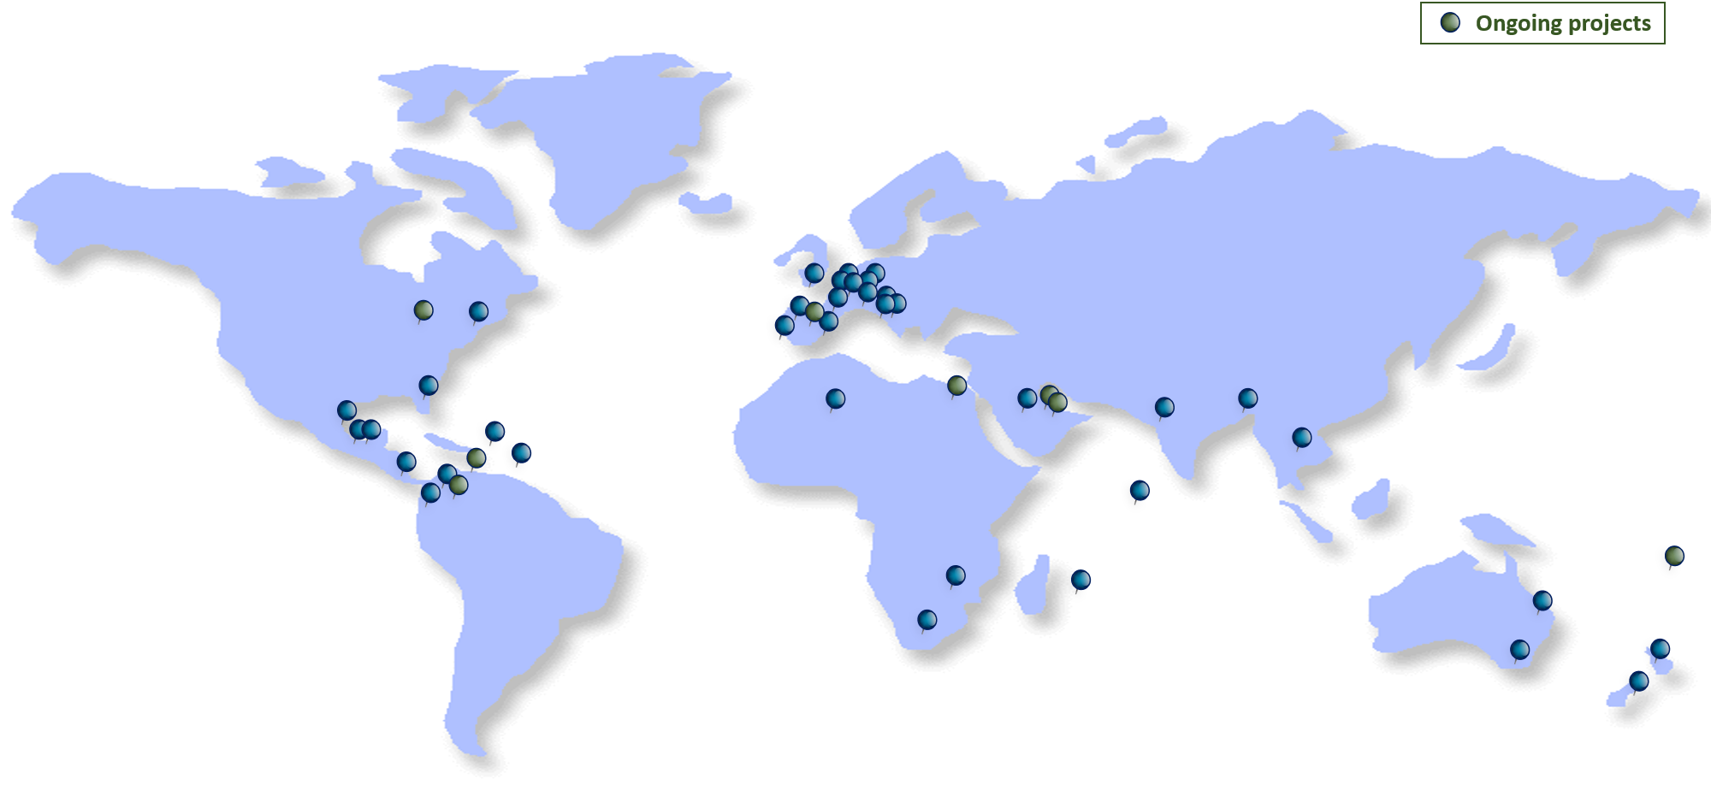









SAP Tax and Revenue Management
Selected Customer Examples
~60
Central and State government
Local government
~200
„One platform for UK Tax“ One of biggest ongoing tax transformation of a G20 country
Real time POS Integration
Core tax types delivered on 700 offices for 40 M taxpayers
1998
New Tax Agency with go-live in 6 moths
Customs integrated with tax
Payments across all tax types are coming in via SAP
Partner implementation & knowledge transfer for Customer ownership
Full E2E process covered, Compliance, Prediction, Engagement and CX deployed on HANA Enterprise cloud

Slide 6
Tax and Revenue Management
Implementation Approach, Customer Approaches
Hannes Venter – SAP Industry Advisor Tax and Revenue Management
April 2021

Slide 7
Revenue Management Platform – Beyond Tax
ENERGY & WATER
DISTRIB.
HEALTH
EDUCATION
SOCIAL SERVICES
TAX &
REVENUE
MGMT
URBAN
TRANSP-ORTATION
URBAN SAFETY
WASTE & RECYCLING
MGMT
Public Revenue Management
Public Administration (Integrated platform)

Slide 8
Platform Flexibility - Business Rules
Data Validation
Completeness
Rejection
Compliance Rules
Determine Risk
Validate Data
Calculation Rules
Calculate Liability
Calculate Refund
SAP Financial Contract Account (FICA Sub-ledger)

Slide 9


SAP Tax and Revenue Management Business Capabilities
Strategy Development
Planning & Budgeting
Analytics / Business Intelligence
(Reporting, Predictive Analytics & Modeling, Simulation & Optimization)
Taxpayer (Online) Services
(Online Account Management, filing obligations, account summaries, payments, enquiries, education, communication)
Taxpayer Master Data Mgmt
(Registration, Account Data Mgmt, 3rd party management, Filing Obligations)
Tax return processing (filings, assessments, …)
Receivables & Payables
(Financial Account Management, Payments, Clarifications, Deferrals, Dunnings)
Revenue Accounting
Overdue Debt Mgmt
(Debt Collection and Enforcements)
Compliance Mgmt (Disputes, Audits, Fraud, Risks)

Slide 10
SAP Tax and Revenue Management Manages All Tax Types
Personal Income | Business Income | GST/VAT/SUT | Customs & Excise | Land/ Property | Others
Vietnam | Pennsylvania | Slovenia | Queensland (Land Transfer, Insurances) | UK | Saudi Arabia (Religious)
Florida | Florida | Vietnam | UK (Gaming, Land Transfer) | Queensland | Maldives (Hotels)
Michigan | Vietnam | Maharashtra | Mauritius (Betting, Gaming, Lotteries, Liquor) | South Australia | South Australia (Payroll, Health Levy)
Bangladesh | Mauritius | Mauritius | Vietnam (Agriculture) | Auckland, Christchurch | Florida (Child Support, Payroll)
UK (PAYG only) | Slovenia | Zimbabwe | South Africa (Customs) | Tel Aviv, Cape Town | British Columbia (Student Loans, Infringements)
Mauritius | Michigan | Florida, Michigan | Luxembourg (Customs) | Austria (Shared Services) | Guanajuato (Vehicle Tax)
Maldives | Maldives | Bangladesh | Florida (Liquor) | Vietnam | Queensland (Mining Royalties)

Slide 11

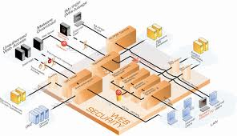


Implementation Approaches
Big Bang approach
Phased approach

Slide 12
Typical Tax and Revenue Management Implementation Phased Approach
Program Steering Committee
Program
Quality Controlling
Program
Program Management Office
Program Management
Project Management
Project Office Administration
Program
Change Management
TRM Program
Project Assistance
Organizational Units and functions / IT
Baseline
Release1
Release2
Release3
ERP
TRM Baseline
Tax type1
Tax type2
Tax type3
Tax type4
Tax type N
Tax type
N+
Tax type
N++
CRM
Reference Network
Process
Owners
Technology
Online Services
Portal
Migrate
Maintenance

Slide 13
Implementation synergies
Dependents
significantly
on the similarity
of Tax Types
Reporting omitted for Clarity
Collection does not include Enforcement
(source SAP Consulting)

Slide 14
Phased approach
Phased approach implementation with cross tax type functionalities besides, the core tax type requirements.
Project priority targets definition, allowing quick wins over taxpayers segments, e.g. by industry, corporate vs individuals, …
Core functions full integrated in the core solution (Registration, Returns with assessments as well full integration within backend components as Financials and Budgetary). Additional functions defined according to Customer needs.
Typically phased approach based on:
  Individual tax types followed by Corporate or vice versa, or according to the legacy systems maturity.
Incorporation of further tax types will benefit the achievements in terms of taxpayers accounts management as well on the synergies and speed on implementation, allowing the template deployment approach.

Slide 15









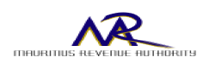
SAP TAX AND REVENUE MANAGEMENT
global solution – references worldwide
„One platform for UK Tax“: Biggest ongoing tax transformation of a G20 country
Shared services for cities
POS Integration for VAT
Instant Compliance
Dealer Matching VAT
All (56) tax types
Other revenue types
All tax payers and all tax types
Partner implementation
Go-live in 6 mo.
Online services
Cloud Solution; HANA based compliance management
Customs integrated with tax
Payments across all tax types are coming in via SAP
Partner implementation & knowledge transfer
© 2017 SAP AG or an SAP affiliate company. All rights reserved.

Slide 16
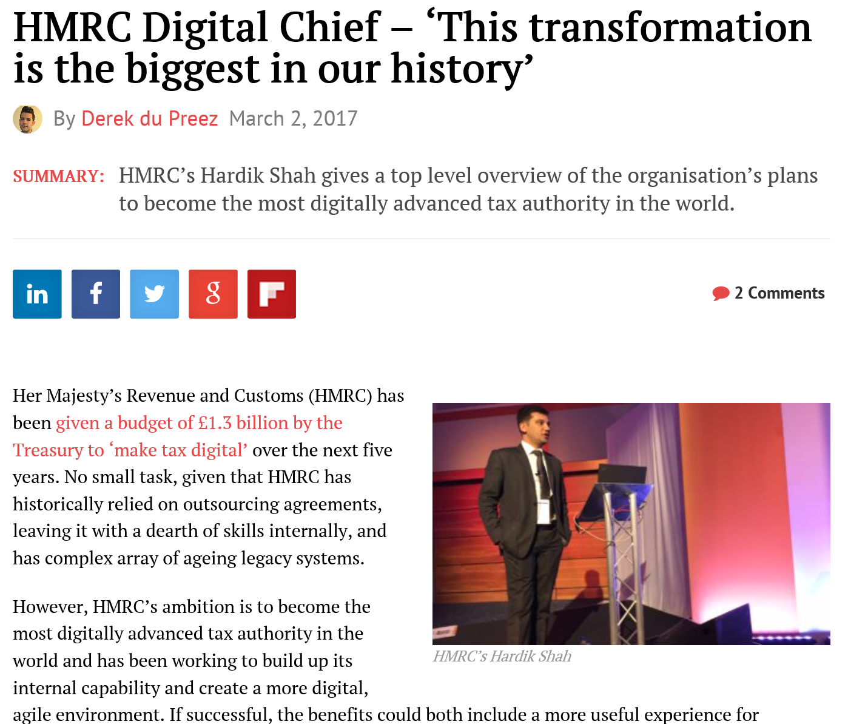
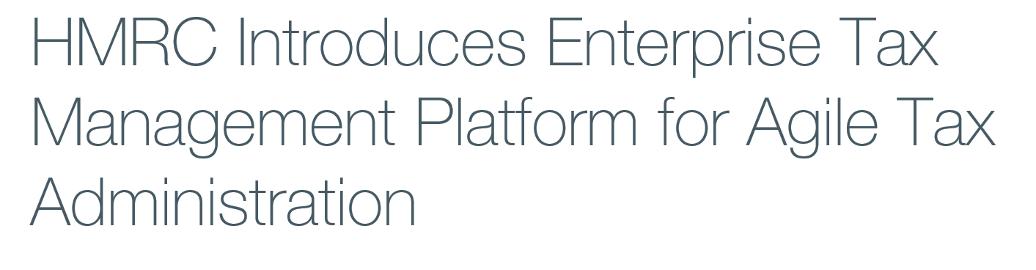
HMRC UK – Biggest Tax Transformation using SAP TRM COTS solution

Slide 17
Case Study
Client name: HER MAJESTY REVENUE & CUSTOMS
Country: United Kingdom
Timelines:
Unification between Inland Tax and Costumes organizations resulting on HMRC in 2005
1st project: Stamp Duty Land Tax
2nd project: Strategic Accounting Framework: Tax for all excises taxes
3rd project: National Direct Debit System for all UK Business and Personal Taxes
4th project: Single Business Identifier: Master Data Mgmt for all main taxes not yet migrated to TRM
5th project: "Registration Wizard" Registration form processing for 4 major taxes (VAT, CT, SA, PAYE).
Next projects: full E2E tax+accounting for regimes a) RTI for PAYE, b) Machine Gaming Duty, c) Charities Repayments System.
HRMC is driving the biggest ongoing tax transformation of the G20 Countries

Slide 18

Case Study
Client name: FLORIDA DEPARTMENT OF REVENUE
Country: Florida state – United States
Timelines:
Project objectives:
Implement a package solution for tax administration becoming the first state in US to achieve this.
Usage of solution components for the Child Support enforcement
Key Activities:
FDOR implemented SAP to support their General Tax Administration (GTA) program. Over 95% of the taxes and fees administered by FDOR are supported through the solution. FDOR manages 1.3 million taxpayers, staffs over 2,400 employees, handles 10 million transactions annually, generates $38 billion in annual revenues and supports 58 different tax and revenue types with 36 offices, and a 17M Florida population.
1998 | 1999-2000 | 2001-2002 | 2003 | 2004 | 2005-2007
integrated registration for two taxes | TRM solution procurement process integrated registration for 7 taxes | corporate and communications services tax incorporation | integrated sales and use tax, audit case management, CIC call center (CRM application) | Integrated Fuel, Gross Receipts and Documentary Taxes Integrated Business Warehouse and Expert Penalty System | fuel tax and severance taxes discovery case management bankruptcy case management insurance premium tax, Unemployment Compensation Tax Fed/State e-File & Pay

Slide 19

Case Study
Client name: FURS
Country: Republic of Slovenia
Timelines:
The project had 3 phases, start in June 2010.
With the 1st phase was implemented the cross processes on Revenue Management and account integration together with the first Tax Type – VAT. First go-live on Oct.2011.
Project objectives:
Replacement of outdated solution and adoption of COTS solution.
Coverage of the 15 FURS branches spread through Slovenia.
Provide a single interface to almost 2500 system users and increasing the level of service to the taxpayers (around 3.000.000 )
Coverage with a single COTS solution the full set of revenue, which between taxes and excises duties are ++50

Slide 20
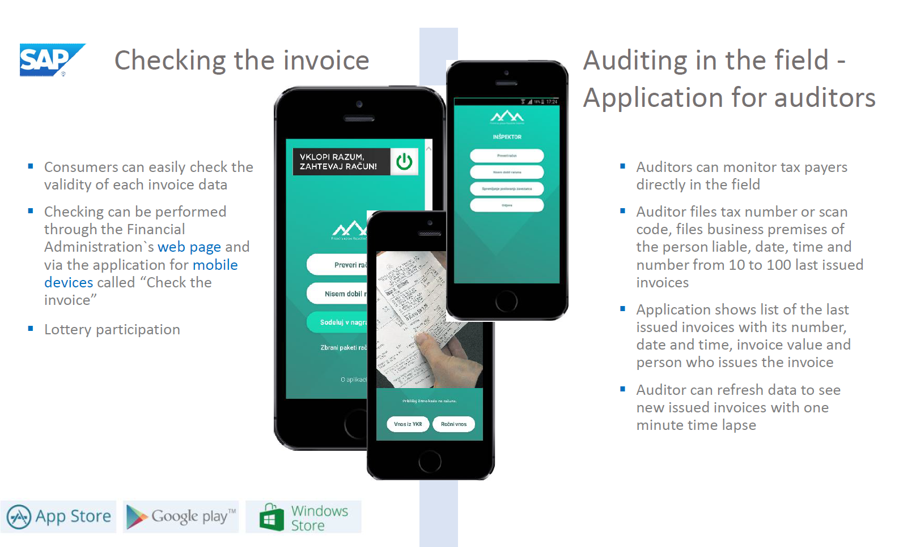
FURS – Online Cash Registers

Slide 21
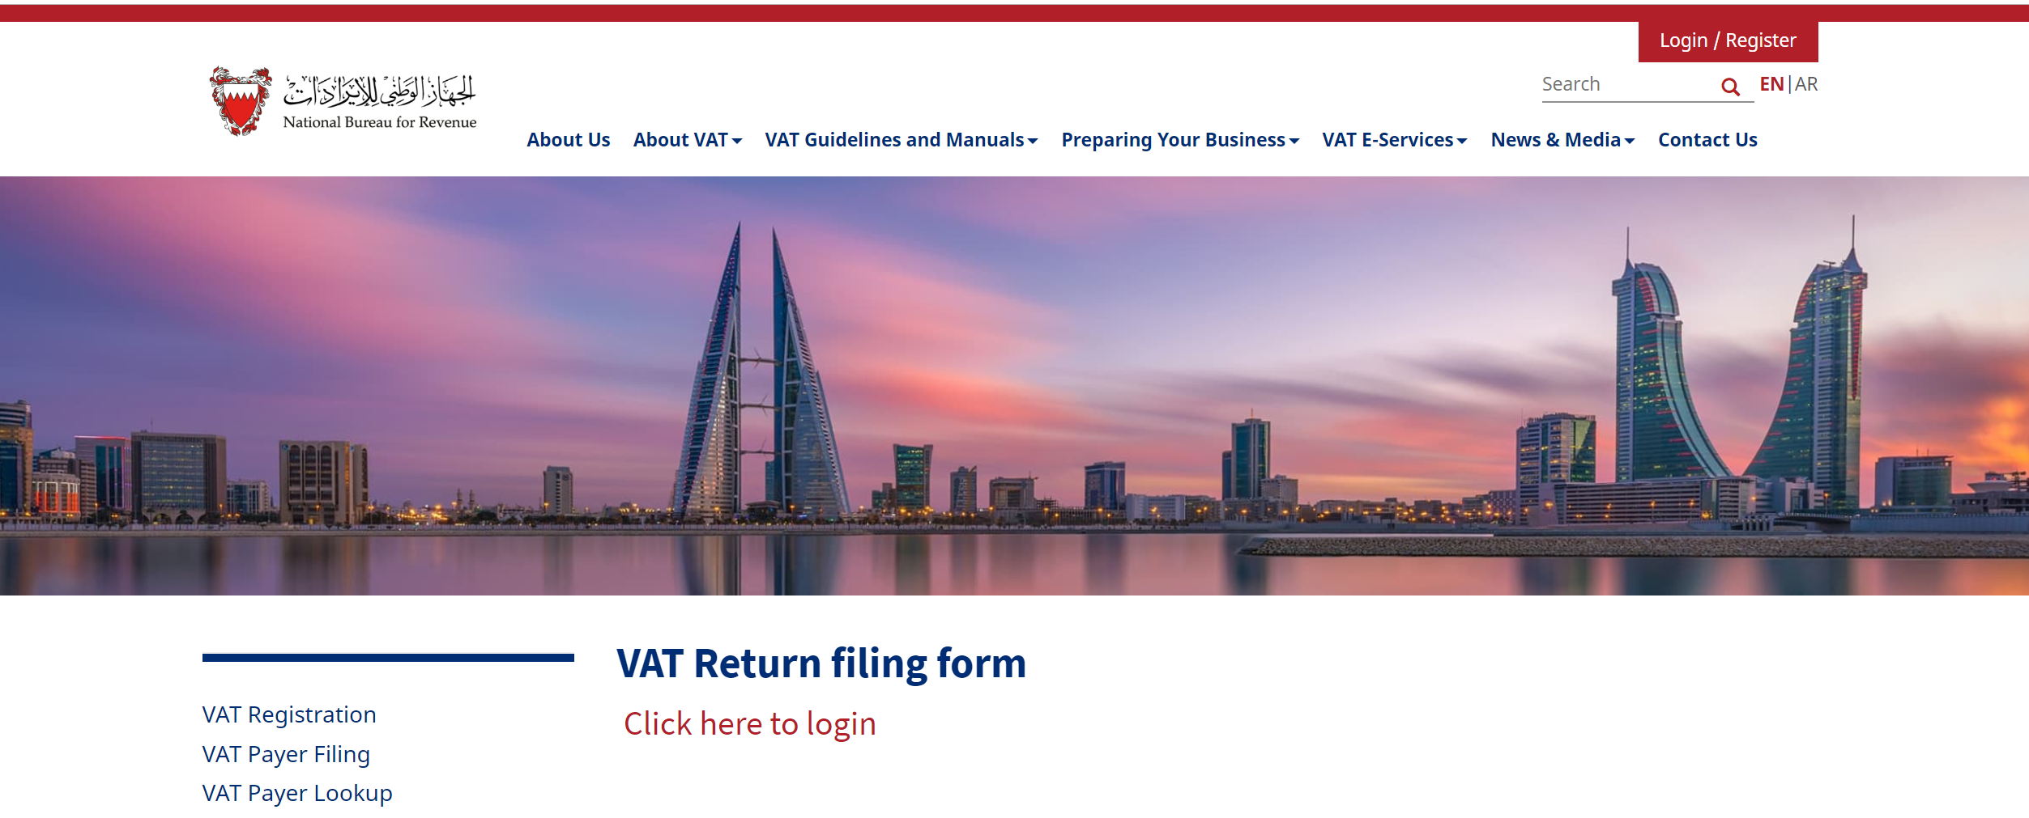
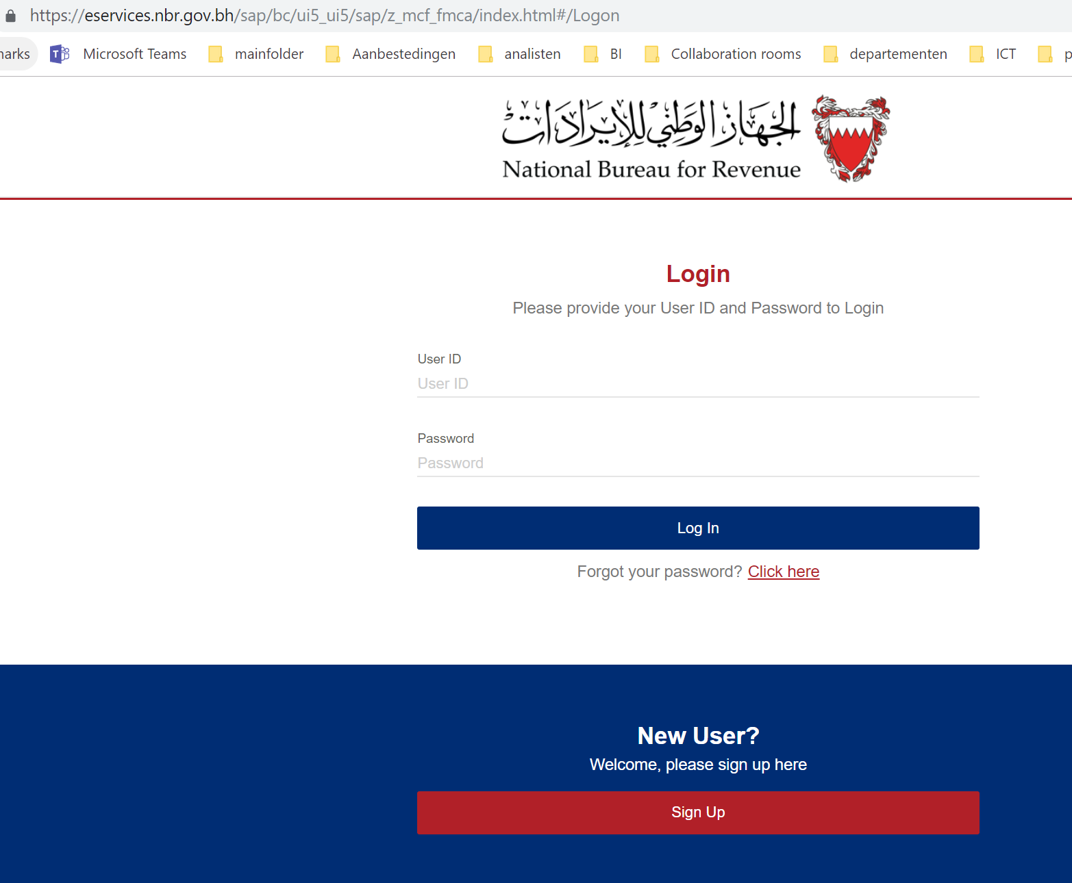
Bahrain: live in 5 months

Slide 22
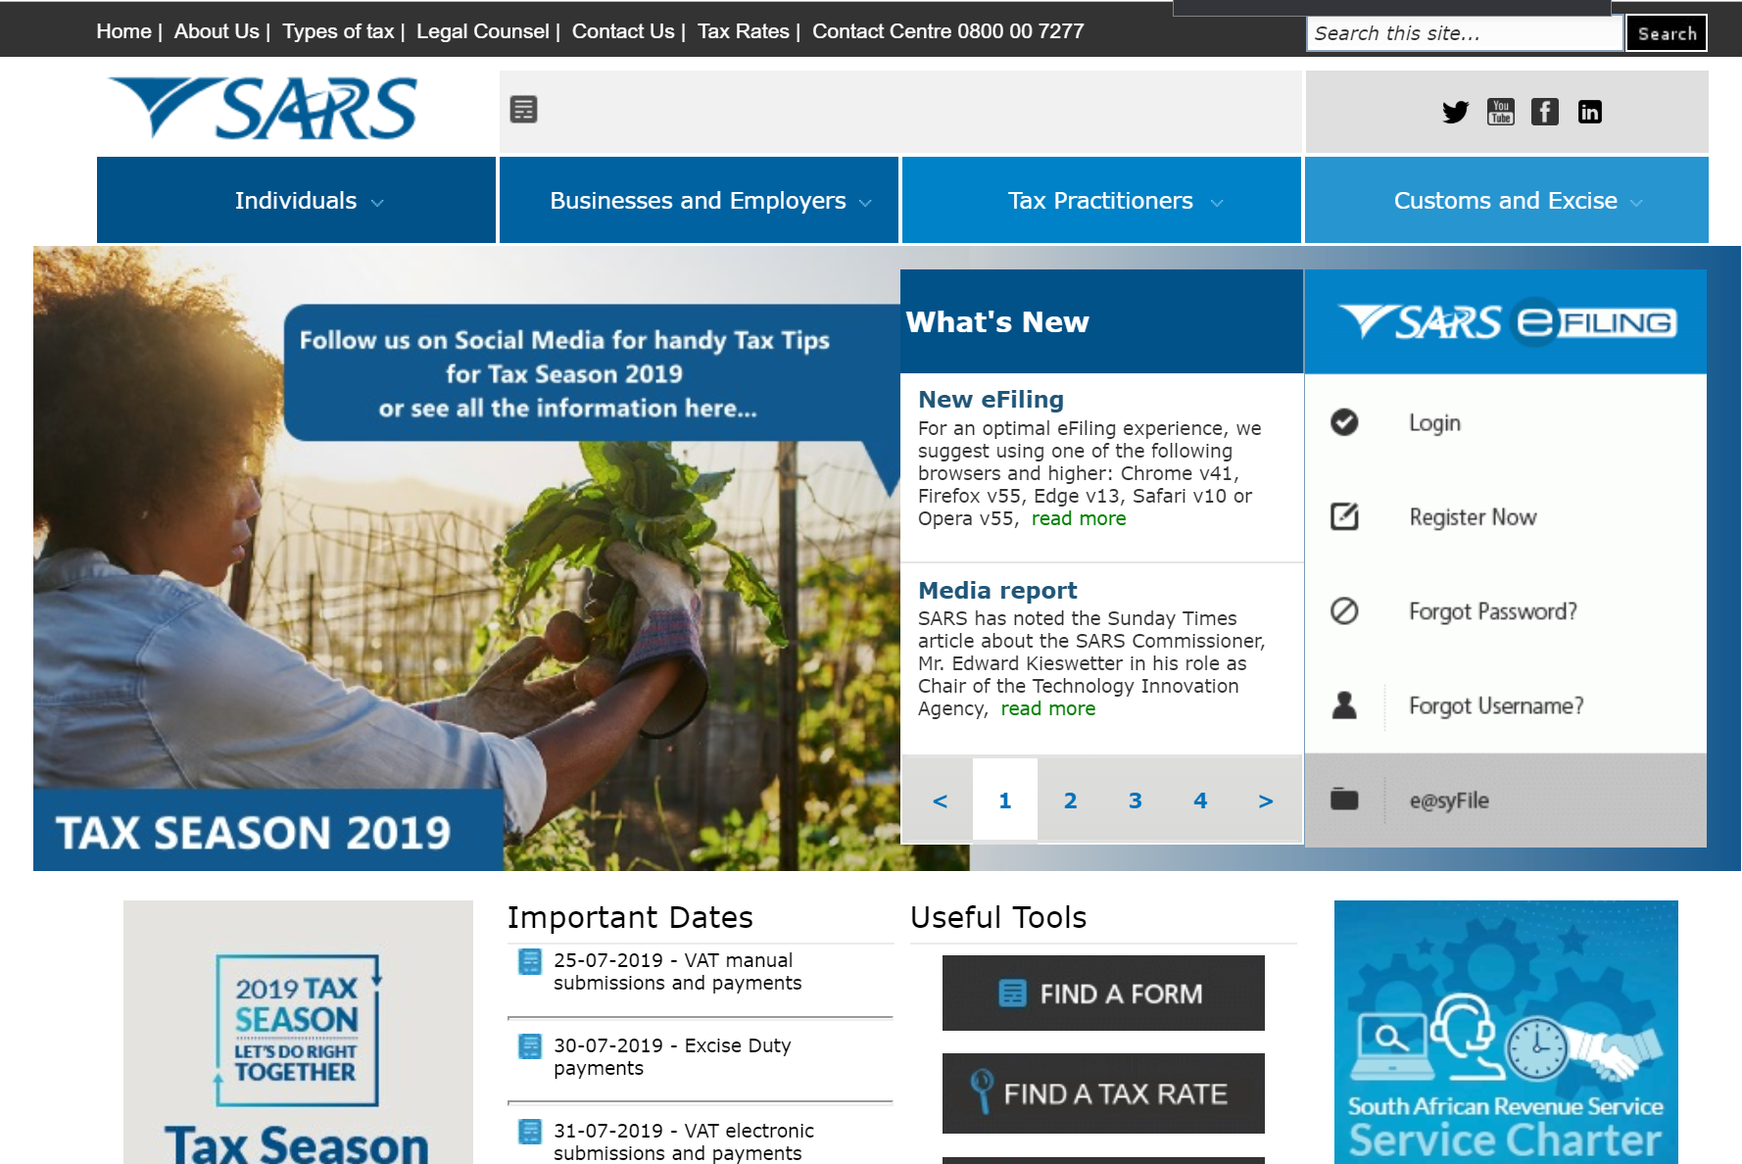
South African Revenue Services (SARS)
Objectives
Single accounting view of the Tax Payers
One single system for all tax types
Integrated tax and customs system
Same technology platform for own and revenue accounting

Slide 23
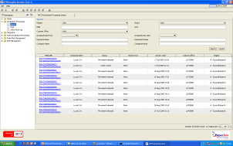




Typical Customs Implementation Approach
Customs Officers
Economic Operator
Community
OGAs / Large Traders
Off-line Forms & Replication
Enterprise Service Bus
Third Party Customs Solution
Declarations Processing
SAP
SAP
Tariff Management
Financial Reporting
Duty Calculator
Case Management
Document Mgmt
Billing & Payments
Cargo & Transit Control
Data Warehouse
License and Certificates
Collections
Risk and Inspection
Bonded Warehouse
Trader Registration Mgmt
Excise Processing
Rules Engine
Management Consoles

Slide 24

Case Study
Client name: City of Cape Town
Country: Western Cape Province, South Africa
Timelines:
December 2000: Mergers of 7 previous autonomous Municipalities into a single Metropolitan Uni-City for Cape Town.
Project objectives:
3.2 million Utility contracts on single system – 7200 users
All revenue types managed in one single platform
Payment ratio increased from 84% to 98% in one year leading to:
  ROI in 36 months
  Cash Position improved from less that R500m to more than R2 billion
  A+ Credit rating

Slide 25

Case Study
Client name: OFFICE OF STATE REVENUE
Country: Queensland Government - Australia
Timelines:
Project started in July 2008 and went live with the cross tax processes and a total of 11 taxes (payroll tax, stamp duties, gambling, land tax, grants, mining royalties… by July 2009.
Project objectives:
Replacement of unsuccessful attempts of implementation using custom build solution.
Reduce the cost of operations through the introduction of online returns and refunds as well the payments assignment
Creation of a data warehouse repository to provide management information
Coverage of the + 2.200.000 Taxpayers increasing the service provided.
Through the years all the new functionalities delivered had been adopted being today a reference on modernization.

Slide 26


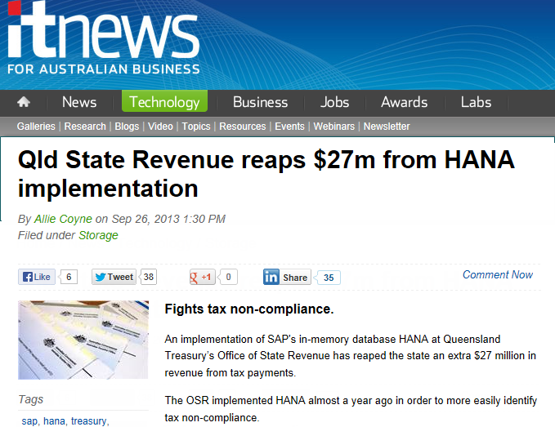
Queensland OSR Becoming a Digital Tax Office

Slide 27
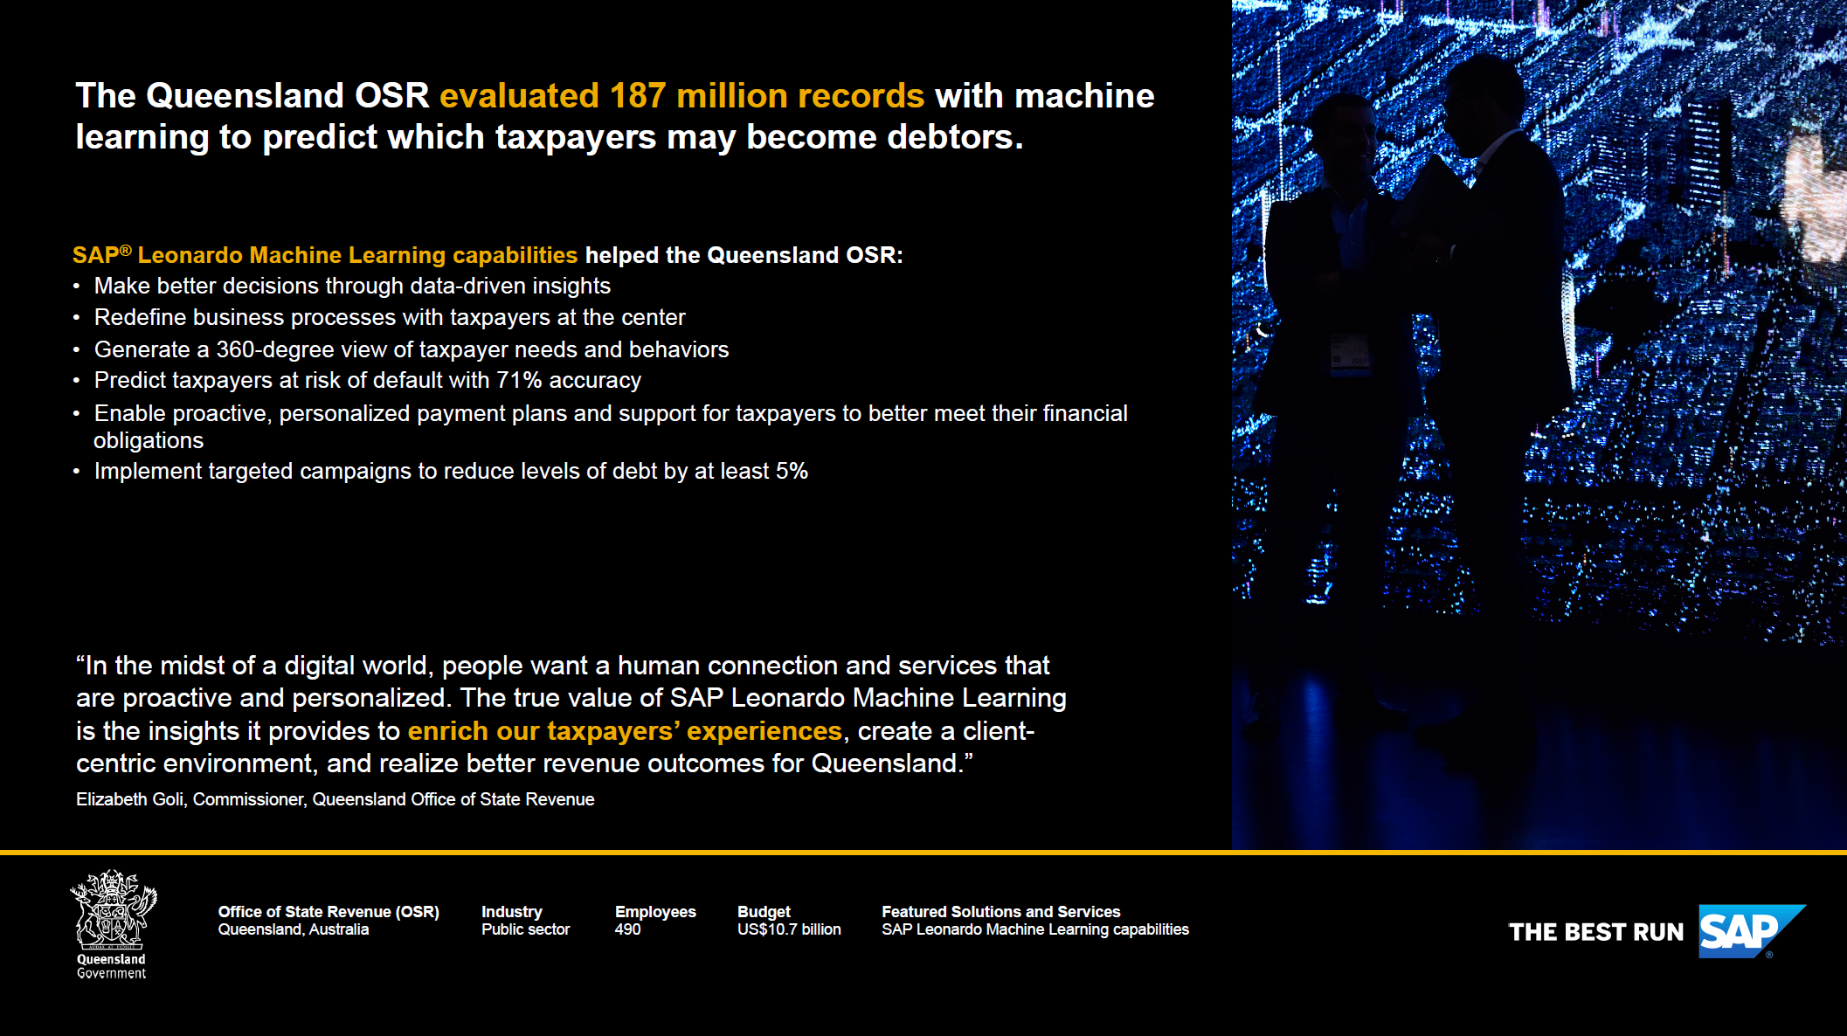
Play
Video

Slide 28
Thank you.
Titilayo Adewumi - SAP Regional Sales Director, WEST AFRICA
Titilayo.adewumi@sap.com
Hannes Venter – SAP Industry Advisor Tax and Revenue Management
hannes.venter@sap.com

