Slide 1
TRAFFIC MANAGEMENT SYSTEM
BOOSTING IGR VIA HARMONIZED TRAFFIC MANAGEMENT SYSTEM

Slide 2
PREAMBLE
Final Presentation Was Made to NGF on February 2018
  Letter of Award on April 2019
  Formation of Technical Committee at NGF
  Presentation for NGF on May 2019
  Finalization of MOU on October 2019
  Pending the Signature of the MOU
  Once MOU is Signed: Project Inauguration and Roll Out Plan
Long Term Public Private Partnership Contract. Nigerian Government Investment $0
The Proposed TMS is Inline with National Road Safety Strategic Plans (Safer Roads, Traffic Enforcement, Centralized System and Database)
Based on the Latest Technologies and Worldwide Best Practices. The Most Important, TMS will be 100% Championed by States and Federal Traffic Agencies
  All Systems, Databases will be Installed Centrally at Relevant Agency, (DR Site at DIT GHQ)
  Empower State and Federal Traffic agencies to Perform All Support Activities
  Empower State and Federal Traffic agencies to Train and Certify TMS Agents
  Empower State and Federal Traffic Agencies to Perform Law Enforcement Activities (4G Handheld Devices and Tablets)
Use the Existing Platform of Service Providers, We are in Talks with These Service Providers
If Required, Dimensions will Introduce More Service Centers
Copyright © 2020 DIMENSIONS. All Rights Reserved.

Slide 3
TRAFFIC MANAGEMENT SYSTEM
Financial and Contractual Benefits:
Long Term Public Private Partnership Contract. Nigerian Government Investment $0
DIMENSIONS Total Investment is more than $500M
Contract Will Generate NGN 3.553 Tn over the 15 Years, and NGN 560 Bn for Current NGF
Dimensions will install and provide all the required systems and equipment, allowing motorists to finish their services immediately
Partial fixed fee for DIMENSIONS per each Service. NO any burden on motorists as there will be NO new fees structure
One Record- One Driver Approach: latest practice in the Traffic Industry where Motorists must have a clear record to be able to process any Traffic service which will drastically increases the Government revenues and solves the problem of leakages and loss of revenues through harmonization
Job Creation
Immediate Collection of Government Fees through Certified Banks and e-Payment System.
Increase the revenues generation from Customs Duties and indirectly from vehicle registrations by Eliminating Vehicles Smuggling
The resulting benefits will be improved Human Capital Development, Security, transparency, greater convenience, and exponential revenue growth, all at Zero Cost.
Copyright © 2020 DIMENSIONS. All Rights Reserved.

Slide 4
TRAFFIC MANAGEMENT SYSTEM
Technical and Security Benefits: (1/2)
Central Nation-wide Traffic Database (Drivers Bio and Non-Bio Data, Vehicles, fines, and others)
Improved Security: Vehicle Profiling, Fraud Prevention through ONE Vehicle ID Number (VIN)
Exponential Increase in DL and VL Production
Trace and Track Capabilities of Vehicles to Increase Security and Prevent Crime Around Nigeria
100% Secure Driver License, Vehicle License, and Customs Duties Certificate by applying the latest security features to prevent fraud.
State-of-the-art Solution that manages the full cycle of all traffic services and procedures
Highly compliant with Local, Federal Vehicle Regulations, as we as international standards (PKI, SSL, MRTD, ISO)
Integration with Existing Systems (PLIS, VIS, NCS SW, and Others)
IMMEDIATE Sharing of Data between the Other stakeholders (States, Police, FRSC, etc) for More Security and Information Efficiency
Allows Government to Determine the Overall Resources required to Formulate and Implement Road Transportation Policies, Projects, and Programs
Help Analyze and Identify Areas for Urban Regeneration and Actions to be Taken
Copyright © 2020 DIMENSIONS. All Rights Reserved.

Slide 5
TRAFFIC MANAGEMENT SYSTEM
Technical and Security Benefits: (2/2)
Prompt and Accurate Accident Reporting
Increase Public Safety- Safer Vehicles, and Safer Roads
Effective Violation Processing
Facilitates Better Traffic Management
Helps in Determining the Most Appropriate Transportation System Suitable for Different Parts of the Country
Assists the Governments to effective Plan and Implement of Disaster Management Strategies.
Expandable System Allowing to Add new modules and services Whenever Required
Higher Monitoring, Law Enforcement, More Security, Tracking Capabilities, and Lower Violation
Guaranteed Higher Revenues Generation for States and Federal Government of Nigeria
Copyright © 2020 DIMENSIONS. All Rights Reserved.

Slide 6
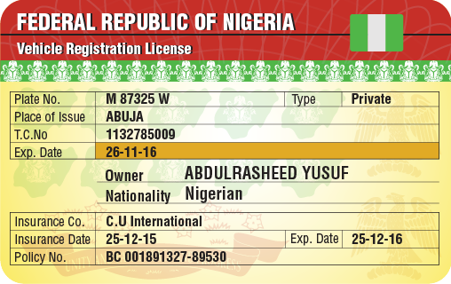
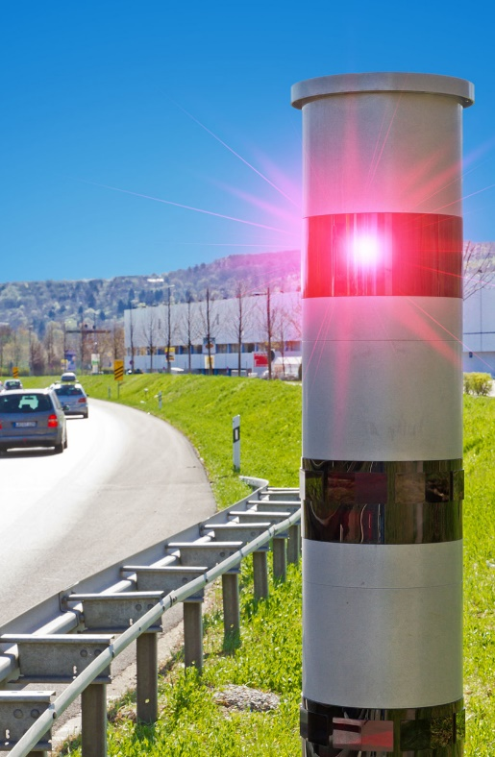
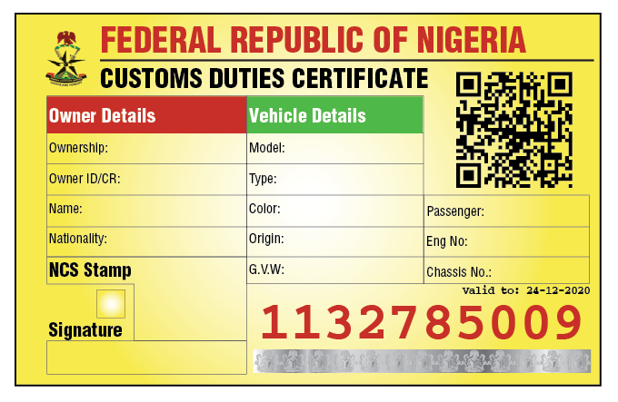
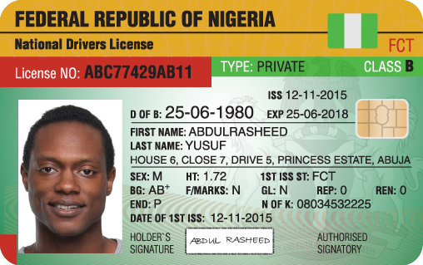
TRAFFIC MANAGEMENT SYSTEM
Available Services Under this Contract:
  Smart Driver License Issuing
  Vehicle License Issuing
  Mapping of All Vehicle Dealers, Agents, and Parks.
  Law Enforcement Services (Handheld Devices, etc)
  Integration with Existing Systems (PLIS, VIS, NCS SW, and Others)
  Overspeed Violation Radars
  Traffic Light Violation Radars
  NCS Duties Certifications
  Training and Support
Vehicle License
Customs Duties Certificate
Driver License
Over Speed Radar
Copyright © 2020 DIMENSIONS. All Rights Reserved.

Slide 7
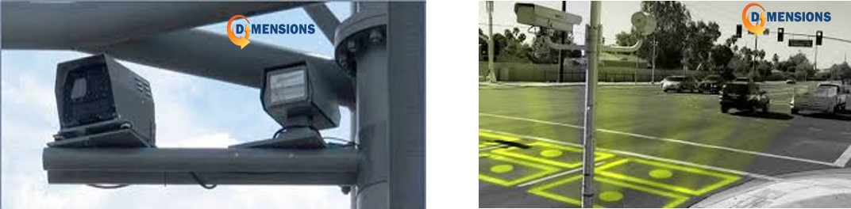
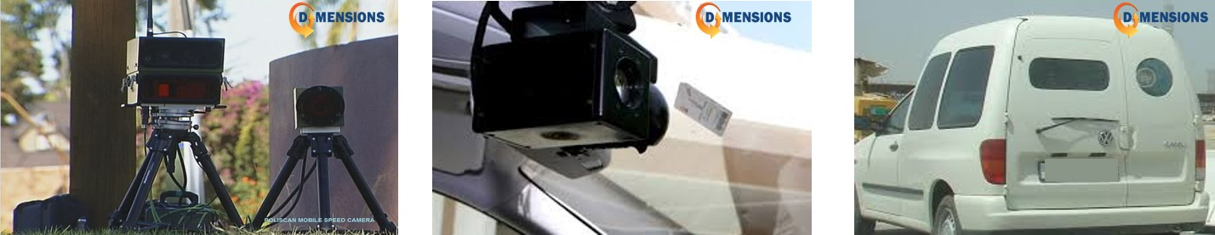
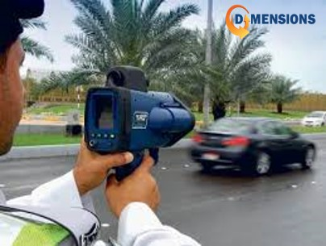
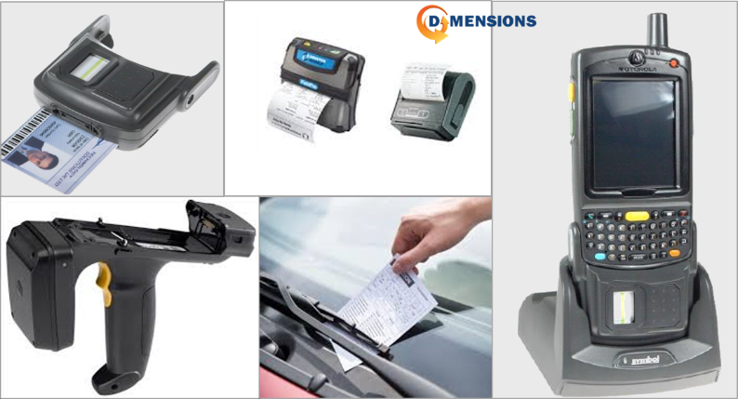
LAW ENFORCEMENT
Traffic Light Violation Radar
Fixed Over Speed Radar
Mobile Over Speed Radar
Handheld Device
Handheld Over Speed Radar
Copyright © 2020 DIMENSIONS. All Rights Reserved.

Slide 8
Copyright © 2020 DIMENSIONS. All Rights Reserved.

Slide 9
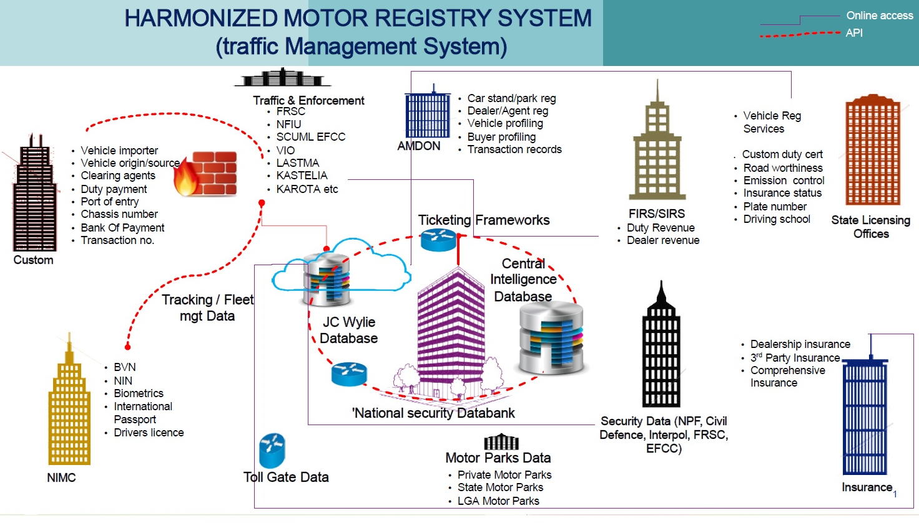
TRAFFIC MANAGEMENT SYSTEM
Copyright © 2020 DIMENSIONS. All Rights Reserved.

Slide 10
Driver License and Vehicle Registration 15 Years
Projection
NGN 1,822 Bn
Copyright © 2020 DIMENSIONS. All Rights Reserved.

Slide 11
15 Years Revenue Projection
Assumptions
Fines cover; Negligence, bad roads, poor vehicles, reckless driving, alcoholism and brutal attacks
Unit price for drivers license issuance is N6,500 and N6,000 for vehicle registration
Total Revenues: NGN 3.55 Tn
DL: NGN 750 Bn
VL: NGN 1,822 Bn
Other Services: NGN 797 Bn
Copyright © 2020 DIMENSIONS. All Rights Reserved.
Notes:
Build better slides – and do it faster with the Quick Presentation Toolkit add-in for PowerPoint (www.QPT.Accenture.com)

Slide 12
THANK YOU
Copyright © 2020 DIMENSIONS. All Rights Reserved.

