Slide 1
DIGITAL LIBRARIES: AN OVERVIEW Dr. Chris Egbu

Slide 2
Traditional Libraries
Libraries with the same purpose, functions, and goals
Collection development and management
Technical Processing
Index creation
Counter Transactions
Reference work
Preservation

Slide 3
What is Digital library ?
A Service? An Architecture?
A set of Information Resources?
A set of tools to locate, search, retrieve information?
Possibly the tools to create such resources and services also fall within the purview of DLs
Digital face of traditional libraries
Include both digital collections and traditional
Backbone and nervous system of libraries.

Slide 4
Defining the Digital Library
“A digital library service is an assemblage of digital computing, storage, and communications machinery together with the software needed to reproduce, emulate, and extend the services provided by conventional libraries based on paper and other material means of collecting, storing, cataloguing, finding, and disseminating information.” (Gladney H.M, et. al. 1994)
“Digital Libraries are a set of electronic resources and associated technical capabilities for creating, searching,and using information…they are an extension and enhancements of information storage and retrieval systems that manipulate digital data in any medium (text, images, sounds,static or dynamic images) and exist in distributed networks” (Borgman, 1996)

Slide 5
What is Digital library ?
Borgman identifies two major aspects
DL researchers from Computer Science focus on content for user communities and therefore emphasize the enabling technologies
Library professionals appear to emphasize DLs as services
However require both the skills of librarians as well as those of computer scientists

Slide 6
What is important?
Site Neutrality
Access-Anytime (24*7)
Anywhere (Office, Residence, Travel)
By Anyone
Open Access and Sharing of information
Greater variety and granularity of information
Up-to-date ness
New forms of rendering ( New Genre)
Integration of digital media into traditional collections
Digital libraries are different in that they are designed to support the creation, maintenance, management, access to, and preservation of digital content

Slide 7
Five Elements in Various Definitions of DL
The digital library is not a single entity;
The digital library requires technology to link the resources of many;
The linkages between the many digital libraries and information services are transparent to the end users;
Universal access to digital libraries and information services is a goal;
Digital library collections are not limited to document surrogates: they extend to digital artefacts that cannot be represented or distributed in printed formats.
Association of Research Libraries (1995)

Slide 8
Goals of DL
Focused on digitization technology, metadata schemes, data management techniques, and digital preservation.
Second-generation digital library
exploring new opportunities and developing new competencies.
Third-generation digital library
focusing instead on fully integrating digital material into the library’s collections through a modular systems architecture.

Slide 9
Ingredients for DLs
Hardware
The minimum machinery to do the job
Software
The programs for handling data
Digital Objects
Articles, Conference Papers, Thesis,……
Basic Skills
Things one has to learn

Slide 10
Hardware
A Server
You’ll need access to a web server
A good PC
Scanners
Flatbed – Auto feed, Back to back
MF
Book Scanner

Slide 11
Software
Open Source Software (OSS)
Dspace, E-Prints, Fedora, GSDL……
Proprietary software you can’t avoid
Image Editing and Optical Character Recognition Software have to be purchased

Slide 12
Hardware- Software Network
High-speed local networks and fast connections to the Internet
Relational databases that support a variety of digital formats
Full text search engines to index and provide access to resources
Web servers and FTP servers (both intranet and internet)
Electronic document management functions

Slide 13
FTP servers
FTP is a standard network protocol used for the transfer of files between a client and server on a computer network. FTP is a very well-established protocol, developed in the 1970s to allow two computers to transfer data over the internet. One computer acts as the server to store information and the other acts as the client to send or request files from the server.

Slide 14
Digital Library Content
Content Types
Text
Documents
Video
Audio
Geographic
Information
Software,
Programs
Bio
Information
Images
and
Graphics
Articles
Reports
Books
Manuscripts
News Papers
Theses
Tech. Reports
Speech
Music
Movies
(Aerial)
Photos
Genome
Human
Animal
Plant
Models
Simulations
Photographs
Paintings
2D
3D

Slide 15
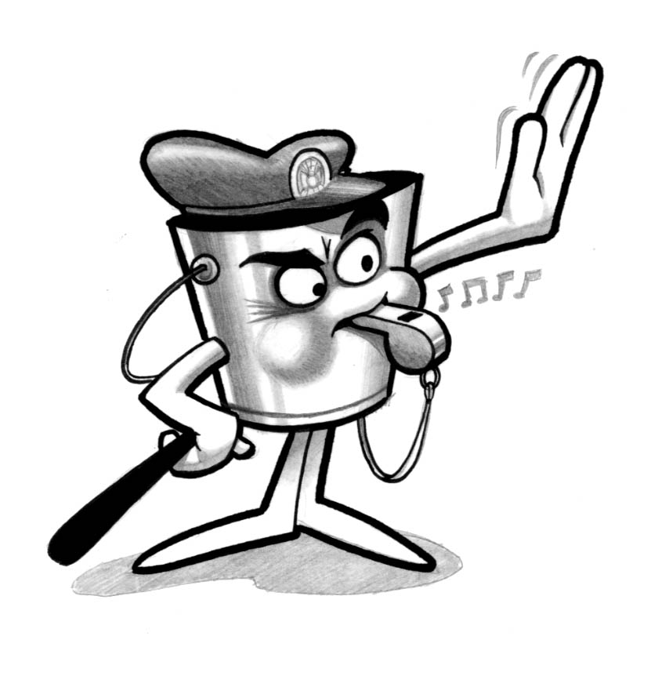
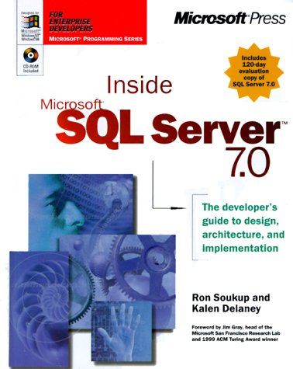
Content is King
The information content is more important than the systems used for its storage, management and retrieval
Objects should not be “locked” in specific DLs or archives

Slide 16
Types of Digital Collections
Digitization
Converting paper and other media in existing collections to digital form
Acquisition of original digital works
Created by publishers and scholars like electronic books, journals, and datasets
Access to external materials
Like Web sites, other library collections, or publishers' servers

Slide 17
Resources
Bibliographic databases that point to both paper and digital materials
Indexes and finding tools
Collections of pointers to Internet resources
Directories
Teaching and pedagogic materials
Photographs
Numerical data sets
E-books and e-journals

Slide 18
Creating DLs …
Six steps
Selecting
Acquiring
Digitization
Organizing
Archiving
Providing Access

Slide 19
Process
Identification of
Books
Selection of
Books
Meta Data
Scanning
Process
Scanning
Image
Processing & QC
OCR
Publishing

Slide 20
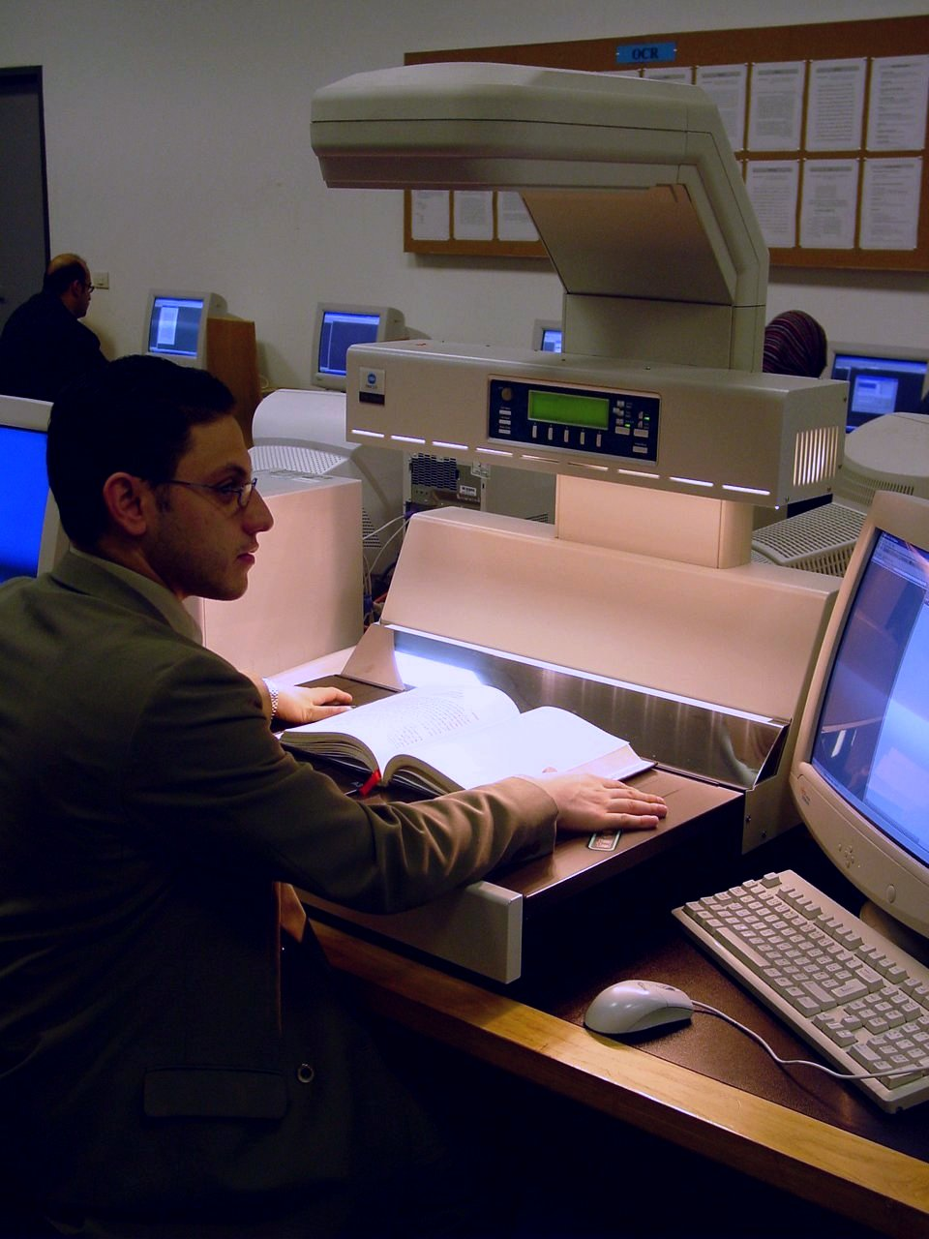

Slide 21
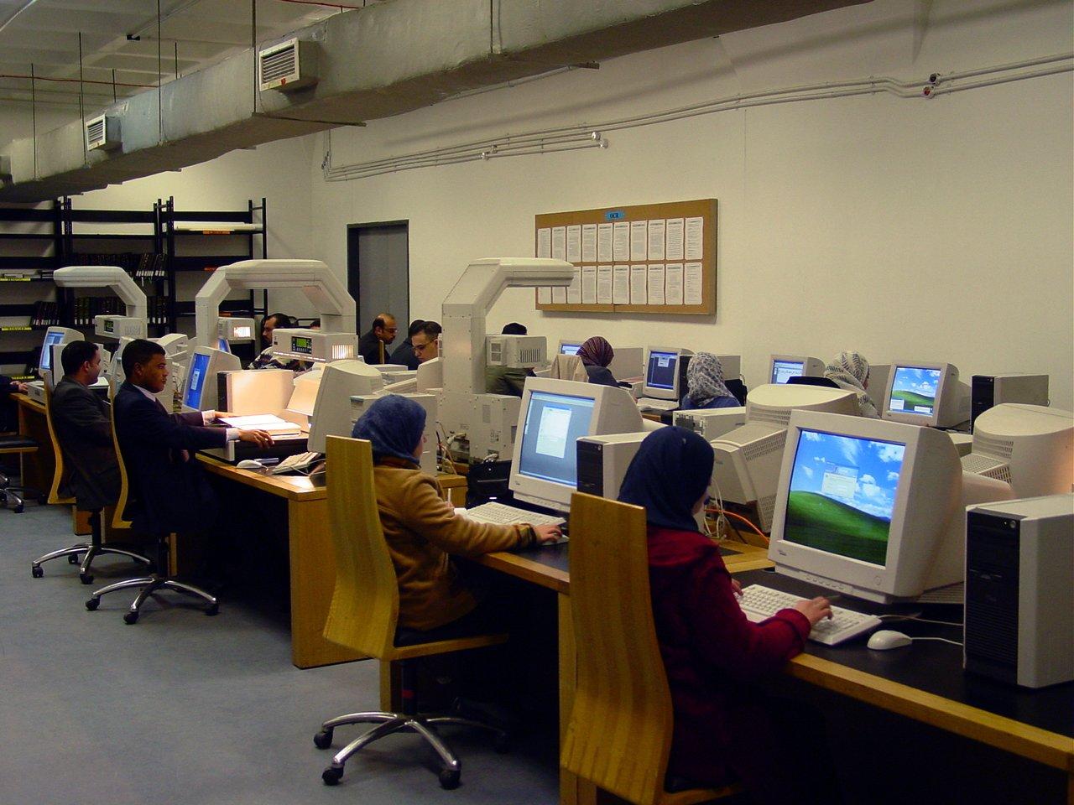

Slide 22
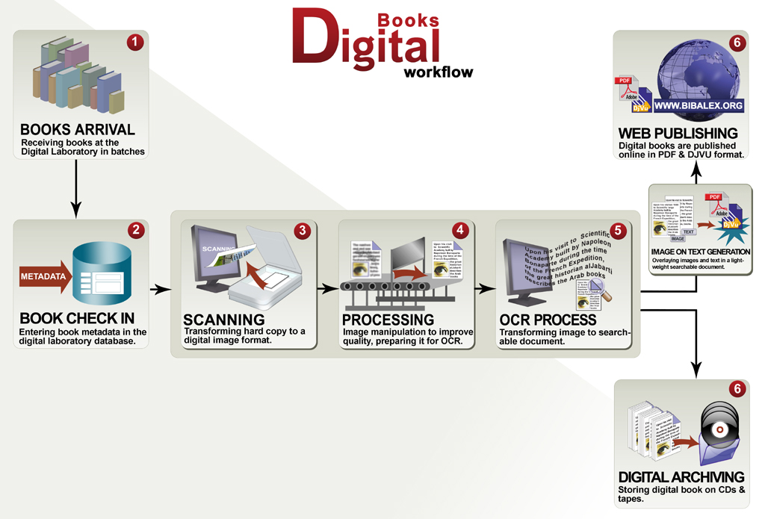

Slide 23
Digitization
“Conversion of any fixed or analogue media--such as books, journal articles, photos, paintings, microforms--into electronic form through scanning, sampling, or in fact even re-keying.”

Slide 24
Digitization Process ….
Determine copyright or restrictions
Digital conversion
Outsource or in house?
Text conversion, formats, headers, compression, and delivery media
Digital capture with camera or scanner ?
File handling
File naming

Slide 25
Digitization Process
Preparing the objects
Scanning
Moving files to temporary storage
Value addition- metadata preparation etc
Long term storage
Derivative image/thumb nail for access copy
Merging files

Slide 26
Digital Production Process
Data
Management
Workflow
Management
Content
Management
Project
Management
Quality
Management
Supplier Management

Slide 27
Data Management
Data
Management
Workflow
Management
Content
Management
Project
Management
Quality
Management
Supplier Management
Formats: TEX, PDF,PS
Metadata and content data
Structuring (Tagging)
Media neutrality

Slide 28
Workflow Management
Data
Management
Workflow
Management
Content
Management
Project
Management
Quality
Management
Supplier Management
Processing
Conversion
Automatization
Interfaces - input / output

Slide 29
Content Management
Data
Management
Workflow
Management
Content
Management
Project
Management
Quality
Management
Supplier Management
Style files
Information /Object models
Archiving

Slide 30
Quality Management
Data
Management
Workflow
Management
Content
Management
Project
Management
Quality
Management
Supplier Management
Data consistency
Process consistency
Content consistency

Slide 31
Good Principles
What to digitize?
Selection and policy is important
Collection description is important
such as scope, format, restrictions on access, ownership etc

Slide 32
Digitization: Issues
Copyright
Access copy and archive copy
File size
Storage media( CD, Hard disc…)
File format ( TIFF,JPEG…)

Slide 33
Challenges in Publishing
Preservation of layout
Searchability of content and metadata
Efficient image compression
Easy browsing of books
Accommodating low bandwidth user
Multilingual text support
Multipaging

Slide 34
Digitization .. Factors
Collection strengths
digitizing selected portions
adding new digital works
Unique collections
only copies of something
Priorities of user communities
Like demands of a curriculum
Manageable portions of collections
what is reasonable for any one institution to collect or digitize
Technical architecture
also be factor in selecting who digitizes what
Skills of staff
whose staff don't have the necessary skills

Slide 35
Retrospective Conversion
Complete conversion would be impractical or impossible technically, legally, and economically
Digitization of a particular special collection or a portion of one
which is highly valued
Highlight a diverse collection
High-use materials
Approaches can be objects used alone or in combination depending upon a particular institution's goals

Slide 36
Metadata
The data that describes the content and attributes of any particular item
Key to resource discovery and use of any document
Facilitate searching and discovery, as well as administrative and structural metadata to assist in object viewing,management, and preservation.

Slide 37
Barriers
Digital objects are less fixed, easily copied, and remotely accessible by multiple users simultaneously
Libraries mostly are simply caretakers of information, own the copyright of the material with restrictions
To develop mechanisms for managing copyright, mechanisms that allow them to provide information without violating copyright, called rights management

Slide 38
Rights Management
Usage tracking
Identifying and authenticating users
Providing the copyright status of each digital object, and the restrictions on its use or the fees associated with it
Handling transactions with users by allowing only so many copies to be accessed, or by charging them for a copy, or by passing the request on to a publisher

Slide 39
Preservation
Keeping digital information available in perpetuity
Real issue is technical obsolescence
Like the deterioration of paper in the paper age
Constantly coming up with new technical solutions

Slide 40
Three Types of Preservation
Preservation of the storage medium
Preservation of access to content
Preservation of fixed-media materials through digital technology

Slide 41
Preservation of the Storage Medium
Tapes, hard drives, and floppy discs have a very short life span
Obsolete anywhere from two to five years before they are replaced by better technology
Possibility of non-availability of the hardware or software to read them
May have to keep moving digital information from storage medium to storage medium

Slide 42
Preservation of Access
Access to the content of documents, regardless of their format:
- When the formats (e.g., Adobe Acrobat PDF)
containing the information become obsolete
- Translate data from one format to another for
preserving the ability of users to retrieve and
display the information content
- Data migration is costly
Still no standards for data migration
Distortion or information loss

Slide 43
Conclusion
“Digital Libraries are a set of electronic resources and associated technical capabilities for creating, searching,and using information…they are an extension and enhancements of information storage and retrieval systems that manipulate digital data in any medium (text, images, sounds,static or dynamic images) and exist in distributed networks” (Borgman, 1996)

