Slide 1
PROTOCOL LECTURE
DELIVERED
AT
THE EXECUTIVE GOVERNORS ’ SUMMIT
BY
AMB. GLADYS MODUPEOLA QUIST ADEBIYI
(FORMER CHIEF OF PROTOCOL MINISTRY OF FOREIGN AFFAIRS)
AT THE
BANQUET HALL, PRESIDENTIAL VILLA, ABUJA
1st MAY 2019 .

Slide 2
OUTLINE
Definitions
Order of Precedence
The Art of entertaining
Relations with the Diplomatic Corps and International Organizations
Notes:
This is another option for an Overview slides using transitions.

Slide 3
PROTOCOL ?
Protocol is “the set of rules prescribing good manners in official life”

Slide 4
NATIONAL ORDER OF PRECEDENCE
President
Vice President
President of the Senate
Rt. Hon. Speaker of the House of Representatives
Chief Justice of the Federation
Former Presidents / Heads of Government
Executive Governors
Members of the National Assembly
Honourable Ministers
Members of the Diplomatic Corps, etc.

Slide 5
DIPLOMATIC CORPS
Dean of Diplomatic Corps(The longest serving Ambassador in a country)
Apostolic Nuncio (always the dean in catholic countries)
Ambassador/ High Commissioner / Apostolic Nuncio
Charge’d ’Affaires (en titre)
Charge’d ’Affaires (ad interim)
Minister Plenipotentiary
Minister Counsellor
First Secretary
Second Secretary
Third Secretary

Slide 6
DIPLOMATIC MISSIONS
Ambassador / High Commissioner
Minister Plenipotentiary
Minister Counsellor
First Secretary
Second Secretary
Third Secretary

Slide 7
ART OF ENTERTAINING
The purpose of entertaining is to accord maximum pleasure and entertainment for your guests, to make friends and cultivate contacts which may prove useful, obtain information and discuss matters of mutual interest.

Slide 8
THE SEATING PLAN
The seating plan can make or mar your event.
Seating plans where only the host or hostess is present and guests are all male or female(See Diagrams).
The following examples may be adapted to circular tables without basic changes.

Slide 9
All male/female seating patterns: host/hostess and seven guests
:
7
6
5
4
3
2
1
Host (ess)

Slide 10
In the event of hosting a luncheon or dinner in honour of a specific guest, the following plan is advised;
8
4
Guest of Honour
3
7
9
10
6
2
Host
1
5

Slide 11
When both host and hostess are present, the principle is extended as follows: Mixed seating plan: host, hostess and six couples
2
4
6
5
3
1
Host
Hostess
1 3 5 6 4 2

Slide 12
RELATIONS WITH THE DIPLOMATIC CORPS AND INTERNATIONAL ORGANISATIONS
The Ministry of Foreign affairs is the channel through which all representations should be made to a government by another state, its diplomatic representatives or an international organization.

Slide 13
Interactions with the diplomatic corps and international organization should not be below the head of mission or in unavoidable circumstance the next man in charge of the Mission.
Personal or Official trips abroad

Slide 14
It is advisable that the spouses of top government functionaries seek appropriate advice from our Missions abroad through the office of the chief of protocol on the status of organizations inviting them abroad or giving them awards in order to avoid any form of embarrassment.

Slide 15
TABLE SETTING

Slide 16
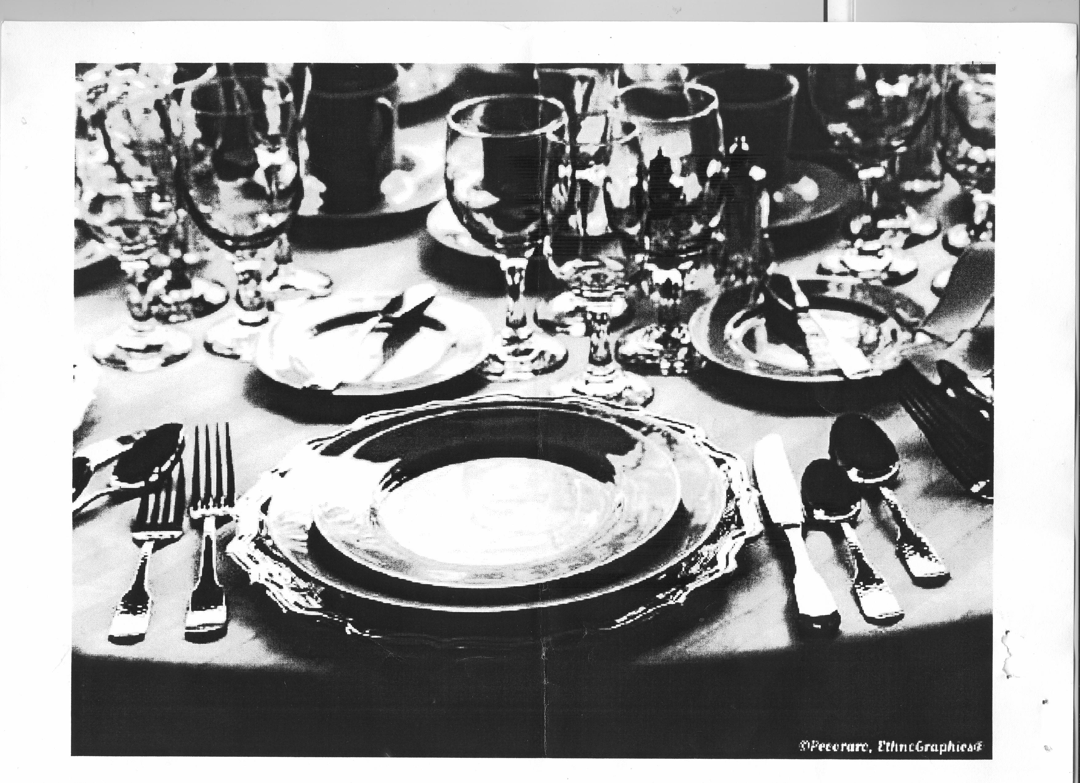

Slide 19
CONCLUSION
Finally, I would like to remind us all that in modern day protocol, Norms, Culture and Tradition of the people in a particular situation determines the protocol applied.

Slide 20
Thank You!!!

