Slide 1
A Refined Personality

Slide 2

Mavi Sokia Isibor (MSI)
The Etiquette Icon
Seasoned banker
Pioneered the soft skills industry in Nigeria
Founder and initiator of first Finishing School in Nigeria – Poise Nigeria
Etiquette expert
Author of first and only indigenous etiquette book in Nigeria: The Art of Refinement
Founder and initiator of Facebook group: Broken But Not Shattered

Slide 3


Slide 4
Refinement is an art, a skill that is acquired by study and practice.
Comes from a compelling aspiration to improve ourselves

Slide 5
***
The hardest victory is the victory over self – Aristotle
Victory in Self Awareness
  Victory over the need to expect and accept lower standards
  Ko-mean (it does not matter) Syndrome is degrading, demeaning, dehumanising

Slide 6
***Globalisation
Demands
  Higher standards
  Courtesy
  Basic protocol
  Does not accept ignorance as an excuse
If you do not develop yourself, the world has a way of rubbing your nose in it

Slide 7
.” “In this life, there are two kinds of Class:
First Class or No Class.
You must develop the first or you will have to live with the second. Many people go through life unaware of the consequences of how they present themselves
William Thourlby

Slide 8
Class is not a function of
  Position
  Age
  Status
  Education
  Level
  Money

Slide 9

Class is………………
Not scratching your body the way it itches you; or else you will draw

Slide 10
Etiquette for Public Appearances
What you say, and the way you say it will tell a discerning listener a lot about your personality.

Slide 11
Etiquette for Public Appearances
Be Punctual
Seating protocol
Master the art of introductions
Card etiquette savvy
First name paradox
Etiquette of applause
Speak out

Slide 12
Three tips for speaking with more presence & power?
1. Use your breath efficiently to support the sound of your voice
2. Enunciate your words with conviction
3. Project your voice “forward and out”

Slide 13
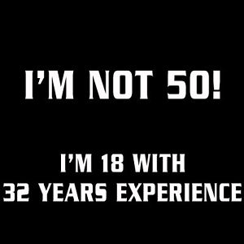
Redefine Age

Slide 14
Attributes to Master
Personal Appearance
Elegance/Suave
Courtesy Language
Manner of Speaking
Social Intelligence
Carriage
Savvy
Table Manners
Charm

Slide 15
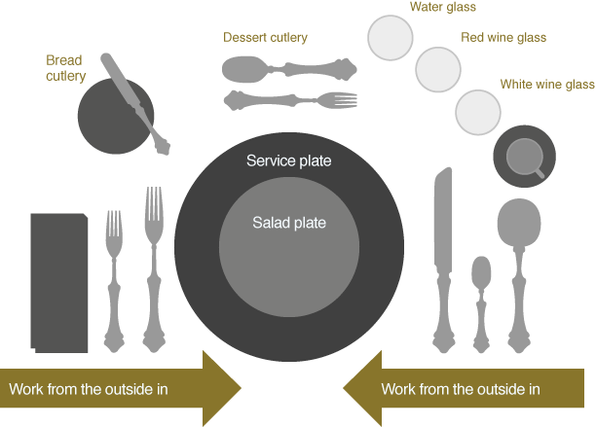

Eating is not an executive skill… but it is especially hard to imagine why anyone negotiating a rise to the top would consider it possible to skip mastering the very simple requirements… what else did they skip learning?
- A Fortune 500 CEO

Slide 16
Dinning Dilemmas
Where should I put my napkin?
What cutlery do I start with?
How do I hold my wine glass?
What do I do with my bag?
Should I upturn my teacup when am done?
Should I sandwich my bread at dinner?
Should I drink when I’m being toasted as the special guest?
Should I pick up my chicken with my fingers?

Slide 17
Every time we settle for less, we get even less than we settled for.
A little polish
A dose of comportment and poise
Brushing up of speech
A pat here and there of grammar

Slide 18
Thank you for Listening

Slide 19
Excerpts for this presentation was taken from the book:
‘’The Art of Refinement’’
By
Mavi Sokia Isibor

