Slide 1


National Primary Health Care Development Agency
Transforming the PHC Landscape in Nigeria
Dr. Faisal Shuaib
ED/CEO NPHCDA
April 30th , 2019
NATIONAL PRIMARY HEALTH CARE DEVELOPMENT AGENCY

Slide 2
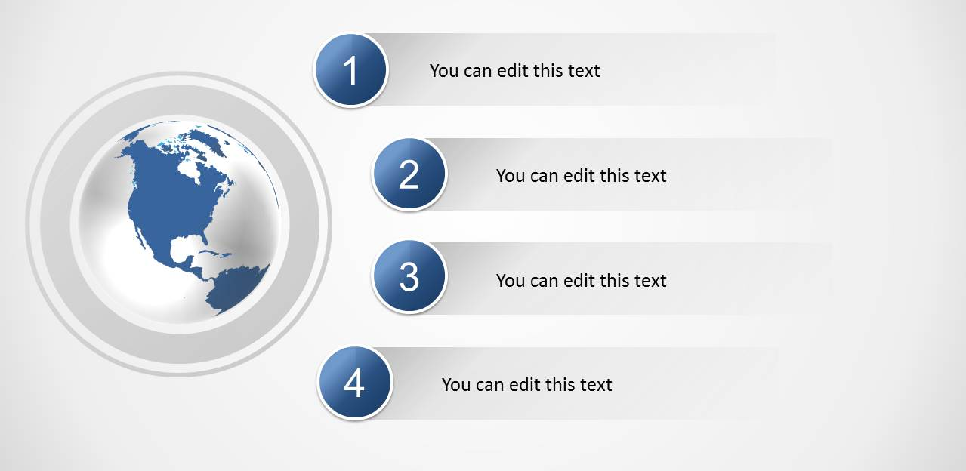

Outline
About the National Primary Health Care Development Agency (NPHCDA)
Universal Health Coverage
NPHCDA’s Strategic Interventions
Prayers to the Executive Governors

Slide 3







NPHCDA is a parastatal of FMoH with the mandate to provide technical and programmatic support to states and LGAs on the Development of PHC in Nigeria
1
Control Preventable Diseases:
Eradicate polio, and limit the occurrence and impact of diseases using education, immunization and other proven interventions.
2
Improve access to Basic Health Services:
Make basic health services available by ensuring communities have access to health facilities, services and health insurance.
3
Improve quality of care:
Ensure basic health services are people-oriented and delivered according to established quality standards and protocols.
We have 7 core mandates
4
Strengthen the institution:
Strengthen Zonal structures, State representation, internal communications, monitoring and evaluation, procurement and the financial management system.
5
Develop high-performing health workforce:
Organize systems and structures to deliver effective support services through, for example, PHC guidelines, norms and enabling acts for states and LGAs
6
Strengthen partnerships:
Mobilize and coordinate stakeholders such as Ministries, Departments and Agencies and development partners to support the implementation of PHC.
7
Strengthen community engagement:
Promote community participation, ownership and responsibility for health through Ward Development Committees and communication and programmes.

Slide 4
NPHCDA’s organizational vision is to build a robust agency that will deliver tangible results to improve primary healthcare in Nigeria
NPHCDA’s transformation…
. . . Will drive concrete results
Revamp the financial system
Entirely revamp the NPHCDA’s financial structure to meet international best practices, transparency to all partners in a clear and structured engagement process
1
Finally declare Nigeria polio free
The program has been successful in interrupting the transmission of wild polio virus, but we are not relenting, until Nigeria is certified polio-free
2
Drive immunisation rates up to 84% by 2028
We are making progress on vaccine supply chain and RI service delivery, and we are beginning to see gradual improvements in immunization coverage
Transform the organization
Re-examine organisational structures and staff capabilities to build an Agency that operates with clear, fit-for-purpose roles and responsibilities executed by capable staff with appropriate performance management
3
Provide strategic direction on primary care
NPHCDA is taking the lead on developing a pragmatic PHC delivery model to ensure universal health coverage for the poor and vulnerable
4
Strengthen governance and accountability
We are transforming NPHCDA into a credible, accountable and reliable partner to all our stakeholders

Slide 5
Why we will succeed
… rethinking the way PHC programmes are managed and accountability ensured
From
To
  A comprehensive approach to addressing health issues
  Focus on mostly inputs and processes
  Public sector only lens
  Poor data management, monitoring and evaluation
  Fragmented approach within Departments, Agencies and across Partners
  Ruthless prioritisation of high impact pragmatic interventions
  Focus on system outputs and outcomes
  Public and private sector lens
  Performance management and accountability mechanisms
  Cross cutting and programmatic approach aligned under one agenda

Slide 6
Outline
About the National Primary Health Care Development Agency (NPHCDA)
Universal Health Coverage
NPHCDA’s Strategic Interventions
Prayers to the Executive Governors

Slide 7
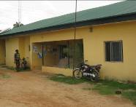
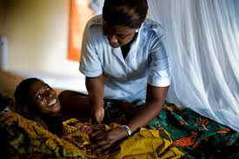
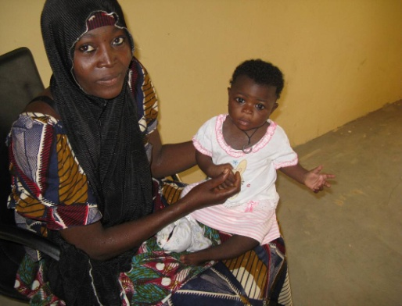
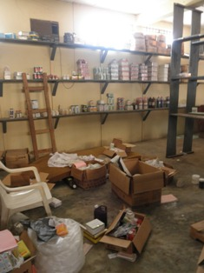
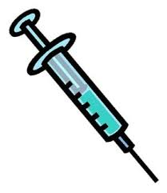
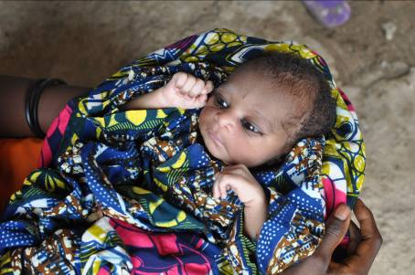
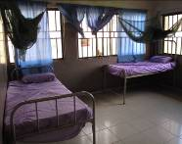
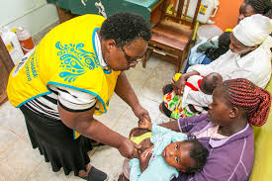
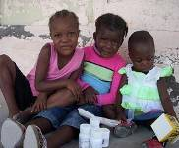
Despite some progress, the health system in Nigeria is beset with several challenges with resultant poor health indices
Everyday, Nigeria loses about 2,300 children under age of 5; and 145 Women of Child Bearing Age
Weak health system & poor demand
Poor coverage with health interventions
Poor health outcomes
  Supply challenges
  ~30,000 health facilities but with different levels of functionality
  Shortage of critical human resources
  Insufficient funding
  Only 38% of women have skilled births
  Only 58% of women attend ANC
  Maternal mortality rate is 560/100,000 live births = 33,000 women each year
  1 in 9 maternal deaths worldwide
  Supply challenges
    Inadequate power or water supply
    Commodity stock-outs
    Equipment inadequacy
    Weak standards / quality
  Only 1 in 4 Children (33%) are fully immunized
  Only 42% immunized for measles
  Infant mortality rate is 75/1,000
  8% of the global total,
  An estimated 70% of these deaths are preventable
  Demand side challenges
  Demand for critical services very low, largely driven by a loss of confidence in the system
  Poor access to Health care Services
  Sociocultural beliefs
  Child mortality rate is 117/1,000 = ~1 million deaths per year
  ~10% of the global total
  Only 18% received treatment for diarrhea
  Only 20.6% treated for fever
Source: NDHS 2013, MICS 2016

Slide 8
Why a focus on Primary Health Care?
An Effective Primary Health Care System is the Foundation for Achieving Universal Health Coverage
Changing Nigeria’s health indices Nigeria requires that an effective PHC delivery system is in place for both facility- and community based services
Additionally, without strengthening the PHC system in Nigeria, the Basic Health Care Provision Funding mechanism cannot be implemented effectively
- Routine Immunization
- RMNCAH + N
Primary Health Care
Universal Health Coverage
Health Insurance
8

Slide 9

Achievement of Universal Health Coverage is the central theme of Sustainable Development Goal 3
Universal health coverage is defined as ensuring that all people have access to needed health services (including prevention, promotion, treatment, rehabilitation and palliation) of sufficient quality to be effective while also ensuring that the use of these services does not expose the user the financial hardship.
(World Health Organisation)
9

Slide 10
Outline
About the National Primary Health Care Development Agency (NPHCDA)
Universal Health Coverage
NPHCDA’s Strategic Interventions
Prayers to the Executive Governors

Slide 11
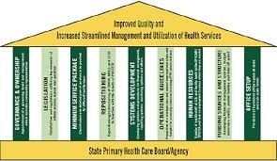

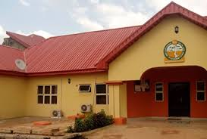

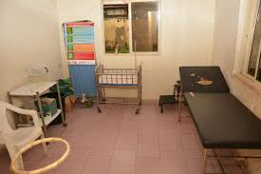

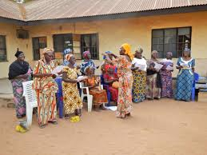
NPHCDA is implementing multiple innovative strategies that cut across 7 domains to drastically improve the health indices in the country
Our goal is to achieve a functional and effective Primary Health Care System that, at a minimum, supports the delivery of Routine Immunization and Maternal, Neonatal and Child Health plus Nutrition Services in every communities, wards and LGAs
Domain
Innovative strategies
Facility- Based Services
Improve Facility Based Services by functionality of PHC facilities
Governance & Systems Strengthening through PHCUOR
Technical support program, Quarterly engagement with SPHCBs¹
HRH management
Health workers audit², Expanded Midwife Service Scheme²
Infrastructure, Equipment, Tools & Commodities
PHC revitalization³, CCEOP³
Financing for PHC
(Revenue collection, Pooling, Purchasing)
Basic Health Care Provision Fund, NSHIP⁴
Facility Services (Fixed & Outreach)
NERICC⁵, NEMCHIC⁵
Community - Based Services
Improve service effectiveness, citizens’ confidence in the PHC system, and their health seeking behaviours
Data Management
LQAS⁶
Community Services & Demand Creation
CHIPS⁷, CES⁷

Slide 12
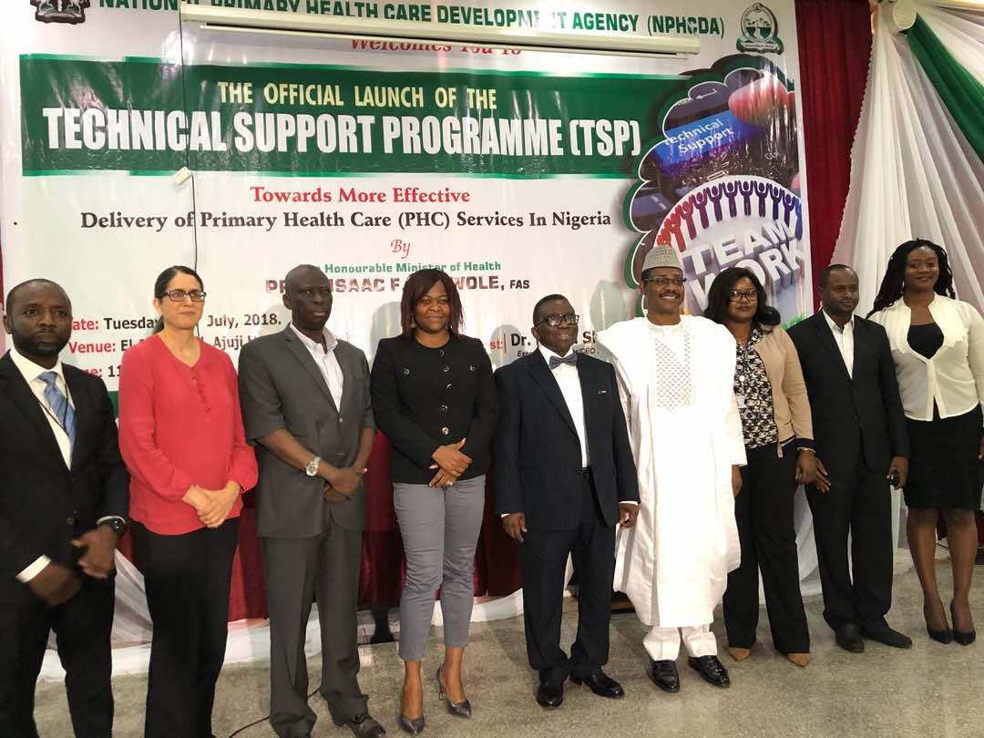
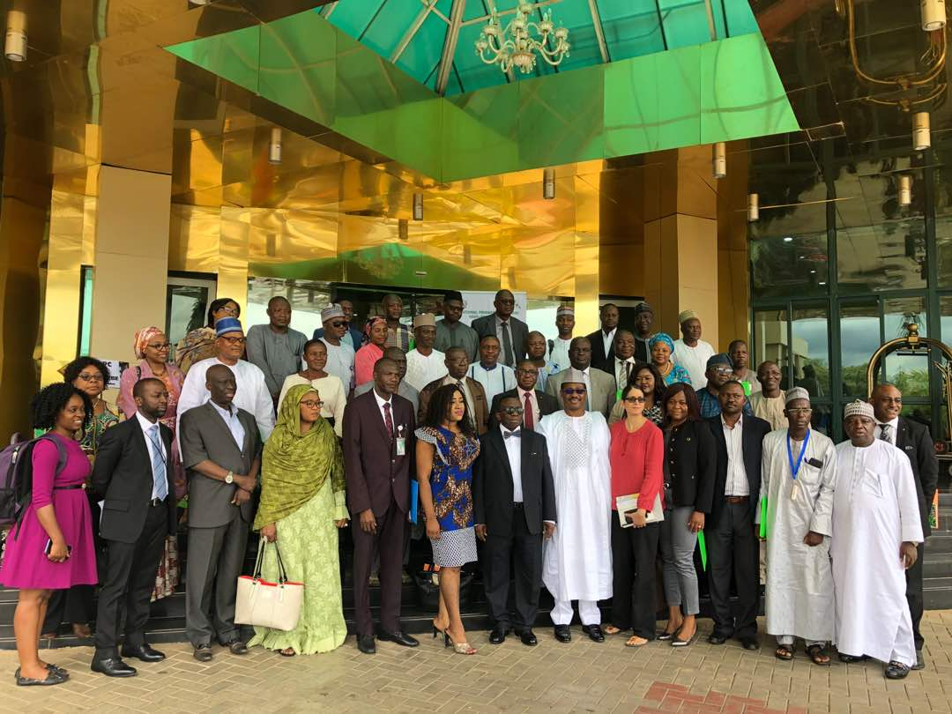
¹The Honourable Minister of Health flagged-off the Technical Support Program on Tuesday, the 17th of July to provide direct and specialized technical support to SPHCDAs
Key objectives of the TSP
1
Structured system for NPHCDA to deliver effective and specialized technical assistance to State Primary Health Care Boards
States are required to:
Set-up Technical Support Program desks within the SPHCBs to enable cascade of technical support to LGA and PHC levels
2
Public Health Institute starting with a Leadership Development Academy (LDA) to develop in-house capacity to lead and coordinate TA delivery to states
  NPHCDA will work with all resource persons within and outside the Agency to ensure successful implementation of both initiatives
SOURCE: Team analysis

Slide 13
¹The Agency developed a 3-year road map to design and independently run the technical support program
Focus
This year
2020
2019
2018
  Ensure NPHCDA TSP is independently run by NPHCDA staff (TSU)
  Establish SPHCB peer learning network
  Develop program workplan
  Set up office
  Set up online portal on NPHCDA website for TA request transmission and categorization
  Conduct end of program Evaluation
  Set up TA system implementation team (TSU)
  Design the TA delivery system
  Conduct mid-term evaluation of the technical support program
  Determine the TA needs landscape
Ensure government funding for TA delivery
Build NPHCDA staff capacity to independently run the TSP
Commence and sustain TA delivery to SPHCBs
Expand pool of NPHCDA staff capable of providing technical support to SPHCBs (LDA)
Monitor and improve quality of TA delivery to the states
SOURCE: Team analysis

Slide 14
¹So far the TSU has made remarkable achievements across set targets including fulfilment of requests made by SPHCBs
Categories
Key achievements
Program coordination
Developed and rolled-out a robust system for the determination of state TA needs, electronic transmission of TA needs from states to NPHCDA and prioritization and response to TA requests
1
Engaged a 4-man team (TSU) of NPHCDA staff to run the program
TA program roll-out
Conducted an initial TA needs assessment across 36+1 states that identified 77 unique TA needs
Delivered targeted on-site technical assistance to requesting states on themes covering MSP adaptation and costing (5 states), PHCUOR implementation (2 states); PHC data management (4 states); development of SPHCB operational guidelines and regulations (2 states); and set up of top management teams (TMTs), a PHC coordination platform made up of executive leadership of SPHCBs and implementing partners (2 states)
2
Rolled-out NPHCDA’s leadership development academy (LDA); a capacity building program utilizing a mix of adult learning techniques to build staff capacity to provide technical assistance to states. The LDA enrolled its first cohort of 30 high-performing NPHCDA staff selected competitively
Facilitated a peer-learning meeting between involving eight states focused on immunization data quality improvement
Sustainability measures
Developed a monitoring and evaluation framework to guide the assessment of the quality of TA delivered to the SPHCBs; the competencies and capabilities transferred to the SPHCBs; and the effects of the TA interventions on targeted SPHCB functions and program outputs
3
Reinforced program ownership and enhanced its sustainability by including TA funding as a line item on NPHCDA’s annual workplan; NGN 57m captured on the budget for 2019
Source: Team analysis

Slide 15
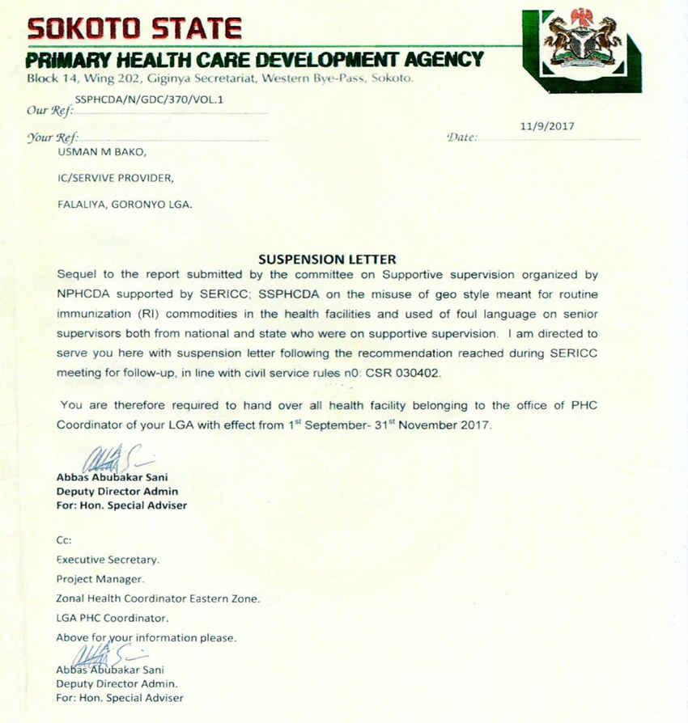
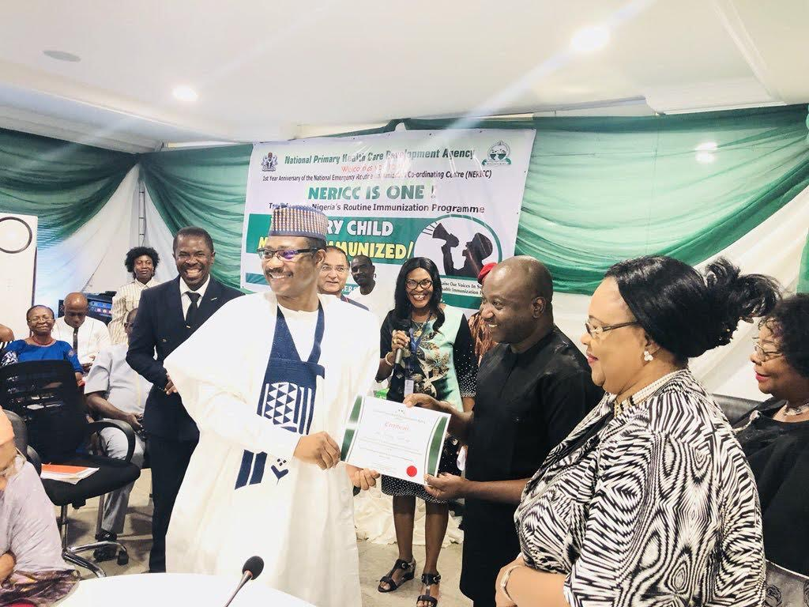
¹Internally, the NPHCDA is enforcing an accountability framework that demands increased responsiveness from health workers and managers for RI at national and states levels through quarterly meeting with Executive Secretaries of SPHCBs
Rewards and Sanctions
Implementation of accountability at all levels
Ownership of results
Zero tolerance for data falsification
Naming and shaming of states and LGAs to increase responsiveness to RI
Awards to best performing states and staff
Suspension of RI focal person in Sokoto
Award given to a WHO staff at NERICC

Slide 16
¹NPHCDA convenes quarterly meetings with the Executive Secretaries of SPHCBs to boost accountability and strengthen collaboration with states on PHC and RI Activities
Objectives of the quarterly meeting with SPHCBs leadership
To outline Key performance indicators for RI and PHC programs.
To provide updates to States on national programs – TSU, BHCPF, PHCUOR, Polio activities
To share State specific PHC best practices and lessons in Nasarawa State.
To deliberate on the impact and interventions for the reduction of maternal and child deaths in Nigeria
Key activities carried out during the meeting:
RI performance score cards with state executives
Best practices and lessons from PHC implementation from states
Health facility based assessment – quick spot check assessment of the functionality of health facilities
Advocacy to Executive Governor of state

Slide 17
We have put in place a number of measures to ensure the Task-shifting program is successfully implemented to the end
RECOMMENDATIONS
CONTINUITY MEASURES
²NPHCDA is proposing 4 steps to ensuring an effective, efficient and transparent migration of PHC health workers from LGA to SPHCDA
Establish a task-force
  Set up a high-profile task-force/committee to manage the migration
  Ensure this committee has a wide representation e.g. MoH, MoF, AG’s Office, LGAs, LGA service commission HCW’ unions, Partners
1
Conduct PHC staff audit
  Conduct an audit of existing PHC workers to verify current numbers, competencies using the task-force and HR audit firm
  Use the audit to also establish qualifications of verified HCW
2
Migrate qualified staff
Migrate only staff who have relevant healthcare qualifications
Post verified staff who do not have relevant training or qualifications to other state/LGA ministries & departments
3
Ensure transparency & accountability
Ensure that there is no opacity surrounding the process
Ensure that political considerations do not override health system needs in the migration process
4
SOURCE: NPHCDA

Slide 18


²Looking ahead: Reducing Maternal and Child Mortality
Expanded Midwifery Services Scheme
(EMSS)
Re-strategized to deploy adequate numbers of skilled birth attendants to provide 24-hour service in rural PHCs across a wider geographical area than the initial MSS Scheme.
Will involve deployment of unemployed and newly graduated midwives.
To be funded by both Federal & State Governments through the Basic Health Care Provision Fund (BHCPF).
Will significantly improve on the gains of MSS through adequate engagement of state and local policy makers, prioritization of local recruitment and strengthening demand side issues too.
Federal will exit and hand over to States after 5 years, but will continue to provide oversight functions

Slide 19
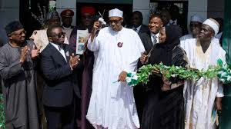
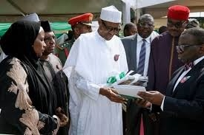
As a first step, Mr. President flagged off the Primary Health Care Revitalization Program…States are Following on this as well and there is progress with SPHCDAs
³The PHC revitalization agenda aims to revamp 10,000 PHCs across Nigeria, and so far, ~4000 PHCs have been revitalized
QUOTES FROM MR. PRESIDENT
PHC improvement is critical to the Achievement of Health Objectives
‘Our vision is to reverse this unsatisfactory situation and better care for the poor and needy’
It is the mandate of the State Government to identify and revitalize primary health care facilities across the state to ensure achievement of the 1 functional PHC per ward agenda of the Presidency, in order to improvement health outcomes in the state
‘Health Workers should also play their parts in ensuring the sustainability of this Primary Health Care Revitalization’
‘Revamping the primary healthcare system is the platform for achieving UHC’
Notes:
Introduced in 2001; endorsed in the NHAct 2014
Adopts political wards as the operational implementing units for PHC programmes
Provides PHC services to a political ward, constituency from which a councilor is elected
Goal is to improve and ensure sustainable health services with full and active participation of people at the grass root level

Slide 20
³Renewed engagement between the NPHCDA and Gavi has resulted in joint commitment of $120 million dollars to ensure 100% saturation of functional cold chain equipment (refrigerators, freezers, etc.) across the country
Annually, NPHCDA and partners invest over NGN 90 billion in procuring life-saving vaccines for all the states in Nigeria
To ensure availability of these vaccines at all health facilities, there must be functional cold chain equipment for storage within required temperature
However, a recent assessment in 2018 showed that only 52% of wards have functional CCE
To bridge the gap in CCE availability across the country, the Federal Government of Nigeria and Gavi, the Vaccine Alliance have jointly committed over $120M to procure over 12,000 CCEs
This will ensure that there is at least a functional cold chain equipment in every ward in Nigeria
State Governments need to establish and fund maintenance mechanisms for all cold chain equipment in the state to ensure continued functionality and vaccine availability at the last mile
- No. of sites visited are 8,065
- Total no. of CCE assessed is 14,596

Slide 21



⁴The National Health Act established the Basic Health Care Provision Fund, which is 1% of Consolidated Revenue Funding (CRF)
Flow of funds from the 1% CRF
NHIS
Basic Minimum Package of Health Services (BMPHS) to be provided in primary and secondary levels of care
50%
NPHCDA
Essential Drugs, Vaccines & Consumables in PHCs
20%
BHCPF
NHIS
NPHCDA
FMoH
Provision & Maintenance of Facilities, Equipment & Transportation in PHCs
15%
BHCPF
1
Development of Human Resources in Primary Health Centers
10%
FMoH
SOURCE: FMoH
5%
Emergency Medical Treatment
Other initiatives
The president officially launched the BHCPF on January 8, 2019

Slide 22
⁴Implementation of the BHCPF will ensure adequate availability of funds to Primary Health care facilities across the country
NPHCDA Gateway |  |  | Disbursed to which level |  |  | Purpose & Mode of Payment
NHAct Item | % | Proposed Channel | NPHCDA | SPHCDA & LHA | PHC Facility
Vaccine, Drugs & Consumables | 20% | Vaccines | 10% | – | – | TSA Transfer as additional funding for Procurement of Bundled Vaccines
 |  | Drugs & Consumables | – | – | 10% | DFF to PHC Facilities through SPHCDB (TSA)
Infrastructure, Equipment and Transport | 15% | Infrastructure Development | – | 7.5% | – | TSA transfer for Infrastructural development (new constructions and renovations).
 |  | Medical Equipment (& Cold Chain) | – | 2.5% | – | TSA transfer for Medical Equipment to elevate 1 PHC per Ward to Minimum Standard
 |  | Transport & Maintenance | – | 2.5% | 2.5% | SPHCB: TSA transfer to support Vaccine push/pull; Ambulance Service etc PHC: Minor infrastructural and equipment maintenance and out-reach transportation
PHC Human Resource Development | 10% | Dev. of Training Institutions, Support for Midwives & CHEWs | – | 5% | – | Development of Training Institutions and support recruitment of Midwives and CHEWs for PHC deployment Training on financial and operational mgt.
 |  | Support for CHIPS Agents | – | 5% | – | CHIPS Agents: mobilisation, training and payment of stipends
22

Slide 23
⁴Nigerian State Health Investment Program (NSHIP) is a performance-focused approach to strengthen service delivery at the health facilities
Aim
Area | From… | To…
Financing | Input-based | Result-based
Accountability | Fragmented and unclear | Defined with indicators and monitored
Investments (Autonomy) | By LGA (top down) | By health facilities (bottom-up)
Drug supply | Distributed from central stores (mainly push) | Purchased by health facilities (mainly pull)
Performance | No verification | Independent verification and counter verification
NSHIP seeks to provide managerial autonomy to health facilities whilst strengthening accountability mechanisms at the LGA Primary Healthcare Authority and State Primary Healthcare Development Agencies through a collective package of institutional and operational level results based financing approaches.
Objective
To increase the delivery and use of high impact maternal and child health interventions and to improve the quality of care at selected health facilities in participating States.

Slide 24
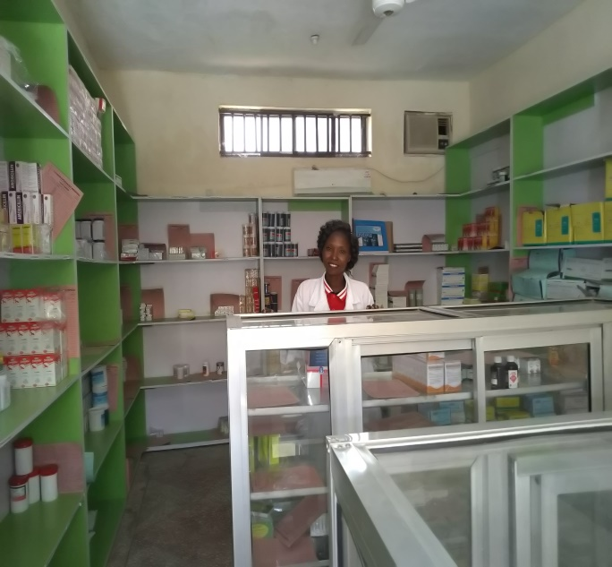
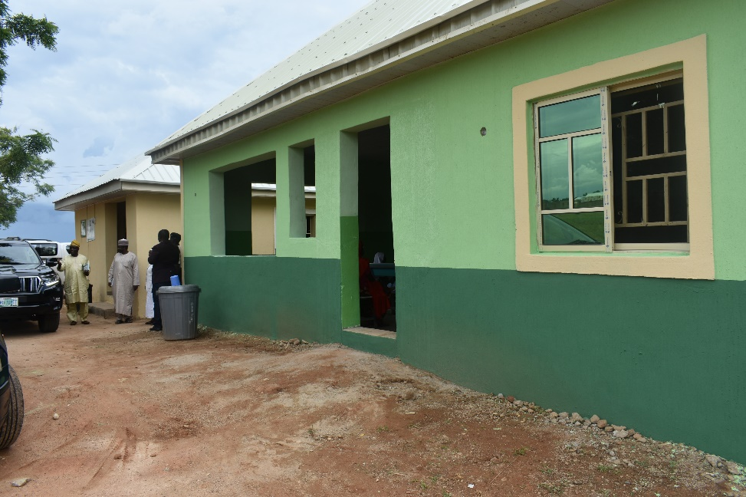
⁴Current Health Facility Coverage (1,866 PHCs in 8 States)
PHC Infrastructure improvements in the Short-Term (6 months to 1 year)
At least one functional PHC per ward in implementing LGAs(maternal and child care, curative care, laboratory services, community outreach in a well maintained facility with qualified friendly staff and adequate drugs & health commodities, improved referral system
Aim of revitalizing at least 2000 HFs by the end of the year
State | # of Contracted PHCs | # of Wards
Adamawa | 403 | 226
Nasarawa | 467 | 147
Ondo | 516 | 203
Bauchi | 133 | 104
Borno | 101 | 122
Gombe | 58 | 43
Taraba | 75 | 65
Yobe | 113 | 126

Slide 25
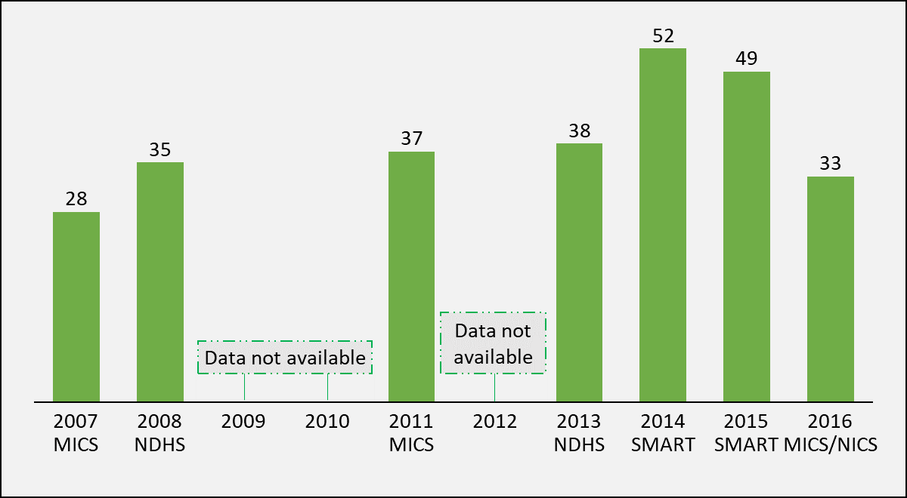
⁵Nigeria’s immunization coverage has fluctuated significantly over the last decade
This dismal performance had largely been masked by high reported administrative coverage results
Measuring progress using administrative data had also masked immunization system deficiencies resulting in a vicious cycle of poor routine immunization performance
The 2016/2017 MICS/NICS report showed a very poor RI performance (National Penta 3 coverage of 33%, against the 2015 admin coverage of 98%)
The National Primary Health Care Development Agency responded to the results of the 2016 NICS/MICS in a most significant way by the establishment of national and states coordinating platforms for Routine Immunization

Slide 26
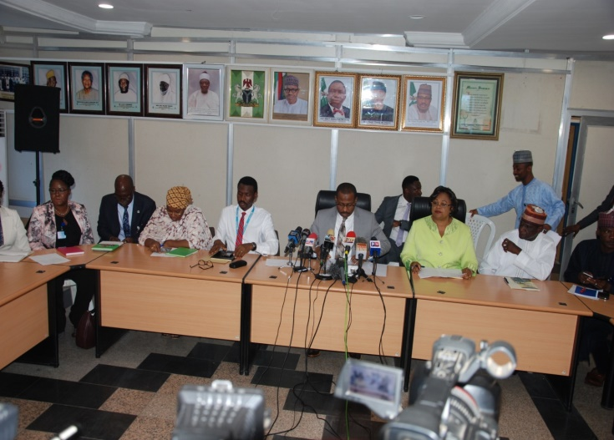
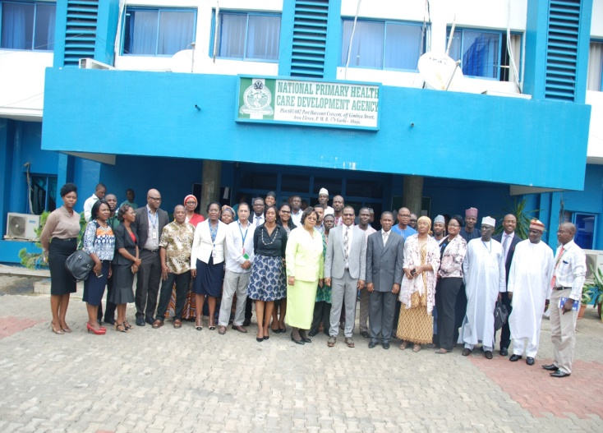
⁵NPHCDA established and institutionalized the NERICC to drive rapid and sustainable improvements in immunization coverage in Nigeria
A Declaration of State of public health concern on Routine Immunization Program was made on June 17 with a decision to establish the National Emergency Routine Immunization Coordination Centre (NERICC). NERICC was inaugurated on the 4th of July 2017 and has been meeting daily ever since.
Vision, Goal and Objectives
Vision
To achieve greater than 80% immunization coverage for ALL antigens in Nigeria
Goal
To provide a national and sub-national coordination mechanism to manage the full implementation of the routine immunization programs, strategies and other recommendations of various expert committees towards achieving routine immunization coverage >80% by 2028 for ALL antigens at national, states and LGAs levels
Objectives
Improve detection and responsiveness in the resolution of RI gaps
Strengthen leadership and accountability
Strengthen coordination
Increase data visibility, quality and use for action at all levels
Increase fixed and outreach services for immunization especially in the very low performing states

Slide 27
⁵Over the last 25 years, Nigeria made no progress towards achieving the MDG targets for MMR
20 countries with MMR >1000 as @ 1990 | MMR (1990) | MMR (2015) | % change in MMR between 1990 and 2015^{c} | Progress towards MDG 5A | Baseline ranking (1990) | Ranking in 2015 | Ranking (by % change from 1990-2015)
Cambodia | 1020 | 161 | 84.2 | Achieved | 2 | 1 | 1
Timor-Leste | 1080 | 215 | 80.1 | Achieved | 5 | 2 | 2
Rwanda | 1300 | 290 | 77.7 | Achieved | 11 | 3 | 3
Equatorial Guinea | 1310 | 342 | 73.9 | Making progress | 12 | 4 | 4
Ethiopia | 1250 | 353 | 71.8 | Making progress | 9 | 5 | 5
Afghanistan | 1340 | 396 | 70.4 | Making progress | 13 | 6 | 6
Eritrea | 1590 | 501 | 68.5 | Making progress | 18 | 9 | 7
Mozambique | 1390 | 489 | 64.8 | Making progress | 15 | 8 | 8
Angola | 1160 | 477 | 58.9 | Making progress | 6 | 7 | 9
South Sudan | 1730 | 789 | 54.4 | Making progress | 19 | 16 | 10
Liberia | 1500 | 725 | 51.7 | Insufficient progress | 17 | 14 | 11
Sierra Leone | 2630 | 1360 | 48.3 | Insufficient progress | 20 | 20 | 12
Mali | 1010 | 587 | 41.9 | Insufficient progress | 1 | 10 | 13
Burundi | 1220 | 712 | 41.6 | Insufficient progress | 8 | 13 | 14
Chad | 1450 | 856 | 41 | Insufficient progress | 16 | 18 | 15
Nigeria | 1350 | 814 | 39.7 | No progress | 14 | 17 | 16
Somalia | 1210 | 732 | 39.5 | Insufficient progress | 7 | 15 | 17
Guinea | 1040 | 679 | 34.7 | Insufficient progress | 4 | 11 | 18
Central African Republic | 1290 | 882 | 31.6 | No progress | 10 | 19 | 19
Gambia | 1030 | 706 | 31.5 | No progress | 3 | 12 | 20
27
ª Source: Trends in maternal mortality: 1990 to 2015: estimates by WHO, UNICEF, UNFPA, World Bank Group and the United Nations Population Division

Slide 28
⁵The National Emergency Maternal and Child Health Intervention Centre (NEMCHIC) will galvanize all stakeholders to rapidly reduce maternal and child deaths in Nigeria
A Declaration of State of public health concern on Maternal and Child Deaths was made on April 8th, 2019 with a decision to establish a National Coordination Centre to provide oversight on RMNCAH + N activities at the Primary Health Care level
Goal
To reduce maternal and child deaths by 50% by 2021
Vision
A country where no woman or child dies from preventable causes
Mission
To promote awareness and ensure effective emergency response to maternal and child mortality that addresses the three (3) delays to care through an integrated approach
Objectives
Improve awareness and promote community involvement in interventions to reduce maternal and child mortality
Strengthen coordination, leadership and accountability in RMNCAH+N programmes
Increase data visibility, quality and use for action at all levels
Improve detection and responsiveness in the resolution of RMNCAH+N service gaps
States will be required to:
Establish State Emergency Maternal and Child Health Intervention Centre (SEMCHIC)
Provide adequate funding to support implementation of SEMCHIC priority activities
Ensure availability of adequate number of trained health workers at all health facilities

Slide 29
⁶The NPHCDA introduced the Lot Quality Assurance Sampling (LQAS) to monitor the Quality of RI programme at LGA and state levels
  Definition of RI-LQAS
  Key objectives of the RI-LQAS
The RI-LQAS is a population-based survey conducted independently by WHO and National Bureau of Statistics (NBS) to monitor the impact of interventions on RI performance and to guide programmatic decision making at the state and LGA levels
1
To estimate LGA-level RI performance
2
To identify key reasons for non-vaccination of eligible children
3
To identify primary sources of vaccination information for caregivers
  Summary of RI LQAS methodology:
  All LGAs in the state are selected; each LGA is considered as a lot
  6 settlements are sampled per Lot (LGA)
  10 households are randomly sampled per settlement and one child (0-11months of age) is selected per household
  The total sample size per lot (LGA) is 60 children, 0-11 months old

Slide 30
Rapid and sustainable improvement have so far been achieved in RI coverage
LQAS conducted between Q4 2017 & Q1 2019 show progressive increase in the number of LGAs that passed Lot: 11 LGAs (3%) in Q4 2017 to 85 (23%) and 139 (37%) in Q4 2018 and Q1 2019
377
379
380
380
376
375
40
(11%)
21
(6%)
11
(3%)
8
(2%)
2
(1%)
1
(0%)
45
(12%)
85
(22%)
141
(37%)
148
(39%)
174
(46%)
209
(55%)
190
(51%)
204
(54%)
187
(49%)
172
(45%)
163
(43%)
117
(31%)
139
(37%)
41
(11%)
52
(14%)
85
(23%)
11
(3%)
21
(6%)

Slide 31
⁶Proportion of children appropriately immunized for age Card+ History in 36 states and FCT comparing RI LQAS in Q2 (June) vs. Q4 (December), has improved in most states by December 2018

Slide 32
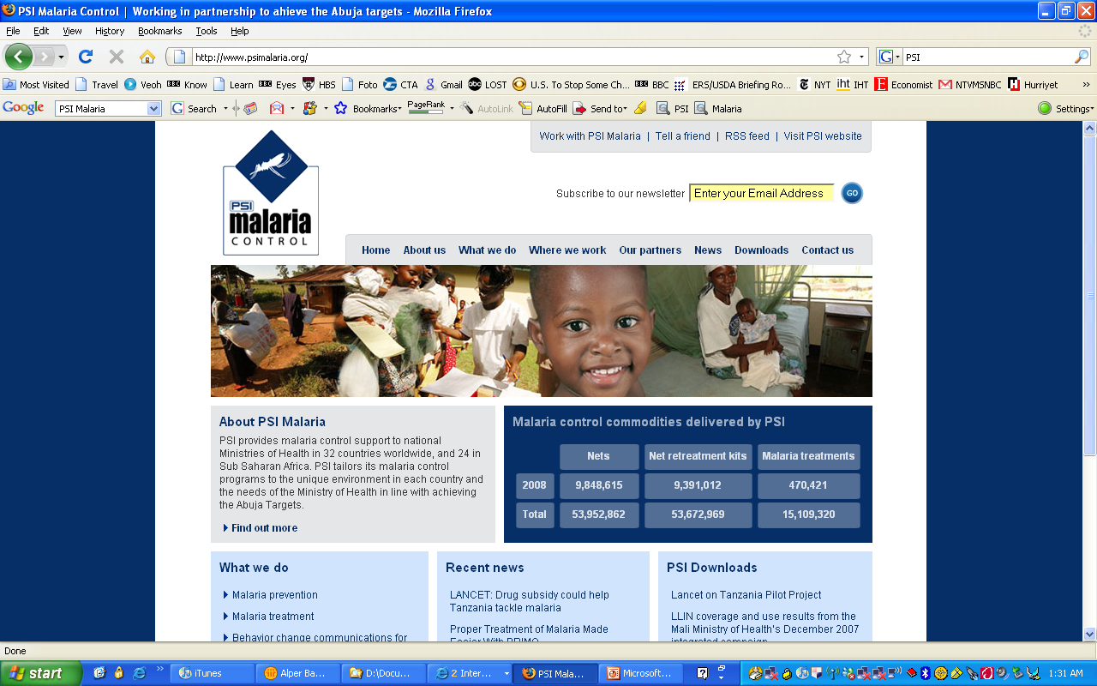
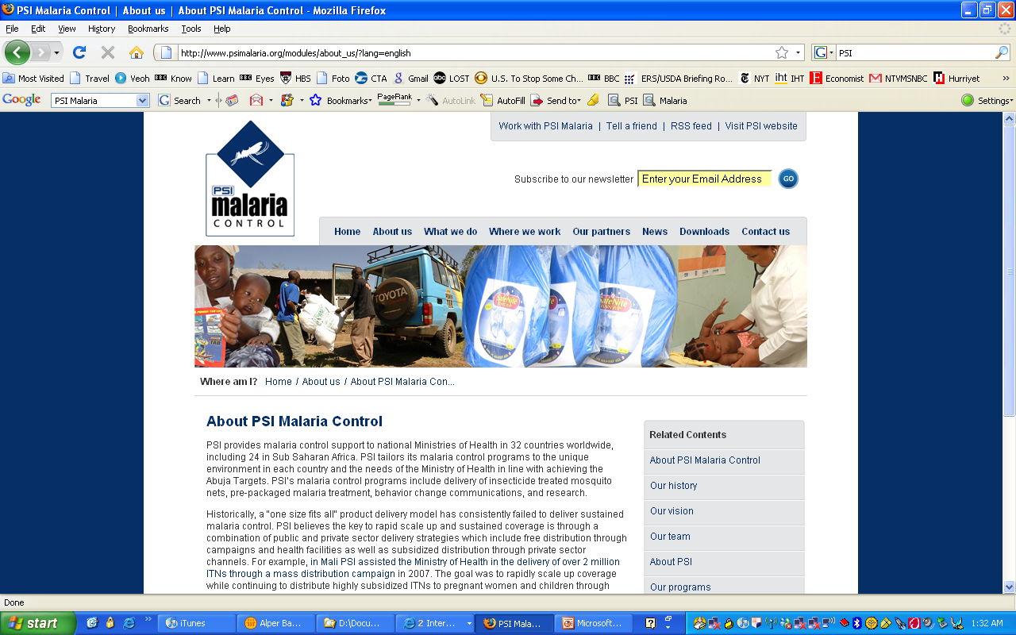
⁷The NPHCDA is driving a Community Health Influencers, Promoters and Services (CHIPS) Programme and linking it to the revitalization of 10,000 PHCs. The Plan is to have over 100,000 CHIPS Agent across the country, to strengthen the “1 functional PHC per ward strategy” of the federal government
The aspiration
WDCs
WDCs
“Reducing maternal and child mortality by addressing supply and demand constraints”
The 3 delays;
Patient
Patient
Client
Client
Delay in decision to seek care
Delay in reaching care
Delay in receiving adequate healthcare
CHIPS Programme will Increase the demand and utilization of MCH services in vulnerable communities through recruitment of a minimum of 10 women per ward
CHIPS
CHIPS
Midwives
Midwives
CHWs
CHWs
referral
PHC
PHC
General
Hospital
PHC
Patient
Patient
Client
Client
CHIPS
Mid\wives
PHC
CHIPS
States will be required to:
Work with traditional leaders to identify and train CHIPS agents
Provide commodities and kits for agents
Provide monthly stipends to the agents
Link agents to income-generation schemes
Midwives
Minimum of 10 CHIPS Agents will be engaged per Ward/Catchment Area, preferably females
Two (2) persons will also be engaged to serve as Community Engagement Focal Persons (CEFPs)
CHWs
CHWs
WDCs
WDCs

Slide 33
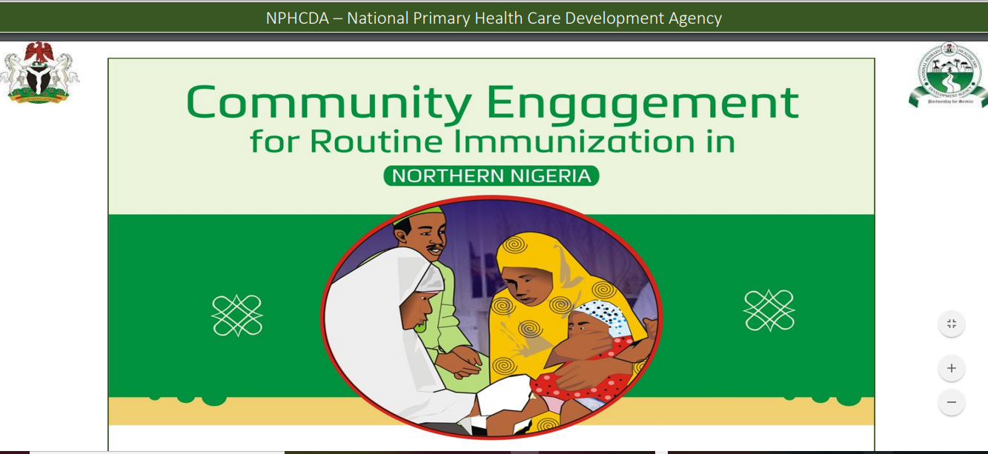
The agency has developed a handbook and flipchart guide on the implementation of Community Engagement Strategy for Northern Traditional Leaders

Slide 34
Outline
About the National Primary Health Care Development Agency (NPHCDA)
Universal Health Coverage
NPHCDA’s Strategic Interventions
Prayers to the Executive Governors

Slide 35
Prayers
Call for quarterly meetings with LGA Chairmen to review the progress in achieving PHC Indicators
Support the Establishment of State Emergency Maternal and Child Health Intervention (SEMCHIC) to coordinate and rapidly reduce maternal and child deaths
Conduct a PHC human resource audit to assess gaps and develop a roadmap to fill these gaps
Review the requirements for drawing down on the Basic Healthcare Provision Funds (BHCPF) and apply for inclusion in the roll-outs

Slide 36


