Slide 1
The internet, social media and other innovation tools
Gerald ilukwe
Knowledge resources limited
gilukwe@knowledgeresources.net

Slide 2
Challenges facing government today
State governments are navigating increasingly complex political and economic environments.
Finance & Budget Constraints
Poverty Alleviation
Improve Internally Generated Revenue
Strategic Communication & Stakeholders’ Management
Governance & Public Service Delivery
Public Safety & Security

Slide 3
THE CONNECTION
Social media is one of several government communication channels.
E-Government + ICT
Governments now consider Social Media a communications channel of strategic priority.
Politicians can no longer afford NOT to be on social networking sites (Facebook, Twitter, Instagram, YouTube etc.).
Social Media & Internet
Strategic Communication
&
Stakeholders Management

Slide 4
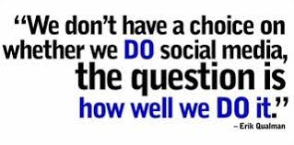
social media
EXAMPLES
Definition
Social media are interactive web-based tools that facilitate the creation and sharing of information, ideas and other forms of expression via virtual communities and networks.
Facebook
Global connectivity. Social marketing platform.
Twitter
Real time expressions and dialogue.
Snapchat
Mobile storytelling and discovery platform.
LinkedIn
Professional conversation and content amplification.
YouTube
Mobile streaming and social TV platform.
Instagram
Peer-to-peer sharing. Growing engaged communities.

Slide 5
registered voters vs internet users (1/2)
State | Registered Voters | Internet Users | Population | % Registered Voters vs. Internet Users | % Internet Users vs. Population
ABIA | 1,932,892 | 2,266,320 | 3,727,347 | 117% | 61%
ADAMAWA | 1,973,083 | 1,890,285 | 4,248,436 | 96% | 44%
AKWA IBOM | 2,119,727 | 2,075,045 | 5,482,177 | 98% | 38%
ANAMBRA | 2,447,996 | 3,055,645 | 5,527,809 | 125% | 55%
BAUCHI | 2,462,843 | 1,989,597 | 6,537,314 | 81% | 30%
BAYELSA | 923,182 | 823,987 | 2,277,961 | 89% | 36%
BENUE | 2,480,131 | 2,622,122 | 5,741,815 | 106% | 46%
BORNO | 2,315,956 | 1,983,035 | 5,860,183 | 86% | 34%
CROSS RIVER | 1,527,289 | 1,576,988 | 3,866,269 | 103% | 41%
DELTA | 2,845,274 | 3,842,591 | 5,663,362 | 135% | 68%
EBONYI | 1,459,933 | 905,908 | 2,880,383 | 62% | 31%
EDO | 2,210,534 | 3,622,527 | 4,235,595 | 164% | 86%
EKITI | 909,967 | 1,071,497 | 3,270,798 | 118% | 33%
ENUGU | 1,944,016 | 2,238,151 | 4,411,119 | 115% | 51%
FCT | 1,344,856 | 5,218,121 | 3,564,126 | 388% | 146%
GOMBE | 1,394,393 | 1,294,297 | 3,256,962 | 93% | 40%
IMO | 2,272,293 | 2,254,764 | 5,408,756 | 99% | 42%
JIGAWA | 2,111,106 | 1,218,033 | 5,828,163 | 58% | 21%
Source: National Bureau of Statistics (NBS); National Population Commission (NPC) Q4 2018

Slide 6
Source: National Bureau of Statistics (NBS); National Population Commission (NPC)

Slide 7
registered voters vs internet users (1/2)
State | Registered Voters | Internet Users | Population | % Registered Voters vs. Internet Users | % Internet Users vs. Population
KADUNA | 3,932,492 | 4,961,210 | 8,252,366 | 126% | 60%
KANO | 5,457,747 | 5,842,117 | 13,076,892 | 107% | 45%
KATSINA | 3,230,230 | 2,533,194 | 7,831,319 | 78% | 32%
KEBBI | 1,806,231 | 1,365,187 | 4,440,050 | 76% | 31%
KOGI | 1,646,350 | 2,247,446 | 4,473,490 | 137% | 50%
KWARA | 1,406,457 | 2,441,444 | 3,192,893 | 174% | 76%
LAGOS | 6,570,291 | 15,675,147 | 12,550,598 | 239% | 125%
NASSARAWA | 1,617,786 | 2,323,665 | 2,523,395 | 144% | 92%
NIGER | 2,390,035 | 3,499,338 | 5,556,247 | 146% | 63%
OGUN | 2,375,003 | 6,595,830 | 5,217,716 | 278% | 126%
ONDO | 1,822,346 | 2,630,850 | 4,671,695 | 144% | 56%
OSUN | 1,680,498 | 2,795,325 | 4,705,589 | 166% | 59%
OYO | 2,934,107 | 5,791,896 | 7,840,864 | 197% | 74%
PLATEAU | 2,480,455 | 2,279,315 | 4,200,442 | 92% | 54%
RIVERS | 3,215,273 | 4,506,694 | 7,303,924 | 140% | 62%
SOKOTO | 1,903,166 | 1,565,236 | 4,998,090 | 82% | 31%
TARABA | 1,777,105 | 1,466,199 | 3,066,834 | 83% | 48%
YOBE | 1,365,913 | 1,170,408 | 3,294,137 | 86% | 36%
ZAMFARA | 1,717,128 | 1,228,000 | 4,515,427 | 72% | 27%
TOTAL | 84,004,084 | 112,065,740 | 193,500,543
Source: National Bureau of Statistics (NBS); National Population Commission (NPC)

Slide 8
Source: National Bureau of Statistics (NBS); National Population Commission (NPC)

Slide 9
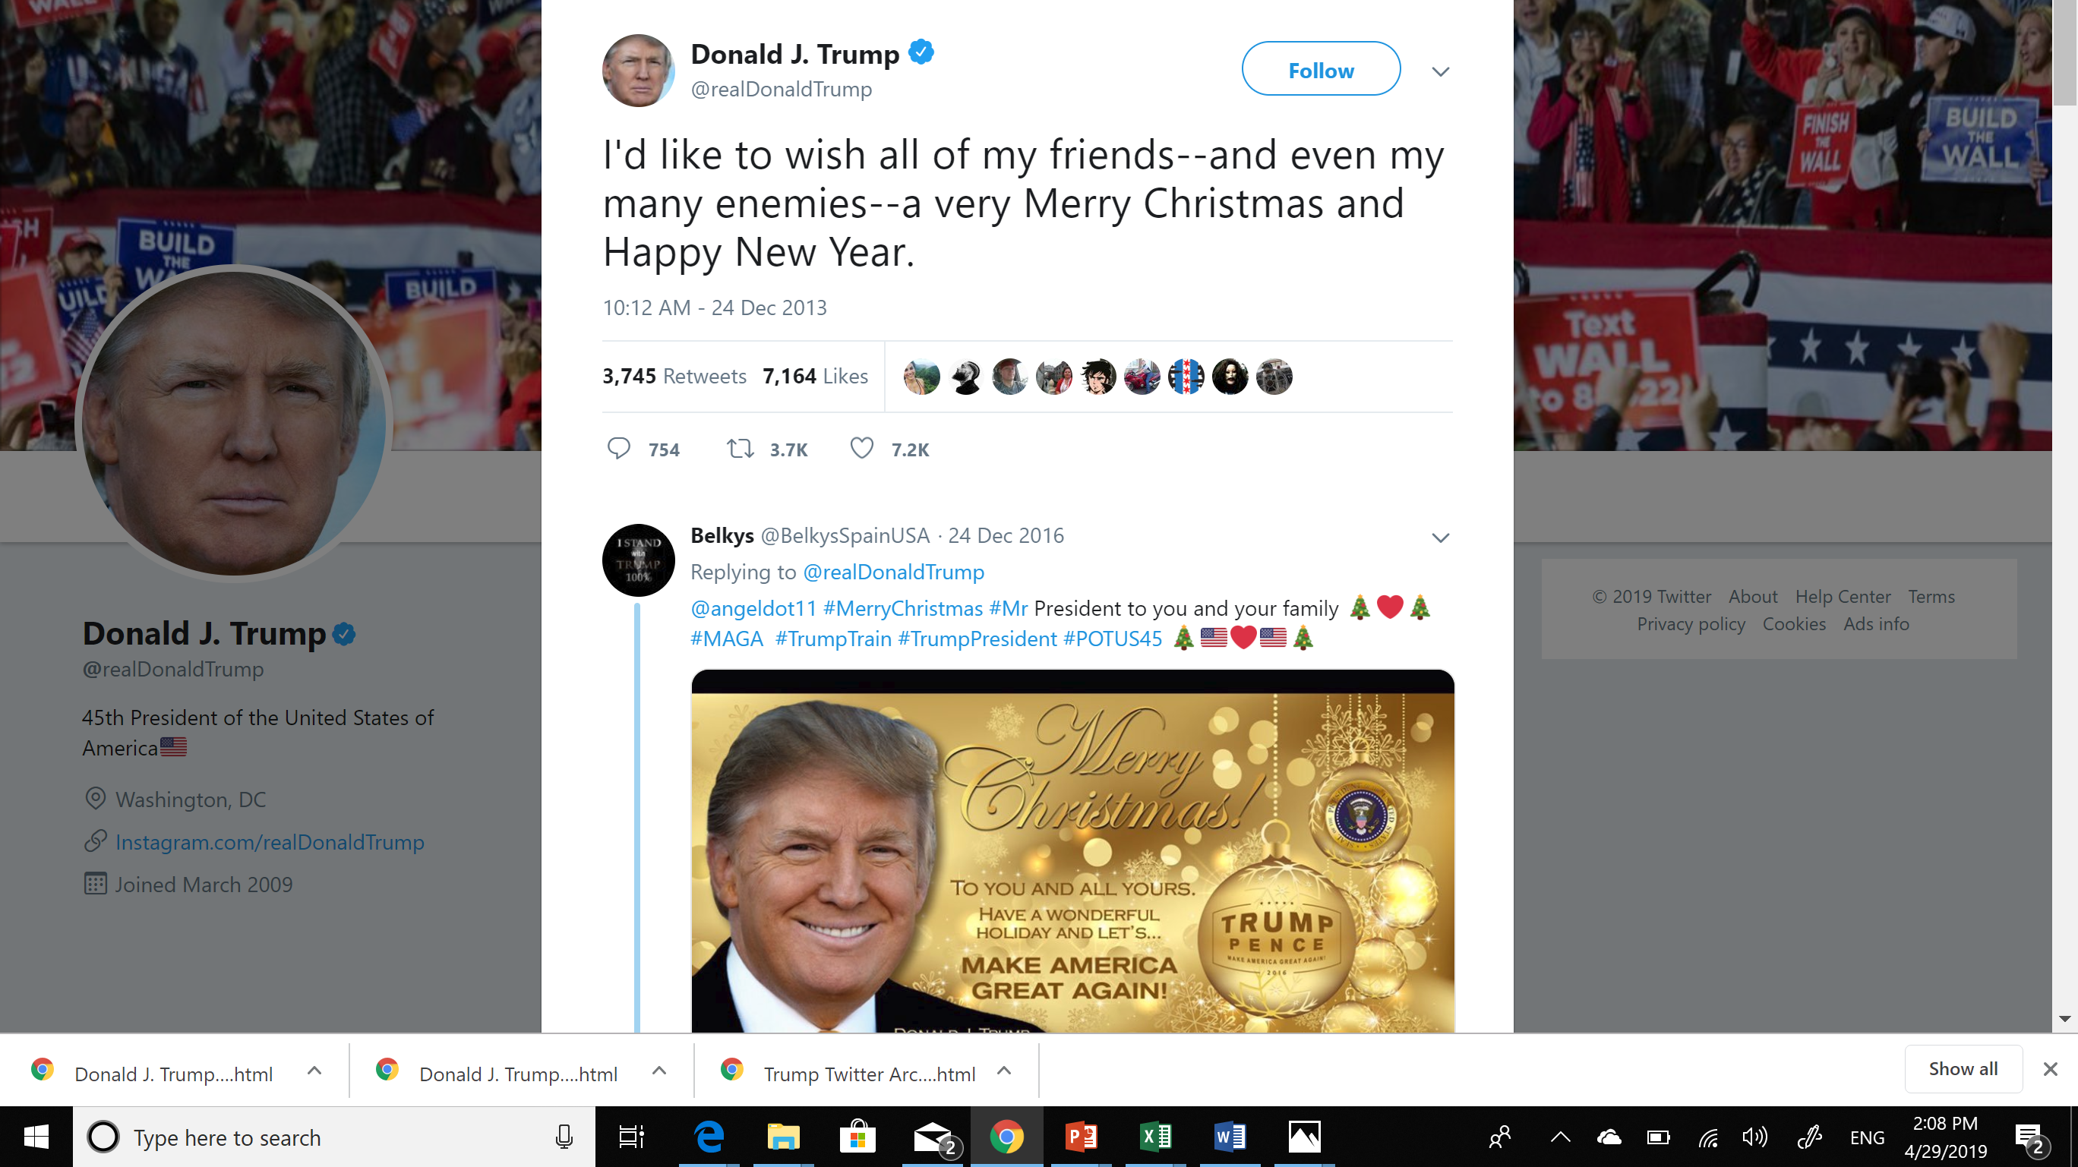

Slide 10
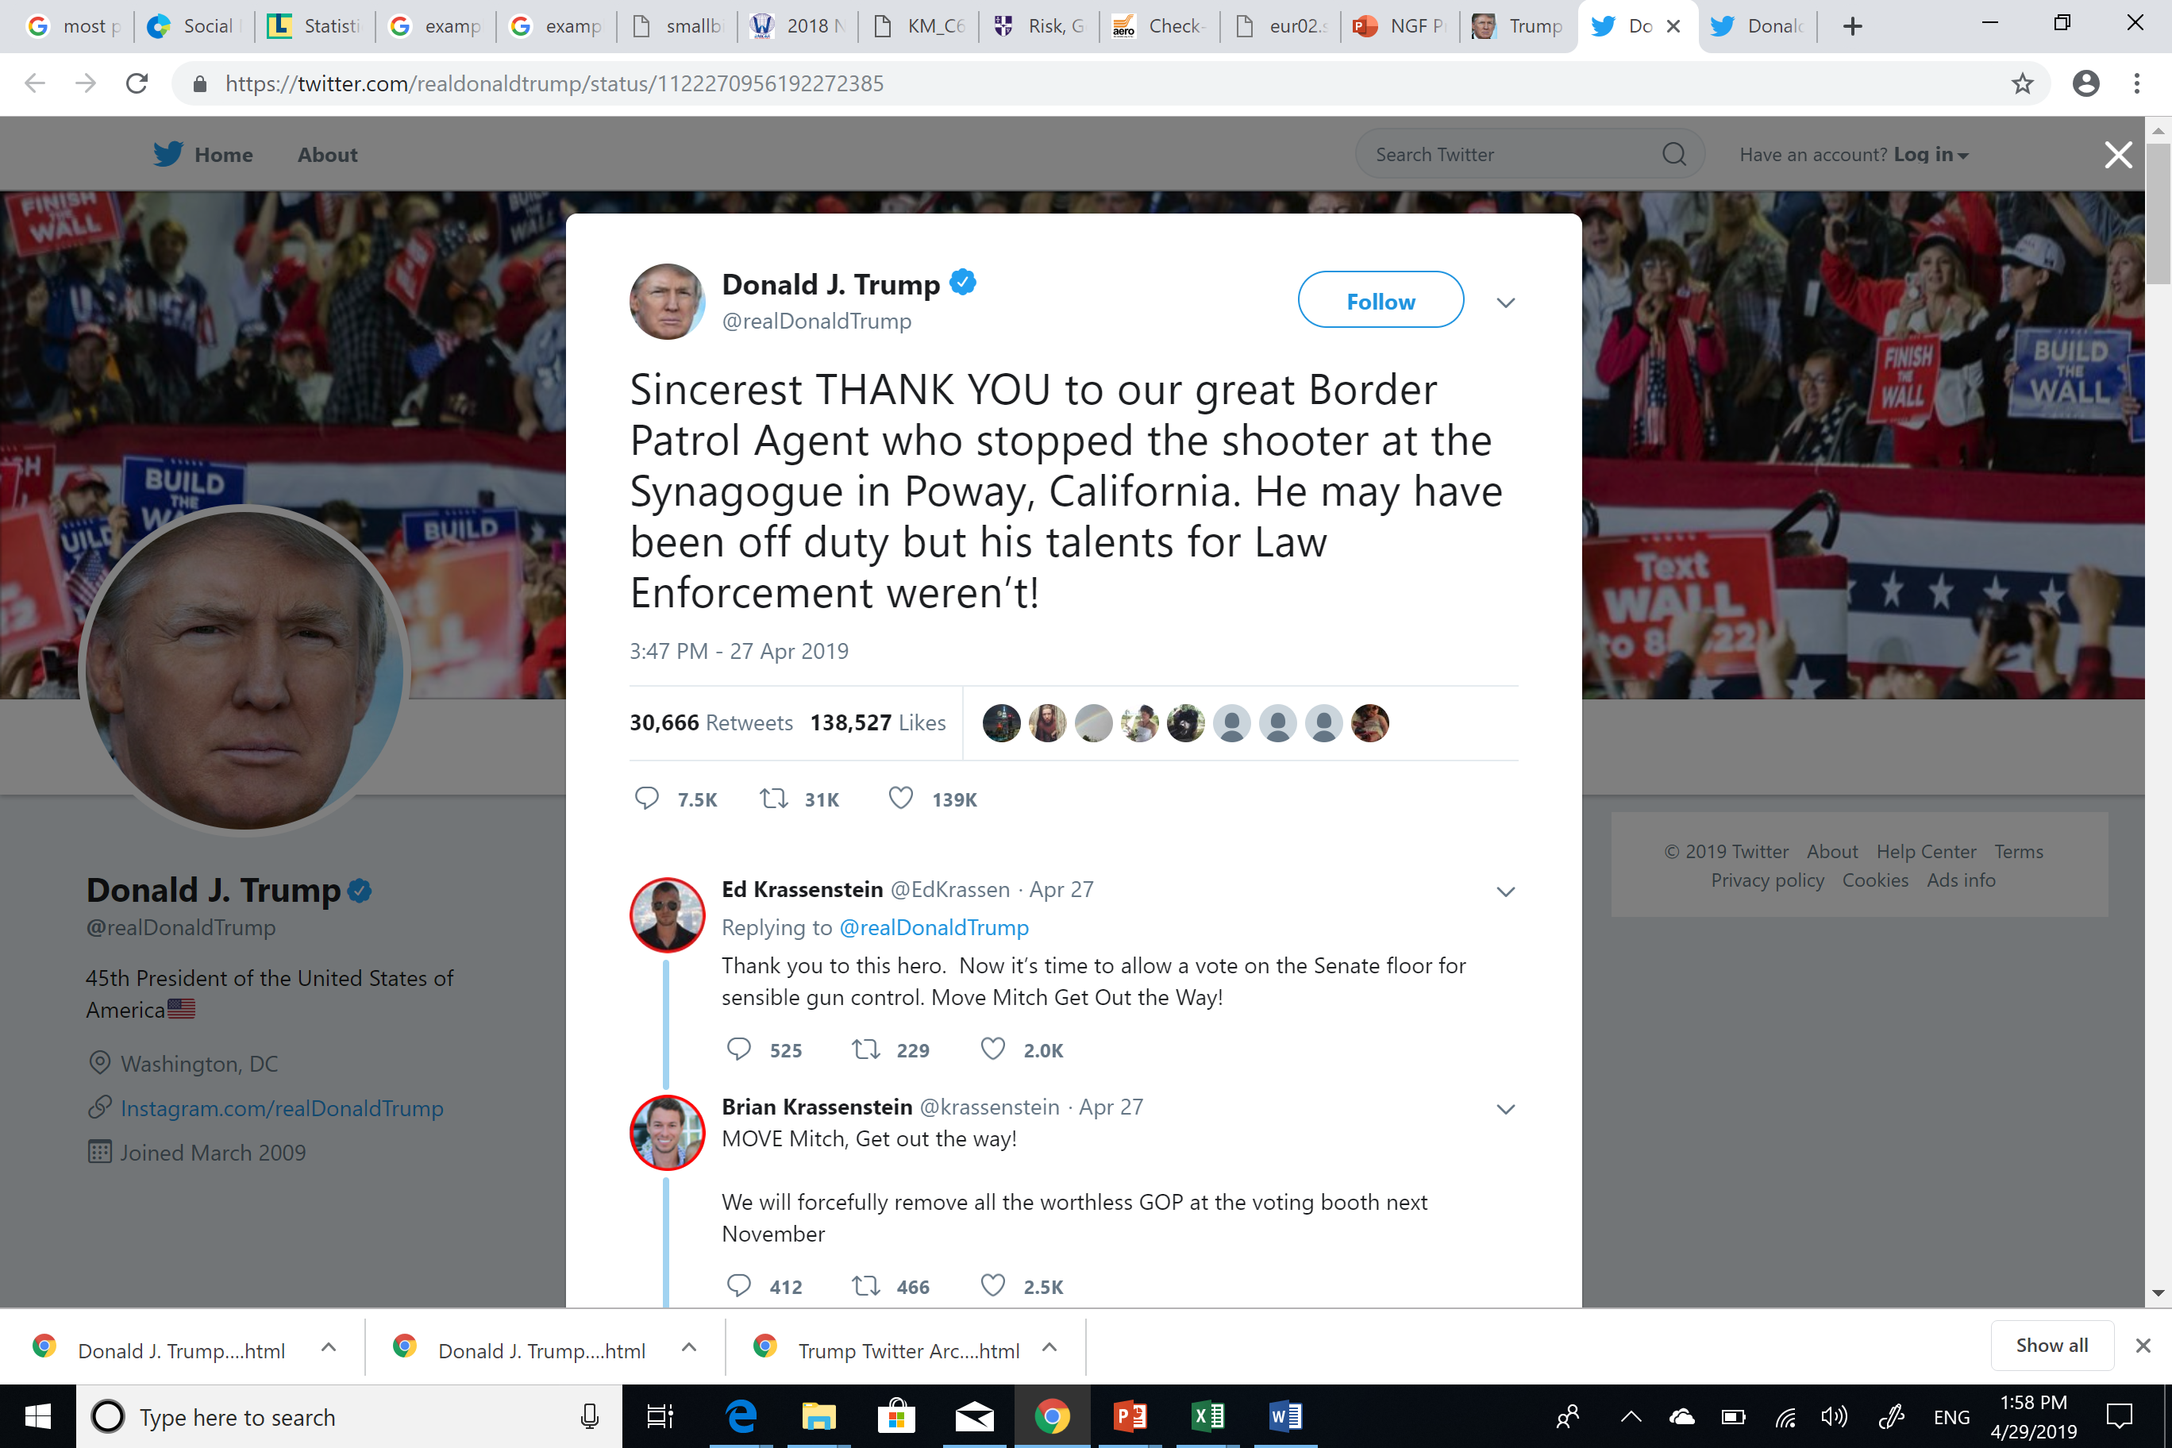

Slide 11
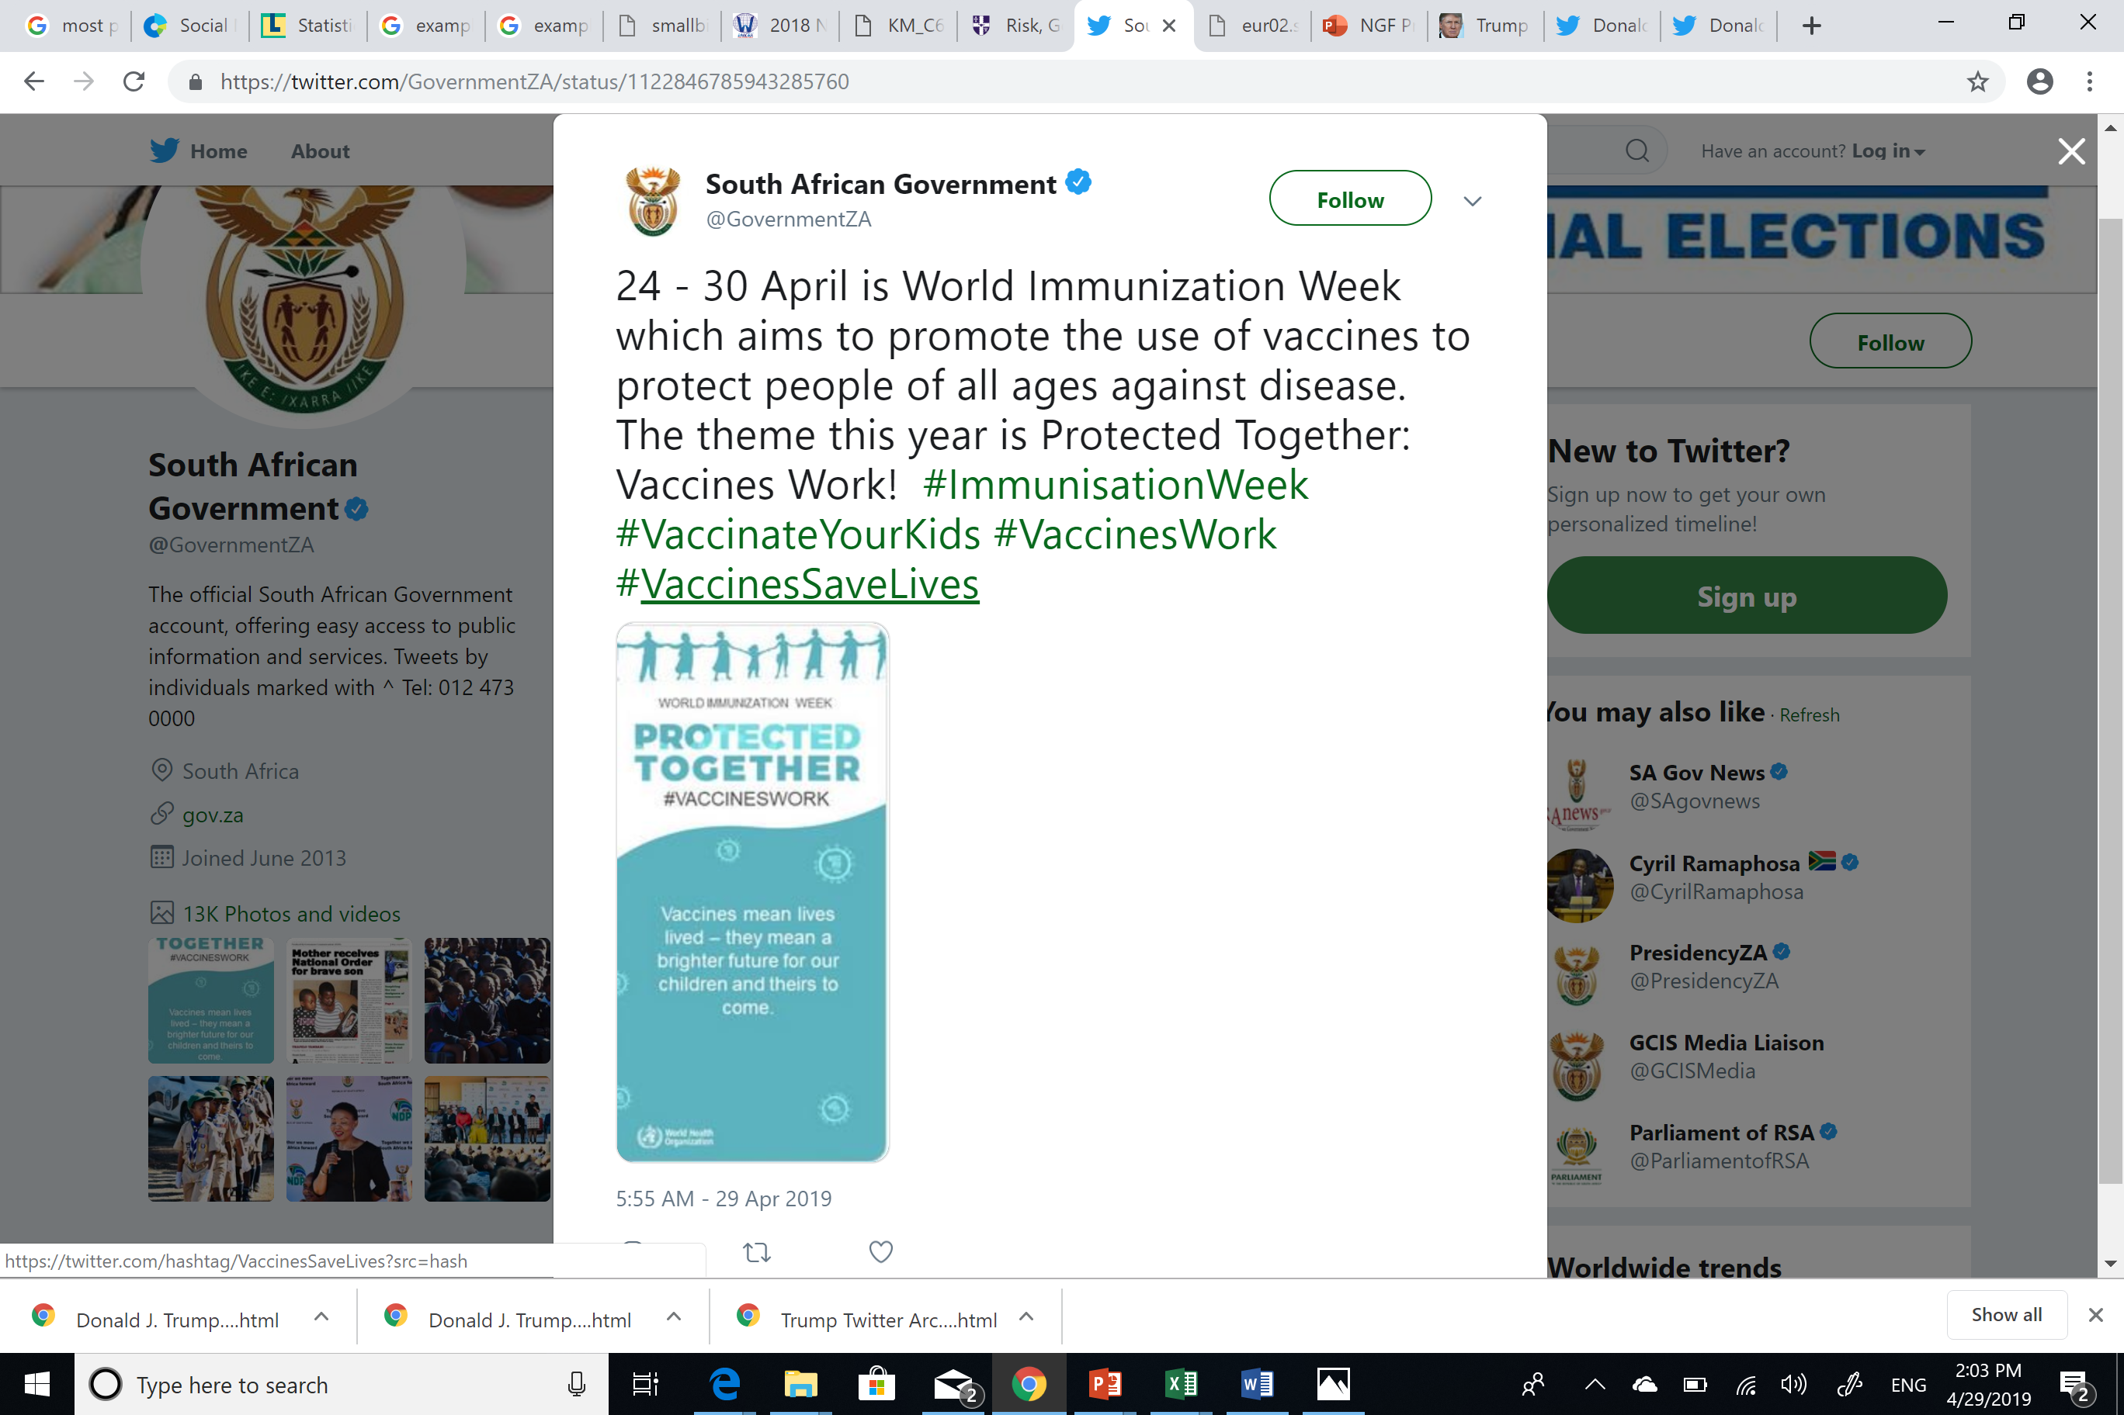

Slide 12
Social media: Friend or foe?
Gov. Ajimobi addressing university Students

Slide 13
Social media: Friend or foe?
Dr. Chris Ngige on Channels TV

Slide 14
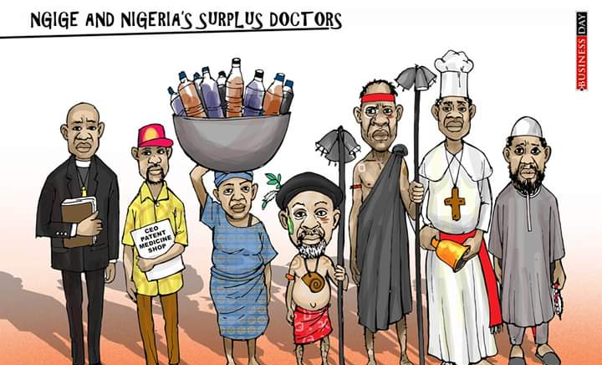

Slide 15
SOCIAL MEDIA IN GOVERNMENT: Game changer
Opportunities
Outcomes
A Tool to Change the Political Landscape
Metrics can tell us about people’s behaviour online
Understanding of citizens’ online behaviour gives government an opportunity to influence it
Engaged and educated citizens and ambassadors
Social Listening
Social Media provides opportunity for participatory governance
A two-way communication provides opportunity for government to engage citizens on a wide spectrum of concerns
Responsive Government Agencies
Spreading Information Efficiently
Information spreads faster and easier on social media
Tweets or Facebook posts can be put it in front of millions of people immediately with the tap of a button
Improved Efficiency
Improved service delivery to constituents
Costs Saving
Government can cut expenses by leveraging social media as a communication channel. Distribution of information is almost at low cost

Slide 16
Scenarios in governance
In 2018, the American city of Frisco, Texas ran a social media campaign it called 100 Days of Progress in Motion, which saw “City of Frisco” staff [produce] one video daily over a 100-day period, highlighting different city departments, services and news updates on the City’s Facebook, Twitter and YouTube accounts.
Day 1
Day 11
Day 55

Slide 17
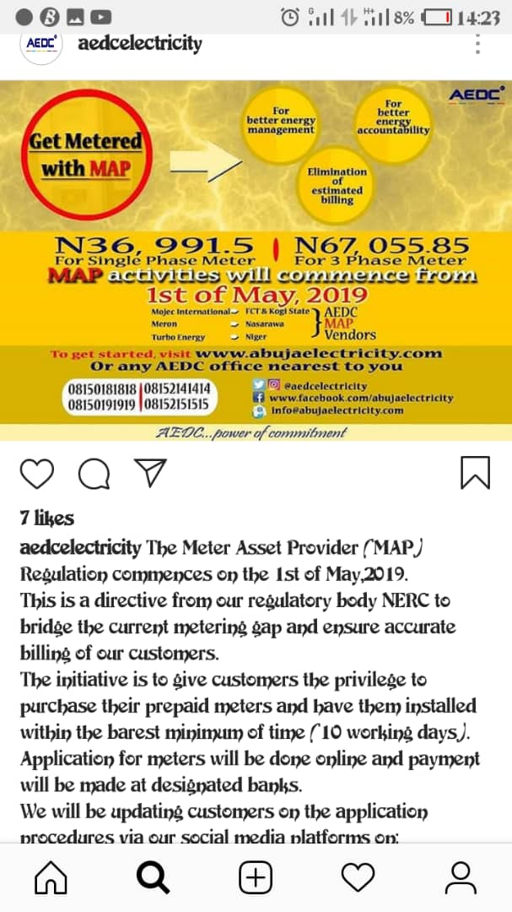
Abuja disco on instagram
Abuja DISCO has used it’s Instragram account to notify customers on new NERC regulation for provision of electricity meters

Slide 18
Innovative uses of the INTERNET & social media
Traffic Information & Management
Emergency Management
Financial Inclusion
Talent Recruitment
Citizen Engagement
Media Monitoring
Online Education & Learning
Performance Measurement & Feedback

Slide 19
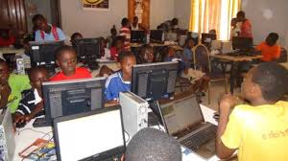
social & economic impact: public service delivery
Centralised Healthcare
Management
Tax & Revenue Collection
Government
Internet & Social Media
Public Internet
Access
Biometric Identity
Management
Land & Property
Registration
Citizens & Businesses
Digital Literacy

Slide 20
Risks of social media in governance
Controlling content
Privacy Issues
Fraud & Identity Theft
Misinformation
Compliance Issues

Slide 21
RECOMMENDATIONS
1. Develop a cohesive social media strategy
2. Build your following in advance
3. Build your government authority & credibility on social media
4. Make plans to own the narrative – before a crisis starts
5. Know how to respond to criticism online
6. Set benchmarks to measure impact.

Slide 22
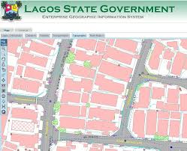
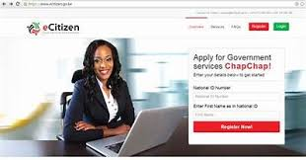
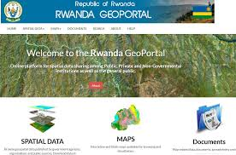
take your state online
KEY QUESTIONS
How interactive is your state government’s web presence?
Does it promote the opportunities in your state?
Does it enable delivery of public services?
Does your state portal expose local businesses?

Slide 23
Take action!
A. Develop a clear social media strategy & roadmap
B. Integrate your social media strategy into your overall
ICT Roadmap & e-Government strategy
C. Build social media awareness & capacity within your government

Slide 24
conclusion
Citizens & Businesses
The Internet and Social media enable state governments to improve service delivery to their constituents, build trust and collaboration.
However, to achieve these objectives, governments need to be strategic and professional in leveraging social media.
Social media programs should be integrated into a cohesive e-Government Strategy leveraging People, Processes & Technology.
Internet & Social Media
People
Processes
Technology
e-GOVERNMENT

Slide 25
CONTACTS GERALD C. ILUKWE – md/CE Knowledge resources limited 48 kitwe street wuse zone 4, abuja +234 8034021793 gilukwe@knowledgeresources.net

