Slide 1
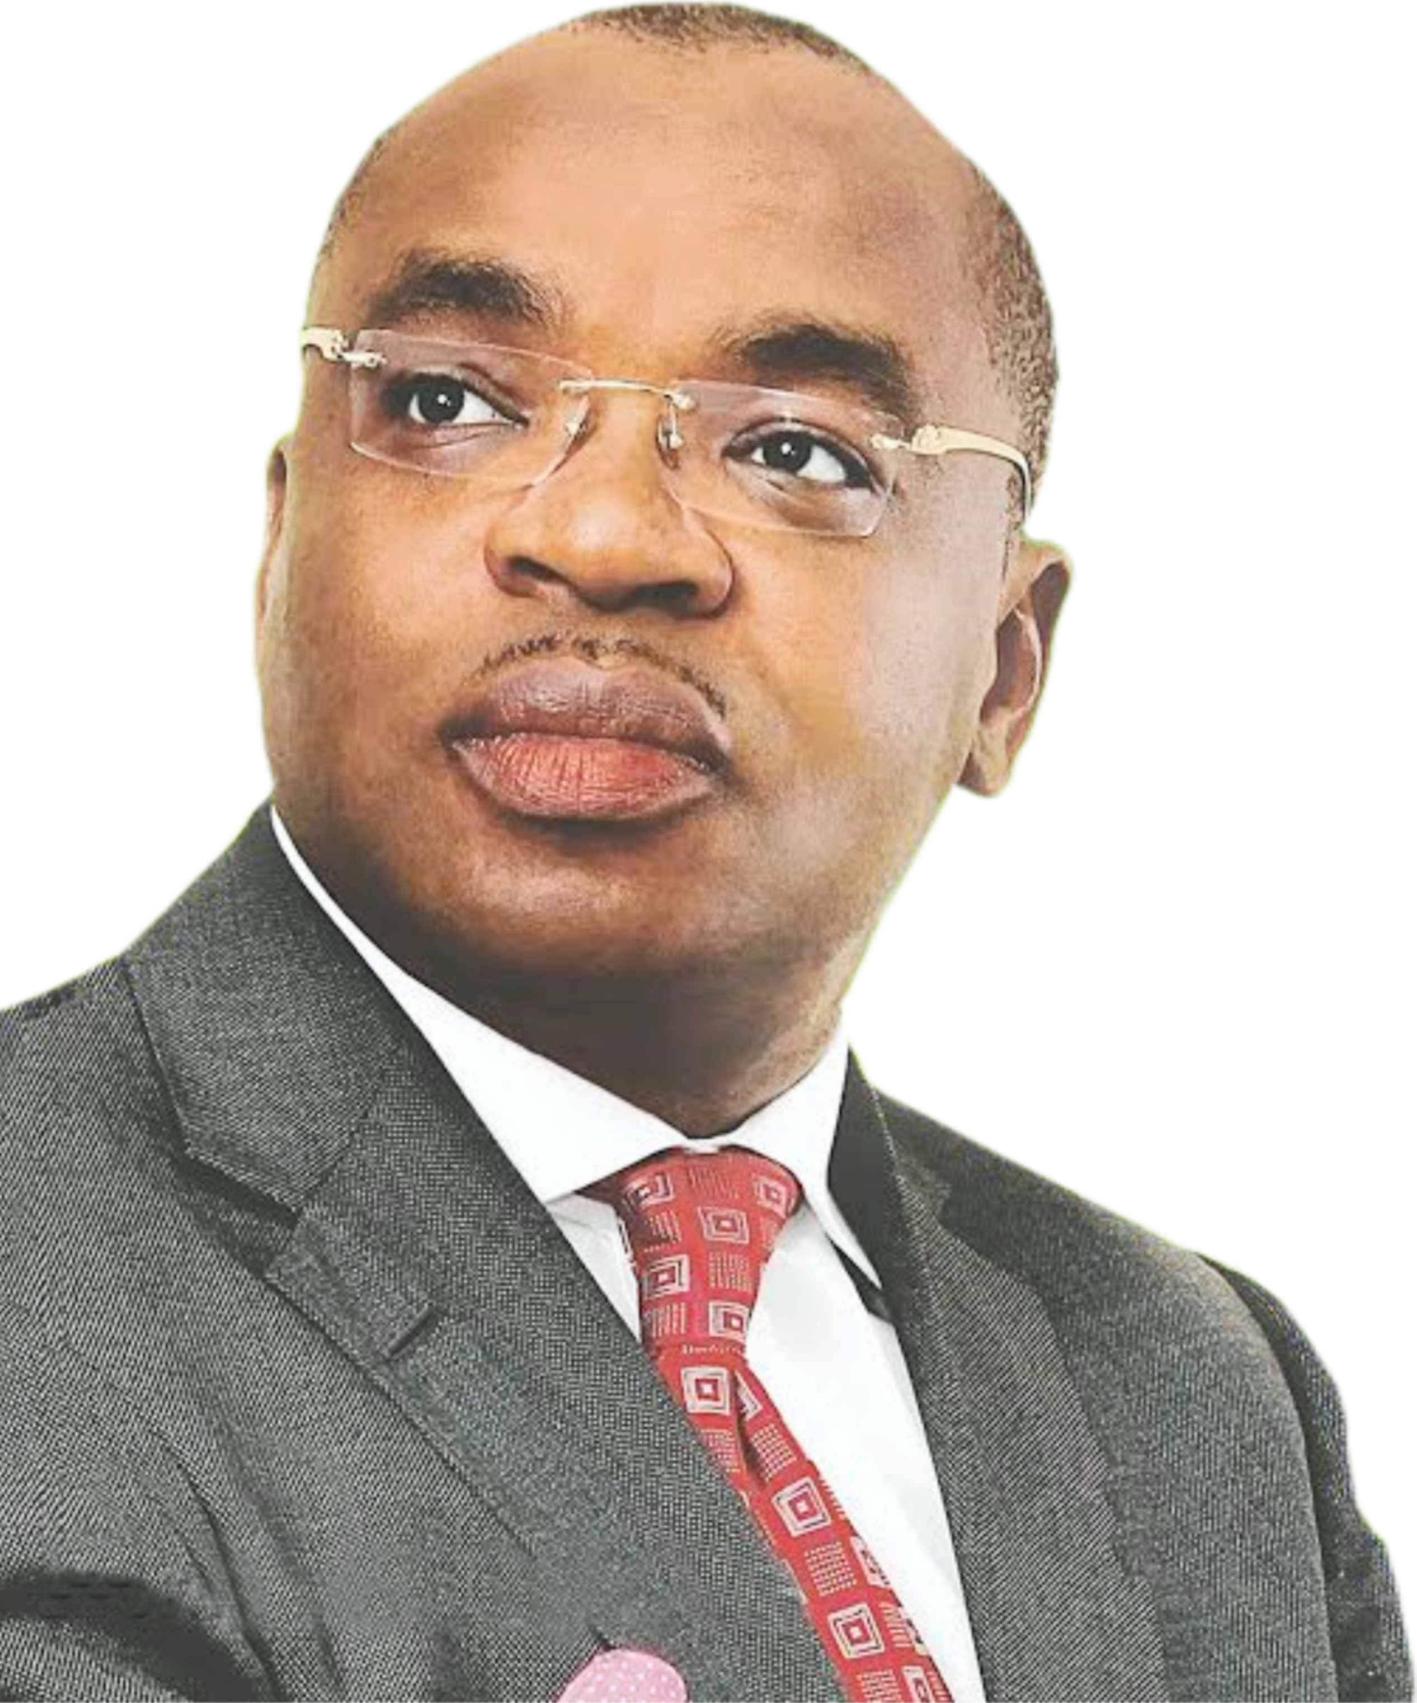
SETTING PRIORITIES, MANAGING PROGRAMMES AND PERFORMANCE EXPECTATION
A presentation by:
UDOM EMMANUEL,
GOVERNOR, AKWA IBOM STATE

Slide 2
SETTING PRIORITIES, MANAGING PROGRAMMES AND PERFORMANCE EXPECTATION
Setting priorities, Managing Programmes and Performance expectation [in governance] is simply, ‘articulating what should be done, how it should be done, who should do it and measurement of the impact’. While priorities connote the strategies, formulating strategic objectives is the WHAT, managing programmes is the HOW & WHO, and performance expectation is the MEASUREMENT of the impact.
This forms the three stages of this discourse:
STAGE 1: What
STAGE 2: How and Who
STATE 3: Impact assessment
OVERVIEW
UDOM EMMANUEL,
GOVERNOR, AKWA IBOM STATE

Slide 3
STAGE 1: WHAT (Setting Priorities/Strategic Objectives)
Governors who are desirous of improving governance should seek to prioritize their plans and programmes and formulate a medium to long term development blueprint. Setting Priorities/Strategic Objectives is the stage of drawing up strategies for governance direction in line with:
- The comparative advantage of the particular State
- Peculiar needs of the State.
- The Sustainable Development Goals
As a Chief Executive of the State, you must understand that SWOT, STEEP, etc are vital tools required for setting your agenda. While SWOT helps to clarify issues and identify the Strengths, Weaknesses, Opportunities and Threats in the State, STEEP x-rays its Sociological, Technological, Economic, Environmental and Political aspects.
EXECUTIVE
SUMMARY
UDOM EMMANUEL,
GOVERNOR, AKWA IBOM STATE

Slide 4
STAGE 1: Cont…
The critical areas to consider include:
- Education
- Health
- Job Creation
- Infrastructure
- Power
- Technology
For example in my State (Akwa Ibom), our comparative advantage include:
- Oil and Gas (Largest Reserves)
- Longest Shoreline (129km)
- Mineral (glass sand, clay etc)
- Good land for Agriculture, etc
- Deepest Natural Port (17.3 meters)
EXECUTIVE
SUMMARY
UDOM EMMANUEL,
GOVERNOR, AKWA IBOM STATE

Slide 5
STAGE 2: HOW & WHO (Managing Programmes/Implementation Strategies)
A well drawn up plan requires a proper management framework for implementation. Literarily, ‘as a Governor, how to execute your well articulated and prioritized strategic plan’ equates the concept of managing programmes.
An outline approach towards programme management is:
Each objective/strategy identified in Stage 1 must be meticulously translated into an implementable step or programme, complete with who will be responsible for implementation, framework for implementation, resources required, and results expected.
Every implementable step must be: Specific, Measureable, Attainable, Relevant and Time-bound (SMART)
EXECUTIVE
SUMMARY
UDOM EMMANUEL,
GOVERNOR, AKWA IBOM STATE

Slide 6
STAGE 2: cont…
Select capable hands (round pegs in round holes), ensure adequate buy-in to Stage 1, then assign them the task of implementation.
Build into the implementation plan milestones or timelines for reporting progress. (GANT Chart)
Strategies should be grouped into:
Low hanging fruits (immediate results, 1-3 months)
Short term (3-12 months)
Medium term (12-24 months)
Long term (24-48 months)
EXECUTIVE
SUMMARY
H.E. UDOM EMMANUEL,
GOVERNOR, AKWA IBOM STATE

Slide 7
STAGE 3: IMPACT ASSESSMENT (Performance Expectation/Measurement)
Having identified both development and implementation strategies, good performance is therefore expected, hence, the need for performance measurement using various tools to determine the level of performance using, for example, the balanced scorecard to measure the impact of projects.
Performance measurement is the process of checking to confirm if the actual results obtained from Stage 2 align with and match the objectives we set out to achieve in Stage 1. This process can only be successfully done if the implementation plan in Stage 2 was designed using the SMART template.
Performance of government must be measured timely in order to ensure that the expected result is achieved. Once performance measures are identified, they should be applied properly for regular monitoring, tracking and reporting in order to ascertain if target goals are met.
EXECUTIVE
SUMMARY
UDOM EMMANUEL,
GOVERNOR, AKWA IBOM STATE

Slide 8
STAGE 3: cont…
Performance measures should include top to bottom and bottom to top tools such as – 360 degree feedback and Key Performance Indicators
When performance is measured and the impact or result achieved meets the expectation, good performance must be rewarded while poor performance should be punished.
Where poor performance is noted, urgent steps must be taken to address identified anomalies.
EXECUTIVE
SUMMARY
UDOM EMMANUEL,
GOVERNOR, AKWA IBOM STATE

Slide 9
CONCLUSION
“
Strategic plans are not cast in hard stone once it is prepared. Rather, it should be seen as iterative documents – accordingly, it should be revisited periodically for updates where necessary, depending on changing economic and environmental parameters.
”
- UDOM EMMANUEL,
GOVERNOR, AKWA IBOM STATE

