Slide 1
Nigerian Digital economy: the role of states
'Lanré OSIBONA
SSA to the President on ICT & Snr. P.A to the Vice President.

Slide 2
The Fourth Industrial Revolution is upon us – Strategy for becoming a LEADER and not just a CONSUMER in the Global Digital Ecosystem.
2010
Digital Global Connectedness
1960
Satellite Communication & Computers
Sensors,BiG DATA, Predictive Analytics , Cognitive Computing, AI, 3D Printing
1870
Electrification & Automation
Embedded systems: Semiconductors, computers, information technologies and increase in trade
1783
Line
Production
Assembly systems: Lighting, electricity and assembly lines
Water, steam, and conveyors; modern materials handling
Era

Slide 3
Provocative Questions From Constituents
Citizen
‘Why should I trust you–how do I know that you will protect me, or that you won’t hurt me?’
‘How do I know that what you say is based on facts and real expertise?’
‘When I do business with different government agencies, why do I have to provide the same things over and over to get services I'm entitled to?’
Public Service Worker
‘Why is it so hard to collaborate across different agencies and levels of government and beyond?’
‘What’s truly preventing me from facilitating, serving and using my expertise at the point of need and why?’
‘Why can’t I get things done in more modern and more efficient ways in this job?’
Business/Industry
'Why can’t we get relevant, reliable business and government data when we need it to make better growth choices?’
’Why is removing barriers that just don’t make sense anymore or reducing burden so hard for me and easier for others?
‘Why is it so difficult to have meaningful regulatory, policy and program dialogue?’

Slide 4
Digital Economy
The digital economy refers to economic activities that use digitized information and knowledge as key factors of production.
Main ingredients include:
infrastructure (hardware, software, connectivity, human capital, etc.)
organizational/governmental processes optimized by technology
Transactions in goods through digital channels, e-commerce
Workforce and citizens with digital skills
Benefits
Democratization of opportunities: anyone in any part of the country can participate simply through access to the internet
Rise of e-commerce and tech-prenuership: the e-commerce sector is in overdrive as buying, distribution, marketing, creating, selling have all become easier (e.g Jumia, Alibaba)
Transparency: digital audit trails
Customer experience: interactions are seamless and personalized
Efficiency: transactions often happen in real-time, reducing time to value

Slide 5
Nigeria Digital Economy
As Pillar of Economic Growth
Entrepreneurship/Digital Skills
Social Inclusion
Fiscal Management
Services (private & public)
Social Investment (SDGs)
Transparency
Digital
Government
e-Commerce & Digital
Financial Services
Digital
Identity
Broadband
Internet
Notes:
Impetus of the FG to diversify the Nigerian economy by focusing on Digital Economy and our quest to creating skilled jobs
We missed the Agricultural and Manufactural industrial revolution, we must not miss this 4th Industrial Revolution which is DIGITAL
Demand for digital solutions is increasing sharply including in matters of development policy and operations
transparency - GIFMIS, IPPIS, BVN
efficiency of transactions and seamless exchange of data
Digital economy enabling business environment
Leveraging digital technologies for development - access to education
Where we can reinforce our efforts to build the digital economy

Slide 6
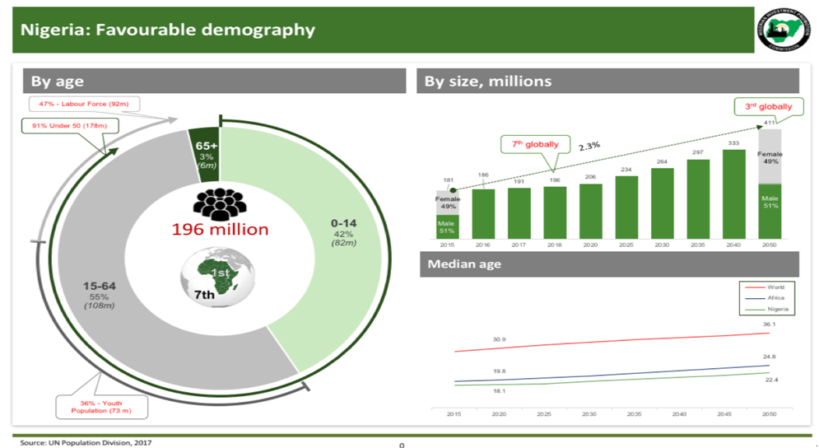
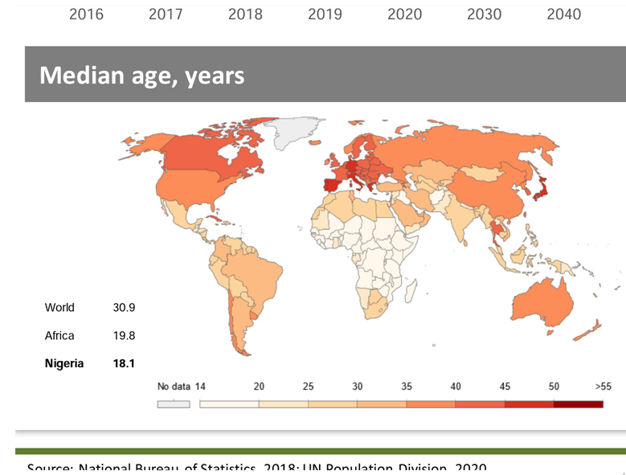
Nigeria TODAY: Socio-Economic Realities
High unemployment - 23.1% (Q3 2018)
Insecurity
Unskilled/Unmotivated workforce
Inadequate Digital Infrastructure

Slide 7
Challenges & Constraints to the Nigerian Digital Economy
Policy & Regulation: many governments do not have any clearly defined policy direction on technology beyond its traditional use, low adoption of technology by States as an enabler of their mandate
Digital Identity: anonymity of the citizens, poor budget planning/forecasting
Low Internet Penetration: only 50% of Nigerians are connected to the internet, compared to the global average of 57%, Kenya’s 84% and South Africa’s 54%.
Inadequate Infrastructures: insufficient broadband network hinged on protracted RoW disputes, funding, etc
Skills: difficulty in maintaining a workforce with the right skills, curriculum review in schools

Slide 8
Digital Economy Opportunities
Outsourcing: with a huge youth population, central time-zone and English language proficiency an advantage, any state in Nigeria can become an outsourcing center if underlying issues of infrastructure and skills are addressed
Government Productivity & Efficiency: technology adoption offers the opportunity to streamline government services and cut waste and duplication.
Revenue Generation: governments can monetise some services and enhance its revenue collection abilities by embracing emerging technology
Higher Value Extraction: tax revenues from successful entrepreneurs domiciled in states, and resultant job creation
Security: an advanced digital identity system provides for a more socially inclusive society, and opportunity to identify criminals and curb criminal activities

Slide 9
Key Steps for States to Leverage Digital Economy
Policy: create a robust, liberal strategy executed through a dedicated team with cross-agency mandate and recruit an expert in digital technology to lead it
Infrastructure: collaborate with the Federal Government (FG) in achieving a pervasive Mobile Broadband infrastructure across the country within the 4year period.
Digital Identity: collaboration with FG in the ongoing digital registration of citizens
Skills: emphasize investment in the right skills to future-proof workforce and local populace, through adoption of e-learning as a option for quality education.
Innovation Ecosystem: create an innovation ecosystem to serve as a revolving for talent and new initiative
PRAYER: The above points are captured in the communique of the Governors’ Forum Induction Programme

Slide 10
Thank you very much for listening your Excellencies

