Slide 1
Imperative for a Digital Nigeria
Presentation By
Jim Ovia, CON
Chairman, Zenith Bank Plc.
At
The Nigeria Governors' Forum Induction for Governors, 2019
Presidential Banquet Hall, State House, Abuja
Tuesday, April 30, 2019 | 2:30 PM – 3:30 PM
Notes:
Protocols/ Opening Pleasantries— Excellencies, distinguished guests, ladies and gentlemen. Good afternoon to all of you.
It is indeed a pleasure to be here today among stakeholders from diverse walks of life, and specifically to be among our distinguished returning, and newly elected governors who have been chosen to help pilot the affairs of their respective states, and this great nation for another four years.
I particularly will like to acknowledge the excellent job done by the executives and officials of the Nigeria Governors’ Forum in putting together this wonderful event, and most especially this afternoon’s session, on the Imperative for a Digital Nigeria.

Slide 2
Outline
Introduction (Singapore Airport)
Digital transformation
Key drivers of digital transformation
Ecosystem for digital economy
Revenue collection by states and the various approach of implementation
Digital Economies – Examples from around the world
Where are we?
Way forward
Concluding remarks

Slide 3
Inside Singapore Airport Lifestyle Hub

Slide 4
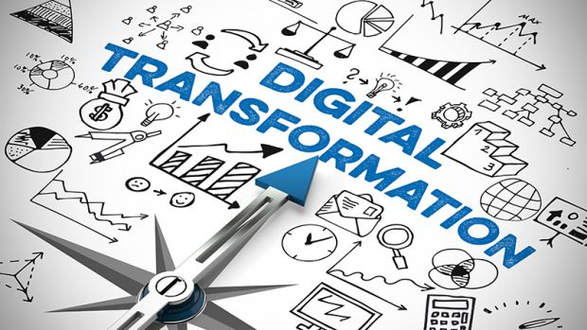
Digital Transformation
Defined as the use of technology to radically improve performance or reach of enterprises (Capgemini Consulting, 2017)
Not limited to disruption or technology
Extends to
Businesses
Governments
Public sector agencies and organizations that are involved in tackling societal challenges
Notes:
Digital Transformation
Defined as the use of technology to radically improve performance or reach of enterprises (Capgemini Consulting 2017).
Digital transformation is not just about disruption or technology (i-Scoop 2019).
Its impact can be felt by:
Businesses as well as governments, public sector agencies and organizations that are involved in tackling societal challenges.

Slide 5
Having a clear understanding of what digital means, allows business leaders to develop a shared vision of how it can be used to capture value (McKinsey & Company, 2015)
“Big expectations are riding on the continued expansion of the digital economy”, especially for its far-reaching social, political, and economic impact (WEF, 2014)
The concept of DIGITAL has gone from being an innovation to being indispensable
We now live in a digital world that cuts across all spheres of life
Digital has become the very core of the way we engage with each other
Digital affords us limitless opportunities
Potential to unlock growth
Digital revolution is fast transforming economies, businesses, and the lives of citizens
Notes:
Digital revolution is no longer a mere technical term in our lexicon. It has gone from being an innovation to being indispensable.
We are living in a digital world that cuts across all spheres of life. It extends beyond technology, and has become the very core of the way we engage with each other today at play, work, or in business.
Digital has proven to be the key to unlocking growth and hidden potentials, and I agree with McKinsey & Company that, having a clear understanding of what digital means, allows business leaders to develop a shared vision of how it can be used to capture value (McKinsey & Company 2015).
Digital therefore, affords us limitless opportunities.

Slide 6
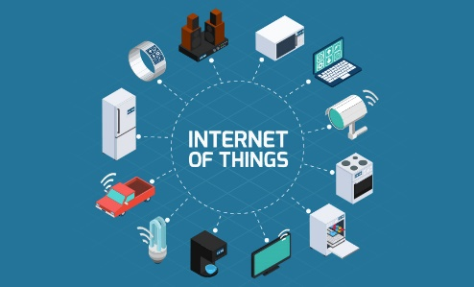
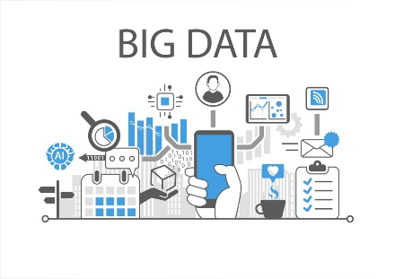
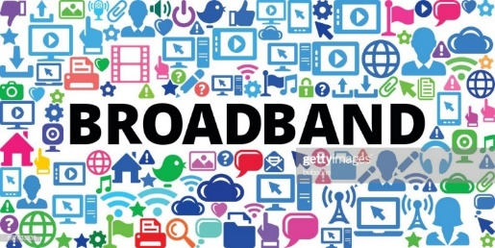
Key Drivers of Digital Transformation
Artificial Intelligence
Digital economy can only flourish within the right digital ecosystem
Notes:
We cannot stress enough the significance of the digital economy.
Digital transformation will provide a future powered by big data, artificial intelligence (AI), the internet of things (IOT), and broadband infrastructure.
A future where connectivity, high speed internet, mobile and the cloud promises to drastically transform and revolutionize the way we live, work and interact.

Slide 7
Ecosystem for Digital Economy
Broadband Technology, Connectivity for Development
Digital Identity Building a smarter, safer community
Digitizing Government Processes Roadmap to achieving digital goals
Capacity Development Internet governance, infrastructure and technical standards, cybersecurity, IT in schools curriculum

Slide 8
Government Processes and Revenue Generation
Revenue generation is a critical aspect of government
It is the nucleus and the path to actual development
It enables the provision of infrastructure
Security
Service delivery
The social contract between citizens and government can be fulfilled with the judicious management of generated revenue
Sources of revenue in Nigeria
Internally generated revenue (IGR)
Taxes, levies etc.
FAAC

Slide 9
TOTAL REVENUE AND REVENUE PER CAPITA AT STATE LEVEL - 2017 FISCAL YEAR
STATE | TOTAL STATE GENERATED REVENUE (₦) | NET FACC ALLOCATION (₦) | TOTAL REVENUE AVAILABLE (₦) | POPULATION | REVENUE PER CAPITA (₦)
ABIA | 14,917,141,805.80 | 38,876,702,908.70 | 53,793,844,714.50 | 4,100,235 | 13,119.70
ADAMAWA | 6,201,369,567.23 | 37,436,462,193.81 | 43,637,831,761.04 | 3,756,000 | 11,618.17
AKWA IBOM | 15,956,354,035.30 | 143,614,945,782.83 | 159,571,299,818.13 | 5,600,000 | 28,494.87
ANAMBRA | 17,365,385,830.51 | 41,338,238,321.08 | 58,703,624,151.59 | 5,900,000 | 9,949.77
BAUCHI | 4,369,411,450.27 | 39,515,179,181.38 | 43,884,590,631.65 | 4,653,066 | 9,431.33
BAYELSA | 12,523,812,450.59 | 105,258,243,351.38 | 117,782,055,801.97 | 2,321,000 | 50,746.25
BENUE | 12,399,414,557.79 | 39,801,371,551.26 | 52,200,786,109.05 | 4,892,365 | 10,669.85
BORNO | 4,983,331,049.24 | 46,535,736,179.12 | 51,519,067,228.36 | 4,917,000 | 10,477.74
CROSS RIVER | 18,104,562,225.62 | 23,451,782,733.00 | 41,556,344,958.62 | 3,218,000 | 12,913.72
DELTA | 51,888,005,338.33 | 111,203,709,891.98 | 163,091,715,230.31 | 5,800,000 | 28,119.26
EBONYI | 5,102,902,366.82 | 35,490,890,739.38 | 40,593,793,106.20 | 3,000,000 | 13,531.26
EDO | 25,342,829,212.22 | 36,844,999,470.24 | 62,187,828,682.46 | 4,600,000 | 13,519.09
EKITI | 4,967,499,815.79 | 25,633,665,721.07 | 30,601,165,536.86 | 3,400,000 | 7,171.39
ENUGU | 22,039,222,902.86 | 37,833,557,959.83 | 59,872,780,862.69 | 4,267,120 | 14,031.19
GOMBE | 5,272,273,408.28 | 31,232,979,502.22 | 36,505,252,910.50 | 3,365,230 | 10,847.77
IMO | 6,850,796,866.07 | 38,116,470,854.23 | 44,967,267,720.30 | 4,927,000 | 9,126.70
JIGAWA | 6,650,200,980.11 | 45,264,749,165.00 | 51,914,950,145.11 | 6,200,000 | 8,373.38
KADUNA | 26,530,562,880.89 | 50,807,097,529.87 | 77,337,660,410.76 | 8,600,000 | 8,992.75
Source: National Bureau of Statistics; BusinessDay.ng; Worldpopulationreview.com

Slide 10
TOTAL REVENUE AND REVENUE PER CAPITA AT STATE LEVEL - 2017 FISCAL YEAR (CONTD)
STATE | TOTAL STATE GENERATED REVENUE (₦) | NET FACC ALLOCATION (₦) | TOTAL REVENUE AVAILABLE (₦) | POPULATION | REVENUE PER CAPITA (₦)
KANO | 42,418,811,470.64 | 65,140,059,241.98 | 107,558,870,712.62 | 13,980,000 | 7,693.77
KATSINA | 6,029,850,857.76 | 46,339,868,732.24 | 52,369,719,590.00 | 8,300,000 | 6,309.60
KEBBI | 4,393,773,965.39 | 40,076,938,773.08 | 44,470,712,738.47 | 4,600,000 | 9,667.55
KOGI | 11,244,260,974.75 | 39,646,840,921.91 | 50,891,101,896.66 | 4,700,000 | 10,827.89
KWARA | 19,637,873,512.22 | 33,107,193,728.78 | 52,745,067,241.00 | 3,400,000 | 14,967.97
LAGOS | 333,967,978,880.44 | 89,694,754,919.47 | 423,662,733,799.91 | 12,900,000 | 32,842.07
NASARAWA | 6,174,136,952.59 | 35,197,763,035.01 | 41,371,899,987.60 | 3,101,000 | 13,341.47
NIGER | 6,517,939,033.07 | 42,473,678,019.42 | 48,991,617,052.49 | 4,121,003 | 11,888.28
OGUN | 74,835,979,000.51 | 26,185,030,796.12 | 101,021,009,796.63 | 4,750,120 | 21,267.04
ONDO | 10,927,871,479.76 | 45,897,247,825.41 | 56,825,119,305.17 | 4,405,000 | 12,900.14
OSUN | 11,731,026,444.38 | 10,436,789,071.79 | 22,167,815,516.17 | 4,416,000 | 5,019.89
OYO | 22,448,338,824.61 | 44,473,339,482.90 | 66,921,678,307.51 | 8,000,000 | 8,365.21
PLATEAU | 10,788,283,409.45 | 29,620,161,161.72 | 40,408,444,571.17 | 4,500,000 | 8,979.65
RIVERS** | 89,484,983,409.10 | 119,632,192,162.38 | 209,117,175,571.48 | 7,400,000 | 28,259.08
SOKOTO | 9,018,844,307.29 | 41,243,655,071.76 | 50,262,499,379.05 | 5,300,000 | 9,483.49
TARABA | 5,764,251,233.85 | 33,922,215,995.69 | 39,686,467,229.54 | 2,895,000 | 13,708.62
YOBE | 3,598,131,936.59 | 39,493,537,224.68 | 43,091,669,161.27 | 3,300,000 | 13,058.08
ZAMFARA | 6,023,994,930.94 | 28,452,828,222.31 | 34,476,823,153.25 | 4,600,000 | 7,494.96
TOTAL | 936,471,407,367.06 | 1,739,290,877,423.01 | 2,675,762,284,790.07 | 188,185,139 | 14,089.14
Source: National Bureau of Statistics; BusinessDay.ng; Worldpopulationreview.com

Slide 11
REVENUE PER CAPITA (₦) AT STATE LEVEL – 2017 FISCAL YEAR

Slide 12
Digitizing Government Processes: Roadmap To Achieving Digital Goals
Governments digitization efforts mostly anchored on four capabilities
Services, Processes, Decisions, and Data sharing (McKinsey & Company, 2016)
Benefits of digitizing government processes
Using current technology, digitizing government processes could generate over $1 trillion annually worldwide (McKinsey & Company, 2016)
About 1.7% of Nigeria’s GDP could be generated every year by digitalizing government payments (IMF, 2017)
Achieving digital goals requires innovation-friendly policies and regulatory environment

Slide 13
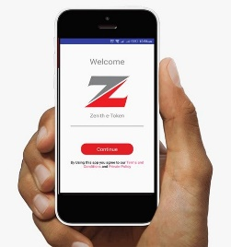
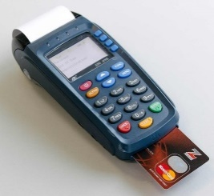
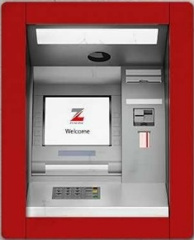
Revenue Collection By States And The Various Approach of Implementation
ICT can aid in the development of an integrated revenue collection system
Ensure a more efficient means of collection
Enhance the decision making process through
Improved data collection
Visual data representation
Analytical metrics
Transparent billing, payment and remittance
Eliminate the problem of high collection costs, fraud, underpayment and revenue leakages
Mobile App
POS
Integrated Revenue Collection System
USSD
ATM
QR Code
Various electronic channels of revenue collection

Slide 14
Digital Economies – Some Global Examples
1. use
Estonia
Public Services:
Revenue Collection: e-solution platforms with secure digital identities are provided to citizens to pay government revenues.
Registrations: Businesses, car licensing, government contracts are done with digital tools.
99% of public services are now available to Estonians as e-services.
e-Tax: Taxes are paid in one click – all you need is 3-5 minutes for the tax filing and it is done.
Around 95% of all tax declarations are filed electronically.
Blockchain Revolution since 2012 has helped to solve many of the problems that data governance professionals have been trying to solve for years: national health, judiciary, legislative, security and commercial code systems, cyber security etc.
The use of IT tools in the security services e.g. e-police, rescue board, emergency centres has resulted in a 50% decline in the number of deaths recorded in the last 2 decades.

Slide 15
Digital Economies – Some Global Examples
1. use
China: 802 million internet users and 470 million online-government users (60% of all internet users in the country) (June 2018)
Public Services:
Revenue Collection: Computerized tax collection system prevents tax evasion and fraud, and reduces tax losses. It also allows customs department to verify a range of data to facilitate customs management.
Golden Card: Creates a unified payment settlement system to enable the wide use of credit and debit cards.
Golden Quality: Enhances regulation, quality, transparency and service orientation of government agencies in quality control activities like certifications of products & services.
Golden Shield: Strengthens central police control, responsiveness and crime-fighting capacity.
Digital Tools Application Use: More than 80% for financial management system and over 75% for security system.
Singapore
Public Services:
Revenue Collection: Online channels are made available to citizens to pay government revenues.
Registrations: Businesses, car licensing, government contracts are carried out digitally.
87% of the people are satisfied with the quality of the government’s e-services.
e-Tax: Digitized tools are deployed in the country’s tax processing and payment systems.
More than 95% of all tax declarations are filed electronically.
e-Contracts: The procurement system is electronically driven. Very transparent tender and vetting system.

Slide 16
Digital Economies – Some Global Examples
1. use
Sweden: More than 80% of Sweden citizens use e-government services compared with OECD’s average rate of 50%.
Internet Penetration: 89.14% in 2015, projected to reach 92.87% in 2022
Public Services:
Revenue Collection: All public service related activities are done online.
e-Tax: Filling of tax returns and payments of taxes are electronically carried out. The payment solution is real-time using mobile phone etc.
Registrations: Car licensing, passports, insurance, residency, company etc are provided via e-services.
Security: A system that allows for crime reporting online is in place.
e-Contracts: Online platform maintained by the Public Procurement Board. It provides information on tenders and tender procedure for suppliers and authorities.
South Korea
Public Services:
Registrations: e-platforms are available for government services e.g car licensing etc
Tax services: Filing, billing and payment of taxes are processed online and information can be retrieved anytime by taxpayers.
e-gov: People can request for over 5,000 services online without visiting administrative offices and receive results by regular email.
Government for Citizen: e-Auditing System, e-National Assembly, Government e-Procurement System, e-Approval & e-Document Exchange, e-Signature & e-Seal System etc

Slide 17
Digital Economies – Some Global Examples
1. use
New Zealand
Public Services:
Revenue Collection: e-public revenue collection system that ensures efficiency in public processes is in place.
e-Tax: Filling of tax returns and payments of taxes are electronically carried out. Unified digital payment system is also operational. It enhances transparency and openness.
Registrations: Car licensing, certifications of products and services are done via online platforms.
Security: The policing control in the areas of crime control capability and responsiveness is electronically enabled real-time.
e-Contracts: Public contracting and vetting system is e-service driven; it enforces transparency in the system.
Malaysia
Public Services:
Revenue Collection: Public revenue collections are carried out on the government’s e-services platform.
Registrations: Businesses, duties and car licensing are registered via digital tools.
e-Tax: Tax returns filling and payment of all government taxes are made online.
e-Procurement: Public contracts and vetting process are advertised online for citizens’ participation. Faster turn-around time in processing procurement transactions.
e-Project Monitoring System: Improve regulation, transparency, accountability and quality of service delivery across government agencies.
e-Syariah: Provides efficient and quality management of judicial process.

Slide 18
Digital Economies – Some Global Examples
1. use
India
Public Services:
Revenue Collection: Public revenue collections are being done online.
e-Tax: A growing e-channel driven tax return and tax payment system.
Registrations: Lands, car licensing, permits – ensuring that landowners get computerized copies of ownership, crop and tenancy and updated copies of Records of Rights on demand.
e-Procurement: Reduces the time and cost of doing business for both vendors and government.
Security: Enhances the effective policing at all levels and creation of IT-enabled state-of-the-art tracking system.
Aadhar Enabled Payment System (AEPS): A bank led model which allows online interoperable financial inclusion transaction via any bank using the authentication code.
UAE
Public Services:
Revenue Collection: e-channels are provided for public revenue collections.
e-Tax: The UAE does not levy tax on individuals. However, corporate tax, excise tax and VAT are electronically paid.
Registrations: Car licensing, permits and businesses registrations etc are done online.
Security: There is a robust policing system that is digitally driven and helps to control crime in the country.
e-Contracts: The public procurement system is ICT driven and highly transparent.

Slide 19
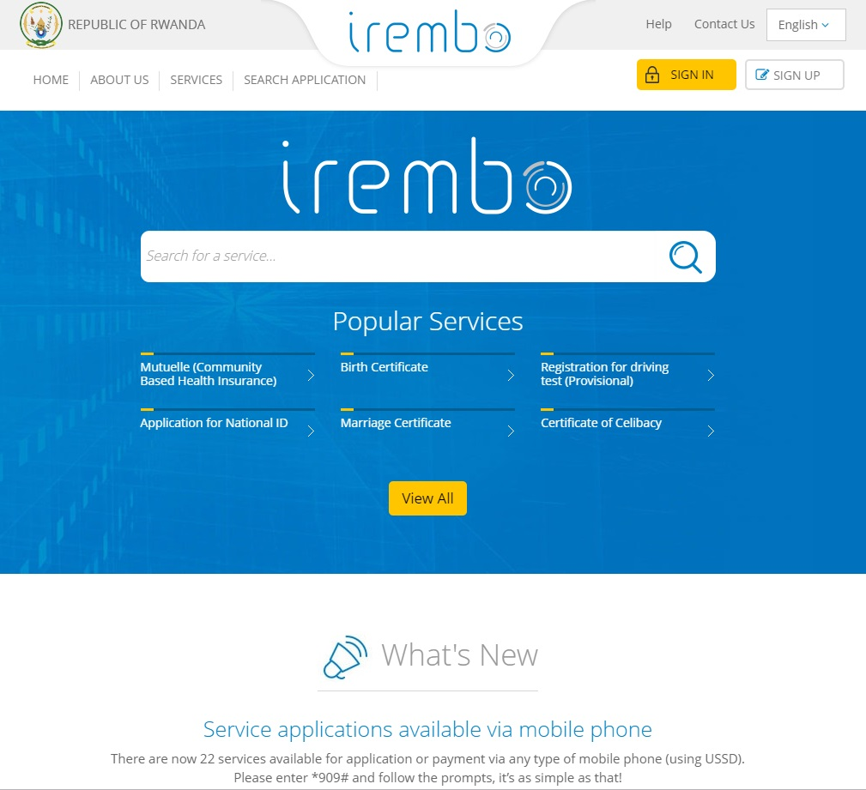
Digital Economies – Sub-Saharan Africa: Rwanda (An ICT-centric and innovation-prone nation)
Aggressive digital strategy by Paul Kagame’s government to transform the country into a knowledge based-economy” (ITU 2017)
Institution of the necessary infrastructure and environment that supports digital transformation
Irembo.gov.rw
A highly functional e-government platform which serves as a one-stop portal for government services administered online with ease, efficiency and reliability
Perfect example of how the proper policies and regulatory support can spur fantastic innovation in an emerging economy
Source: https://irembo.gov.rw/rolportal/en/home

Slide 20
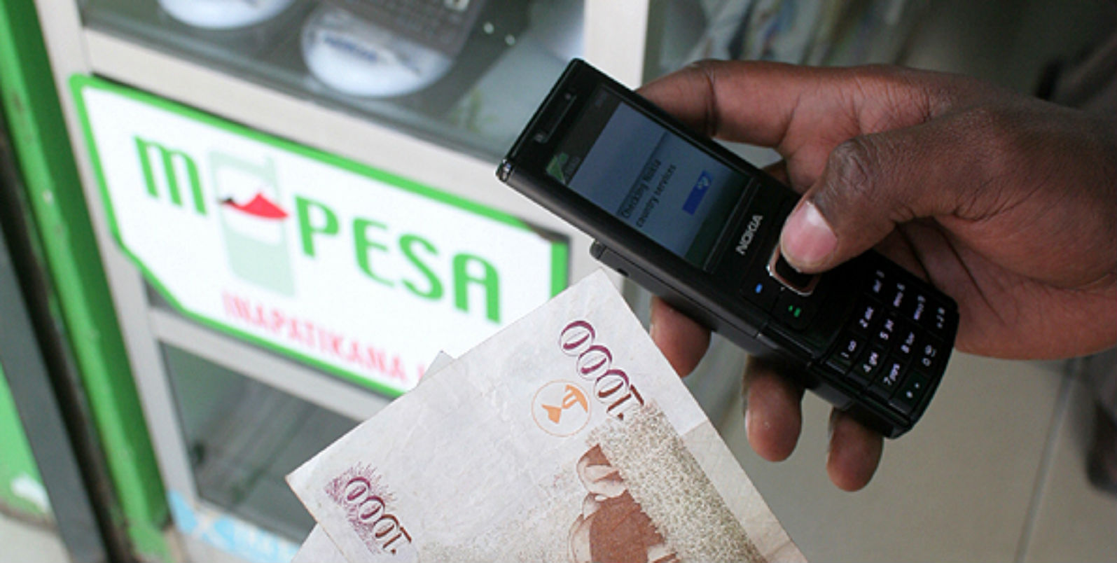
Digital Economies – Sub-Saharan Africa: Kenya
An impressive digital economy ecosystem
Remarkable achievements in e-commerce, money transfer, mobile banking, agriculture, health and e-government
M-Pesa
One of the most remarkable digital tools
Mobile money
Financial Inclusion
Source: https://businesstoday.co.ke/safaricom-inks-deal-with-paypal-to-boost-ecommerce/

Slide 21
Digital Economies – Sub-Saharan Africa: Ghana
Significant contributions by the government of Ghana towards the development of ICTs under the e-Ghana and e-Transform projects
The Ghana Shared Growth and Development Agenda (GSGDA)
Increased use of ICT across economic sectors
e-government and implementation of the National Electronic Security System
Proliferation of other ICT-related mechanisms for public benefit
Targeted projects by the National Information Technology Agency and the Ghana Investment Fund for Electronic Communication ensured:
Stable growth in the use of ICTs
Very favorable environment for further development and deployment of e-government mechanisms

Slide 22
Digital Economies – Sub-Saharan Africa: South Africa
Electronic Communications Act: South Africa Connect
An ambitious national broadband strategic plan which aims to deliver affordable broadband access to 90% of the country's population by 2020, and 100% by 2030 (WEF, 2016)
Strategy to create a dynamic and connected knowledge economy that is more inclusive, equitable and prosperous
VULA Mobile
Secure medical referral and chat application
Medical diagnosis app that connects health workers with specialists

Slide 23
Where Are We? – Nigeria’s Present Situation
Progress is being made, albeit slowly ….
Broadband has predominantly been facilitated via mobile networks
33.08% penetration with 63.14 million subscribers as of February 2019
We surpassed the 30% broadband penetration target by 3 percentage point in February, 2019 (NCC 2019)
Teledensity of 124.5% and a subscription base of 173.67 million subscribers as at 2018
Internet subscriber base of 114.73 million as of February 2019
(NCC 2019)
However, Nigeria ranks among the countries with the slowest internet speed
108th out of 139 countries at 13.41 Mbps (Speedtest, 2019)

Slide 24
Where Are We? – Nigeria’s Present Situation
Some states have deployed commendable ICT projects
Kaduna – Broadband equipped Kaduna ICT Hub
Lagos – E-Government Platform
Electronic Tax Clearance Certificate (e-TCC) and e-Revenue collection
Delta State – ICT Innovation Hub
Akwa-Ibom – Nigerian Content Development and Monitoring Board (NCDMB) ICT Centre
More needs to be done especially in the area of ICT infrastructure and policy

Slide 25
Way Forward
Develop and implement pro-innovation policies as exemplified by the Governments of Florida, and Maharashtra.
Florida is Open -
Governor Ron DeSantis welcomes Amazon to put its second HQ in Florida after the online retailer pulled out of a deal to build its campus in New York City (Miami Herald 2019)
Benefits forfeited by New York
40,000 jobs to the area
Projected revenue increase of $27 billion in exchange for an approximately $3 billion incentive package from state and local governments (CNBC 2019)
MUMBAI, INDIA
Government of Maharashtra approved the Fintech policy of the State and the setting up of the “Global Fintech Hub” in the Mumbai Metropolitan Region
Incentives to start ups
Provision of physical infrastructure
Reimbursement of:
Internet and electricity charges
Expenditure towards hosting infrastructure
State Goods and Service Tax
GovTech - Funding and encouragement for start-ups involved in Blockchain, AI, IOT solutions for improved governance in the State
(Government of Maharashtra 2018)

Slide 26
Way Forward
Encourage collaboration and sharing of ideas
Create a community of practitioners consisting of the government, private sector, and academia
Review the academic system to reflect a more forward-looking curriculum
Students should be prepared for the workplace of the future
Keep the Fourth Industrial Revolution (4IR) in the horizon
Investment in capacity development by both the government and corporate sector
Co-ordinated effort towards digital skills development
Nigerian youth should be encouraged to be more of developers of ICT applications than mere consumers

Slide 27
Concluding Remarks
Leverage the abundant human capacity and resources in Nigeria
Replicate successful models from other emerging economies
Create ICT platforms tailored towards government service delivery, as well as awareness and enlightenment on how to use ICTs to gain better access to government services

Slide 28
Quotes of a Tech Guru: Bill Gates’ Comments on the Power of Digital Finance in Nigeria
“In a country where ¾ of people have mobile phones,.. digital finance offers the potential to boost the economy from top to bottom.
Right now, more than 50m Nigerians are at the whim of chance and the informal economy. With access to digital financial tools, they can cope better with disasters that threaten to wipe them out, build assets and gradually lift themselves out of poverty.
Consider the impact this would have on businesses. Of the 37m micro, small, and medium enterprises in Nigeria, more than 99% are micro. According to the best estimates, digital financial services will create a 12.4% increase in Nigeria’s GDP by 2025. Meanwhile, oil accounts for about 10% of Nigeria’s GDP. Imagine adding another oil sector and then some to the economy, but one whose benefits spread far and wide and reach almost every single Nigerian”

Slide 29
THANK YOU
www.zenithbank.com
…in your best interest
20

