Slide 1
BUILDING FOUNDATIONS, INSPIRING FUTURES: THE EVOLUTION OF THE NIGERIA GOVERNORS’ LIBRARY FROM INCEPTION TO INNOVATION
NAOMI UBOGU, MA, CLN, PMIIM

Slide 2
Content
Overview
Key Achievements
Personal Impact & Contributions
General Impact of the NGF library
The Evolution of the NGF library
Transformation of the NGF library
The transformed NGF library in pictures
Sustainability of the NGF library
Continuous Growth as a librarian and information professional
Review
Stand out from the crowd
Conclusion

Slide 3
OVERVIEW
As Senior Librarian/Manager at the Nigeria Governors' Forum Secretariat, I led transformative initiatives to transform knowledge management and archival practices.

Slide 4
Key Achievements
Established both physical and digital libraries from the scratch, enhancing accessibility to information.
Developed a cutting-edge digital repository (https://ngfrepository.org.ng:8443/jspui/) and e-library (https://ngflibrary.org.ng/) using Dspace and Koha Integrated Library Software.
Implemented robust records management systems for efficient document preservation and retrieval.

Slide 5
Personal Impact & Contributions
Impact
Facilitated seamless access to a wealth of knowledge, empowering stakeholders for informed decision-making.
Safeguarded invaluable organizational assets through best practices in document collection and archiving.
Contributions:
Shared insights through publications, presentations, and training programs on library setup and digital repository navigation. (See publication links at the end of the slide)
Cultivated a culture of continuous learning and collaboration within the organization.

Slide 6
General Impact of the NGF library
Case Study to set up libraries in state and MDA’s
Enhanced Access to Information: By providing access to a diverse range of resources, the NGF library empowers governors, policymakers, researchers, and other stakeholders with timely and relevant information.
Knowledge Sharing and Collaboration: The library serves as a hub for knowledge exchange and collaboration among governors and their teams.
Facilitation of Research and Analysis: Researchers, analysts, and policymakers leverage on the library's resources to conduct in-depth research and analysis on various topics relevant to governance.
Documentation and Archiving: The NGF library plays a crucial role in documenting and archiving important documents, reports, and publications related to governance. This ensures the preservation of institutional memory and facilitates easy access to historical records for future reference and analysis.

Slide 7
The Evolution of the NGF Library
The project commenced in August 2018 with the very first library in a small space with few bookshelves and reader’s section. As the library collections and patron usage continue to grow; there was need to transform the library into a bigger and befitting modern library.

Slide 8
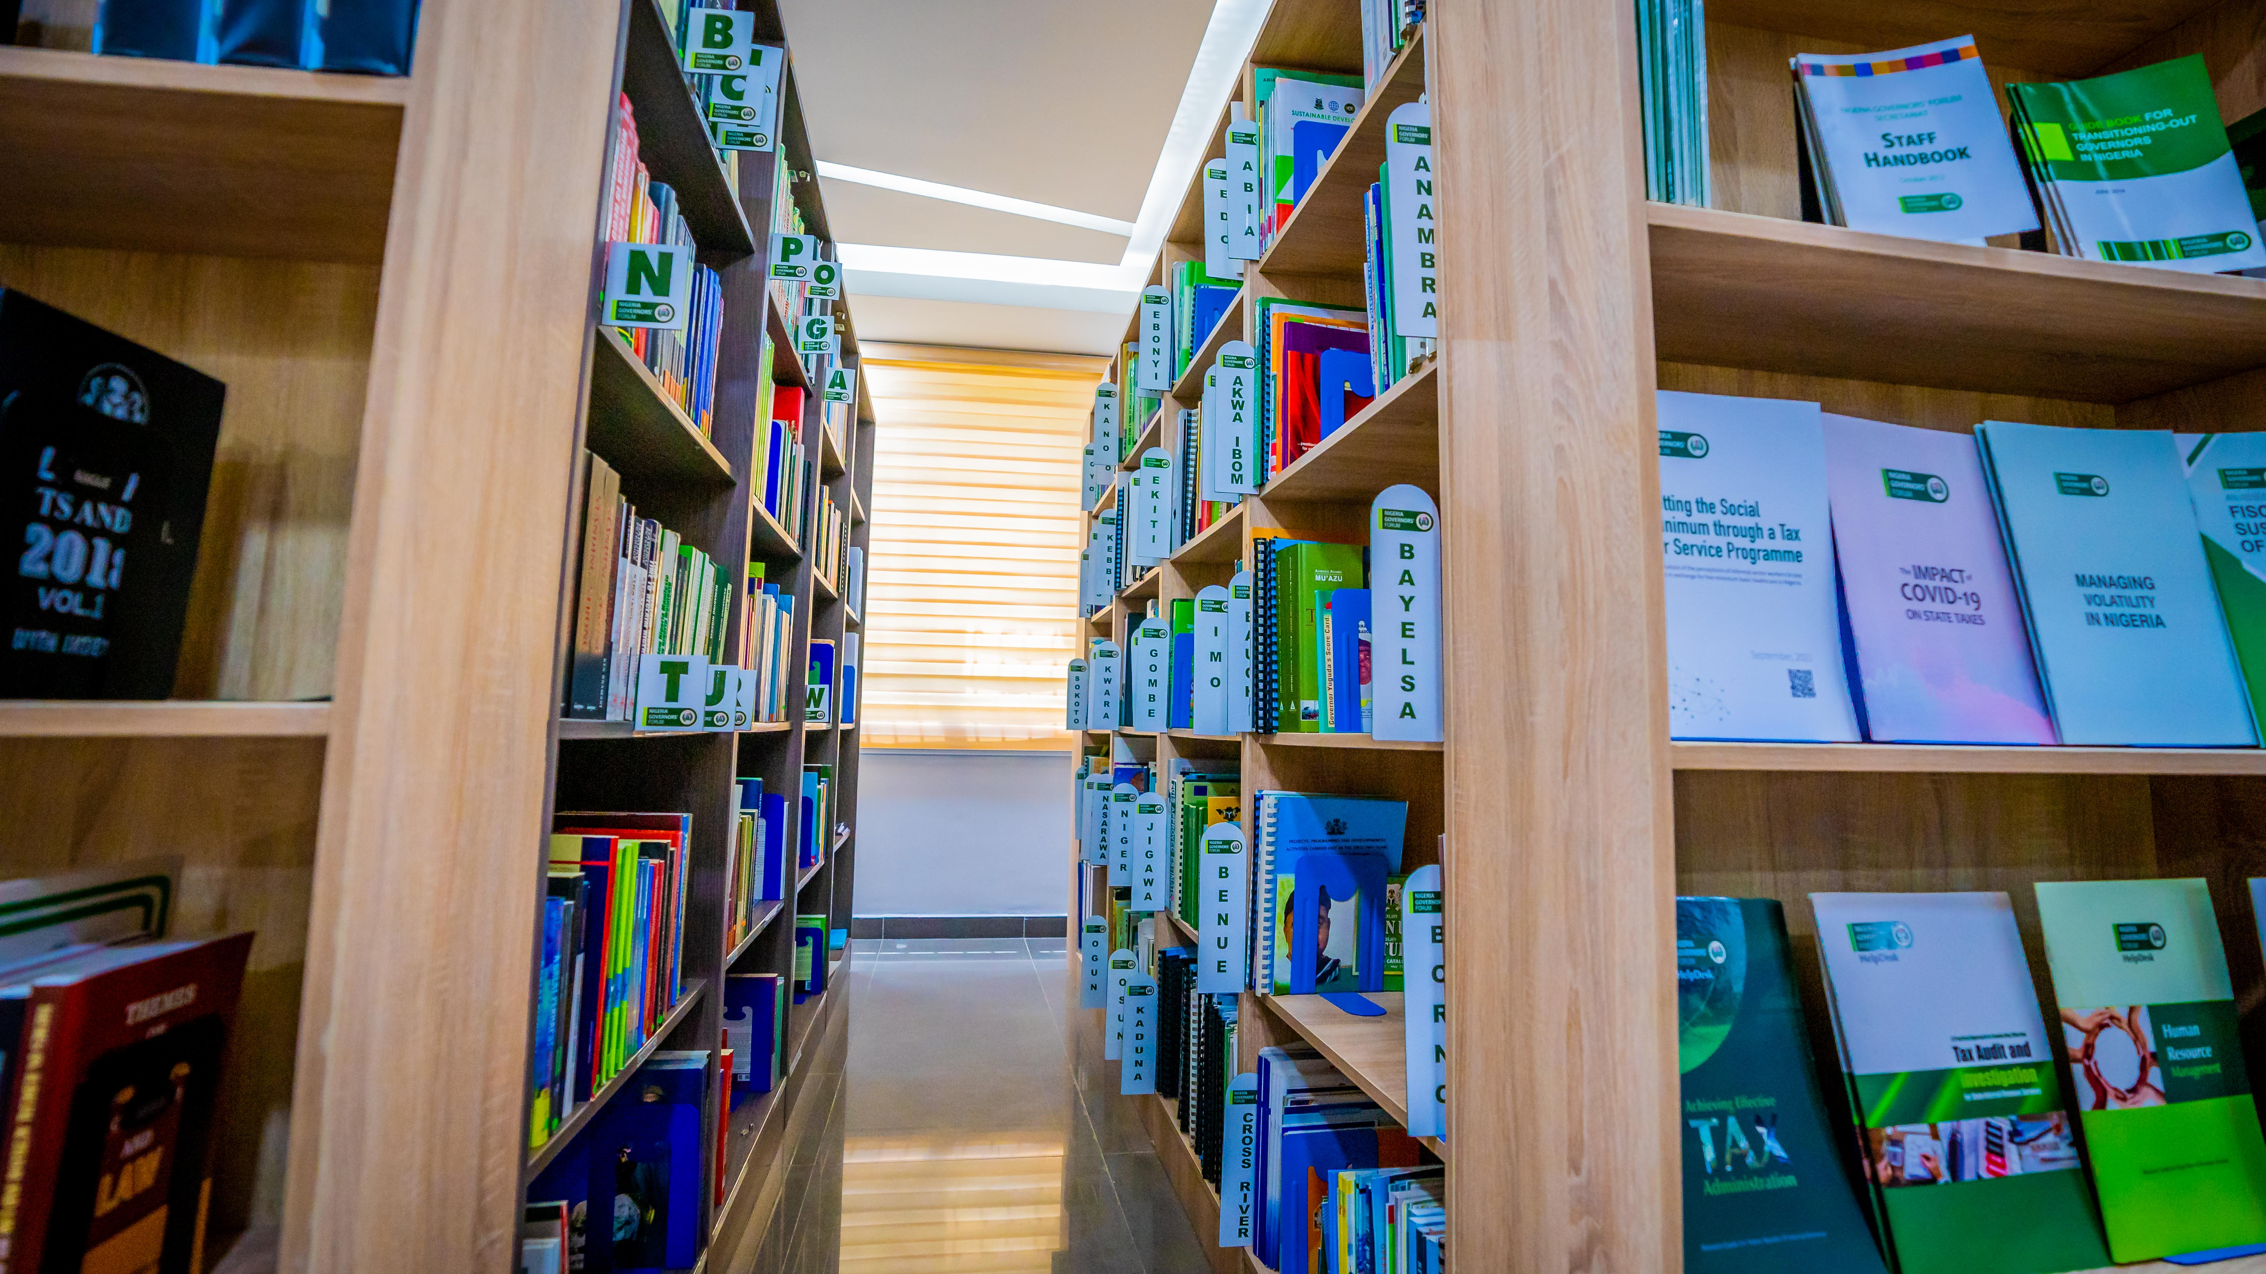
Transformation of the NGF library: Planning the process. (2022 -2023 )
Developing the Concept Note
Transforming the Concept Note into 3D Design
Getting Approval for the Project
Sourcing for Vendors & Procurement Process
Project Execution
Work Plan

Slide 10
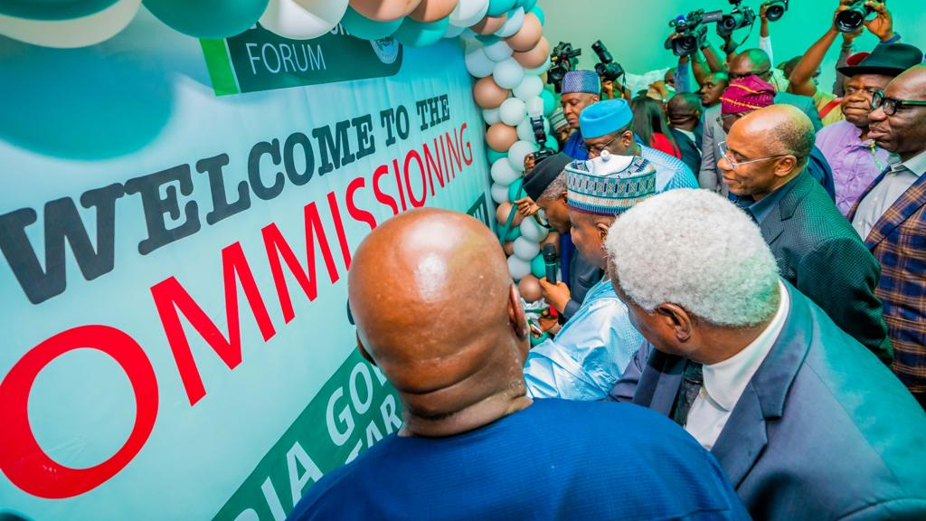
The current NGF Library in Pictures

Slide 22
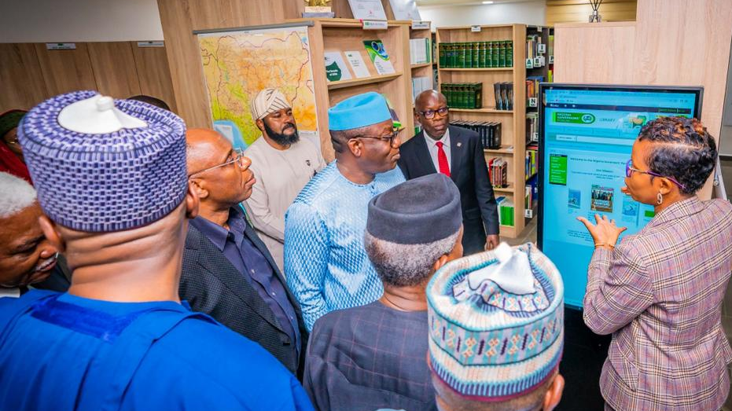
Sustainability of the library after setting up
Outreach, Advocacy & Engaging with Stakeholders
Keeping up with current library trends
Evaluations & Continuous Improvements
Monitoring & Reporting

Slide 23
Continuous Growth as a Librarian and Information Professional
Investment in oneself extends beyond academic achievements. It encompasses a commitment to continuous learning, personal growth, and self-improvement.
Throughout my career, I have embraced opportunities for professional development, acquiring certifications, attending training programs, and staying abreast of emerging trends and technologies in library and information management.

Slide 24
Review

Slide 25
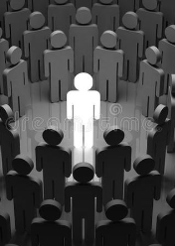
Stand out from the crowd
Keep
keep learning - CPD
Join
Join professional bodies
Get
Get certifications (locally & internationally)
Attend
Attend conferences, trainings, workshops and webinars
Have
Have a mentor
Be
Be a mentor
Get
Get more professional hands-on experience in libraries by volunteering

Slide 26
Conclusion
My journey underscores the pivotal role of women in driving positive change and advancing information management practices in organizational settings.

Slide 27
“To be a librarian is not to be neutral, or passive, or waiting for a question. It is to be a radical positive change agent within your community.” ― R. David Lankes

Slide 28
Developed Publications
PUBLICATIONS | ACCESS LINK
EVOLUTION AND TRANSFORMATION OF THE NGF LIBRARY. PAGE 4-5 OF THE NGF EXECUTIVE SUMMARY NEWSLETTER | https://ngfrepository.org.ng:8443/handle/123456789/5090
NGFS IN HOUSE LIBRARY TRAINING | https://ngfrepository.org.ng:8443/jspui/handle/123456789/5397
NGF LIBRARY RULES AND REGULATIONS | https://ngfrepository.org.ng:8443/jspui/handle/123456789/5376
NGF LIBRARY POLICIES AND PROCEDURES | https://ngfrepository.org.ng:8443/jspui/handle/123456789/5373
NAVIGATING THE NIGERIA GOVERNORS’ FORUM E-LIBRARY: A STEP-BY-STEP GUIDE | https://ngfrepository.org.ng:8443/jspui/handle/123456789/5375
NAVIGATING THE NIGERIA GOVERNORS’ FORUM DIGITAL REPOSITORY: A STEP-BY-STEP GUIDE | https://ngfrepository.org.ng:8443/jspui/handle/123456789/5374

Slide 29
Thank you!
Questions

