Slide 1
USING DATA TO SUPPORT STORIES
Theophilus Abbah, PhD

Slide 2
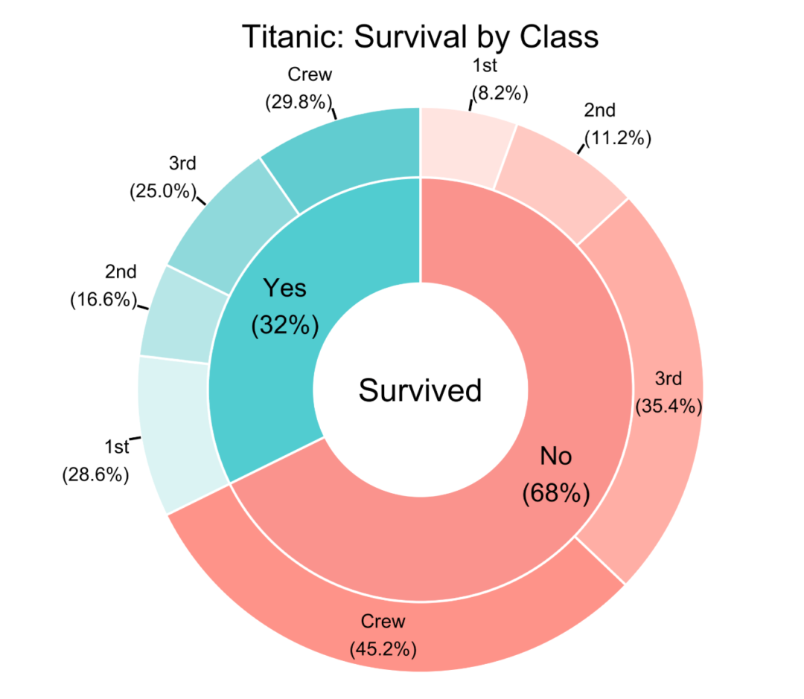
Introduction
Data brings to mind statistics:
facts, figures and numbers.
We also have symbols, images
in the form of visualization
Computers: data processing
Quantitative data: use of numbers

Slide 3
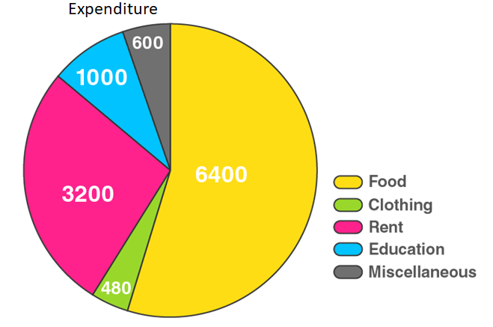
Introduction
Data has been in use by social scientists over the years in order to understand phenomena and to
predict what should be done.
How do people spend their
money? What businesses
should we engage in?
This is basically precision
research, which has been in
vogue before the computer.

Slide 4
Computer-Assisted Reporting
Computer
Data Mining
Data Cleaning/Sorting
Data Analysis/Visualization
Publication

Slide 5
Data in stories
In today’s journalism data is used to present stories in a compelling manner:
Read this story: What is the situation in Gaza’s Khan Younis as Israel intensifies attacks? | Israel-Palestine conflict News | Al Jazeera

Slide 6
Story presentation
Maps
Information presented in percentages
Pie charts
Bar charts
Line charts
Visualization using symbols
Timelines

Slide 7
Data in stories
Read this BBC story: The impact will be felt in Ukraine war if US aid dries up - BBC News

Slide 8
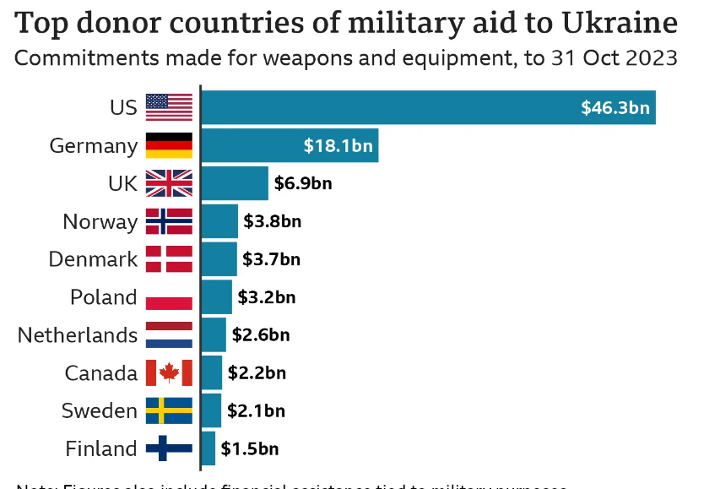
Donors to Ukraine

Slide 9
Why data journalism?
A (not too) new approach to story-telling, similar to the use of photographs, video, audio (podcast), livestreaming, etc.
Making sense by filtering abundant data or ‘sense-making journalism’
Providing deep insight
Showing trends and implications
Explainers
Lasting impression with infographics and visualization

Slide 10
How do journalists gather data?
In the age of the Internet, data gathering is made easier because of diverse tools that are available. What journalists must strive to do is know how to use the various tools. This is what data mining is all about.
We need primary data & secondary data.
For instance, in trying to find out why the military would mistakenly kill so many persons in Igabi Local Government Area in Kaduna State, you may want to know how bandits threaten the lives of the people in the area. You could just do simple Google Search

Slide 11
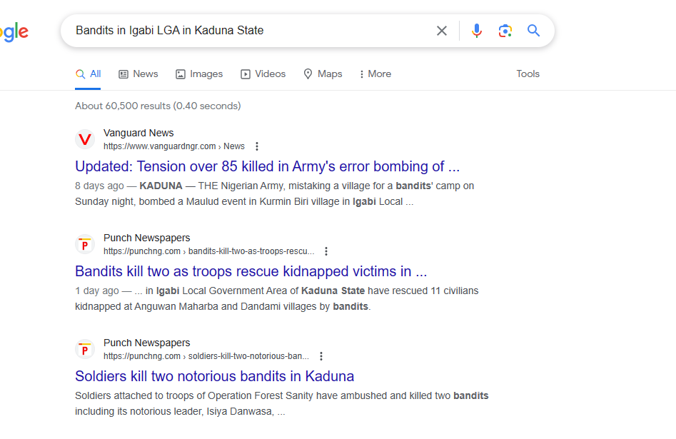
Bandits in Igabi LGA

Slide 12
Google Advanced Search
File types: pdf, xls, ppt, csv, etc.
Search within a website
Date or period
Specific words that must be included
Specific words that must not be included
Exact words or phrases
Narrow to region, language, etc

Slide 13
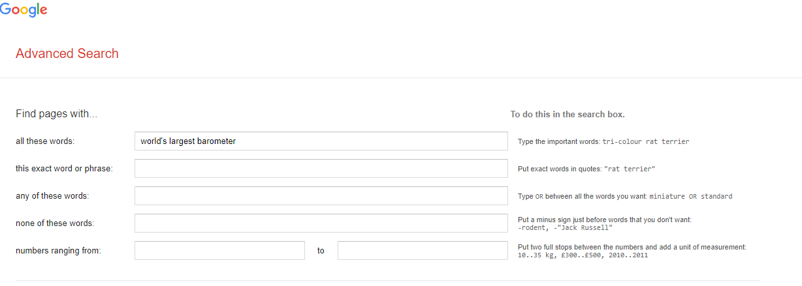
Quick Search

Slide 14
Using Google
If you right-click your mouse, select ‘Web Capture’, you will be able to download all the stories about ‘bandits in Igabi’. The hard work there, however, is for you to count the number of attacks by bandits in the LGA and the number of deaths.
Doing it manually could be tough, so also is the process of scraping the data from websites, uploading them on your Excel for cleaning and analysis. You may need to use premium version of tools.
You may be lucky: some researchers may have gathered the data already. You need to extract (give credit), and use it in a way it will be relevant to your story. For instance, if the data is about bandit attacks in Kaduna State, you could isolate the data on Igabi LGA for your analysis.

Slide 15
Bandits attacks in Igabi

Slide 16
Quick sources of data mining
Websites & Official data portals:
National Bureau of Statistics
Central Bank of Nigeria
World Bank
UNDP
NNPC
Ministry of Budget and National Planning
Ministry of Finance, etc

Slide 17
Quick Search
Research works with relevant tables, using ‘table capture’
Web scraper
Instant data scraper
Data scraper
Tabula
Octoparse
Conversion of PDF files to xls, csv, word, ppt.

Slide 18
Infographics/Visualization
You must first of all use Microsoft Excel or Google Sheet to clean-up, refine and filter your data for analysis
You could use it for infographics
Tools for infographics and visualization are many now, but mostly as paid-for products:
Flourish
Infogram
Datawrapper
Picktochart

Slide 19
Steps in doing data-driven stories
Story Idea
Hypothesis
Collaboration
Mine the data
Refine the data
Analyze the data
Contextualize through interviews
Seek interpretations by experts
Point out implications

Slide 20
Resources
1. Beginner’s Guide to Extracting Data from PDFs – Global Investigative Journalism Network (gijn.org)
No Coding Required: A Step-by-Step Guide to Scraping Websites With Data Miner – Global Investigative Journalism Network (gijn.org)
data mining – Global Investigative Journalism Network (gijn.org)
Visualization Tools – Global Investigative Journalism Network (gijn.org)
Getting Started – Tip Sheets – Global Investigative Journalism Network (gijn.org)

