Slide 1
PARTNERING WITH THE LOCAL PHARMA MANUFACTURING GROUP:
AN OPPORTUNITY FOR STATE GOVT TO INVEST & CLOSE THE GAP IN ACCESS TO MEDICINE.
2023 INDUCTION FOR NEW &RETURNING GOVERNORS @ PRESIDENTIAL BANQUET HALL STATE HOUSE, ABUJA
PHARM. FRANK MUONEMEH EXECUTIVE SECRETARY PMG-MAN

Slide 2
OUTLINE
PMG-MAN Since 1983
Why this is a huge opportunity for States.
- Universal Health Coverage
- Strengthening the PHCs
- Reduce out of Stock to barest Minimum
- Create supply chain Jobs in your State
- Stimulate the state economic activity
- Build a sustainable health ecosystem
- Opportunity to access grants for development.
Invest In Partnership that Works
What we expect from State actors.

Slide 3
PMG-MAN
SINCE 1983

Slide 4
120+
MEMBERS
PMG-MAN is an umbrella body of over one hundred and twenty (120+) active members.
We collectively play key roles in ensuring that Nigerians have timely access to affordable, safe and high-quality medicines.
We contribute largely to National Development.

Slide 5
Huge Opportunity For State Government
Sustainability of the State Health Insurance Scheme, beyond Launch to achieve Universal Health Coverage &SDG 3.
Strengthening of the State Health Component Supply chain, beyond Secondary Healthcare providers, the PHCs for guaranteed access to safe, quality and affordable medicines.
Stimulating the economic activity of the State, built around public health supply chain, creating Jobs .

Slide 6
2,000,000
EMPLOYEMENT
(DIRECT & INDIRECT)
Number of persons that are employed directly or indirectly by the Industry.

Slide 7
70%
LOCAL
The National Drug Policy demands that at least this percentage of medicine be procured from local manufacturers.
This is in line with Executive Order 003 of the Federal Government of Nigeria.

Slide 8
GOAL
CHANGING THE NARRATIVE & FOCUSING BEYOND
DONOR AID
To reverse our over dependence on imported medicine.
We are changing the narrative, we have sowed the seed towards Self Reliance and looking beyond Donor Aid.

Slide 9
WHY INVEST IN PARTNERSHIP WITH
LOCAL PHARMA
MANUFACTURING SECTOR

Slide 10
Invest In Partnership that works!!
Re-Imagine today your Stock value in health product component for your healthcare facility is Zero stock and with this partnership you have an investment of N268 Million Naira to 1.5Billion in 3years of the partnership- Yobe State Case Study
Re-imagine reducing the non-availability of health care product on the shelves in your healthcare facilities from 80% to 20% and an average order re-fill rate increasing from 38.41% to 76.85% in 4months of partnership with us. The case of Kaduna State Sept 2021 to January 2022.
Re-Imagine your State having access to the best prices money can buy, and positioning your facilities to be one stop facility for quality, safe and affordable medicines, produced in Nigeria, even in time of crisis or scarcity.
Cost Saving Strategy- Invest in pool procurement that could save you close N60 Million in a procurement cycle investment, and could also attract an impactful corporate social responsibility to build a robust supply chain system in your state.

Slide 11
Partnership that works!!
YOBE STATE, EKITI STATE
NIGER STATE, NASSARAWA
STATE DMAs ARE THE DRIVERS.
KADUNNA STATE, SOKOTO STATE

Slide 12
WHAT THE INDUSTRY
EXPECTS OF THE
STATE ACTORS TO GO INTO THIS PARTNERSHIP

Slide 13
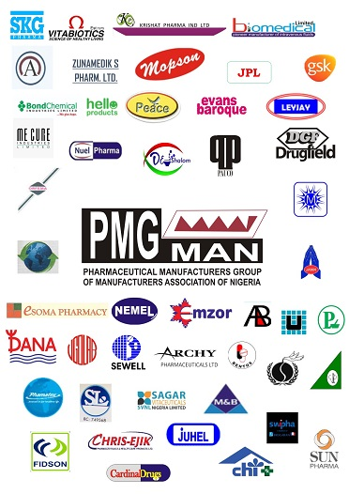
TRUST IS A BURDEN

Slide 14
DRUG MANAGEMENT AGENCY OR THE DRUG REVOLVING FUND MECHANISM(DMAs)
INSTITUTIONALISED
SYSTEMS
DEVOID OF POLITICAL INTERFERENCE, SHARED ACCOUNTABILITY AND TRANSPARENCY

Slide 15
ENGAGING THE THIRD PARTY EXPERT FOR EFFECTIVE QUANTIFICATION, FORECASTING, BUILDING TRUST &CAPACITY.

Slide 16
LEADERSHIP

Slide 17
OUR MANTRA PPP

Slide 18
THANK YOU

