Slide 1
HCD Programme Update
NGF Governors’ Induction
May 2023

Slide 2
Overview of the HCD Programme

Slide 3
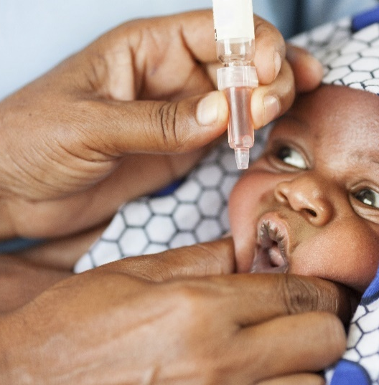
Overview
The Nigerian Government recognizes the critical role Human Capital Development plays in driving sustained economic growth, boosting productivity and reducing poverty
1
The Country has put in place several steps to accelerate Human Capital Development. This is being driven by a Human Capital Steering Committee and Core Working Group established by the National Economic Council
2
HCD focuses on 3 Thematic Areas and 6 critical Human Capital Development outcome areas (Health and Nutrition; Education and Labour Force Participation). The Plan builds on existing efforts and the progress made to date
3
The Core Working Group has articulated a unified long term HCD Vision through a co-creation and co-development process involving representatives of the States of the Federation
4
Several enablers critical to accelerating HCD include high quality data, improved funding and better coordination between Federal Government, States and Development Partners
5
The CWG derives its mandate as a Standing Committee of NEC to lead the implementation of the National HCD agenda
6
The Core Working Group is working directly with the States to ensure the implementation of the National HCD Vision and make certain the transformation of the nationwide HCD Landscape.
7
3

Slide 4
The National Human Capital Development Program was launched in March 2018 by the National Economic Council at a special meeting convened for that purpose
The National HCD Program
Nigeria’s Human Capital Development Program was designed in recognition that human capital development plays a critical role in addressing poverty while ensuring participatory and sustainable economic growth
The Program is aimed at increasing investments in the Nigerian people thereby improving Nigeria’s human capital development indices
To drive the HCD Program, the Core Working Group was established with the mandate to;
Develop
a strategy and action plan to increase countrywide HCD investment
Engage
State Governments to ensure prioritization of HCD investment
Highlight
quick wins at State and Federal Levels to improve the HCD indices of the country
Institute
a robust country wide monitoring and evaluation frame
For ease of execution, the CWG’s mandate was phased into two key components: Phase One with a focus on the development of the National Human Capital Development Strategy and Phase Two with a focus on State Level Engagements
4

Slide 5
HCD Implementation Approach
A two phased approach was adopted to actualize the mandate of the HCD Steering Committee and the CWG
The first phase involved the articulation of a national vision through a co-creation and co-development process. This vision would guide Government in aligning multisectoral HCD efforts and drive human capital development
The second phase involves engagement with States in articulating their HCD strategies
However, a third phase is evolving which will involve the launch of the CIMI project – a community-based demonstration of HCD in its simplest form.

Slide 6
The HCD Program focuses on three (3) Thematic Areas and six (6) critical human capital development outcome areas
Nigeria’s HCD Thematic and Outcome Areas
Cross-cutting themes
1
Under-five mortality rate
2
Malnutrition (under-five stunting)
Social inclusion
Social protection
3
Adult mortality
Health and nutrition
Education
4
Expected years of school (primary and secondary school completion)
5
Quality of learning
Labour force participation
6
Labour force participation rate (particularly female and youth)
Gender empowerment
6

Slide 7
The National HCD Vision
Healthy, Educated, and Productive Nigerians for a globally competitive nation by 2030
Overall Target
~24 million additional healthy (under-five year old children surviving and not stunted), educated (completing secondary school) and productive (youth entering the labour force) Nigerians by 2030
State-Led Service Delivery Transformation
Strategic Themes
Health and nutrition
Education
Labour force
Health and nutrition
Education
Health and nutrition
Education
Health and nutrition
Education
Labour force participation
Labour force participation
Labour force participation
Vision
Provide equitable access to affordable and quality healthcare for every Nigerian
Promote a quality, inclusive and functional education system
Empower youth to have the capacity and skills to create or seek employment
Improve nutrition and reduce childhood stunting by half, from 44% to 22% by 2030
Reduce under 5 mortality rate by half, from 120/1000 U5 population to 60/1000 by 2030
Reduce maternal mortality by half, from 576 deaths/100,000 live births to 288 by 2030
Double primary school enrolment rates from 46% to ~90% by 2030
Double female enrolment
Double secondary school comple-tion rates from 42% to ~80% by 2030
Reduce out-of-school children (~10m) by at least 70%
80% pass rate, students that reach curricular objectives at end of primary school (reading and mathematics national learning assessment)
Double youth participation in labour force from 23% to 46% by 2030
Double female labour force participation from 21% to 41%
Targets
Data: Improve data collection at Federal, State and LGAs for optimal tracking and data-driven decision making
Cross-cutting enablers
Funding: Increase revenue mobilization, funds allocation and release, and employ effective financing mechanisms
Governance: Drive greater political commitment to ensure improved coordination and accountability
7

Slide 8
Articulation of the National HCD Strategy and unified HCD Vision
The CWG organized a series of workshops with Partners and relevant stakeholders which included State Representatives and Sector Experts
Strategy
The National HCD Strategy was articulated along with the unified National HCD Vision captioned “Healthy, Educated and Productive Nigerians for a globally competitive nation by 2030”
Targets
Analysis
Interventions
Targets were also set across three thematic areas namely Health and Nutrition, Education and Labour Force Participation
A list of sixteen (16) preliminary high-impact Interventions across the three thematic areas were also identified
The Strategy also included a Landscape analysis on HCD in Nigeria as well as an assessment of existing efforts, system challenges and gaps
Workshops
Outcomes
Six (6) outcome areas were identified across the three thematic areas
8

Slide 9
Nigeria’s Human Capital Development agenda sits across multiple levels and stakeholders
Existing structures
Supporting HCD structures (new)
Responsibilities
National
National Economic Council
The National Assembly
Line Ministries, Departments & Agencies
Core Working Group of government representatives, donors, and development partners
Provide transparency on progress in HCD
Galvanize strong political will, commitment, and leadership sponsorship from executive powers
Drive nationwide commitment to HCD through consistent messaging
Set nationwide vision and drive alignment with consistent messaging
States
Governors
State Ministries, Departments & Agencies
State House of Assembly
LGAs
Tailored Subnational HCD structure
State House Committees relevant to HCD program
Set State priority outcome areas in line with National Vision
Service delivery transformation and acceleration of intervention areas
Enact relevant laws in support of State HCD program
Other (Development partners, grass roots, CSOs)
Development Partners & Donors
CSOs & NGOs
Community based structures e.g., ward development committees
Multi-stakeholder HCD focus groups
Independent data tracking teams supported by the State
Support government service delivery transformation e.g.via funding, M&E support
Driving community participation to accelerate interventions in HCD
Creating visibility on grass root needs
Maintaining upward pressure

Slide 10
Development of State-Level Engagement Strategy
Phase II Objectives include
1. Engage State Governments to ensure prioritization of HCD investment
2. Highlight quick wins at State and Federal levels to improve Nigeria’s HCD indices
3. Institute a robust country wide monitoring and evaluation framework to assess implementation of interventions and impact
The CWG in furtherance of these objectives has embarked on the following activities;
1
2
3
4
5
6
7
State-level Engagement Strategies
State Implementation Guidebook & Templates
State Focal Persons Inaugural Workshop
State Sensitization Visits
Regional
HCD Meetings/
Conferences
HCD Stakeholder Meetings
State Deep-Dive Meetings
State Governments have begun to
Institutionalize the National HCD Agenda
Articulate their HCD vision and priorities
Establish State HCD architecture
Develop and Implement HCD implementation plans as well as monitoring and evaluation frameworks
10

Slide 11
State Delivery Mechanism

Slide 12
A delivery mechanism has been suggested to ensure coordination of the HCD agenda
Meeting frequency
Level
Org chart
Key activities
L₁
Deputy Governor
Monthly-Quarterly
+
State HCD council
Review State dashboard
Debottleneck issues on delayed milestones
Present at State cabinet meetings
State CWG Secretariat
+
Focal person¹
Budget & Plan’g comm’r
Labour comm’r
Education comm’r
Health comm’r
Donors & NGOs
+
L₂
Health/Education/ Labour commissioner
Focal person
Once-Twice monthly status update meetings for each of the commissioners (3-6 total)²
+
State Ministry Team
Individual meetings with each of the commissioners of the HCD thematic areas
Review intervention implementation plans and track milestones and activities
Escalate challenges where necessary
Permanent Secretary
+
Dir₁
Dir₂
Dir₃
Dir…
+
TA
Permanent Secretary
L₃
Director
TA
Weekly
+
MDA
Review progress on implementation tasks
‘Do the work’
_{Technical working group}
Implementing partners
+
To ensure continuity, States should look to embed these activities as agenda items in existing meetings

Slide 13
The Human Capital Development (HCD) Council is meant to provide cross sector coordination of HCD activities. It should be chaired by the Deputy Governor
No | Composition
1 | Deputy Governor | Chairman
2 | Commissioner - Budget & Planning | Member
3 | Commissioner - Health | Member
4 | Commissioner - Education | Member
5 | Commissioner - Labour & Productivity | Member
6 | Commissioner – Youth & Sports | Member
7 | Commissioner – Women Affairs | Member
8 | HCD Focal Person | Secretary
Role
Provide cross-sector coordination of HCD activities
Articulate State HCD vision – Define priorities and develop relevant policy framework
Supervise development of State HCD plan
Stimulate stakeholder participation
Mainstream HCD initiatives into State budget and strategic development plan
Establish Monitoring and Evaluation framework

Slide 14
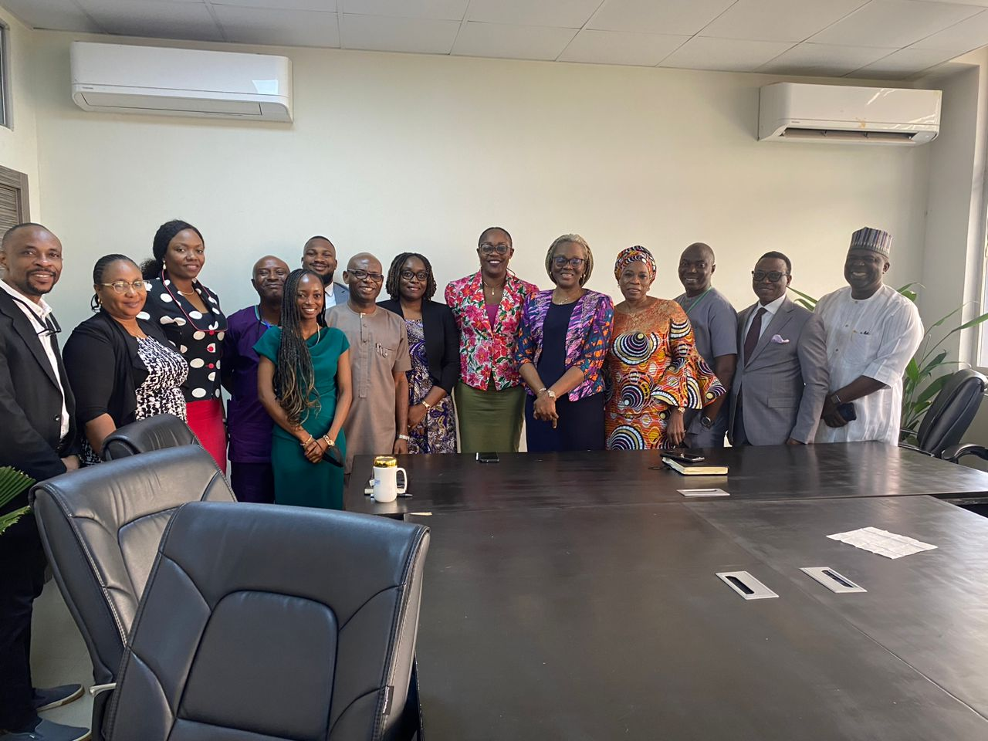
The Human Capital Development (HCD) Technical Working Group is chaired by the State Focal Person and is meant to provide technical leadership for the State HCD Programme
No | Composition | Composition
1 | HCD Focal Person | HCD Focal Person | Chairman
Directors; Planning, Research & Statistics | Directors |  | Member
2 | Health |  | Member
3 | Education |  | Member
4 | Labour & Productivity |  | Member
5 | Youth & Sports |  | Member
6 | Women Affairs |  | Member
Role
Provide landscape analysis for HCD outcome areas
Determine critical HCD challenges for ministries
Make recommendations regarding HCD priorities
Recommend targets across HCD outcome areas
Assess ongoing Interventions/Initiatives
Provide information on HCD programme implémentation
Propose initiatives to address HCD outcomes
Identify expected outcomes from initiatives/program milestones
Cost HCD initiatives
Recommend relevant policies to guide and track programme implementation

Slide 15
Expectations from State (1/2)
Inauguration of State Human Capital Development Team/Council under Chairmanship of the Deputy Governor: (Members to include Commissioners of Ministries of Health, Education, Labour, Budget and Planning, Heads of Relevant Agencies and Departments with the State Focal Person as Secretary)
1
Set up regular meetings of the State HCD Council to address the different aspects of the State HCD Plan development and implementation.
2
The State HCD Council is to define the State’s priorities based on the peculiarities, challenges and opportunities of the State; - This should be drawn from Mr. Governor’s vision for the State/other Strategy Documents of the State.
3
Set Targets across various HCD indices and Outcomes.
4
Identify on-going Interventions (by State Govt./Donors) and select from the list of Preliminary HCD Interventions (under the National HCD Program) that can help to achieve the State’s HCD Targets and align them to HCD Outcomes.
5
6
Identify Stakeholders from across the State that can make inputs and meaningful contributions into State HCD Plan and define their roles.

Slide 16
Expectations from State (2/2)
Organize In-State HCD Workshop involving all Stakeholders (Policy Makers, Directors of Planning of Key Ministries, CSOs, Donor Community, Youth Groups, Women Groups, and Other relevant Development Associations) to undertake an assessment of on-going interventions and select new interventions based on viability and ease of implementation.
7
8
Draw up a Strategy and an Implementation Plan that links On-going/Activities and New Interventions to Key HCD indices and Outcomes.
9
Undertake Costing of Interventions and activate process of mainstreaming Interventions into State Budgets and Medium-Term Plans.
10
Set up State HCD Monitoring and Evaluation Team to periodically monitor Implementation progress and evaluate program impact.
11
Provide regular updates to State’s Executive Council to facilitate policy discussions and actions

Slide 17
State HCD Plan Development

Slide 18
Steps to the development of State HCD Action Plan
1
Develop draft HCD plan (based on sector strategies and State development plan)
Establish State HCD baseline
4
Define priorities and set targets
Engage stakeholders to seek their inputs into the draft plan
2
5
Select relevant interventions
3
Finalize and launch HCD Action Plan
6
Set up Monitoring team to track progress and assess impact
7

Slide 19
Support to States

Slide 20
The CWG has supported States in various ways to implement HCD at the sub-national level
1
Onboarding of State focal persons
5
Regional Peer Learning Engagements
2
6
Deep-dive Sessions with State HCD teams
Visits to States
3
7
HCD Implementation Guidebook
Deployment of Regional Consultants
4
Stakeholder Mobilisation through Regional Conferences
8
Facilitate financial support

Slide 21
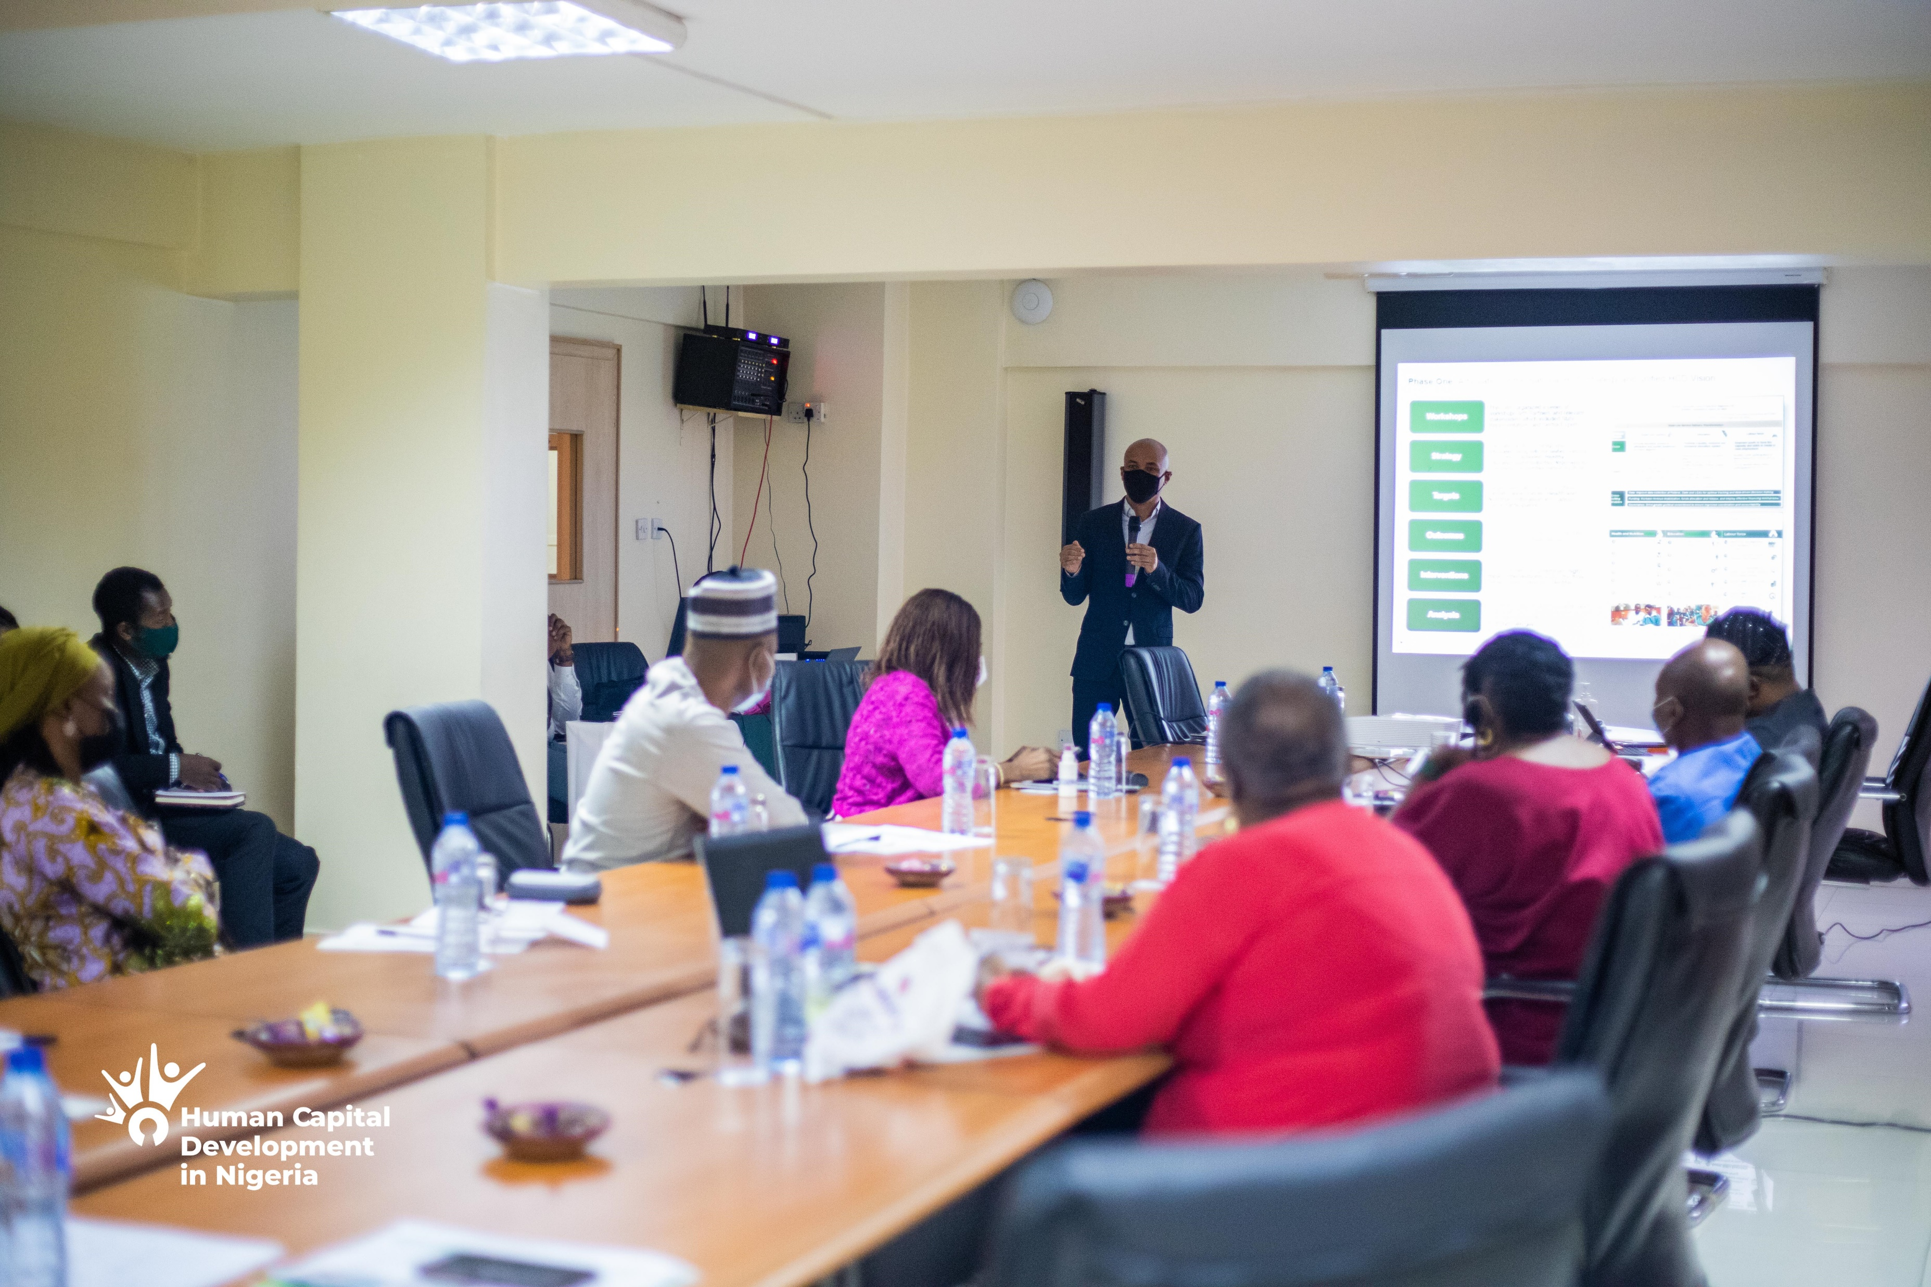
Regional Consultants have been deployed to provide technical support to State HCD Councils and teams in their assigned regions
To make the process of “handholding” seamless due to geographical spread and regional uniqueness, Regional Consultants were engaged
Regional Consultants are;
Providing technical support to State HCD Councils within their assigned regions
Assisting States in achieving their key objectives under the National HCD Agenda
Building Capacity of States’ Focal Persons and other relevant members of the States’ HCD Steering Committees on Program Implementation and Management.

Slide 22
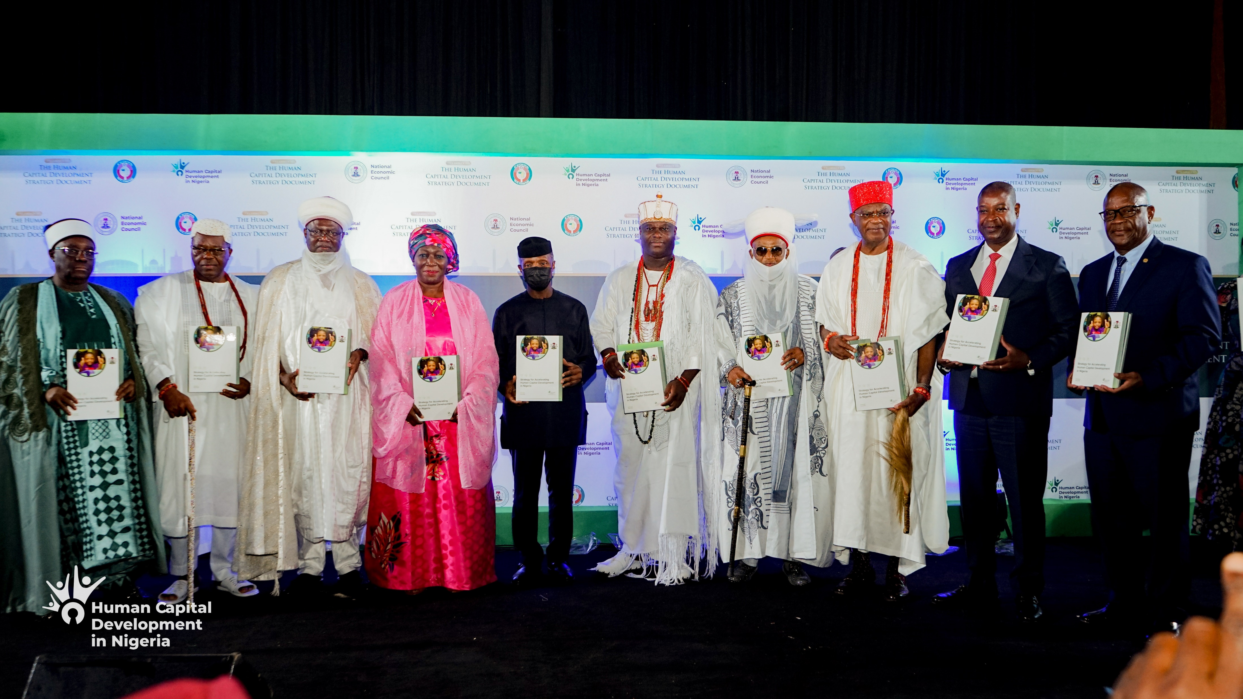
Nigeria’s Partnership with ECOWAS
There have been two partnership opportunities
The joint launch of Nigeria’s “Strategy for Accelerating Human Capital Development” and ECOWAS’s “Integrated Regional Human Capital Development” held in June 2022.
Grant agreement to provide support to twelve (12) selected Nigerian States and the Federal Capital Territory on their implementation of the Human Capital Development (HCD) Agenda
The Selected Nigerian States are Kaduna, Kebbi, Gombe, Bauchi, Nasarawa, Kwara, Ogun, Ekiti, Edo, Akwa-Ibom, Enugu, Abia and the FCT

Slide 23
State Selection Criteria
The following criteria was used to select the States
Commitment of the State Governor to the Human Capital Development Program
Kebbi
Nomination of State Focal Person on HCD
Establishment of a State HCD program delivery mechanism
Kaduna
Bauchi
Gombe
Determination of baselines across HCD Outcome areas
Kwara
FCT
Nassarawa
Definition of HCD priorities and targets
Ekiti
Ogun
Enugu
Human Capital indices
Edo
Abia
Two States were selected per Region
Akwa Ibom
The Core Working Group Secretariat executed a Memorandum of Understanding (MOU) with each of the selected States in line with the grant agreement.

Slide 24
HCD Regional Conferences
At the March 2021 HCD Steering Committee Meeting, it was agreed that several measures were required to further accelerate HCD program outcomes, facilitate Stakeholder connectivity and engender results.
The hashtag #push4HCDresults was developed to rally the support of all Stakeholders across the Country.
His Excellencies, the Regional Champions also agreed to the organization of Regional HCD Conferences to sensitize and bring every Stakeholder on board as this would demonstrate the highest level of political commitment to the Program.
Regional Conference Concept
Expected Takeaways
States within each Geo-political Region are meant to discuss the HCD Challenges they face, and jointly proffer solutions:
HCD issues clearly articulated, and solutions proffered
Sensitization and onboarding of key regional Stakeholders
Mobilization of key stakeholders within the Zone
Collaboration between States on joint HCD Interventions and Programs
Peer review of States’ HCD plans and Implementation
Regional monitoring & evaluation of HCD program impact and results
The improvement of regional Human Capital Indices (HCI)
HCD campaign (Road Shows)
Partnerships established with key stakeholders
Regional HCD ambassadors to drive HCD activities identified
Technical support team instituted and charged to:
identify and bridge resource and capacity gaps
facilitate peer review and experience sharing amongst States
Regional monitoring and evaluation framework instituted

Slide 25
HCD Regional Conferences held so far
The Core Working Group on Human Capital Development in conjunction with the regional champion states and other States' teams have organized three regional conferences in the South.
The conferences were structured into two days:
Day-One being a technical session where HCD challenges of the region are articulated and policy recommendations developed, and
Day-Two with the Governors in attendance, to consider possible solutions to the challenges in the region.
North East
North West
South
TBD
TBD
North Central
South East
South South
4th – 5th May
2023
26th – 27th January
2023
17th – 18th January
2023
North
South West
23rd – 24th November
2022

Slide 26
HCD Milestones

Slide 27
Since inception to date, the HCD program has covered several milestones and achieved key successes
Phase Two Milestones
March 2018
HCD Program launch by the National Economic Council and creation of the HCD CWG
September 2019
Inaugural State Focal Persons Workshop
CWG presentation to the UNGA Side Event on ‘Improving HCD in Nigeria
March 2021
CWG presentation to the World Bank Focal Points Meeting
April - June 2021
HCD Database Systems Architecture Design
July - August 2021
Engagement and deployment of Database and Editorial Consultants
December 2020
- June 2021
Regional HCD Peer Review Meetings
State Deep Dive Meetings
April to
November 2018
National HCD Workshops and Strategy Sessions with Partners and Key Stakeholders
September to November 2019
Creation of State Level Implementation Guidebook and Templates
September 2021
HCD Communication and Strategy and Validation Events
September 2020
Stakeholder HCD Engagement Meetings with CSOs and the Private Sector
March 2022
Deployment of HCD Regional Consultants
December 2018
Launch of National HCD Strategy and unified HCD Vision at the National Dialogue on HCD
November 2019
HCD Sensitisation Visits to select States in Nigeria’s Geopolitical Regions
August 2020
Regional HCD Engagement Meetings with key Public Officers &
Civil Servants at State level
June 2022
Launch of Nigeria’s HCD Strategy Document
January 2020
CWG Webinar presentation to 69 Country HCD Focal Points anchored by the World Bank
September 2022
CWG HCD Media Event
April 2020
Discussion on the Integrated Learnings from Nigeria into ECOWAS Regional HCD Strategy
Phase One Milestones
November 2022 to date
HCD Regional Conferences

Slide 28
State engagements highlighted key success stories with lessons learnt for the effective implementation of state-level HCD initiatives
Lessons Learnt
Example
1
Robust governance structure for program design, implementation and program assessment
Policy Councils chaired by the State’s Executive Management Council have greatly improved the coordination and execution of state initiatives
2
Institution of data collection and management systems
Data Laboratory created by the State has helped in the generation of accurate baseline data which has reduced the cost of HCD interventions by 50%
3
Strategic engagement and partnerships with stakeholders nation wide
A State’s partnership with the CBN on the AGSMEIS and ABP schemes is designed to empower 52,000 Agri-prenuers and empower 150,000 people via multiplier effect
4
Program ownership across key stakeholders even at the grassroots level
States unanimously agreed that Traditional Rulers were crucial to the overall success of HCD programmes, including program design to incorporate critical cultural nuances
5
HCD program institutionalisation
States agreed that HCD interventions and initiatives that are currently successful need to be institutionalised for long term adoption by subsequent administrations
6
Transparent resource mobilization and coordination of donor agency funding
The State has a structured donor engagement process which ensures that funding is disbursed and utilised appropriately

Slide 29
Third Phase –
CIMI Project

Slide 30
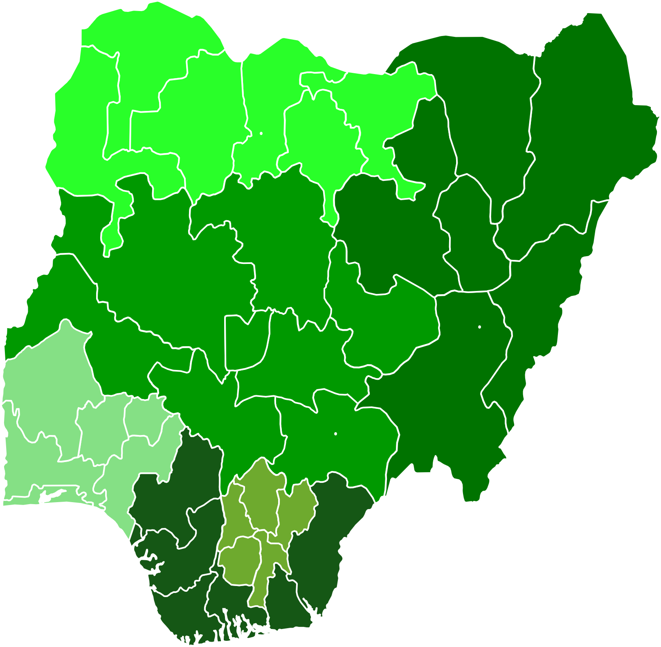
CIMI Project
The CIMI Project is a community-based demonstration of the HCD programme in its simplest form, that can be replicated across various communities in each Local Government Area. ‘CIMI’, which connotes development, was coined from the three main Nigerian languages (Hausa, Igbo, and Yoruba) in Nigeria.
CIgaba
Mmepe
Idagbasoke
Hausa
Igbo
Yoruba
each of these words meaning DEVELOPMENT
The CIMI Project is expected to sustain the continuity of the HCD programme within communities. The project does not require huge expenditure but will use pre-existing structures within the communities to drive results across the Six (6) HCD critical outcome areas.
The success of the CIMI project will be dependent on the support of HCD partners as results can be better achieved when they get involved with HCD activities.
Notes:
The divergences of each local govt area should be captured to enhance the development agenda and sharpen the key areas that will be appropriate to each local govt.

Slide 31
Objectives
1
To replicate easy to implement initiatives with impact across the three thematic areas of HCD
2
Ensure HCD programme implementation cascades down to the communities
3
Encourage community ownership of the HCD programme
4
Foster partnership between the communities and key stakeholders towards ensuring improvement in HCD outcomes
5
To promote sustainability and continuation of the HCD program
6
Increase investment in HCD
Notes:
Here local heads, apart from the local govt heads, must be identified and encouraged to key into the HCD project to quicken community ownership objective.

Slide 32
CIMI Project: Community-Driven Project (Health & Nutrition)
Unit of measure
Ensure functionality of Primary Health Care (PHC) centers in their domain
Support by the State Government/Donor Partners
Local Government Authorities
Ensure availability of Community Healthcare Workers (CHEWs)
Ensure monitoring and evaluation of the PHCs in the communities (Data gathering)
Target capacity building and training of CHEWs.
Target a specific community need as reward for their inputs and participation (Water supply, provision of malaria-treated nets, road networks etc)
Improve coverage on the distribution of malaria-treated nets
U-5 Mortality
U-5 Stunting
Adult Survival
Improve coverage on immunization
Create awareness on the importance of family planning
Educate women on good nutrition and sanitary practices
Communities
Provide comfortable residence for doctors, medical personnel and CHEWs posted to their communities
Ensure CHEWs observe service charter
Joint monitoring of PHCs with Local Government

Slide 33
CIMI Project: Community-Driven Project (Education)
Unit of measure
Support by the State Government/Donor Partners
Increase enrollment drives for out of school children
Incentives to intensify community and Local Government collaboration
Engender competition amongst communities on the basis of their active participation in community programs
Target capacity building and teachers' professional development.
Target a specific community need as reward for their inputs and participation (Provision of community-based Library services, road networks, e-libraries etc)
Adoption of existing/new schools
Local Government Authorities
Ensure functionality of schools in their domain
Facilitate assessment of teachers' competencies
Improve National School Enrolment rates
Quality of Learning
Ensure monitoring and evaluation of the schools in the communities
Ensure that the children are enrolled in schools
Communities
Create awareness on the importance of education
Ensure no child is on the streets during school hours

Slide 34
CIMI Project: Community-Driven Project (Labour Force)
Unit of measure
Ensure residents of the communities are prioritized for employment
Support by the State Government/Donor Partners
Facilitate skill acquisition and business development programs
Local Government Authorities
Maintain job portals and connect residents to jobs
Incentives to intensify community and Local Government collaboration
Promote TVET and skills-oriented programs in the communities.
Target a specific community need as reward for their inputs and participation (creation of micro programs/awarding grants to communities that have demonstrated commitment)
Joint implementation of empowerment programs
Improve employment rate
(Women & Youth)
Organize residents into Teams/Cooperatives
Communities
Ensure women and youths register with the Local Government Job portals
Joint implementation of empowerment programs
Notes:
One shouldn’t lose sight of the preoccupation of the community and integrate same into the labour thematic. The skills required for improved productivity. Agriculture and it’s value chains together with required skills should be looked at, to address the poverty reduction objective.

Slide 35
Next Steps

Slide 36
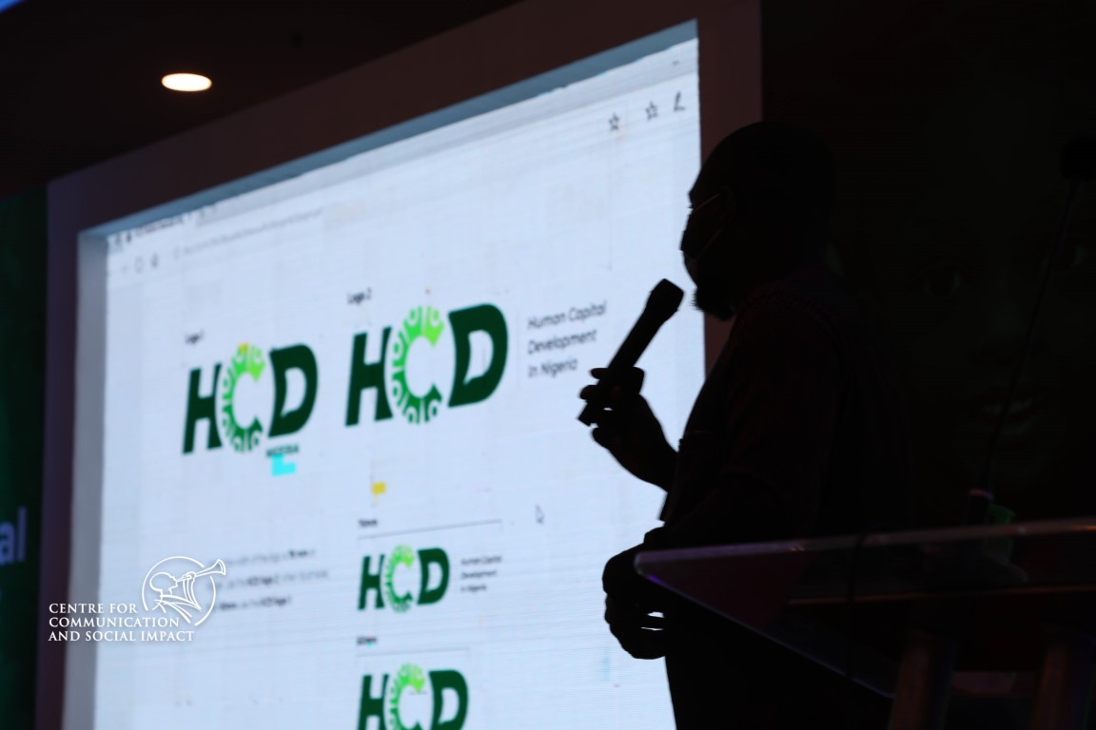
The CWG invites the attention and consideration of Council on the following activities designed to ensure sustenance and effective implementation of the National HCD agenda
Knowledge Sharing
Peer Learning Sessions
Study Tours
Monitoring and Evaluation for Results
Roll-out of CIMI Project
Regional Conferences
Resource Mobilisation
NEC Special Events on HCD Outcomes
Girl Child
Maternal Health
Youth Innovation
National School Competition
Africa Heads of State Summit

Slide 37
Thank You

Slide 38
Appendix

Slide 39
Proposed Initiatives –
CIMI Project

Slide 40
Proposed initiatives and possible outcomes (1/3)
Thematic Area | Strategic Measures | Outcome
Health and Nutrition | Organize campaigns to increase awareness on immunization by PHCs | Reduction in Under-5 mortality rates
 | Distribution of nutrition packs to expectant/nursing mothers and U-5 children | Improve Adult Survival Reduction in Under-5 stunting rates
 | Training and sensitization on family planning practices/Distribution of contraceptives | Reduction in fertility rates
 | Distribution of mosquito-treated nets | Reduction in Under-5 mortality rate Adult survival
 | Community involvement in operations of PHCs | Impacts positively on health outcome areas

Slide 41
Proposed initiatives and possible outcomes (2/3)
Thematic Area | Strategic Measures | Outcome
Education | Community involvement in schools’ operations | Impacts positively on education outcome areas
 | Establish Learning Centres within Markets | Impacts on school completion rate
 | Establish “No Child is left behind’’ initiative Campaign/re-orientation Scholarship to children from poor families Enforcement of the Policy | Impacts on enrolment, retention and school completion Reduce out-of-school children
 | Campaigns to sensitize the Girl child on best Sanitary practices, sex education and provision of sanitary wares and facilities | Impacts on fertility rates and school completion rates
 | Provision of learning materials (books, computers etc) and equip School Libraries | Increases the quality of learning amongst children
 | Adopt a School initiative | Impacts on quality of learning
Notes:
Establishment of skills acquisition/vocational centres is also important here.

Slide 42
Proposed initiatives and possible outcomes (3/3)
Thematic Area | Strategic Measures | Outcome
Labour Force Participation | Empowerment programs for women and provision of business start up packs | Increases household income which improves access to healthcare and education for them and their dependents
 | Skill acquisition programs for youth and provision of start up packs | Reduces unemployment rates and social vices in the community
 | Organisation of Business Clinics to offer counsel/guidance on business management | Improves business practices to create more employment opportunities
 | 3-monthly entrepreneurship training sessions for youth | Improves business practices to create more employment opportunities
 | Bi-annual Trade fairs to showcase products and services from the community | Increases access to market and investors for business growth
 | Campaigns on the dangers and consequences of drug abuse | Reduces crime rate in the community and increases the productivity of the youth

Slide 43
Policy Recommendations from Regional Conferences

Slide 44
South
West

Slide 45
Health and Nutrition
Outcome Area | Policy | Issues | Proposed Measures | Potential Impact
U-5 Stunting | Increase investments in child nutrition in their early years | High under-five mortality rates High percentage of children stunted and under-weight | Increase Human resources Improve integrated services Regulate Traditional Birth Attendants (TBAs) | Reduced stunting in children Increased quality of life
U-5 Mortality | Increase investments in child health care | Lack of access to proper health facilities for pregnant women Inadequate family planning services Underage child bearing | Improved Health Financing (BHCPF) | Reduction in death rates per live births Increased family planning
Adult survival rate | Invest in multi-sectoral initiatives that impact maternal health, and life expectancy | Lack of access to primary health care facilities and antenatal services | Improved health care service delivery Health Insurance Scheme | Increased life expectancy ratio Improved maternal health

Slide 46
Education
Outcome Area | Policy | Issues | Proposed Measures | Potential Impact
Expected years of schooling | Ensure children complete secondary education | Increasing out-of-school rates Reduced access to secondary school education Low education outcomes among girls from poor households | Comprehensive school models Remote learning | Increased enrollment rates Increased secondary school education completion rates
Quality of learning | Ensure children have quality education | Decline in quality of education Obsolete teaching methods Out-dated school curriculum | Teacher recruitment and capacity building Digital learning | Increased quality education for all children

Slide 47
Labour Force Participation
Outcome Area | Policy | Issues | Proposed Measures | Potential Impact
Women and Youth | Increase investments in programs that boost skills and access to financing for Youth and Women | Little or no access to financing mechanisms Cultural norms Little or no access to job market information Less employment opportunity for women of working age | Employability Project Entrepreneurship Training & Capacity Building Access to financing for MSMEs Graduate Conversion Programme Youth Entrepreneurship in Agric business for Graduates | Increased access to financing Access to job market information Increased gender parity Increased overall Labour force participation for youth and adults

Slide 48
South
South

Slide 49
Health and Nutrition
Outcome Area | Policy | Proposed Measures | Potential Impact
Under 5 Stunting | Domesticate, operationalize, and create a sustainable Funding Pathway for the National Policy on Nutrition | Establish quarterly coordination meetings of Health data consultative meetings Initiative for early identification of Malnutrition in Preschool Integrate mandatory growth monitoring into immunization programs Training of School teachers on the use of growth monitoring tools for the assessment of stunting among school children Intensify school health programs | Reduced stunting in children Increased quality of life

Slide 50
Health and Nutrition
Outcome Area | Policy | Proposed Measures | Potential Impact
Under 5 Mortality | Prioritize the goals and targets in PHC leadership Challenge. | Availability of functional equipment in PHCs Accommodation and security coverage for Health Centers in rural areas | Increase access to post-natal care for mothers and babies
Adult Survival | Domesticate the Policy on family Planning (to increase access to, and demand for family planning) | Ensure continuous availability of family planning commodities Advocate for Male Involvement in Family planning | Increased demand and use of family planning services and measures Reduced fertility rate

Slide 51
Health and Nutrition
Outcome Area | Policy | Proposed Measures | Potential Impact
All Health Outcomes | Leverage Private sector expertise, financing and technology to support the achievement of the HCD health thematic area goals. | Identify viable Programs for PPP in each fiscal year Encourage exchange of Best practices between Public and Private health sectors in the States | Positive change in the Health outcome indices Impact on the quality of lives of people in the States
 | Develop an incentive scheme to maximize retention and protection of Health care workers | Compulsory Life Assurance Policy coverage for Health care workers Adequate renumeration and incentives to Health care workers | Increased life expectancy ratio Improved maternal health

Slide 52
Education
Outcome Area | Policy | Proposed Measures | Potential Impact
Expected years of Schooling | Ensure that children complete secondary education (measures that especially keep girls in school) | Comprehensive school models and remote learning instruments Community-centered practice (Learning for children in hard-to-reach areas) Advocacy for free secondary school education | Increased enrolment, especially amongst the girl child Increase completion rate for secondary school education Decrease in fertility for the girl-child
Quality of Learning | Ensure that children have quality education | Teacher professional development center Scripted lesson plans that aligns all schools to the curriculum | Increased quality of education for all children – especially targeting the rural communities

Slide 53
Labour Force Participation
Outcome Area | Policy | Proposed Measures | Potential Impact
Women and Youth | Increase investments in programs that boost skills and access to financing for Youth and Women | Job creation program – (Creation of Job bureau backed by law) Build and Strengthen entrepreneurial skills (micro & Small-scale Initiatives) through Industrial skills and training centres Enforcing Local Content Laws Access to inclusive financing packages and linkages to market Access to job market information | Increased access to financing Increased gender parity through women-owned enterprises Increased overall Labour force participation for youth and adults

Slide 54
Policy Recommendations

Slide 55
Summary of Policy Recommendations (1/2)
Policy message | Issues | Proposed Measures | Likely Impact
Support measures that keep girls in schools | Low secondary school enrollment Low availability of secondary school Low educational outcome among girls from poor households | Construction of secondary schools, especially in the North and provision of safe learning spaces for adolescent girls outside of school Adoption of the Childs Right Act 2003 by remaining States Advocacy for free secondary school education Community level dialog to address discriminatory social norms` | Increase in school enrollment among girls Decrease in fertility and increased use of contraception
Expand access to, and demand for, family planning | Low unmet demand for family planning Lack of access to family planning services in rural areas | Provide information on benefits of delaying, spacing, and limiting births Provide vouchers for use of family planning services Engage community leaders in the North and women’s groups to address societal norms and behaviors leading to low uptake of family planning services | Increased demand for family planning services Increased use of family planning measures

Slide 56
Summary of Policy Recommendations (2/2)
Policy message | Issues | Proposed Measures | Likely Impact
Invest in multi-sectoral interventions that improve maternal and child health | Some of the highest rates of infant and under-five mortality in the world Close to one-third of children aged between 6 and 59 are stunted | Expand immunization and vitamin A supplementation in lagging areas Provide unconditional cash transfers to pregnant women during pregnancy and until the child is two years of age Supplement cash transfers with counselling on nutrition and health | Improved maternal and child health Reduction in childhood stunting
Support programs that boost earnings and labor force participation for young women | Close to 20 percent of Nigeria’s youth (15-35) unemployed, unemployment rate higher for young women Girls face limited labor market opportunities and a difficult school-to-work transition | Remove constraints to labor market participation for women including by providing childcare services Offer vocational and socioemotional training and job facilitation support Encourage women to get into male dominated sectors Provide productive inclusion packages including grants, training, and market linkage support to ultra poor women | Improved productivity of women farmers and women-owned enterprises Increased labor force participation of women

Slide 57
South
East

Slide 58
Health and Nutrition
Outcome Area | Policy | Proposed Measures | Potential Impact
All Health Outcomes | Provision of Emergency Outbreak Fund – within the Health State Ministries (A minimum provision of 50 million Naira to tackle health emergencies) | Identify and set up a law for the management of the fund | Swift response to disease outbreaks Positive change in the Health outcome indices Impact on the quality of lives of people in the States
 | Develop a policy to mainstream, and regulate traditional and indeginous medical practices | Setup a pool of fund to support research on traditional and indeginous medical practices | Increased life expectancy ratio Improved maternal health

Slide 59
Health and Nutrition
Outcome Area | Policy | Proposed Measures | Potential Impact
Under 5 Stunting | Domesticate and operationalize the National Policy on Nutrition Adoption of regenerative agriculture policies for enhanced production of nutritional foods Promote exclusive breastfeeding | Integrate mandatory growth monitoring into immunization programs Ensure maternal and paternal leave schedules are adhered to Training of Farmers on regenerative agricultural practices Initiative for early identification of Malnutrition in Preschool Establishment of crèches in all public facilities | Overall impact on the health outcome areas Increased access to quality healthcare provision in the State
Adult Survival | Ensure that social protection programs are domesticated | Set up inter-ministerial committees to address and implement this program(s) | Increased life expectancy ratio Improved maternal health

Slide 60
Health and Nutrition
Outcome Area | Policy | Proposed Measures | Potential Impact
All Health Outcomes | Ensure mandatory and effective data collection in public and private healthcare facilities | Establish a Law mandating data collection in the States Ensure that public and private healthcare facilities provide accurate data periodically Continuous training of healthcare workers on data collection procedures | Overall impact on the health outcome areas Increased access to quality healthcare provision in the State
All Health Outcomes | Monitoring and Evaluation | Establish Regional Health Commissioners forum meetings with the aim of evaluating the implementation of health service delivery Implementation of Service delivery charter across the Region | Increased life expectancy ratio Improved maternal health

Slide 61
Education Thematic Area
Technical Session

Slide 62
Education
Outcome Area | Policy | Proposed Measures | Potential Impact
Expected years of Schooling | Free Education for Primary schools | Subsidized costs of school materials for students Transfer of materials Continue to upscale quality school feeding program | Increased enrolment, especially amongst the girl child Increase completion rate for basic education
Expected years of Schooling | Education Trust Fund | Advocacy for free secondary school education Effective management system by trusted boards | Increased number of children in schools and remuneration for Tecahers Increased funding for special education projects and activities to better the experiences of students and teachers
Expected Years of Schooling | Adoption of schools program | Government should encourage adoption of schools in partnership with Private Sector, Development Experts, NGOs and Individuals | Increased quality of education for all children – especially targeting the rural communities

Slide 63
Education
Outcome Area | Policy | Proposed Measures | Potential Impact
Expected years of Schooling | Introduce Market Schools to communities | Advocacy for free education in the communities | Increased access to education – especially targeting young boys who potentially drop out for apprenticeship
Expected years of Schooling | Zero Tolerance to Examination Malpractice | Advocacy against examinations malpractice Improve teaching methodology to accommodate all children at different learning levels | Better quality of the students and children graduating from secondary schools
Quality of Learning | Policy to Improve Quality of Learning | Teacher professional development center Improved lesson plans from the federal curriculum to meet the needs of the students in the States | Increased quality of education for all children – especially targeting the rural communities

Slide 64
Education
Outcome Area | Policy | Proposed Measures | Potential Impact
Quality of Learning | Ensure that children have quality education | Teachers industrial work experience (TIWES) can be cascaded across the region to improve teachers learning experience Give Teachers access to ICT/Tech skills to improve their teaching experience Retraining of teachers on new and global skills Training teachers and administrators on quality assurance as enshrined by the FME | Increased enrolment, especially amongst the girl child Increase completion rate for secondary school education Decrease in fertility for the girl-child
Quality of Learning | Teachers Welfare | Timely remuneration of Teachers Access to material for improvement and development of teachers (Laptops, Books etc) | Increased quality of education for all children – especially targeting the rural communities

Slide 65
Labour Thematic Area
Technical Session

Slide 66
Labour Force Participation
Institutional support structures should be given to MDAs, HCD council and TWG to ensure implementation:
Policy support
Governance support
Funding support
Stakeholders support
Outcome Area | Policy | Proposed Measures | Potential Impact
Women and Youth | Youth schooling policy | Building schools in market areas (Market schools for Apprentices) Enact laws to enforce access to basic education and skills training for youth and women | Increased access to financing Reduction in Increased gender parity through women-owned enterprises Increased overall Labour force participation for youth and adults

Slide 67
Labour Force Participation
Outcome Area | Policy | Proposed Measures | Potential Impact
Women and Youth | Skill acquisition programs | Training and retraining of Youth and women Employment databases to increase access to job market information and match skills to available jobs Curriculum review for effective training and skill acquisition in education systems Engage PPP for funding and technical support to increase access to financing | Increased access to financing Reduction in unemployment Increased gender parity through women-owned enterprises Reduction in rural-urban migration Increase in productivity and income generation Reduction in social vices and insecurity
Women and Youth | Empower vulnerable groups (equity and Inclusion | Formulate, and enact enabling laws for vulnerable groups | Increased overall Labour force participation for youth and adults Decreased dependency ratio

