Slide 1
Gavi in Nigeria
Thabani Maphosa, Managing Director
NIGERIA GOVERNORS’ INDUCTION
Abuja, 17 May 2023

Slide 2
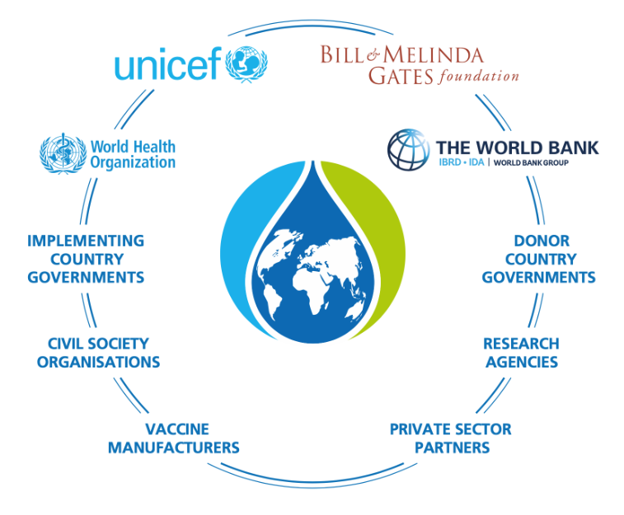
Gavi, the Vaccine Alliance
Gavi, the Vaccine Alliance – Public-Private Partnership to vaccinate over half of children worldwide
Partnership with Bill & Melinda Gates Foundation, WHO, UNICEF, World Bank, CDC, Countries, Donors & Private Sector
Likely vaccinated our 1 billionth child last year. over 25 million deaths averted since inception in 2000
Aiming for 25% reduction on zero-dose children by 2025
Nigeria – home to over 2.2 million zero-dose children – 2nd highest world-wide

Slide 3
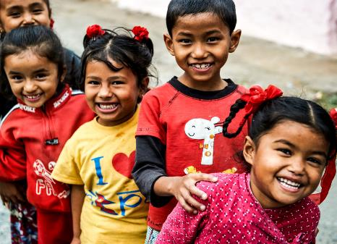
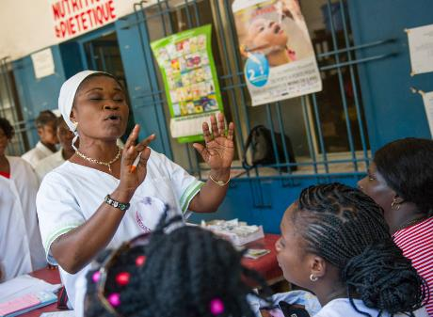
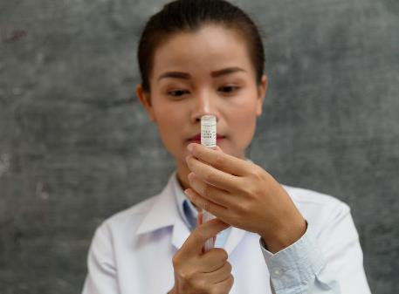
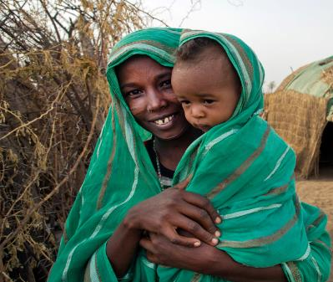
Gavi’s mission: equity is the answer
TO SAVE LIVES
AND PROTECT
PEOPLE’S HEALTH
BY INCREASING EQUITABLE AND SUSTAINABLE
USE OF VACCINES
Gavi support for routine immunisation since 2000: 78 lower-income countries
Eligible for Gavi support in 2021–2025: 57 lower-income countries (54 countries in 2023)
COVAX support for COVID-19 immunisation since 2021: 146 countries (87 lower-income countries)

Slide 4
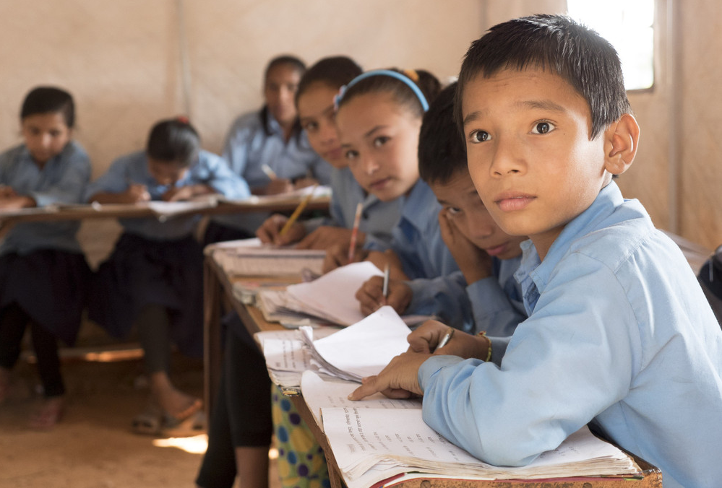
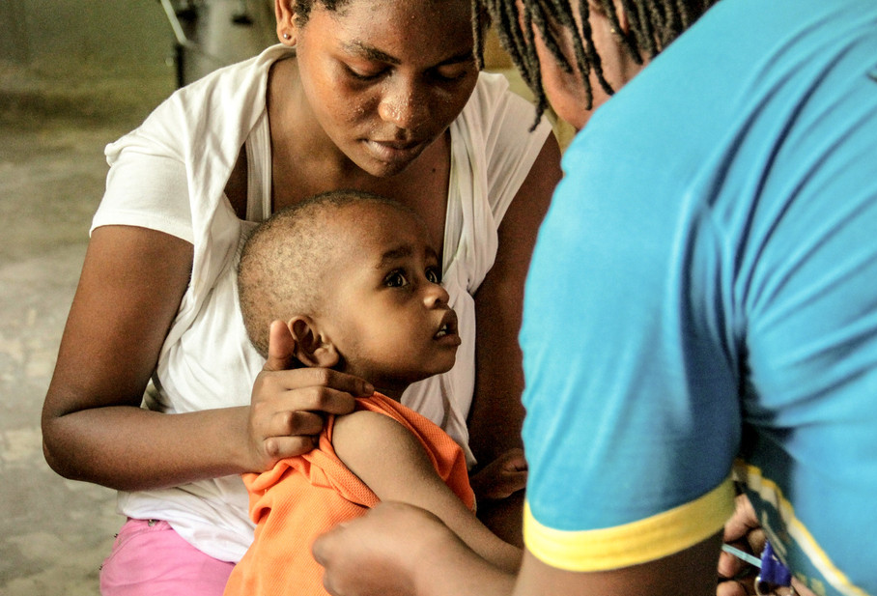
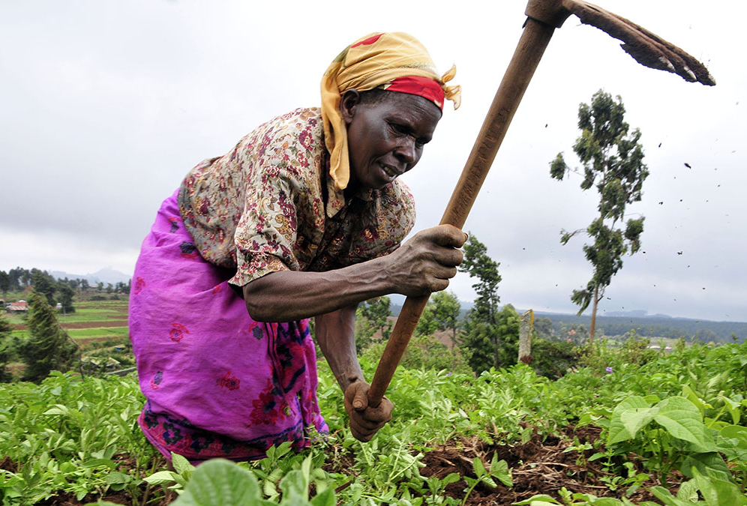
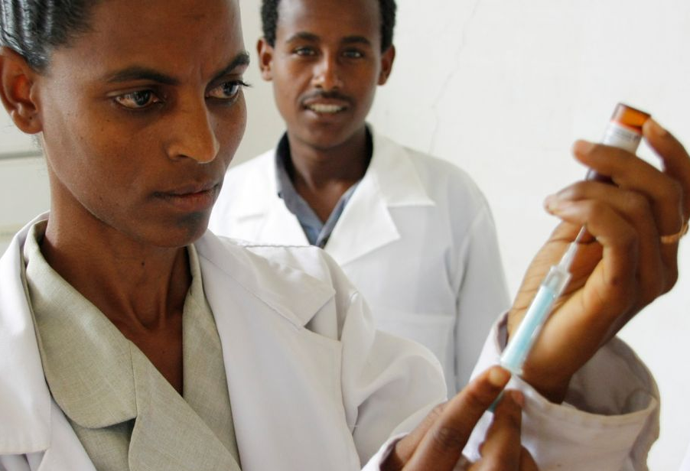
Healthy communities, healthy economies
Gavi-supported countries, 2000–2021
keep people healthy
vaccines save lives
stronger economies
sustainable future
>981
million
>16.2
million
>185.3
billion US$
16
countries
children vaccinated
future deaths prevented
+2.7m
future deaths prevented
by COVAX
through end 2022
generated in economic
benefits (2000–2021)
transitioned out of Gavi
support (+3 in 2022)
Notes:
From 2000 through 2021, Gavi helped vaccinate more than 981 million children in 73 countries through routine programmes, and supported more than 1.4 billion campaign vaccinations.
This has prevented more than 16.2 million future deaths.
By preventing illness, death and long-term disability, vaccines save money for families, communities and countries. Between 2000 and 2021, our work helped generate more than US$ 185.3 billion in economic benefits in the countries we support.
Countries are laying the foundation for a future of self-sufficiency.
Source: 2021 Gavi Annual Progress Report

Slide 5
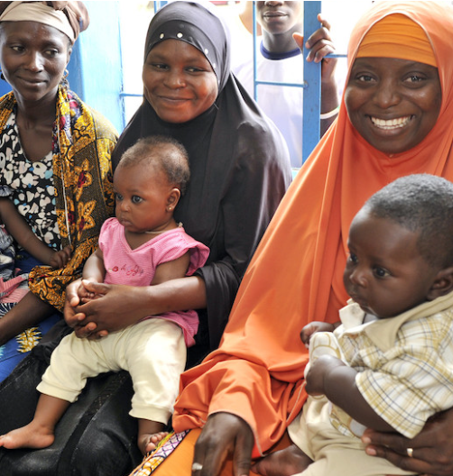
Gavi in Nigeria
$USD 2.2 billion cash & vaccine support to Nigeria since 2002
Accountability Framework agreed upon – with key health financing & programmatic indicators for national and states
Significant improvements from 2016 to 2021: 33 – 57% penta3 coverage, 3.5 million – 2.2 million zero-dose children
Improved immunisation and PHC financing: 4 – 35% FGoN’s share of vaccine financing from 2019 to 2021

Slide 6
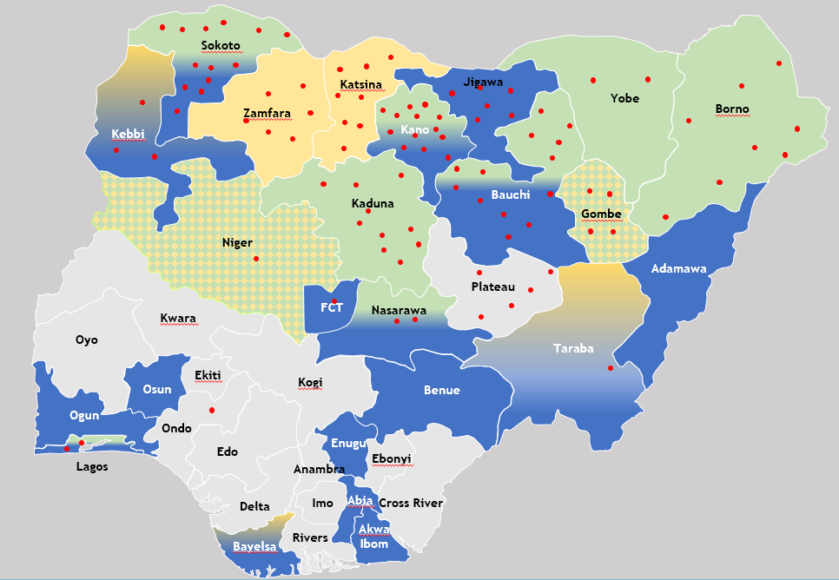
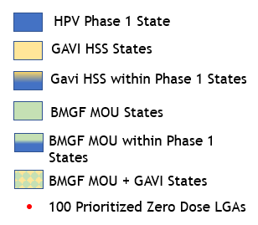
Current Gavi Priorities in Nigeria
Zero-dose: 100 LGAs across 18 States – 25% reduction by 2025
State Engagement: Improve PHC & Immunization outcomes across 8 states – direct funding
HPV vaccine introduction for 9-year-old girls & measles campaign
Accountability Framework implementation
Routine Immunisation & COVID19 implementation strengthening

Slide 7
Call to Action to Governors
Theme
Details
1
HPV Vaccine Introduction
Support successful launch of HPV vaccine & influence uptake to protect all girls from cervical cancer – in and out of school. Support other vaccine programmes – C19, Measles,
2
Routine Immunisation and Zero-dose
Monitor and oversee state PHC entities to identify and reach all zero-dose children/communities with vaccines and PHC services
3
PHC and Immunisation Financing
Allocate adequate funds to extend high-quality immunisation and PHC services to all in the State. Important as Gavi funding comes to an end in 2028
4
PHC and Immunisation State Champion
Advocate for Strengthened PHC and Immunisation in your state

Slide 8
Thank you

