Slide 1
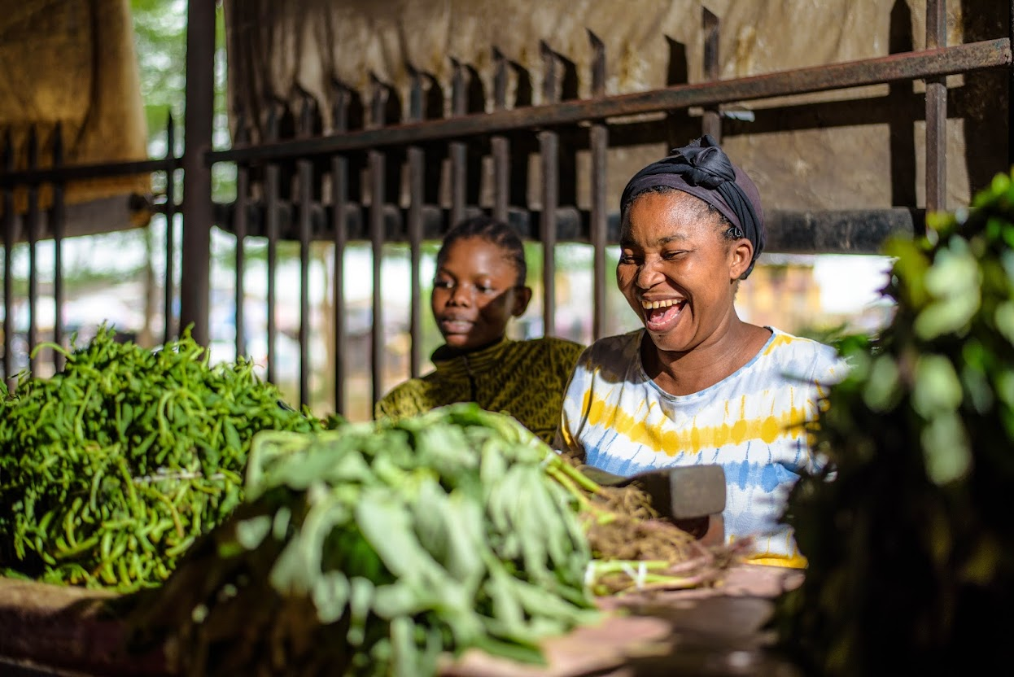
Political and Economic Benefits of Universal Health Coverage to SubNational
Professor Ibrahim Abubakar, University College London

Slide 2
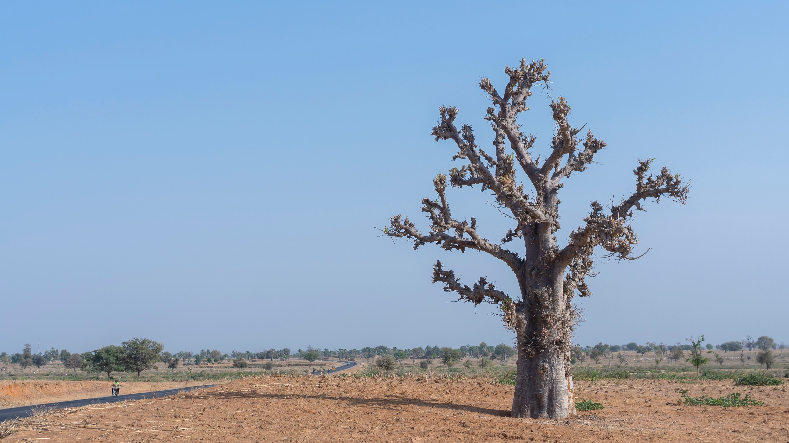
100
Even compared to countries with similar incomes, Nigerian health outcomes are dismal, with drastic inequities between rich and poor, urban and rural populations, and different regions.

Slide 3
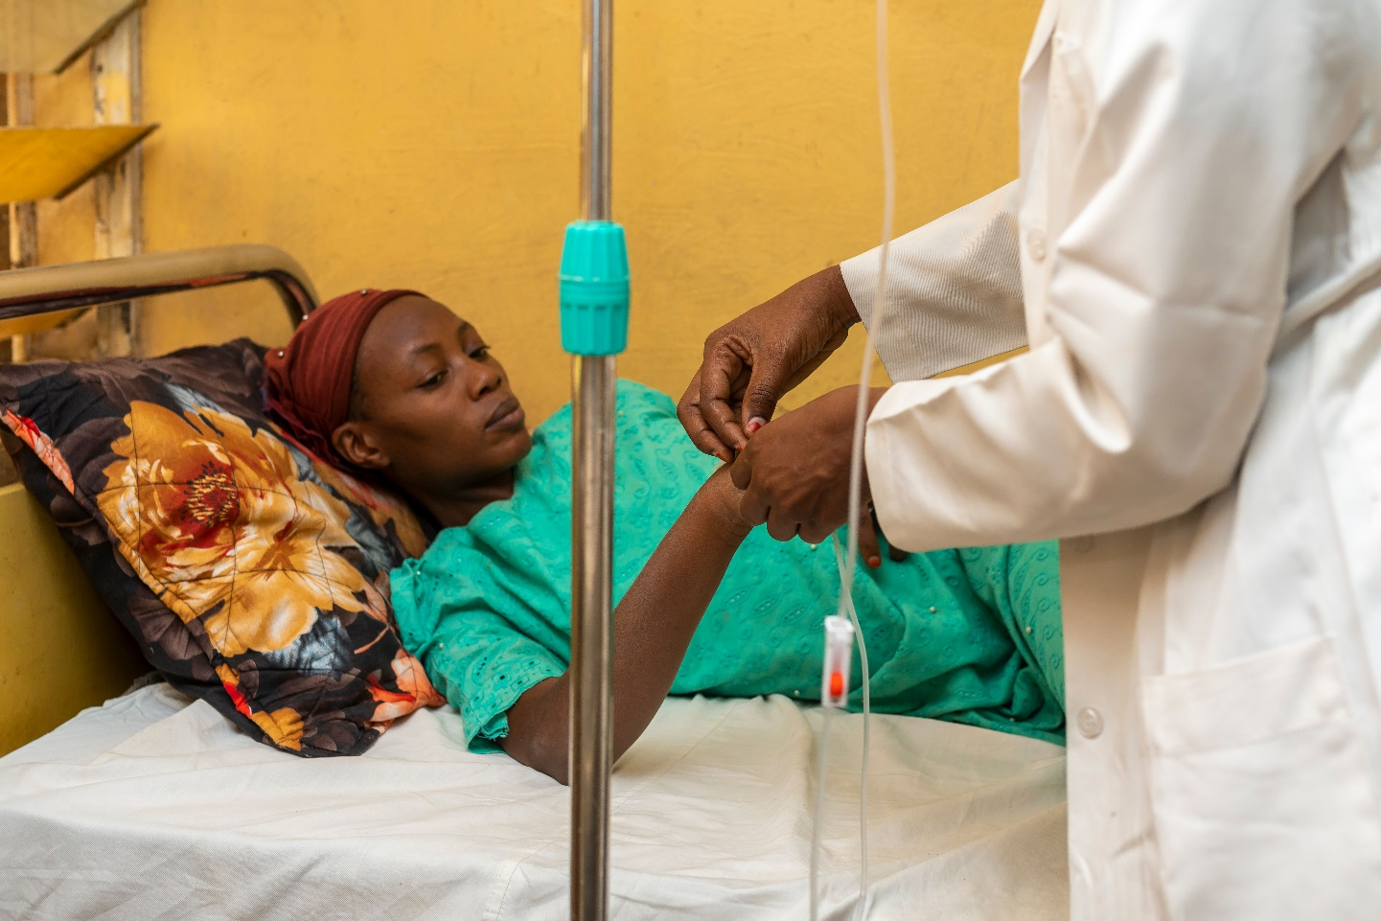
Nigeria is by far Africa’s largest economy – but wealth does not equal health.
Nigeria’s life expectancy at birth is just over 55 years, the fourth lowest in the world
Each year, more children < 5 die in Nigeria than anywhere else in the world
The maternal mortality ratio is exceeded only by Chad, Sierra Leone, and South Sudan
Notes:
Chad, Lesotho and Central African Republic

Slide 4
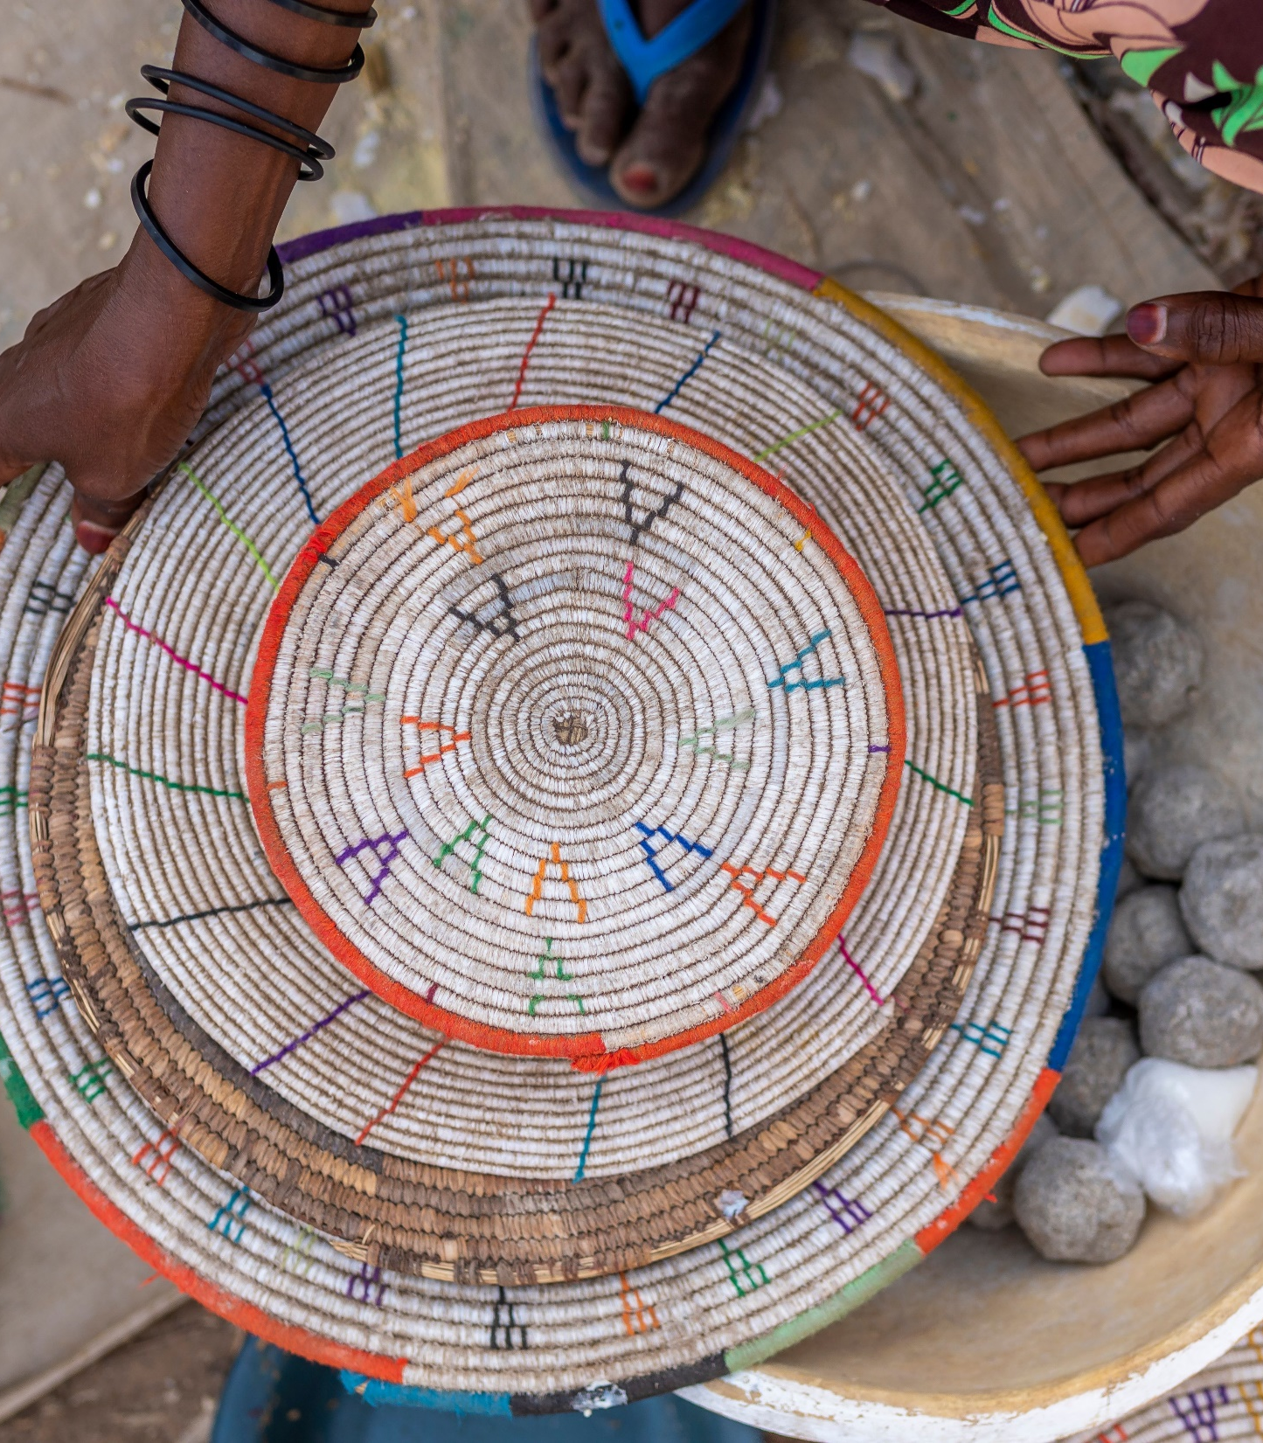
What is the political and economic reward for your excellencies in delivering good health care?

Slide 5
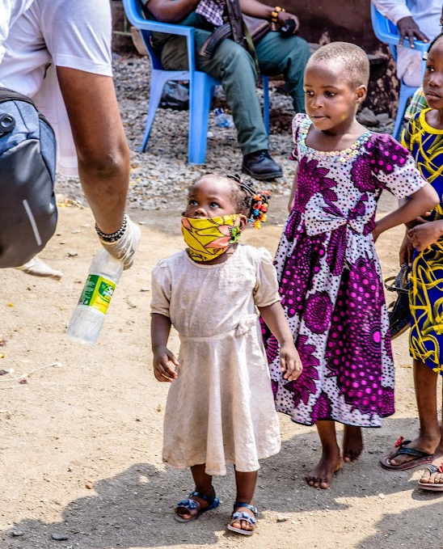
Political
Prioritising and investing in health will lead to improved health outcomes markedly bolstering the positive image of the state government
Healthcare can be the basis of a new social contract between state governments and citizens

Slide 6
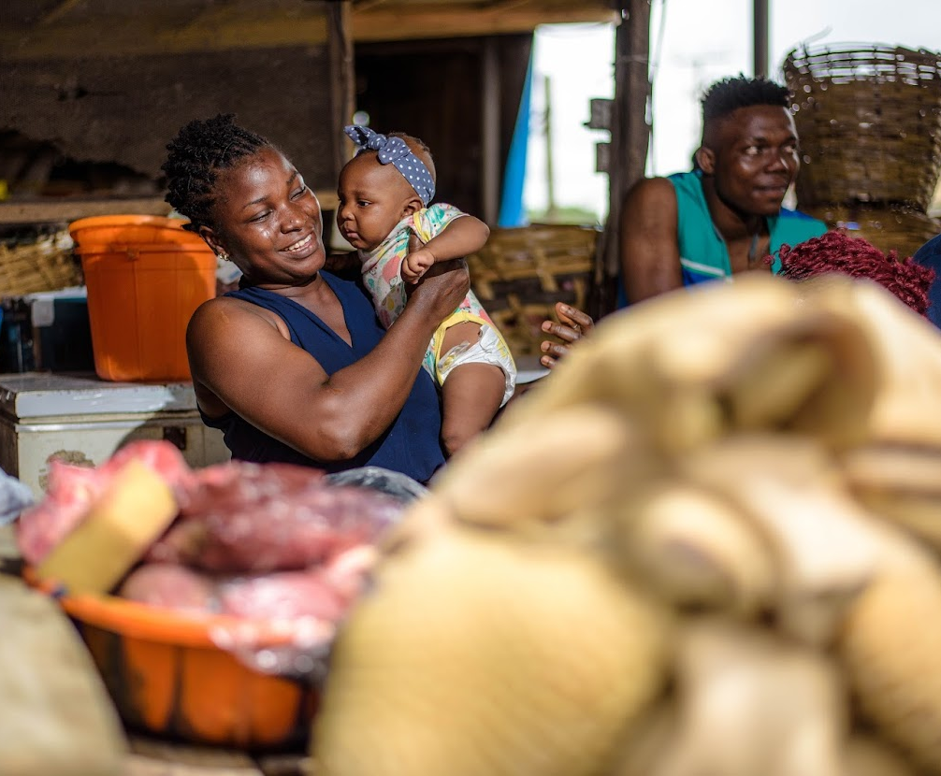
Economic
Demographic Dividend/Disaster
Value for Money
The Business of Health
Health Tourism
Health Security

Slide 7
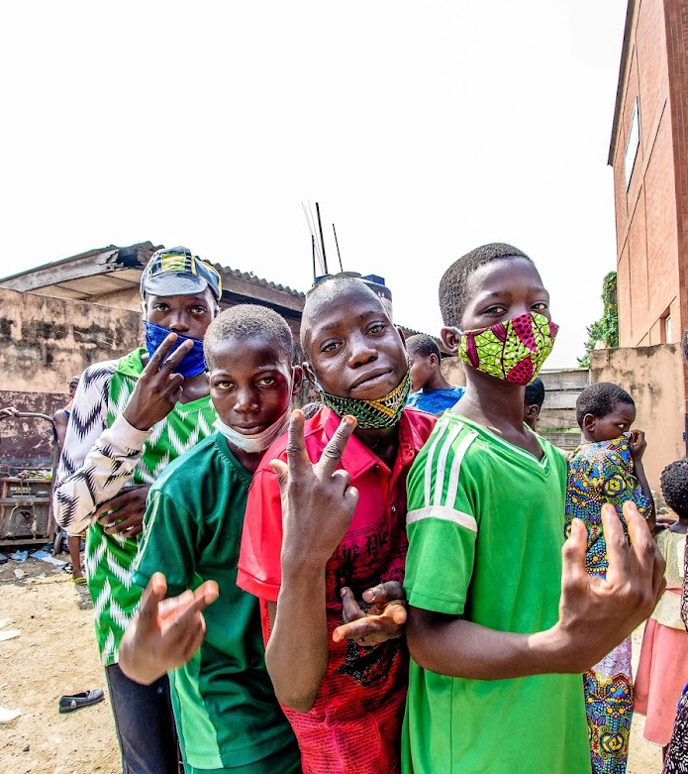
What do we need to do?

Slide 8
We need a whole-of-government and whole-of-society approach to prevent ill health. This means investing in highly cost-effective health-promoting policies and interventions, which have extremely high cost–benefit ratios, and offering clear political benefits for implementation.
Leadership
Infrastructure
Equipment/guidelines
Human resources
Quality and data systems
Financing, UHC, Strategic Purchasing
https://www.thelancet.com/commissions/health-in-nigeria

Slide 9
“The giant of Africa – Africa’s largest population and economy – enjoys considerable unrealized potential. The path to achieve greatness lies in your hands to deliver health and a demographic dividend. The time to do this is now and you have the power to deliver this transformation.”

Slide 10
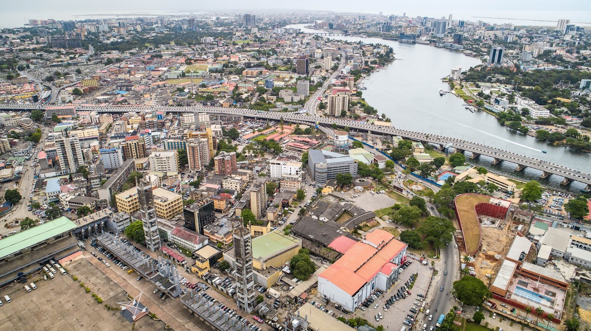
Thank you
For more information,
contact Prof Ibrahim Abubakar:
i.abubakar@ucl.ac.uk
contact@nigeriacommission.org
https://nigeriacommission.org/

