Slide 1
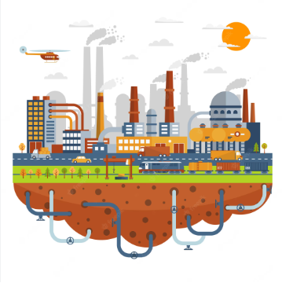
Development Financing in a Debt Mired Environment
Presented by Bismarck Rewane May 16th, 2023

Slide 3
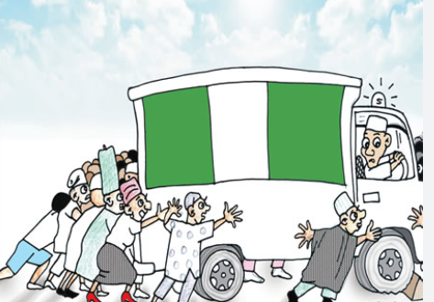
CURRENT STATE ASSESMENT
“The difficulty lies, not in the new ideas, but in escaping from the old ones”
… John Maynard Keynes

Slide 4
FISCAL PICTURE
Indicators | 5-yr Avg. | 2022 (est) | %Change | 2023* (Budget)
Total Federal Expenditure (N’trn) | 9.28 | 14.07 | 51.6 | 21.83
Total Federal Revenue (N’trn) | 4.19 | 5.06 | 20.8 | 11.05
Total Federal Deficit (N’trn) | -5.09 | -8.3 | 36.5 | -10.78
Total state expenditure (N’trn) | 4.52 | 6.4 | 41.6 | N/A
Total state revenue (N’trn) | 3.56 | 6.1 | 71.3 | N/A
Total state deficit (N’trn) | 0.96 | 0.3 | 0.66 | N/A

Slide 5
MACROECONOMIC INDICATORS
Indicators | 5-yr Avg. | 2022 | 2023* | % change
Real GDP growth (%) | 1.22 | 3.2 | 3.10 (2022) | -0.10
GDP per capita | 2,157.4 | 2200 | 2280 | 3.64
Total factor productivity growth (%) | -1.02 | 0.9 | 2.0 | 1.10
Inflation rate (%) | 14.04 | 18.9 | 22.22* | 3.32
Oil Production (mbpd) | 1.63 | 1.20 | 1.18 | -1.67
Oil Price($’pb, end period) | 63.91 | 100.9 | 74.70 | -25.97
Oil Revenue, Gross($’bn) | 15.7 | 25 | 21(2022) | -16.00

Slide 6
SOCIAL INDICATORS
No society can surely be flourishing and happy, of which the far greater part of the members are poor and miserable.
Indicators | Five years ago | 2022 | % change
Multidimensional Poverty (mn) | 91 | 133 | 46.15
Human development index | 0.531 | 0.535 | 0.75
Misery index | 35.2 | 52.2 | 48.30
Life expectancy (yrs) | 53 | 53 | -
Out of school children(mn, UNESCO) | 10.2 | 20 | 96.08
Stunted growth, under -5 children (mn) | 11.5 | 15 | 30.43
Gini coefficient | 35.1 | 35.1 | -
Adam Smith

Slide 7
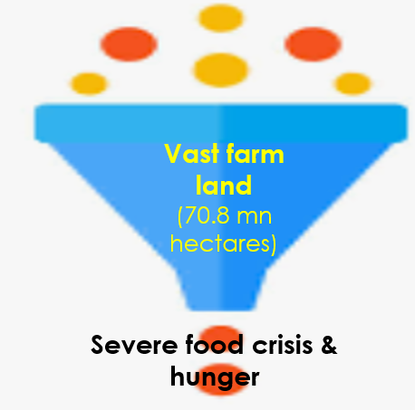
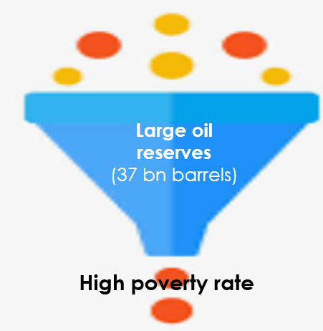
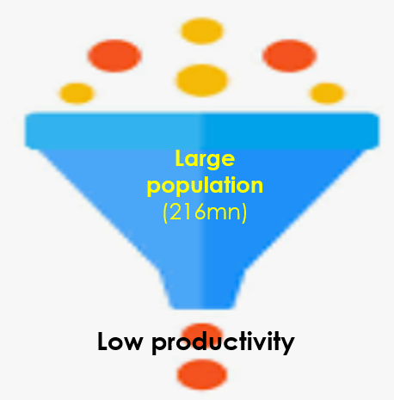
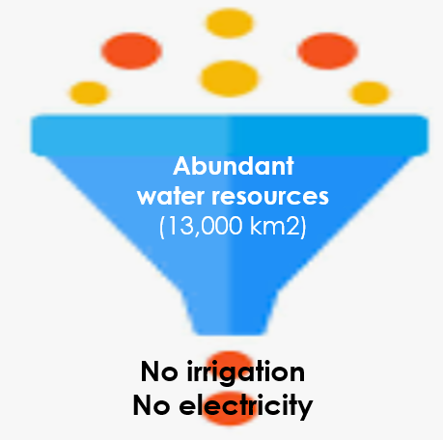
TAKEAWAYS
Bottleneck economy
Sub-optimal resource utilization
Inefficiencies
Structural deficiencies
Bottlenecks

Slide 8
GROWTH IS STAGNATING
Nigeria is facing headwinds on all fronts
Economic growth remains tepid
Nigeria underperforms its peers
Had two recessions in 5 years (2016 & 2020)
Productivity growth stagnated at 0.9%
2022
5 years
(2018-2022)
Nigeria
3.2%
Nigeria
Avg: 1.8%
Highest: 3.6% (2021)
SSA
3.9
SSA
Avg: 2.7%
Highest: 4.8% (2021)
World
3.4%
World
Avg: 2.7%
Highest: 6.3% (2021)

Slide 9
NIGERIA ADDS MORE TO GLOBAL POPULATION THAN OUTPUT
Nigeria
World
Nigeria accounts for
3% of global growth and 0.5% of global output
6% of global population growth and -0.2% of global output growth
Nigeria’s population grew by 21% in 10 years while output decreased by 7%
Global population grew by only 10% in 10 years while output increased by 30%
Population: 216 mn (2022)
% of global: 3%
10-year increase: 45 mn
% increase: 21%
% of Global increase: 6%
Size of the Economy: $477bn % of global: 0.5%
10 year increase: $38bn (decrease)
% increase: 7% (decrease)
% of Global increase: 0.2%(decrease)
Current Global Population
8.0 bn
10-year pop growth
10%
Current Global Output
$100.2trn
10-year growth
30%

Slide 10
2022 GROWTH – WHAT THE BIG NUMBERS ARE MASKING
Nigeria’s economy grew by 3.2% in 2022
Supported by service sector growth
Oil sector contracted 19%
Oil sector has been in recession since 2020
Industry contracted by 4.6% in 2022
Has been in recession since 2020

Slide 11
NIGERIA’S PER CAPITA INCOME LOWER THAN ITS PEERS
Nigeria’s per capita income has stagnated over the past decade
Declined to $2,202 in 2022 from $3,000 in 2013.
Per capita income is lower than that of its peers
Falling as population growth outstrips output growth

Slide 12
MACROECONOMIC STABILITY IS DETERIORATING
Macroeconomic stability is steadily deteriorating due to
Worsening policy uncertainty
Spiraling inflation
Weak external balance
Ever-rising fiscal deficit

Slide 13
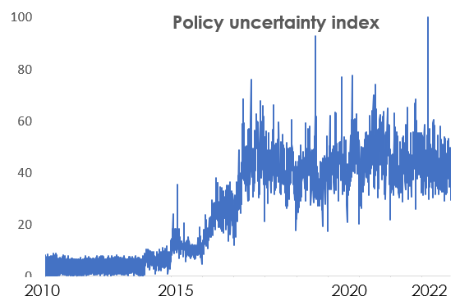
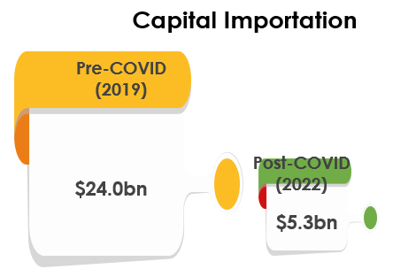
UNCERTAIN POLICY ENVIRONMENT STYMIES INVESTMENT
Policy uncertainty has deteriorated for the past decade
Border closure
FX restriction
Naira redesign
Cashless policy
Census
Election
Capital importation plummeted to an all-time low. Why?
Uncertainty increases the risk premium

Slide 14
INFLATIONARY PRESSURE – PERMANENT OR TRANSITORY?
Inflation races to the rooftop
Exceeded CBN target for more than a decade
No more transitory
Pushing millions into poverty
Nigeria’s inflationary episode predates Russian-Ukraine war

Slide 15
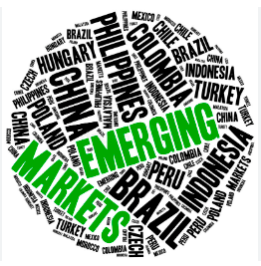
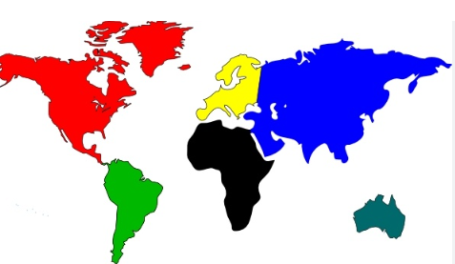
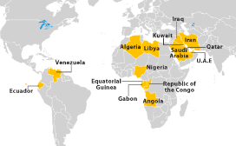
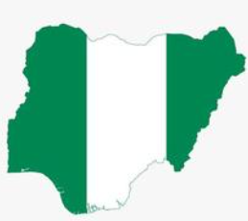
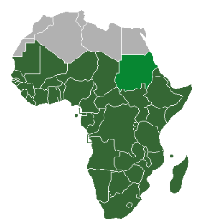
INFLATIONARY PRESSURE – IS NIGERIA AN OUTLIER?
Nigeria underperforms its peers on inflation
Inflation about 3 times OPEC average
Inflation decelerating globally, but spiking in Nigeria
7.0%
14.0%
8.6%
7.5%
22.04%
WORLD
OPEC
(Excluding Venezuela & Iran)
NIGERIA
SSA
EMDE
Emerging Markets & Developing Economies
Inflation (%)

Slide 16
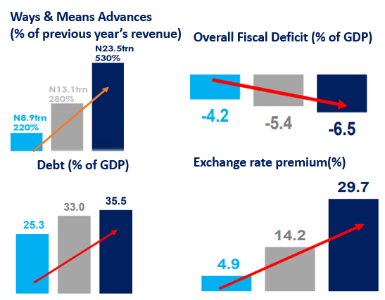
INFLATION STOKING FACTORS ARE STRUCTURAL
Inflation entrenched by
Multiple exchange rate & FX restriction
Debt monetization (WMA)
Excessive borrowing
Ballooning fiscal deficit

Slide 17
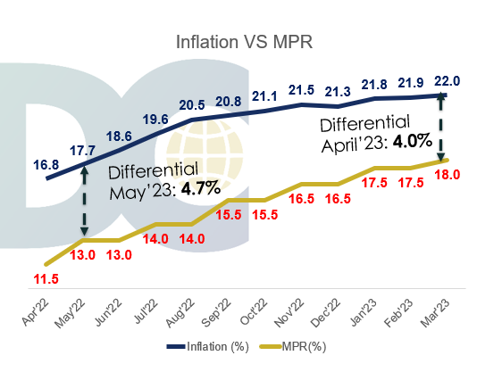
MPR UP, INFLATION UP – WHAT ELSE CAN THE MPC DO?
Inflation defies CBN effort
Inflation-interest rate differential declined by only 0.7% after 12 months of MP tightening

Slide 18
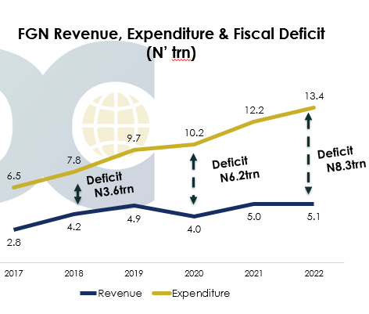
IS NIGERIA APPROACHING A FISCAL CLIFF?
Revenue and expenditure mismatch is worsening
Fiscal deficit to exceed 6% of GDP by the end of 2023

Slide 19
REVENUE AS % OF GDP IS DECLINING STEADILY
Nigeria underperforms peers in revenue generation
FGN revenue-to-GDP decline to 2.7% from 7.2% in 2001-2010
General government (FGN+States+LGAs) revenue-to-GDP is 7%
Has the 4th lowest revenue-to-GDP ratio in the world
Low tax revenue
Nigeria’s tax to GDP ratio is 5%
Africa’s average is 16% (Tax-to-GDP)

Slide 20
OIL REVENUE IN A FREE FALL
Oil revenue falling amid record-high oil price
Suboptimal production
Nigeria (998,000 bpd) lost Africa’s top oil producer to Angola (1.06million bpd)
Ballooning PMS subsidy bill
Oil Vs Non-oil revenue (%)

Slide 21
DEBT SERVICE COST NOW THE KING
He that goes “a borrowing may also go a sorrowing”
Debt service-to-revenue ratio now exceeds 90% (FGN)
Crowds out capital expenditure

Slide 22
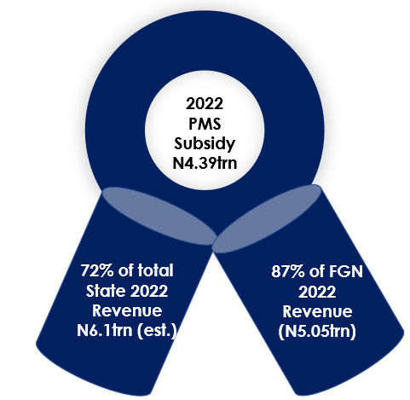
PMS SUBSIDY - AN EXPENDITURE THAT “PASSETH ALL UNDERSTANDING”
PMS subsidy rose 180% to N4.39trn in 2022 from N1.57trn in 2021
NNPC deducts subsidy from source
Will not remit any revenue to the federation account if subsidy exceeds revenue
But the intractable questions are
Who benefits from the subsidy
Can it be reformed?

Slide 23
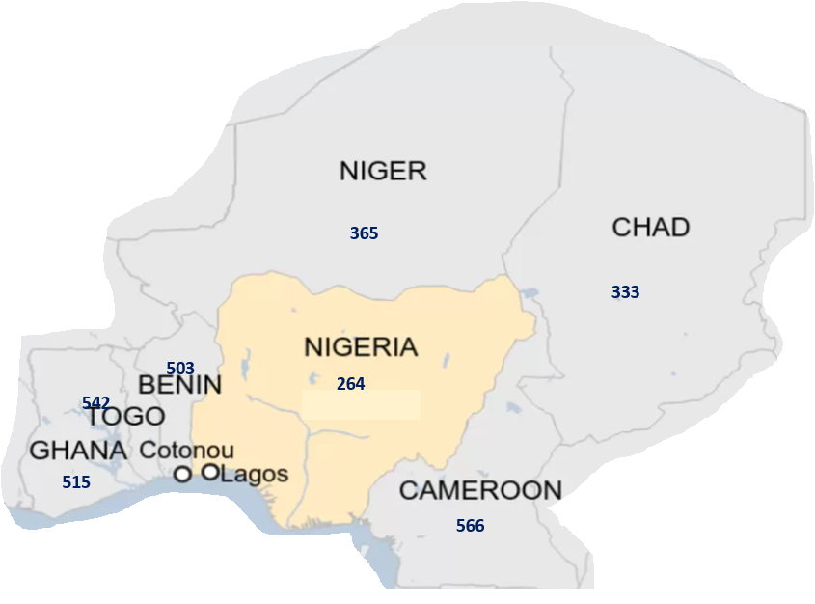
PETROL PRICES ACROSS THE BORDERS
Petrol prices in Nigeria’s Neighboring countries (Naira)
On average, petrol rice is higher in Nigeria’s neighboring countries by average of N207/liter or 78%
Nigeria’s national average is N264/liter
The price differential and regulatory complicity incentivizes smuggling

Slide 24
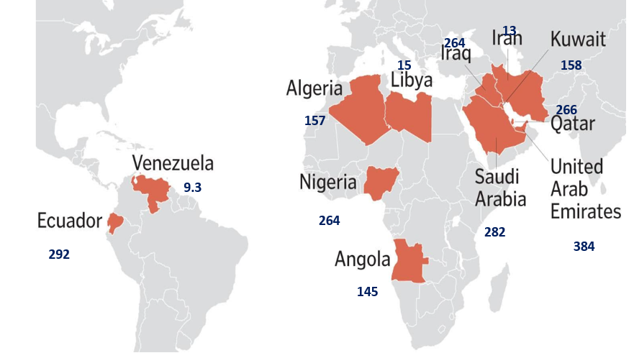
PETROL PRICES IN OPEC COUNTRIES
Average petrol price in OPEC countries is N187
Petrol is cheaper in Venezuela (N9.30),Libya (N15), Iran (13), Kuwait (158)Angola (N145)
Most OPEC countries have fuel subsidy schemes
Some have set out plans for gradual removal (eg Angola)
What is the real problem – subsidy or subsidy management?
Petrol prices in OPEC countries (Naira)

Slide 25
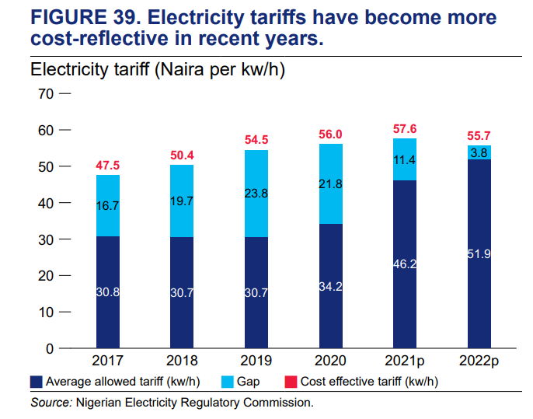
SUBSIDY REMOVAL IS NOT AS EASY AS IT SEEMS
Petrol subsidy removal has been in the air
Easy to talk about but most difficult to be removed
Other subsidies such as electricity subsidy are being gradually phased out
Electricity tariffs have become more cost-reflective
Source: World Bank

Slide 26
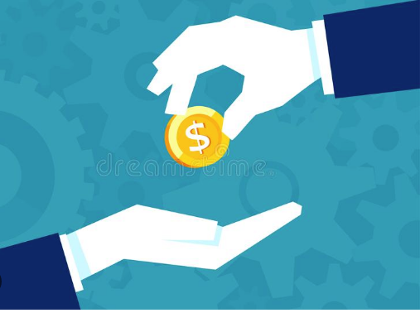
BORROWING FOR VALUE & INVESTMENT
“When the capital development of a country becomes a by-product of the activities of a casino, the job is likely to be ill-done”
John Maynard Keynes

Slide 27
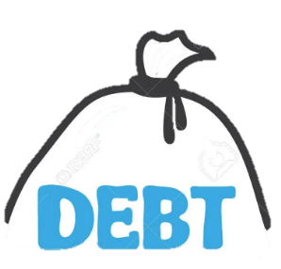
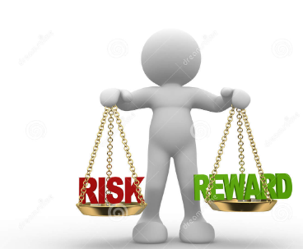
IF YOU MUST BORROW, BORROW TO INVEST
Borrowing is critical for human and physical investment
If you refuse to borrow, you may risk a development crisis
If you borrow, you may risk debt crisis
The way out is to borrow to invest and sell your investment

Slide 28
ANY CORRELATION BETWEEN DEBT & IGR?
High Debt Stock
High IGR
1st
Lagos
N1,384.7bn
1st
Lagos
N753.5bn
2nd
Kaduna
N348.4bn
5th
Kaduna
N52.9bn
….
,
,
3rd
Ogun
N333.4bn
3rd
Ogun
N100.7bn
4th
Delta
N331.9bn
4th
Delta
N80.2bn
States with high debt profile have better development outcome

Slide 29
A TYPICAL DEBT-FINANCED PROJECT
LAGOS STATE BLUE RAIL PROJECT
Project cost is estimated at $1.17bn
About 27-kilometre rail route
To carry about 500,000 passengers daily
Reduce traffic congestion – this could add about N1.04trn to Lagos GDP
Increase IGR by about N80bn
Reduce road accident by 10%
Benefits

Slide 30
A TYPICAL DEBT-FINANCED PROJECT
KADUNA STATE URBAN RENEWAL PROJECT
Funded with $200mn loan from the World Bank
Involves the rehabilitation and reconstruction of roads, bridges, drainage system
Reduce traffic/downtime
Increase the state’s GDP
Bolster FDI inflow
Increase the state’s IGR
Benefits

Slide 31
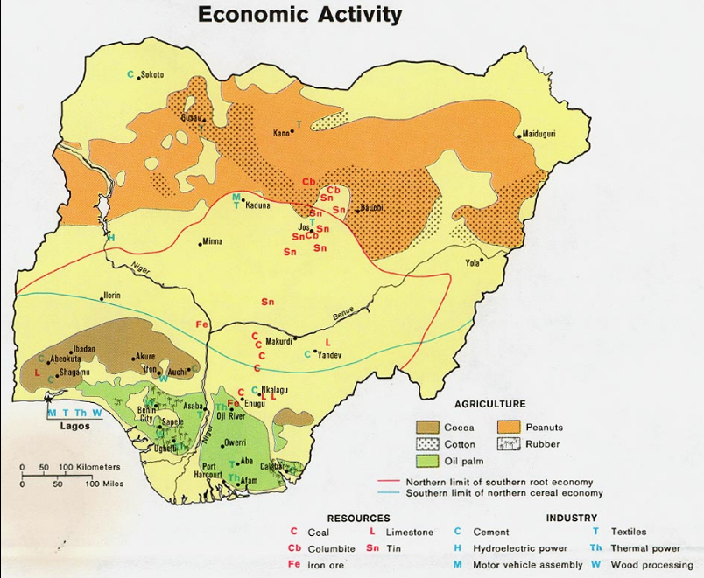
WHERE DOO YOU HAVE COMPETITIVE ADVANTAGE?
Commodity Map
"If you don't have a competitive advantage, don't compete.“
Jack Welsh

Slide 32
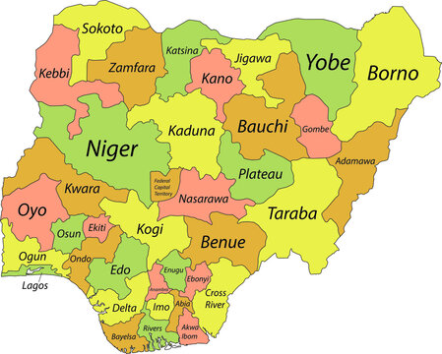
ELECTRONIC MONEY TRANSFER LEVY
State | Bank Branches
Kaduna | 136
Kano | 156
Taraba | 28
Yobe | 31
Zamfara | 32
State | Bank Branches
Abia | 125
Abuja(FCT) | 358
Adamawa | 55
Akwa-Ibom | 91
Anambra | 196
Bauchi | 40
Bayelsa | 30
Benue | 53
Borno | 44
Cross-River | 79
Delta | 167
Ebonyi | 39
Edo | 151
Ekiti | 64
Enugu | 156
Gombe | 34
Imo | 106
Jigawa | 33
Katsina | 48
Kebbi | 38
Kogi | 58
Kwara | 75
Lagos | 1387
Nasarawa | 49
Niger | 60
Ogun | 153
Ondo | 101
Osun | 95
Oyo | 210
Plateau | 84
Rivers | 256
Sokoto | 43
Total | 6918
Why do you rob banks?
Because that’s where the money is – Willie Sutton

Slide 33
WHAT SHOULD THE STATES BE DOING?
Borrow for value – invest in productive ventures
Adopt the PPP investment model – eg NLNG, Indorama
Go for project concession
Road
Airport
Seaports
Rail
Educational infrastructure, eg school hostels
Ascertain project viability

Slide 34
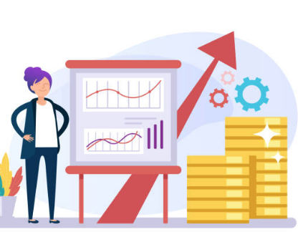
FISCAL CONSOLIDATION & BENEFITS OF REFORMS

Slide 35
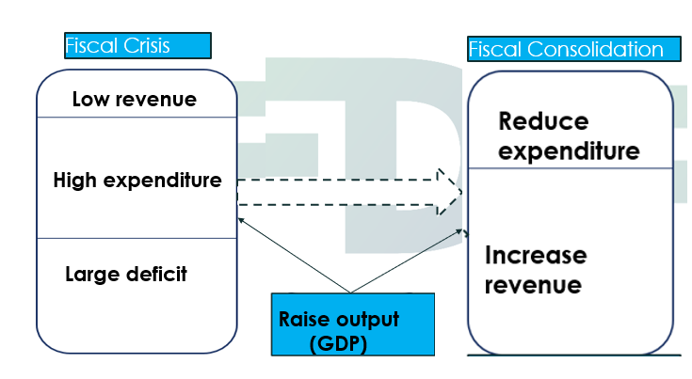
REFORM AGENDA
Options for dealing with fiscal crisis
Fiscal consolidation
Reduce expenditure
Increase revenue
Raise output
Embark on reforms

Slide 36
REFORM AGENDA
Currency Adjustment
Adjust the official rate toward the market-clearing rate
Subsidy Removal
Subsidy is reverse taxes
Increase VAT
States are entitled to 50%
Reforms

Slide 37
SUBSIDY REMOVAL – IMPACTS ON STATES
Removal of Subsidy
N4.39trn
Increased Govt Revenue
Increased investment in critical infrastructure
Reduced debt burden
States to get additional
N1.17trn in FAAC disbursement
N900bn to local governments

Slide 38
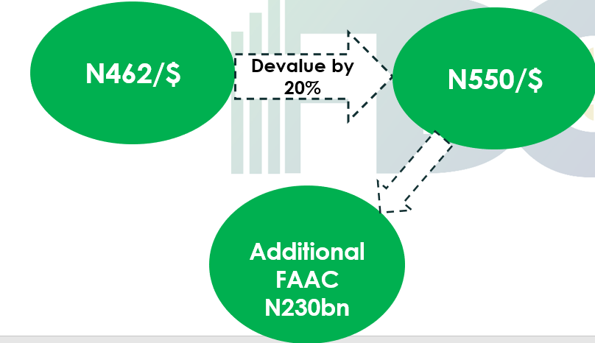
CURRENCY ADJUSTMENT – IMPACTS ON STATES
Over 70% of corporates access FX at the black market
N462/$ VS N750/$
Adjust official rate by 20% to the north of the market rate
FAAC allocation to states to rise by N230bn

Slide 39
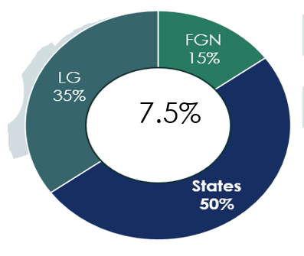
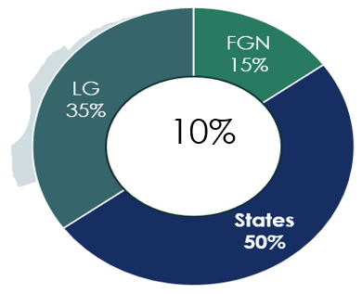
INCREASE VAT TO 10%
Total VAT = N2.5trn(2022)
Total VAT = N3.75trn(Post-adjustment)
States to get additional N625bn post VAT increase

Slide 40
REFORMS ALSO INVOLVES RISK MANAGEMENT
The biggest challenge to reform is public buy-in
There could be fears that exchange rate adjustment could lead to inflation
There is risk that subsidy removal may lead to inflation
VAT increase may squeeze household income
There could be concerns that the gains from reforms will be “looted”

Slide 41
PALLIATIVE PROGRAMMES
Review & Adjustment of Salaries
Increase Spending on Safety Net
Invest in health/education

Slide 42
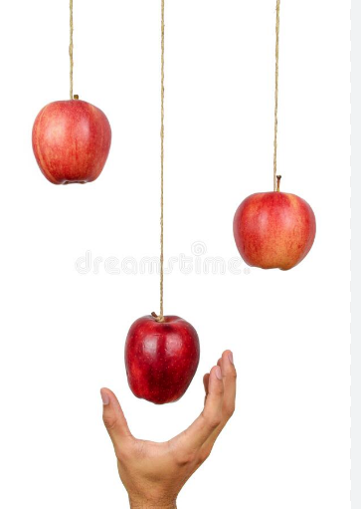
“First stop doing the dumb things and then start doing the smart things before doing the modern things”
…Fareed Zakaria
STOP DOING THE DUMB THINGS

Slide 43
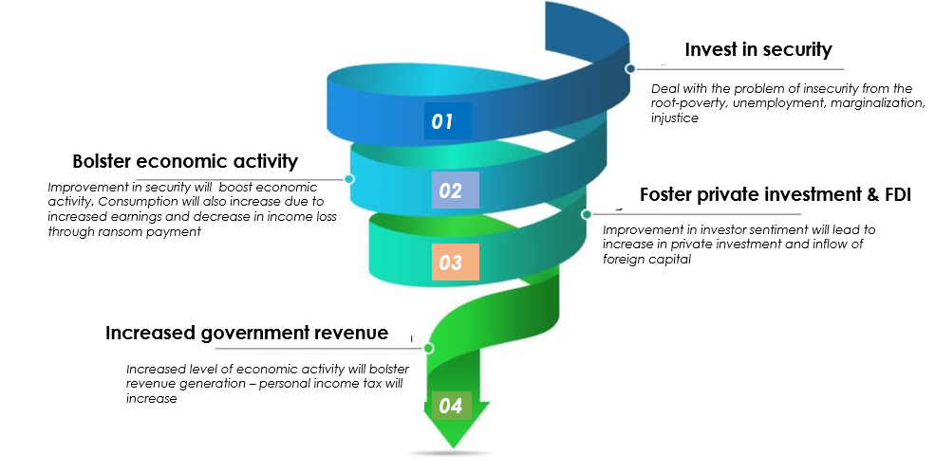
INVESTMENT IN SECURITY

Slide 44
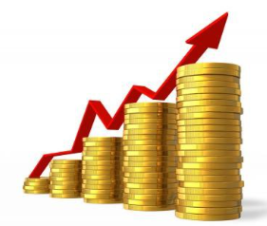
PRIORITIZE REVENUE GENERATION
Focus on resource optimization
Boost tax revenue through efficient and effective tax collection procedures
Block all the leakages
Digitalize the revenue collection and accounting system
Expand the tax net
Envisage fiscal independence … If you can dream it, you can achieve!
Leverage on the state’s comparative advantage

Slide 45
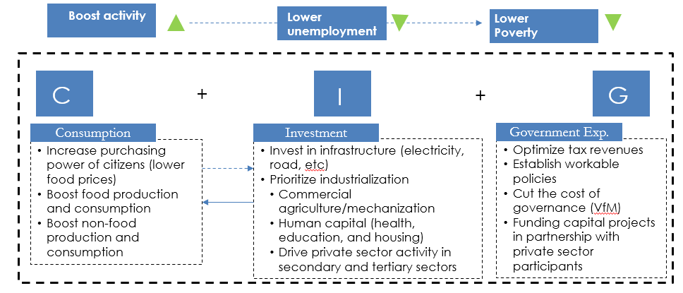
FOCUS ON VALUE CREATION
At every level of the income identity model, activity can be increased which would initiate a trickle-down effect on all other micro sectors of the state economy

Slide 46
POLITICAL, MARKET & POLICY RISKS

Slide 47
WHAT YOU THINK IS NOT WHAT YOU SEE
You can never understand government until you are in government
The challenges may be more daunting than you might have envisaged
It’s during wars that generals are made
Now you are elected, do not make EXCUSES, make HISTORY
Don’t break your promises like biscuits, the people will judge you by them
Elections are tougher now than ever – only the people can give the mandate
Treat the people as kings – you will go back to them after 4 years!

Slide 48
DARE THE RISK, THERE IS TROPHY AFTERWARDS
Only warriors/winners receive a crown
If you serve well, the people will
Make you their legend
Elect you again
Write your name on gold
The reforms you want to undertake will be resisted
The cabals
The warlords
The oligarchs
Will you take the risk of breaking the hard walls or continue business as usual?

Slide 49
IT’S NOT OVER YET
In a “court” democracy like ours, it’s the court that has the final say
Don’t be distracted by the electoral petition
It’s lawyers to the court, the governor to the people
Your stewardship clock begins to tick on May 29
Don’t forget that it was not everybody that voted for you
Consensus building and stakeholder buy-in is key
Think beyond the first 100 days mania
Implement your short term and long term plans contemporaneously

Slide 50
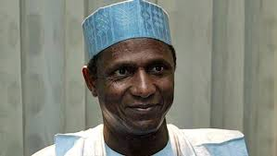
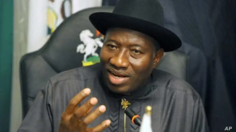
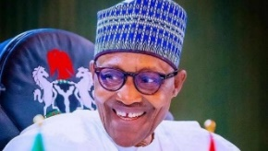
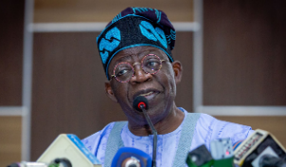
SANCTITY OF CONTRACT – THE P&ID CASE
Nigeria has 60% probability of losing the case
Has a contingent liability of $11bn
Contract has gone through 5 administration
Musa Yar’Adua
2007-2010
Goodluck Jonathan
2011-2015
Muhammadu Buhari
2019-2023
Muhammadu Buhari
2015-2019
Bola Tinubu
2023-2027

Slide 51
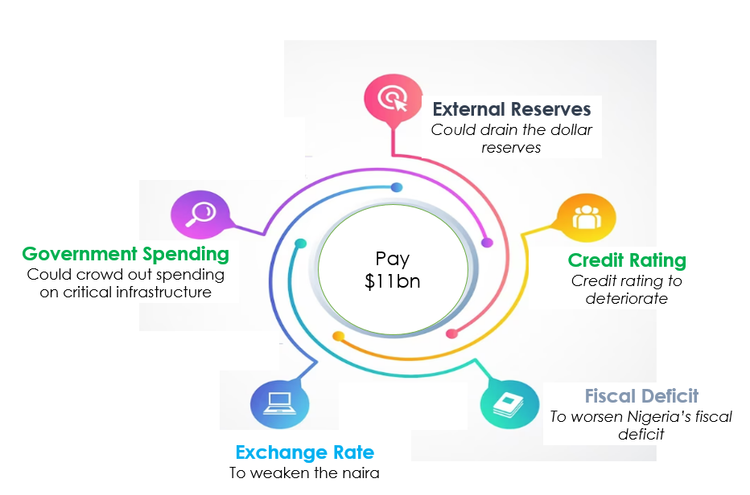
P&ID CASE-CAN NIGERIA BREAK AWAY FROM THE DOOM LOOP?

Slide 52
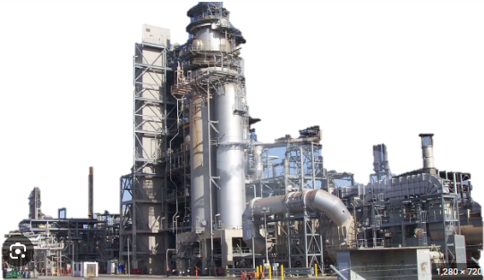
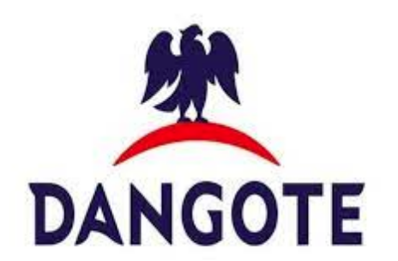
DANGOTE REFINERY – A GAME CHANGER

Slide 53
SEGMENTS OF THE OIL & GAS INDUSTRY
Upstream
Exploration & Production
Midstream
Transportation & Storage
Downstream
Refining & Marketing
LNG
The midstream is still underdeveloped and will need additional investment to make refining more impactful

Slide 54
DANGOTE REFINERY – QUICK FACTS
Dangote Refinery to be commissioned on May 22
Africa’s biggest oil refinery & the world’s largest single-train refinery
Has the capacity to process 650,000 barrels of crude oil per day & 900 KPTA polypropylene
Higher than the combined capacity of the country’s four refineries (445,000bpd)
Kaduna: 110,000bpd
Warri: 125,000bpd
Port Harcourt: 210,000bpd

Slide 55
DANGOTE REFINERY – QUICK FACTS
The refinery can meet 100% of the Nigerian requirement of all refined products and have surplus of the products for exports
The refinery can process large variety of some of African crude, Middle East crude & US light tight oil
Refined products | Million litres per day
Gasoline | 57
Diesel | 27
Kerosene | 11
Aviation jet fuel | 9

Slide 56
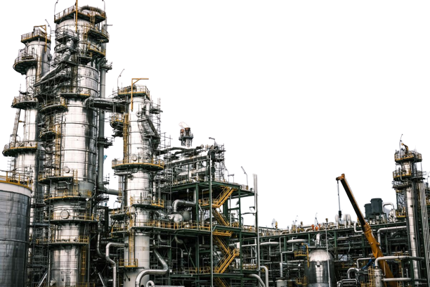
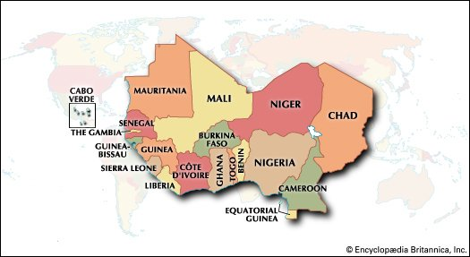
DANGOTE REFINERY - WHERE IS THE MARKET?
Nigeria & other west African countries
African petroleum product demand – 4.3mbpd

Slide 57
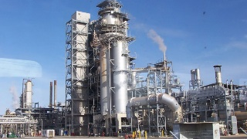
DANGOTE REFINERY: DIMENSIONAL IMPACT ON THE NIGERIAN ECONOMY
Reduction in downtime (fuel queues) & boost in productivity
Increased government revenue due to higher tax payment
Minimal direct jobs but high indirect jobs due to sector linkages
Increased export earnings (export of refined petroleum products)
Improved trade balance

Slide 58
DANGOTE REFINERY: IMPACT ON GOVERNMENT REVENUE
The refinery will boost government revenue through higher tax payment
Highest Tax Payers | Amount (N’bn)
Dangote Cement | 173.92
MTN Nigeria | 138.03
UBA | 35.81
Zenith Bank | 34.39
Lafarge | 10.78
Total | 392.93
The top 5 companies paid over 22% of total company income tax (N1.69trn) in 2021

Slide 59
DANGOTE REFINERY: IMPACT ON PRODUCTIVITY
Increased productivity & output growth
The refinery has a 435MW capacity power plant
Will meet the total power requirement of Ibadan Disco (860,316MWh)
Covering 5 states - Oyo, Ogun, Osun, Kwara, Ekiti
Improved power supply will reduce total energy spend, increase productivity and boost output growth
Increase in employment levels
9,500 direct and 25,000 indirect jobs to be created

Slide 60
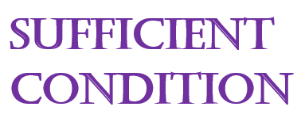
IS DANGOTE REFINERY A SILVER BULLET?
Macroeconomic stability requires much more than a functional refinery!

Slide 61
SUMMARY & CONCLUSION

Slide 62
THE KEY TAKEAWAYS
The economy is in a doldrum, and the state finances are not in good shape
Do not expect a honey moon or tea party
You must hit the ground running on the first day
Remember it’s about people centrism, agent centrism will hurt at last
Prioritize resource optimization – earn more, waste less and achieve big
Borrow to invest and to sell your investment
Prioritize what you must not do first before deciding on what you must do
Stop doing the dumb things, and start doing the smart things

Slide 63
THANK YOU

