Slide 1
2.
3.
Ensure Energy Sufficiency in Power & Petroleum Products
1.
Stabilize the Macroeconomy
Achieve Agriculture
& Food Security
Improve Health. Education & Productivity of Nigerians
4.
Improve Transportation & Other Infrastructure
5.
Drive Industrialization
Focusing on SMEs
6.
7.
Enhance Social Inclusion and Reduce Poverty
8.
Fight Corruption and Improve Governance
9.
Provide Security for All Citizens
THIRD YEAR MINISTERIAL PERFORMANCE REVIEW REPORT
OCTOBER 2022

Slide 2
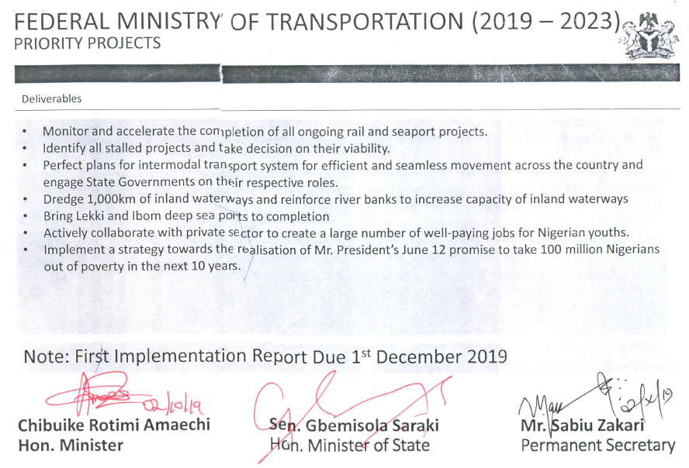

Slide 4
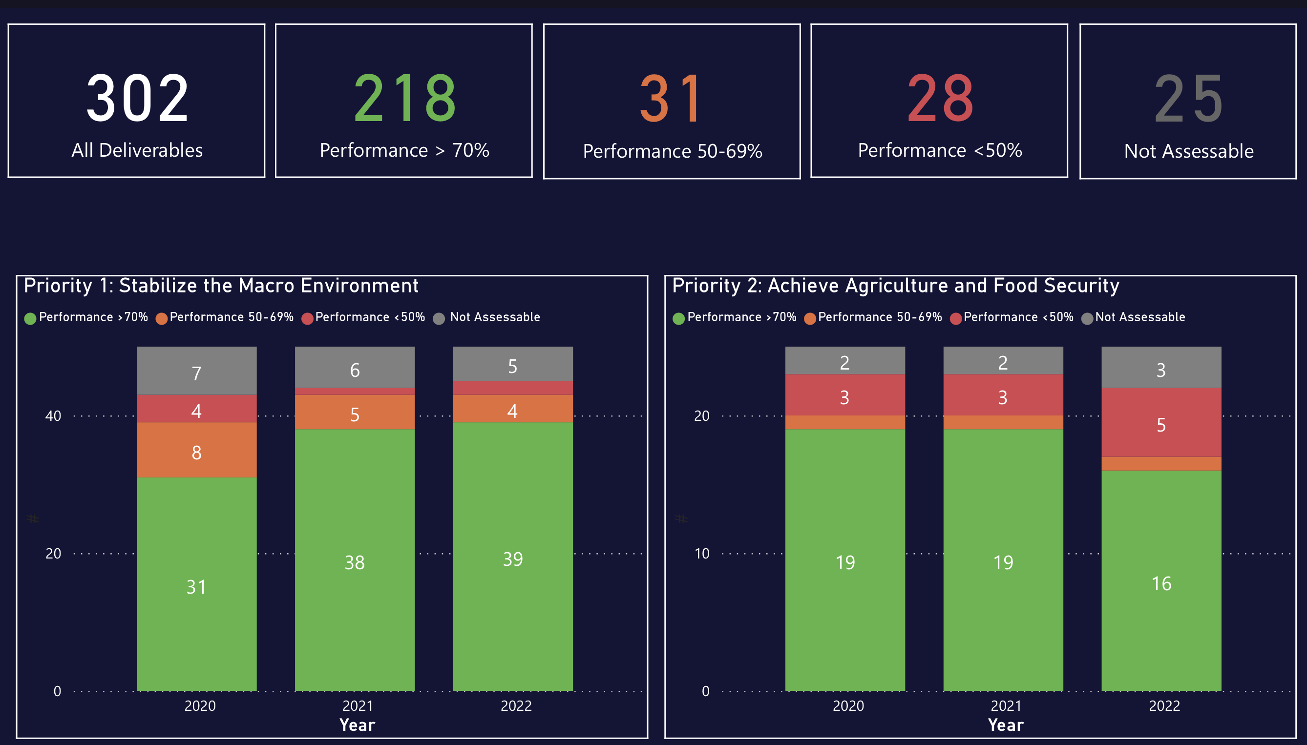
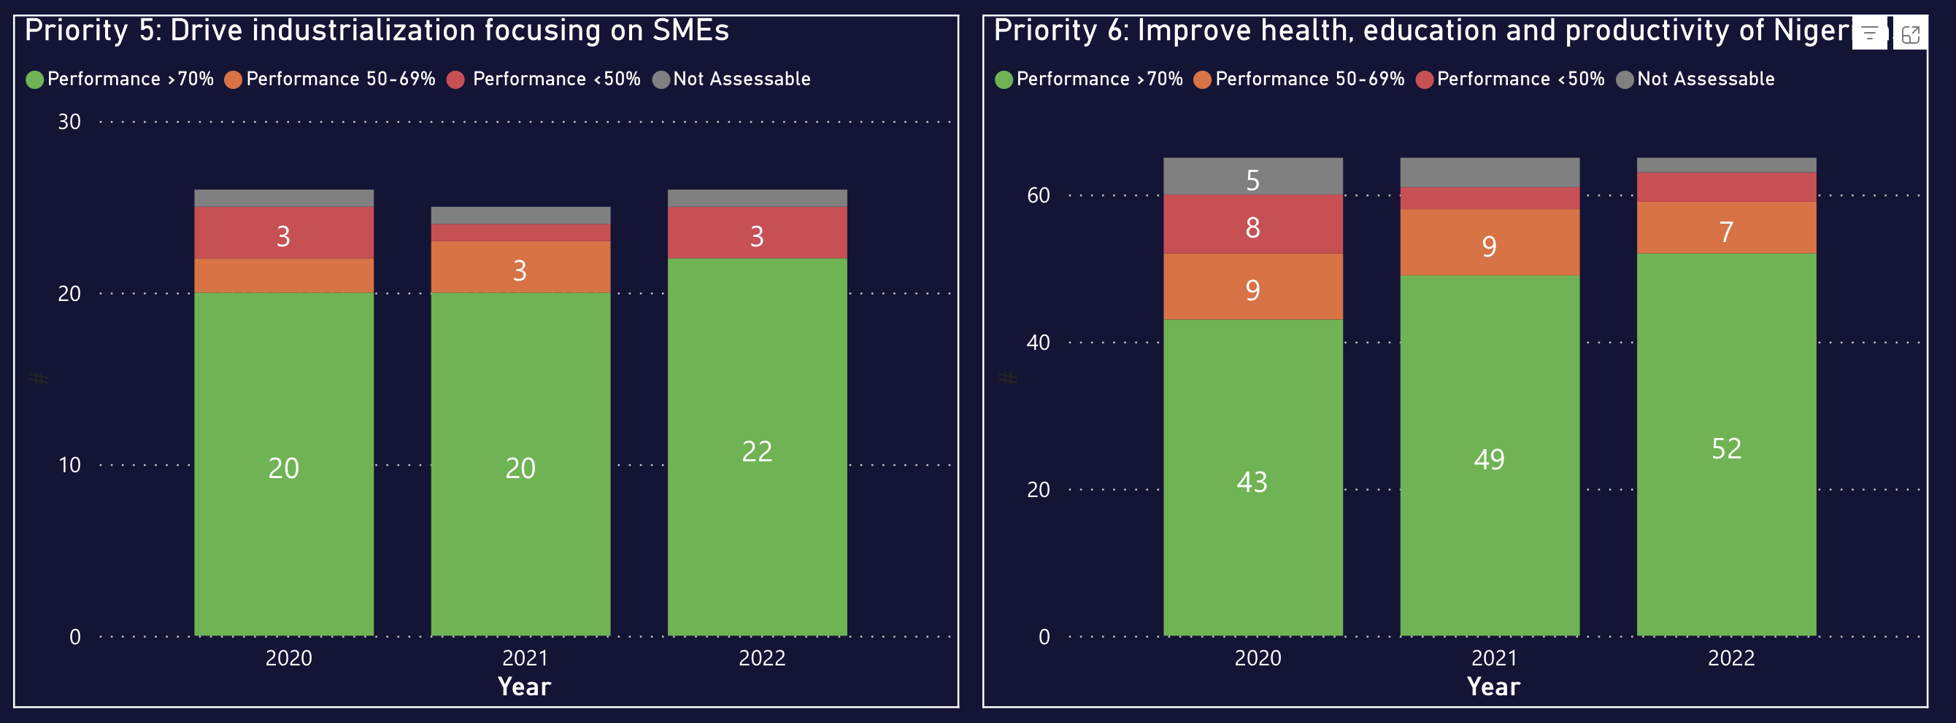

Slide 6
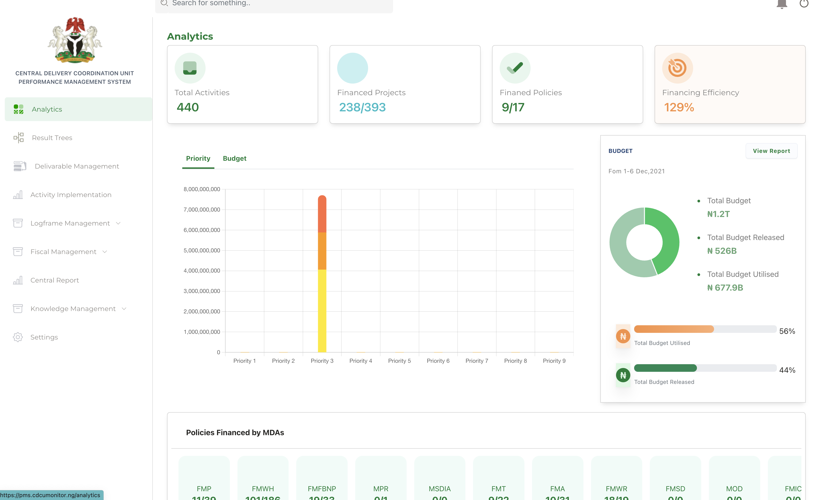

Slide 11
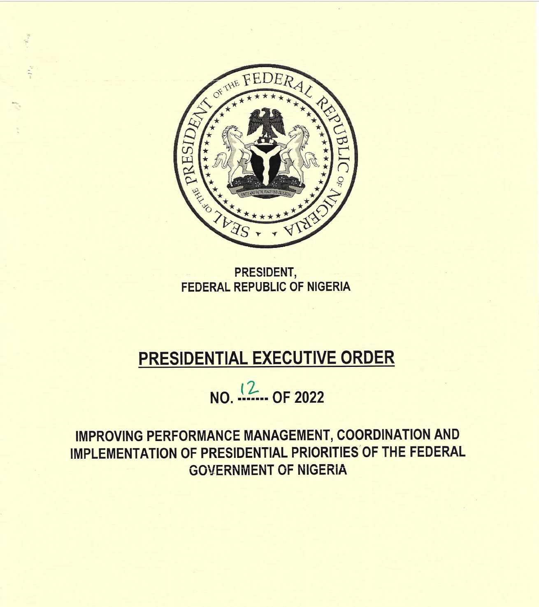
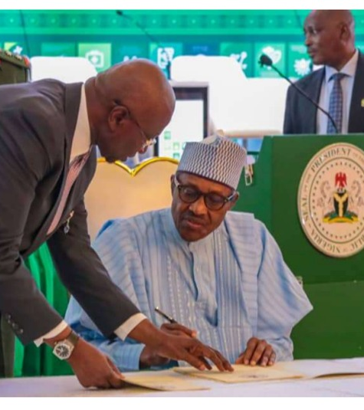
13

Slide 12
