Slide 1
HelpDesk
‘Tapping the Revenue Potentials of States’
Presentation at the 2023 Governors’ Induction for New and Returning Governors
14th to 17th May 2023
Dr Mark Abani FCTI, FNIM, FICA, FNIM
Coordinating Dean, Chartered Institute of Taxation of Nigeria (CITN)
Independent Internally Generated Revenue Consultant

Slide 2
HelpDesk
CONTENT
Setting the Scene
The contribution of internally generated revenue to total state revenues
The Size of the untapped revenue potential
Action plans to close the tax gap
Proven key actions for effective tax reforms
Suggested Next Steps
Thank you and Questions

Slide 3
SETTING THE SCENE
HelpDesk
The Revenue of States is influenced and affected by the realities of the Economic Outlook for 2023 and beyond.
Traditionally the revenues have mainly come from the FAAC allocations, but the dwindling oil revenues have caused states to look inward to manage their revenues by both increasing their ‘Internally Generated Revenue’ and by managing and prioritising their expenses.
Other measure to make state revenue go further include:
Innovative Public Private Partnerships to fund Infrastructure and energy gaps,
The making of realistic budgets that the states can afford and that are focused on the greatest return for the states and their residents,
The development of practical energy transition plans with clearly articulated roadmaps,
The exploration of alternate sources of finance from the Capital Markets, and
The development of Sustainable Debt Management approaches.
This presentation focuses on tapping the revenue potentials of states, mainly through improves Internally Generated Revenue activities.

Slide 4
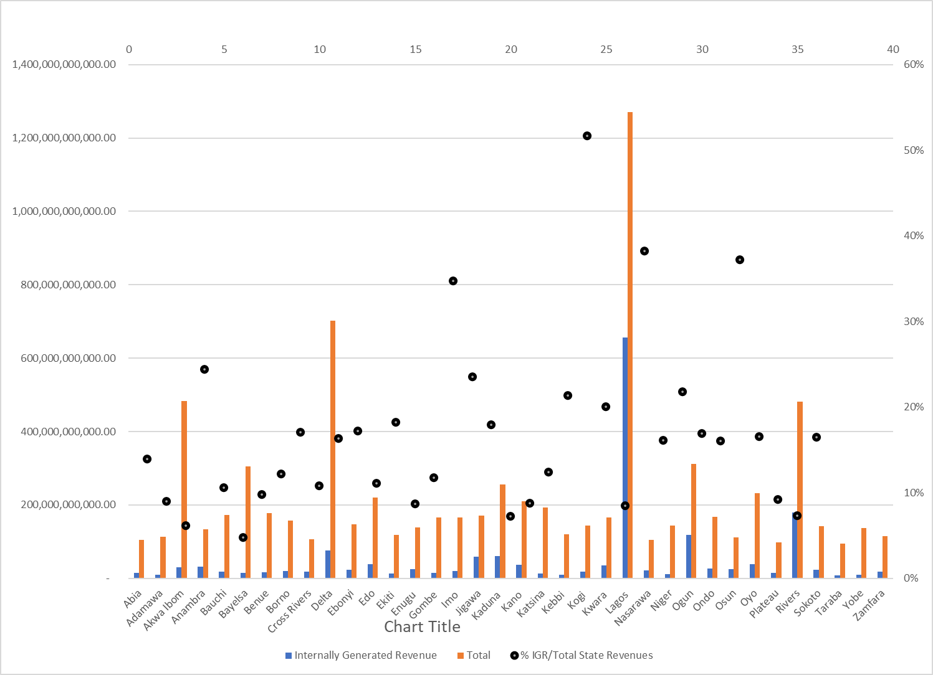
The contribution of internally generated revenue to TOTAL state revenues
HelpDesk
Domestic revenue mobilisation is recognised as a key to achieving fiscal recovery, stability and economic development in the country.
Despite these calls, very few states have generated more than 30% of their total state revenues from Internally Generated Revenue sources.
Some of reasons for the poor performance include the low tax capacity across States and the lack of practical and realistic Medium Term Revenue Strategies and the complexities of the tax system.
On the positive side 32 of the 36 state have passed legislation that addresses some of this complexity and puts the State Internal Revenue Services at the heart of all the state revenue collection and accounting measures.
The performance demonstrates the reliance on FAAC Allocations and the need to actively address the issues inhibiting the tax revenues.

Slide 5
The Size of the untapped revenue potential
HelpDesk
State | Geo Political Zone | Nominal GDP 2017 NGN Billions | IGR 2022 NGN Billions | % Tax to GDP | Potential NGN Tax at 7.5% | Gap (NGN Billions) between potential and actual IGR 2022
Akwa Ibom | South South | 5,141 | 30 | 0.57% | 385.6 | 356.00
Anambra | South East | 3,079 | 33 | 1.06% | 230.9 | 198.30
Ondo | South West | 2,933 | 27 | 0.92% | 220 | 193.10
Kaduna | North West | 2,691 | 60 | 2.23% | 201.8 | 141.90
Gombe | North East | 1,239 | 14 | 1.15% | 92.9 | 78.60
Kogi | North Central | 1,818 | 18 | 0.98% | 136.3 | 118.50
Nominal Gross Domestic Products 2013 – 2017 used as most recent and verifiable,
Figures - Q4 Budget Implantation Reports of States2022 (These may change in Audited Statements)
*Given age of GDP data, the tax potential and hence tax gap will be even higher!
Sources: State Nominal Gross Domestic Products 2013 – 2017, Joint Tax Board Provisional 2022 IGR figures

Slide 6
HelpDesk
ACTION PLANS TO CLOSE THE TAX GAP
The NGF Secretariat in collaboration with the Joint Tax Board (JTB) has developed a 12-point State Action Plan to improve tax administration and revenue generation at the sub-national level.
The plan is aimed at achieving five (5) key objectives, namely;
Ending Double/Multiple Taxation,
Making the most of the State Internal Revenue Service (SIRS);
Improving Taxpayer Compliance;
Blocking Revenue Leakages and
Improving Revenue Budgeting and Reporting.
The plan is based on lessons from the 36 States of the Federation and other international experiences.
*An updated copy will be made available to Governors for discussion and adoption shortly

Slide 7
HelpDesk
Proven key actions for effective tax reforms:
Work by the NGF along with the JTB and other stakeholders and development partners have identified that the following 5 actions, fully support by their Excellencies the Governors should have the necessary impact. These are:
1. Administrative and financial autonomy for the tax authority. - Though many state Laws provide for this very few states have actualised the autonomy (Administrative or financial) thereby undermining the potentials of the various State Internal Revenue Services.
2. A simplified, harmonised, and consolidated revenue code. - While 32 of 36 States have passed a Consolidated Revenue Code these have not in all cases addressed the simplification required for success. Support is also needed to implement, for example, property tax, where tools are already available.
3. A functional social service delivery programme to build public trust. - This is urgently required to rebuild the taxpayer trust by increasing transparency and accountability required for voluntary compliance. It makes it clearer what taxpayers get in return for their taxes.
4. A whole-of-government approach to reform implementation to drive inter-agency collaboration. - While this has started for it to provide the expected revenues the Governors need to actively push this agenda though their support to State Medium Term Revenue Strategies
5. Digital transformation of tax administration and government processes. Though many states now collect some of their revenues through digital platforms Governors need to support the adoption of wider digital adoption and the use of Information Technology to both analysis data and reduce potentials for revenue leakages.

Slide 8
Next Steps
HelpDesk
Ensure that your state has a Medium-Term Revenue Strategy that you support actively and promote MDA and other state actor collaboration for efficiency and effectiveness.
Provide as much administrative and financial autonomy (while reporting to you) for your State Internal Revenue Services.
Promote the Ease of Doing Business within your state as more businesses mean greater contributions of tax to fund State Government Priorities – Key into wider Development Partner support where available (for example SABRE by the World Bank).
Actively support the digitization of state revenue related processes for transparency, efficiency and effectiveness of all stakeholders.
Support the implementation of interventions that directly increase the states’ revenues and indirectly provide support to bring more taxpayers into the tax net – ensuring the tax burden is fairly shared by all those who benefit from the policies and protection of the State.

Slide 9
HelpDesk
Thank you for Listening

