Slide 1
IN-HOUSE TRAINING ON THE NGFS LIBRARY
BY:
NAOMI ONORIODE UBOGU
Manager/Senior Librarian
1st August 2022

Slide 2
TABLE OF CONTENT
The NGF Library – An Overview
Sections in the NGFS Library
The NGFS Library Policies and Procedures
The NGFS Library catalogue
Accessing documents in the physical Library
Software deployed for the automation and digitization of the NGFS Library
The NGFS E-Library
Step by Step Guide on How to access the e-library
The NGFS Digital Repository
Step by Step Guide on How to access the Digital Repository
Knowledge Management Strategy: Building the NGF E-library and Digital Repository Simultaneously
Library Rules and Regulations
Library Opening Days and Time

Slide 3
THE NGF LIBRARY: AN OVERVIEW
Let me start by defining the term “special Library”. A special library is a library that provides specialized information resources on a particular subject, serves a specialized and limited clientele, and delivers specialized services to that clientele. Wikipedia
The Nigeria Governors’ Forum Special Library is a custodian of knowledge base resources of the NGF, State Governments, MDAs, and Development Partners.
Located in a world class serene environment; the Nigeria Governors’ Forum (NGF) Special Library is an information hub that collect, stores, preserve, and disseminate knowledge resources in print and digital formats for the library patrons seeking information and knowledge on the core thematic areas of the Nigeria Governors’ Forum.
The primary mission of the NGF library is to let staff, stakeholders and researchers have access to information and knowledge through physical books and electronic formats held in the library.

Slide 4
SECTIONS IN THE NGFS LIBRARY
The NGFS Library has five sections within the library space. They are;
REFERENCE SECTION: The reference section provides reference services to internal and external patrons of the library. This section is the duty point of the librarian whose responsibility is to assist patrons by providing answers to specific enquires, instruct and guide patrons on the use of the library and assist in getting information from the library resources for study, research and learning. The workstation is also located within the reference section of the library for ease of carrying out daily library task such as scanning, printing, and binding of documents.
NEW ARRIVAL: This section of the library is used for the display of new acquisitions or collections for a limited amount of time (usually 3 weeks) for the library patrons to have a chance to browse the new acquisitions or collections of the library before they are shelved appropriately. Confidential documents are excluded from the collections that are displayed.
READING SECTION: Just as the name implies; this section of the library is where patrons are allowed to sit and read after accessing the collections of the Library. This section also serves as a workstation for library patrons as there are computers on some of the tables where patrons can access the e-library or carry out personal research.
BOOKSHELVE SECTION: This section is where the library books are shelved, classified and displayed with appropriate label to enable patrons have easy access to documents. There are also closed shelves that stores confidential documents.
Relaxation Lounge: The section is where library patrons can sit, relax, and unwind. It is a perfect spot for reading newsletters, magazines, and newspapers. There will also be other activities going on in this space such as playing of educative games. All the activities to be carried out by patrons in this space is to be done moderately and quietly so as not to cause distraction to other library patrons.

Slide 5
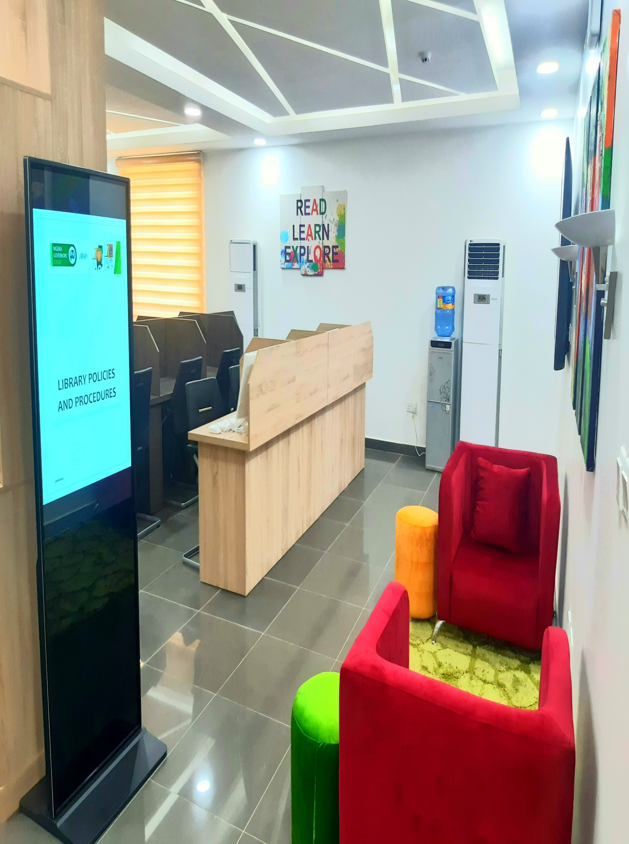
THE NGF LIBRARY POLICIES AND PROCEDURES
Library policies and procedures are rules and regulations guiding every activities of the library including the patrons.
In other to preserve, disseminate and render a first-class service to patrons of the library; the NGFS library has developed a set of rules for using the collections so that they remain safe and usable by all for years to come. The NGFS library policies and procedures covers the following;
Submission of Documents to the library
Purchase of Books for the NGFS Library
Library Room
Duplication
E-Library
Digital Repository
7. Publishing/Reproduction policies.
Note: Detailed information can be found in the Library policy document.

Slide 6
THE LIBRARY CATALOGUE
Let’s start by defining the term “catalogue”.
The term ‘Library Catalogue’ has been formed from ‘Greek’ phrase “Katalogos”, ‘kata’ means “according to” and ‘Logos’ means “order "or ‘reason’. Logos also denotes to logical concept which is based on the reasoning.
A library catalogue is a list of books and other graphic material in a library arranged according to a recognized order and containing specific items of bibliographical information for the purpose of identification and location of the material catalogued.
The NGFS Library catalogue comprises of books, publications, reports and working papers from the Nigeria Governors’ Forum Secretariat, Federal Government, states, MDA’s, Development Partners, individual authors.
The library catalogue can be access through the Online Public Access Catalogue (OPAC) in the NGF E-library platform.

Slide 7
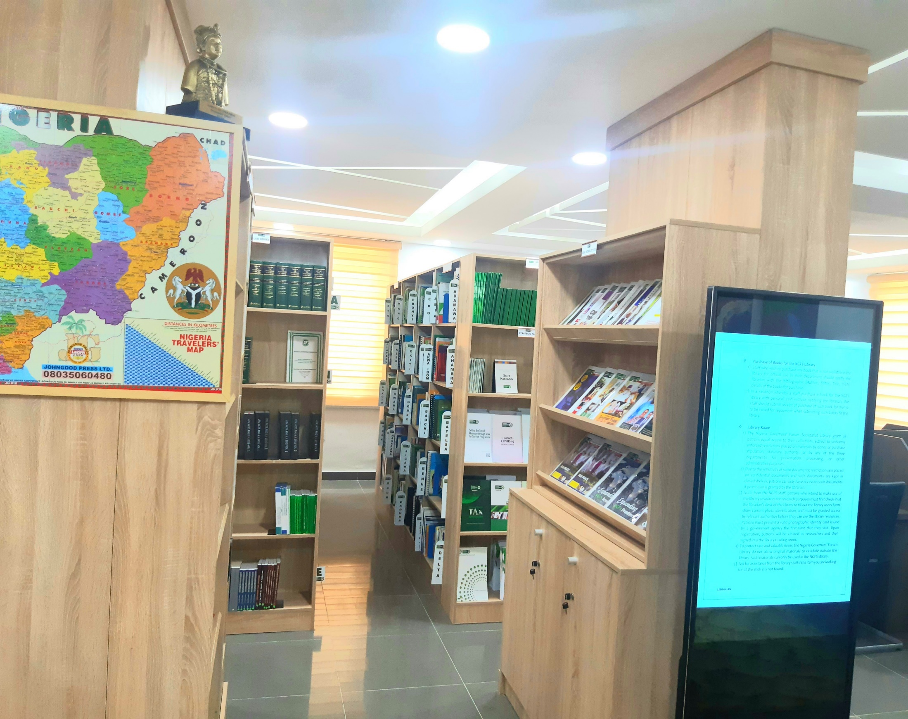
ACCESSING DOCUMENTS IN THE PHYSICAL LIBRARY
The first point to inquiry for a document at the NGFS physical Library is the reference desk. The reference section of the library is where the librarian sits and answer
Documents in the physical library are properly catalogued, classified, shelved, labelled and available on the library open shelves for self-retrieval.
Confidential documents are kept in closed shelves in the library and may not be avail
Shelves are properly labelled and tagged.
There are shelve guides by the side of the shelves which serves as pointers to locate documents on the shelves.

Slide 8
SOFTWARE DEPLOYED FOR THE AUTOMATION AND DIGITIZATION OF THE NGFS LIBRARY
In other to achieve the automation and digitization of the NGFS library resources, two software were deployed;
Koha Integrated Library Software (KILS) was deployed and customized to suit the NGF, capturing quick links to access the NGF website, NGF digital repository, State websites, Development Partners, MDAs, Electronic Journals, Online Resources, Newspapers, and the Online Public Access Catalogue (OPAC). The e-library access link is https://ngflibrary.org.ng/
Dspace Electronic Document Management Software (EDMS) was deployed and customized to suit the NGF. Communities created in the digital repository captures the various NGFS departments. The digital repository access link is https://ngfrepository.org.ng:8443/jspui/

Slide 9
THE NGF E-LIBRARY
The NGF E-library platform is a platform to access catalogued collections of the NGF physical library. Books are catalogued using appropriate metadata. A metadata is a set of data that describes and gives information about other data.
Patrons can access documents in the NGF E-library by typing in their query in the search box using title, author, subject, date-issue, ISBN, ISSN
Cataloguing of documents to the E-library is done from the backend using the Koha admin page and appropriate log in details.
The NGF E-library platform is linked to the NGF digital repository and the NGF website for easy navigation and easy accessibility.

Slide 10
STEP BY STEP GUIDE ON HOW TO ACCESS THE E-LIBRARY
Access the guide using this link
https://ngfrepository.org.ng:8443/handle/123456789/5375

Slide 11
THE NGF DIGITAL REPOSITORY
The Nigeria Governors' Forum Digital Repository is a custodian of records that collects, compiles, stores, preserves, and disseminates in digital form the vast and rich resources of the Nigeria Governors' Forum to clientele seeking information and knowledge on the core thematic areas of the Nigeria Governors' Forum.
In uploading a document to the digital repository; you must ensure that the metadata are accurate and the use of appropriate keyword for search is very important.
Patrons can access documents in the NGF Digital Repository by typing in your query (Title, Author, Subject, date-issue etc.) into the search box or browse our various communities and collections for easy accessibility and retrieval of documents.

Slide 12
STEP BY STEP GUIDE ON HOW TO ACCESS THE DIGITAL REPOSITORY
Access the guide using this link
https://ngfrepository.org.ng:8443/handle/123456789/5374

Slide 13
KNOWLEDGE MANAGEMENT STRATEGY: BUILDING THE NGF E-LIBRARY AND DIGITAL REPOSITORY SIMULTANEOUSLY
Catalogue immediately any publication uploaded to the digital repository using the same metadata – this will aid accuracy on both the e-library and digital repository.
The illustration below captures how cataloguing and uploading documents to both platforms are linked.
UPLOAD
CATALOGUE
DOCUMENTS & PUBLICATIONS
NGF E-LIBRARY
NGF DIGITAL REPOSITORY

Slide 14
LIBRARY RULES AND REGULATIONS
The NGFS library has developed a set of rules and regulations for using the library and its collections so that they remain safe and usable by all for years to come.
Patrons must adhere to theses rules and regulations when using the physical library.
All patrons must maintain quietness in the library.
Group discussions in the reading section is not allowed.
No making or receiving of phone calls in the library. Cell phones must be turned off or set to silent mode while in the library.
If you must connect to any virtual meeting from your personal computer or from the library desktop computer, ensure you use an earpiece device.
Dispose all trash in appropriate containers so that a clean environment can be maintained in the library.
Do not cut out pages or pictures from the library material.
Handle books carefully, especially when photocopying and scanning.
Mark your place with a bookmark; do not bend corners of pages or use tape, post – it notes, paper clips, or other objects on the library books.
Please notify the librarian at the reference desk if you discover a book that needs repair.
Protect borrowed materials from rain, dampness, sun, heat, pets, smoking and tobacco products.
Remove books from the shelf by gripping on both sides of the book spine.
Return library materials in the same condition as you received them.
Take notes rather than using highlighters, underlining, or writing in the margins of the library books and periodicals.
External patrons who wish to use the library for their personal research must be fill the external user form and

Slide 15
OPENING DAYS AND TIME
The physical is open on Mondays to Fridays from 9am to 5pm daily, except on public holidays.
The library is automated and digitized and patrons can access the e-library and digital repository from any where in the world using below links.
E-library access link is https://ngflibrary.org.ng/
Digital repository access link is https://ngfrepository.org.ng:8443/jspui/

Slide 16
THANK YOU!
QUESTIONS!

