Slide 1
Update on the Polio Eradication Initiative, Routine Immunization and PHCUOR
27th September, 2017

Slide 2
Outline
Update from NPHCDA
Update from polio
Update on Abuja Commitments
Upcoming events
Prayers

Slide 3
Updates from Last Meeting
Fulfilment of commitment
GoN Counterpart Funding
The Federal Government has released 3.5 billion naira towards the measles campaign
State counterpart funding – 10 states released
NE Borno , Yobe
NW Kebbi, Kaduna
NC Kogi, Nasarawa
SE Imo
SS Bayelsa, Edo
SW Osun
Important funding opportunities for states to note
GAVI ISS – Funding for RI
SOML - $500M/state for PHC

Slide 4
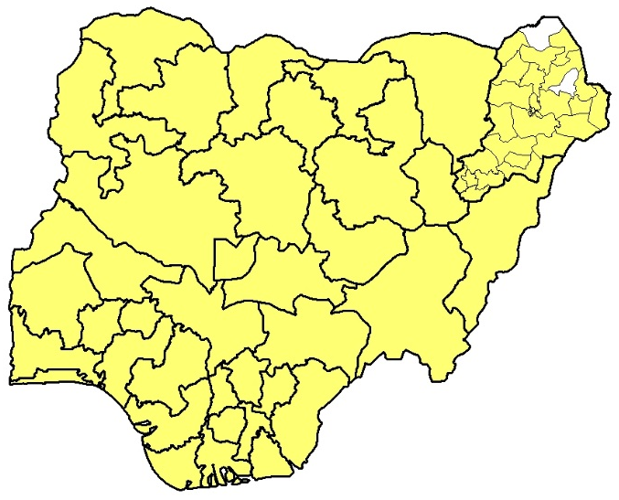
Polio Update 2016 and 2017
No new WPV1 in 2017
Nigeria now 12 months polio free
Certification - in next 24 Polio-free months
Last reported case was in Aug 2016
11 VDPV2 isolates from environmental surveillance sites (Sokoto 7, Gombe 2; Bauchi 1; and Katsina 1)
4 WPV1 from Borno in 2016
2 cVDPV2 – one from the environment (Borno) and another from a case (Sokoto) in 2016
2016
2017

Slide 5
Progress on Abuja Commitments Indicators in HR States, Q2,17
Below 50% performance in both rounds
14 HR states: Katsina, Kano, Kaduna, Borno, Sokoto, Zamfara, Bauchi, Jigawa, Yobe, FCT, Nasarawa, Adamawa, Gombe, and Taraba

Slide 6
Abuja Commitments Indicators in NHR States, Q2-2017
8 states could not achieve a single indicator

Slide 7
High Level Political Commitment
Sokoto State Governor vaccinating a child at the Flag-off assisted by the ES, SSPHCDA on 20th May 2017
Ondo State Governor pledges ownership of the polio eradication initiative

Slide 8
Prayers
Polio
Campaign
Follow up on Abuja Commitment
Flag-off of campaigns
Prompt Release of funds
Meeting with LGA chairmen
Meeting with traditional leaders
Deputy Governors chair task force meetings
Measles
Release of funds (outstanding states)
Routine Immunization
Facilitate access to the GAVI ISS fund
Primary Health Care Under One Roof (PHCUOR)
Facilitate access to the $500,000 SOML incentives per state
Movement of PHC staff to the Board
Movement of PHC programs to the Board
Movement of all PHC facilities to the Board
Pooled accounts for the Board
Enabling law for the Board

Slide 9
Upcoming Events
 | Event
1 | Subnational IPDs | Oct 14th – 17th, 2017:
2 | NW Measles Campaign | 26th – 31st Oct & 2nd - 7th Nov 2017
3 | NE Measles campaign | 30th Nov -5th Dec & 7th – 12th Dec 2017
4 | NC & FCT Measles Campaign | 8th -13th & 15th – 20th Feb 2018:
5 | SS, SW &SE Measles Campaign | 1st – 6th & 8th -13th Mar 2018
6 | Meeting of the Presidential Task Force on Polio | Oct 2017
7 | Meeting on PHCUOR with HC Health and ES SPHCB | 8th Nov 2017

Slide 10
Thank you for Listening

Slide 11
Revised Abuja Commitments at State Level
Num | Indicators | Target
1 | Personal involvement of HE Governor in support PEI and RI such as active supervision of IPDs and RI activities | Every IPDs;
 |  | At least once in a quarter for RI activities
2 | Bulk release of State counterpart funds in quarterly tranches for IPDs and 6 monthly tranches for RI | 3 months tranches for IPDs;
 |  | 6 months tranches for RI
3 | Meeting between Governor and LGA chairmen to review PEI and RI performance and discuss priority actions for improvement | Every IPDs;
 |  | Minimum of four times a year for RI (Quarterly)
4 | Meeting between Governor and traditional leaders to review their involvement in RI and polio | Quarterly
5 | Meeting of the State Task Force to oversee Polio and RI activities chaired by the Deputy Governor | Before every IPDs;
 |  | Monthly for RI

Slide 12
Overview of Abuja Commitments
On 2nd February 2009, the first Abuja Commitments was signed by Governors’ Forum with support from BMGF.
After the 2011 general elections, the Governors’ commitments were reaffirmed by the Governors on 25th September 2011
On 20th January 2016, the revised Abuja Commitments signed
Chairman of NGF signed the commitments on behalf of the 36 Governors
Governors committed themselves to actions aimed at ensuring
a polio-free Nigeria,
strengthening routine immunization and
improving Primary Health Care.
Implementation of Abuja Commitment indicators is being monitored every quarter.

