Slide 1
HelpDesk
TECHNICAL SESSION I:
Overview of State-Level Tax Administration in Nigeria
NGF VIRTUAL TAX LAW WORKSHOP
11th October 2021
Dr Mark Abani ,FCTI FNIM
Lead IGR Consultant NGF

Slide 2
HelpDesk
CONTENT
Overview of the Nigerian tax system
Tax applicable to State (including MDAs) and LGA
Canons of taxation and taxpayer compliance.
Finance Act 2019 changes of relevance to States.
Finance Act 2020 changes of relevance to States.
Managing joint jurisdiction during collection, etc.
State-level tax administration: Issues and Challenges
State-level IGR reforms: 2017 – 2021

Slide 3
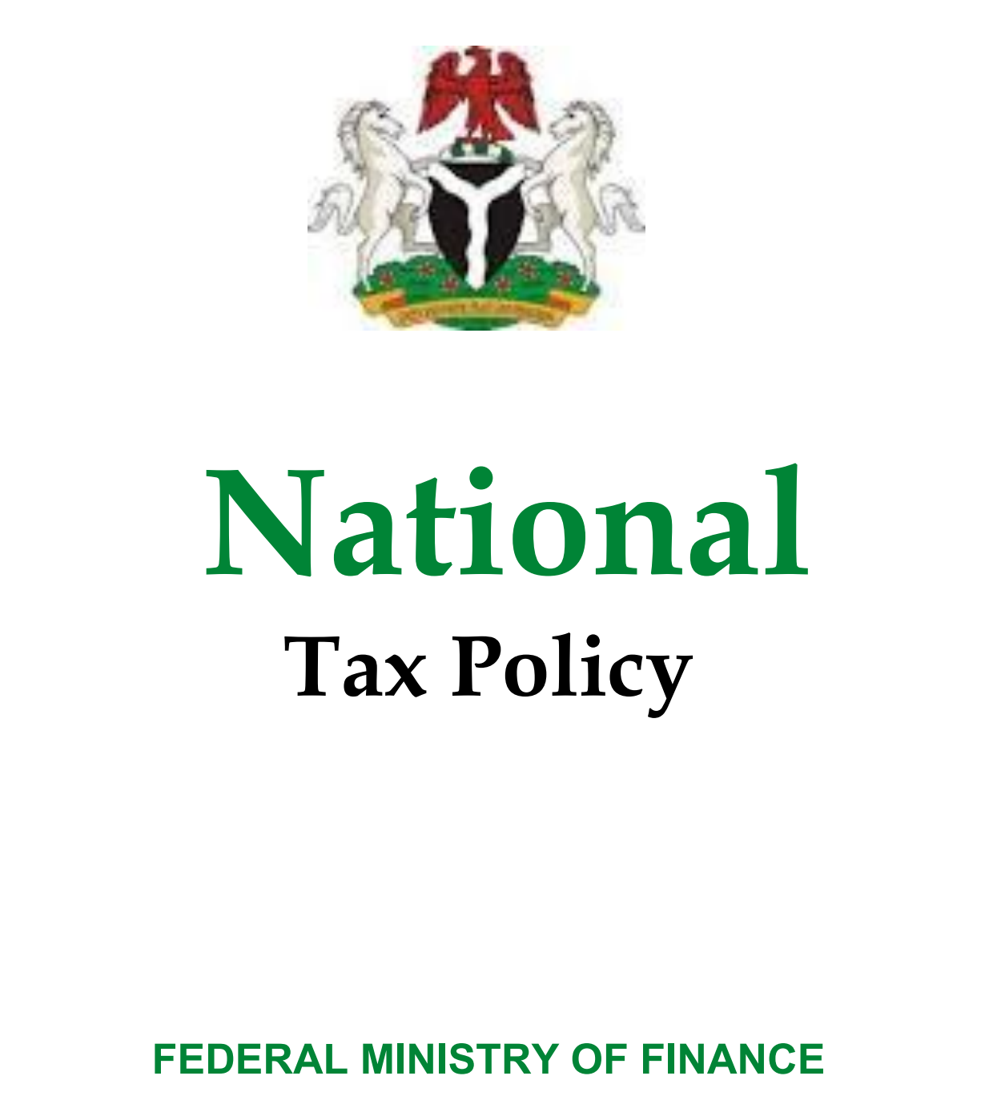
OVERVIEW OF THE NIGERIA TAX SYSTEM
HelpDesk
The Nigerian Constitution specifies three levels of government in Nigeria (federal, state and local government level) and outlines their rights to set and collect taxes, levies and charges.
These constitutional provisions are supported by the Taxes and Levies (Approved list for collection) Act 2004 as Amended 2015, which lists the types of taxes, duties, levies, fees and charges that can be collected by each tier of government.
The principles of taxation should apply regardless of the tier that is administering a tax.
Laws that apply are the Constitution and the various other tax laws in line with the National Tax Policy (NTP). The NTP provides the overall policy direction and has an implementation section that specifically assigns implementation actions to both Federal and State governments.

Slide 4
The HelpDesk
OVERVIEW OF THE NIGERIA TAX SYSTEM
Chapter 2 of the Constitution of the Federal Republic of Nigeria 1999 contains fundamental objectives and directive principles of State policy which are relevant to the NTP. In this regard, appropriate tax laws, administrative processes and procedure should be made to advance the constitutional provisions.
Therefore, tax policies, laws and administration shall promote the attainment of the following:
a) The ability of all taxable persons to declare their income honestly to appropriate and lawful agencies and pay their tax promptly;
b) Residence rights of Nigerians, free mobility of people, goods and services throughout the federation;
c) Promoting fiscal responsibility and accountability that reflects the principle of fiscal federalism;
d) Ensuring that the rights of all taxable persons are recognized and protected;
e) Eradicating corrupt practices and abuse of authority in the tax system;
f) Ensuring that the resources of the nation promote national prosperity and self-reliant economy;
g) Securing maximum welfare, justice and equity;
h) Ensuring that the resources of the nation are harnessed and distributed to serve the common good;
i) Promoting and protecting Nigeria’s national interest;
j) Promoting African integration, international co-operation and eliminating discrimination; and
k) Respecting international law and treaty obligations.
National Tax Policy, 2016

Slide 5
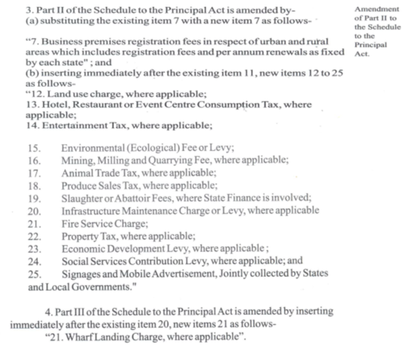
HelpDesk
TAXES APPLICABLE TO STATE (INCLUDING MDAS) AND LGA
Extracts from the Taxes and Levies (Approved list for collection) Act, Cap. T2, Law of the Federation of Nigeria, 2004

Slide 6
HelpDesk
CANONS OF TAXATION AND TAXPAYER COMPLIANCE
According to Adam Smith’s Wealth of Nations, there are 4 basic principles or canons that should underscore a good tax administration, namely:
Canon of Equality or Ability: The subject of every State ought to contribute towards the support of the government as early as possible in proportion to their respective abilities that is in proportion to the revenue which they respectively enjoy under the protection of the State.
Canon of Certainty: The tax which each individual is bound to pay ought to be certain and not arbitrary. The time of payment, the manner of payment, the quantity to be paid all ought to be clear and plain to the contributor and to every other person.
Canon of Convenience: Every tax ought to be levied at the time or in the manner in which it is most likely to be convenient for the contributor to pay it.
Canon of Economy: Every tax is to be so contrived as both to take out and keep out of the pockets of the people as little as possible over and above what it brings into the public treasury of the State.
Five other canons have been developed over the years to include:
Canon of Productivity: This emphasises that a tax should bring in a substantial amount of money to the State.
Canon of Elasticity: This emphasises that tax should automatically bring in more revenue as the country’s population or income increases.
Canon of Simplicity: This emphasises that tax should be simple otherwise there will be confusion and, worse still, corruption.
Canon of Variety: This emphasises that the tax system of a country should be diversified, hence, broad-based.
Canon of Flexibility: This connotes the absence of rigidity in the tax system.
See http://economicsconcepts.com/canons_of_taxation.htm

Slide 7
HelpDesk
TAX ADMINISTRATION IS A MAJOR KEY TO UNLOCK REVENUES
Tax authorities at all levels should administer their mandates in accordance with the following:
Registration of Taxable Persons: If you do not have an accurate list of taxpayers, it is difficult to plan, assess, collect and deter non-compliance. Part of registration is getting, understanding and using data to devise handling strategies for different taxpayers and their businesses.
Tax Compliance: This is best achieved by making it easy to pay, knowing what to pay and why you are paying. Efforts need to be made to drive voluntary compliance so scarce resources can be focused on the non-compliant. Adopting a compliance risk management approach helps to prioritise effort and resource allocation more effectively and efficiently.
Efficiency of Administration: There should be clear processes, trained staff and logistics to support tax education and if necessary enforcement actions.
Technology and Tax Intelligence: All sectors of government have key taxpayer information and this should be shared and leveraged on to increase collection and compliance. Data is the new king, use it.
Dispute Resolution: In tax and revenue matters, there will always be disagreements of what should be, or has been paid and to resolve these and deter non-compliance there must be clear dispute resolution process both administrative and if necessary, by legal route.

Slide 8
HelpDesk
FINANCE ACT 2019 CHANGES OF RELEVANCE TO STATES
Tax Identification Number (TIN): Every individual is now required to have a TIN to operate a bank account for business purposes and in the event of pre-existing account holders; they are required to obtain a TIN
Commencement and Cessation Rules: Revised the basis of taxation for individuals during commencement or cessation of business for Personal Income Tax. The amendment effectively eliminates possible double taxation during commencement or non taxation during cessation. Rather, taxation will be based on the relevant accounting period of such business without any gap or overlap.
Deletion of the Provisions Granting Children and Dependent Relative Allowances and Life Assurance Premium Relief ¹. This amendment seeks to resolve the controversies surrounding the entitlement of chargeable persons to children and dependent relative allowances in addition to the consolidated relief allowance granted under the PITA.
Clarification that a Notice of Objection Submitted via Electronic E-mail will be Considered Valid.
[1] the reference to life assurance premium was corrected in FA 2020 - Inclusion of life assurance premium as a relief claimed in writing.

Slide 9
FINANCE ACT 2020 CHANGES OF RELEVANCE TO STATES
HelpDesk
Restriction of the Amount Exempt from CGT for Compensation for loss of office and deduction and timeline for payment of CGT on compensation for loss of office through PAYE system. Finance Act, 2020.
Clarification on Tax Deductibility of Pension or Retirement Contributions.
Simplification of Commencement and Cessation Rules and elimination of double taxation or no taxation risks associated with their application.
Definition of Gross Income for calculating the Consolidated Relief Allowance (CRA) was clarified
Inclusion of Life Assurance Premium as a relief claimed in writing
Exemption of Individuals Earning Minimum Wage and below from income tax (Employees only).
Removal of Stamp Duties on Electronic Receipts and Replaced it with the Electronic Money Transfer (EMT) Levy. along with a sharing formula for the revenue derived from EMT Levy; 15% of the revenue is allocated to the FG and Federal Capital Territory, and the remaining 85% shared amongst the State Governments

Slide 10
HelpDesk
MANAGING JOINT JURISDICTION DURING COLLECTION, ETC
Nuisance ‘taxes’ and multiple taxation are prevalent at State level (including LG level) across Nigeria. Businesses in Nigeria may be subjected to so many different taxes, charges and levies that impede their growth. This has grown and potentially increases as states (and their LGAs) seek greater funding. Or even worse, seek to increase revenues to meet targets through arbitrary revenue collections.
Despite the existence of provisions, including the statutory Joint State Revenue Committee, which clearly delineates revenue collection responsibilities between the various government levels, revenue collection practices by various agencies at State/MDA level and by LGAs have extended beyond those provisions. The result is taxpayers have been facing “multiple taxation” (taxes/fees/charges on the same or similar income/transactions/assets by different levels of government and by differing agencies at the same level of government).

Slide 11
HelpDesk
MANAGING JOINT JURISDICTION DURING COLLECTION, ETC
It is therefore important for states to ensure that their Joint State Revenue Committees are set up and functional.
For states that have not consolidated their tax laws this should be done to help deal with inter-tier taxation issues and even enter into MoUs for taxes where there is a comparative advantage for the State to collect on behalf of LGAs, for example tenement rates as part of a Land Use Law. This can, and is, being done through LGAs delegating some or all their collection powers to the SIRS which overcomes any constitutional issues.

Slide 12
HelpDesk
Perceived weak social contract between citizens and the government continues to threaten legitimacy of taxation.
Weak transparency and accountability by Government and SIRSs.
Misunderstood tax law(s) and incomplete revenue codes.
Multiplicity of taxes, fees, levies and charges.
Poor collaboration between the SIRS revenue generation and identity management ministries, departments and agencies.
Multiplicity of taxpayer identification systems.
Institutional capacity constraints due to inadequate funding and professional staffing to deliver on mandate.
Lack of standard operating procedures and processes guiding operations of SIRSs and their zonal/area offices.
Proliferation of private contractors/consultants for same revenue items.
Weak collaboration between State and Local Governments on joint collections.
STATE-LEVEL TAX ADMINISTRATION:
Issues and Challenges

Slide 13
HelpDesk
Over the years States have made steady progress in reforming the tax environment and system to improve Internally Generated revenue:
Adoption of Treasury Single Account (TSA) and Cashless Policy.
Improved collaboration of between the SIRS revenue generation and identity management ministries, departments and agencies (Through the Joint Tax Board).
The establishment of Joint State Revenue Committees to improve collaboration between the State, Local Governments and in-State revenue generating MDAs.
SIRSs are being granted financial and administrative autonomy to enable increased capacity in delivering their mandate.
Increase in technology adoption for revenue monitoring and collections – enabling online payment of taxes, fees, levies and charges.
STATE-LEVEL
IGR REFORMS
2017 – 2021

Slide 14
HelpDesk
Improved collaboration between SIRSs, trade unions and associations.
Engagement of mobile money agents for informal sector revenue collection.
Establishment of tax appeal tribunals to improve turn around for closing out tax disputes.
Passage of Consolidated State Revenue Codes across 30 States to address multiplicity of taxes.
Implementation of a structured tax relief in response to COVID-19.
The prohibition of tax consultants for the assessment and collection of Personal Income Tax.
STATE-LEVEL
IGR REFORMS
2017 – 2021

Slide 15
HelpDesk
Thank you for Listening

