Slide 1
State Engagement Paving the Way Toward HIV Epidemic Control
October 2021
Internal Use Only

Slide 2
PICTURE OF HIV EPIDEMIC AT START OF 2019

Slide 3
CURRENT PICTURE OF THE EPIDEMIC
Epidemic Control Zone
Low Unmet need
High Saturation

Slide 4
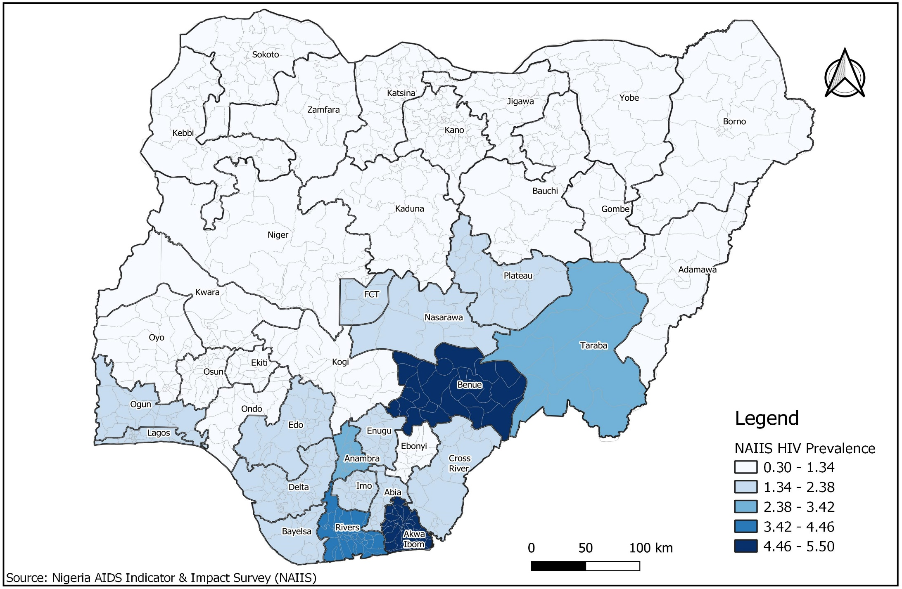
Pinpointing the Epidemic
Benue
Rivers
Akwa
Ibom

Slide 5
The Testing Gap – 1
State | PLHIV | 81% Coverage | PEPFAR Contribution | HIV Testing Gap | Cost of HIV Testing Gap
Abia | 51,070 | 41,367 | GON Support | 363,496 | ₦ 207,546,409
Adamawa | 42,377 | 42,377 | 147,636 | 45,331 | ₦ 57,735,346
Akwa Ibom | 200,051 | 162,042 | 1,560,869 | 328,159 | ₦ 190,907,662
Anambra | 87,312 | 70,723 | GF Support | 661,275 | ₦ 347,758,555
Bauchi | 23,997 | 19,437 | 64,884 | 47,431 | ₦ 58,724,140
Bayelsa | 31,830 | 25,782 | 20,758 | 315,178 | ₦ 184,795,390
Benue | 188,482 | 188,482 | 356,059 | 266,701 | ₦ 161,969,722
Borno | 57,632 | 46,682 | 63,209 | 505,271 | ₦ 274,302,247
Cross River | 48,473 | 48,473 | 178,908 | 16,242 | ₦ 44,038,524
Delta | 83,300 | 67,473 | 337,557 | 401,219 | ₦ 225,308,396
Ebonyi | 16,281 | 13,187 | 50,699 | 67,710 | ₦ 68,272,709
Edo | 48,824 | 39,548 | 54,262 | 286,941 | ₦ 171,499,808
Ekiti | 16,756 | 13,572 | 25,228 | 161,188 | ₦ 112,287,601
Enugu | 66,768 | 54,082 | 187,641 | 367,436 | ₦ 209,401,641
FCT | 38,293 | 38,293 | 174,403 | 9,259 | ₦ 40,750,793
Gombe | 25,464 | 25,464 | 98,769 | 12,462 | ₦ 42,258,678
Imo | 57,553 | 46,618 | 195,144 | 341,496 | ₦ 197,187,357
Jigawa | 12,804 | 10,371 | 63,164 | 28,350 | ₦ 49,739,971
Kaduna | 55,266 | 55,266 | 10,470 | 44,943 | ₦ 57,552,674

Slide 6
The Testing Gap – 2
State | PLHIV | 81% Coverage | PEPFAR Contribution | HIV Testing Gap | Cost of HIV Testing Gap
Kano | 55,910 | 45,287 | 187,467 | 201,614 | ₦ 131,322,595
Katsina | 26,597 | 21,544 | 42,717 | 182,877 | ₦ 122,500,199
Kebbi | 20,476 | 16,585 | 53,782 | 122,457 | ₦ 94,050,933
Kogi | 43,373 | 35,132 | 75,086 | 170,485 | ₦ 116,665,342
Kwara | 24,849 | 20,128 | 49,610 | 159,728 | ₦ 111,600,393
Lagos | 113,523 | 113,523 | 643,406 | 381,057 | ₦ 215,815,012
Nasarawa | 31,756 | 31,756 | 183,451 | 7,813 | ₦ 40,069,573
Niger | 29,463 | 29,463 | 198,905 | 35,911 | ₦ 53,300,034
Ogun | 50,798 | 41,146 | 46,939 | 375,615 | ₦ 213,252,984
Ondo | 27,789 | 22,509 | 53,713 | 133,011 | ₦ 99,020,542
Osun | 32,197 | 26,080 | 20,210 | 272,306 | ₦ 164,608,837
Oyo | 52,388 | 42,435 | 109,656 | 310,621 | ₦ 182,649,719
Plateau | 39,594 | 39,594 | 91,423 | 5,682 | ₦ 39,066,322
Rivers | 197,621 | 160,073 | 2,092,816 | 18,804 | ₦ 45,244,834
Sokoto | 12,844 | 10,403 | 51,434 | 36,270 | ₦ 53,469,198
Taraba | 52,856 | 42,813 | GoN Support | 37,557 | ₦ 54,074,855
Yobe | 13,005 | 10,534 | 24,340 | 55,816 | ₦ 62,672,571
Zamfara | 18,509 | 14,992 | 45,201 | 143,865 | ₦ 104,131,374

Slide 7
HIV New Infection and Mortality Historic Trends
New HIV infections
Decrease in new infections
HIV-related deaths
UNAID HIV epidemic data for Nigeria, 1990 -2018; and Projection of new infections and deaths 2019 - 2023

Slide 8
Thank you

