Slide 1
Accelerating Africa’s health systems transformation with autonomous, instant delivery
Daniel Marfo, Zipline
August 2021

Slide 2
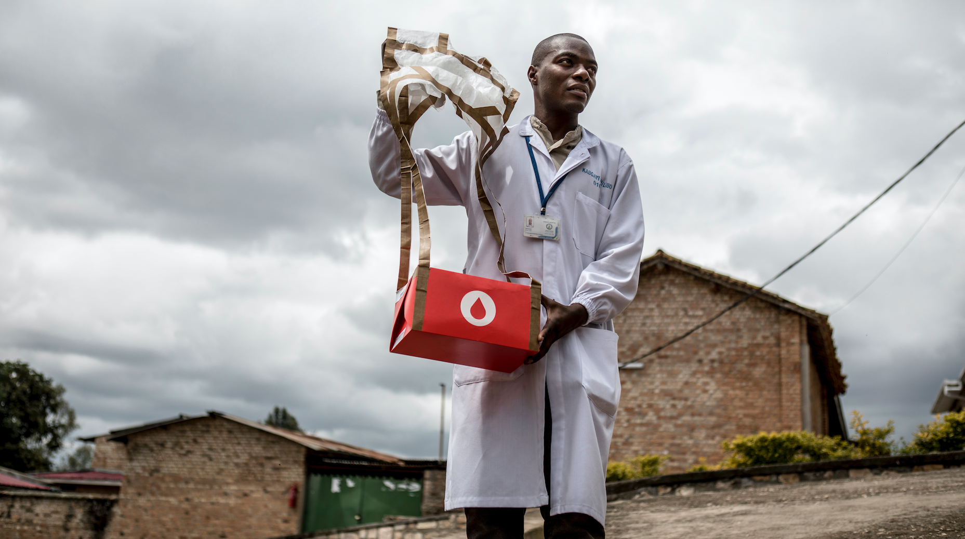
Our Mission:
To provide every human on Earth with instant access to vital medical supplies
Zipline proprietary & confidential. © 2020 Zipline International Inc. All rights reserved.
Zipline proprietary & confidential. © 2020 Zipline International Inc. All rights reserved.
Notes:
Zipline covers 3 of 4 SDG3 goals (access to affordable vaccines and meds, support for health workforce in developing countries, early warning systems)
Enabling universal access and then driving up the quality of that

Slide 3
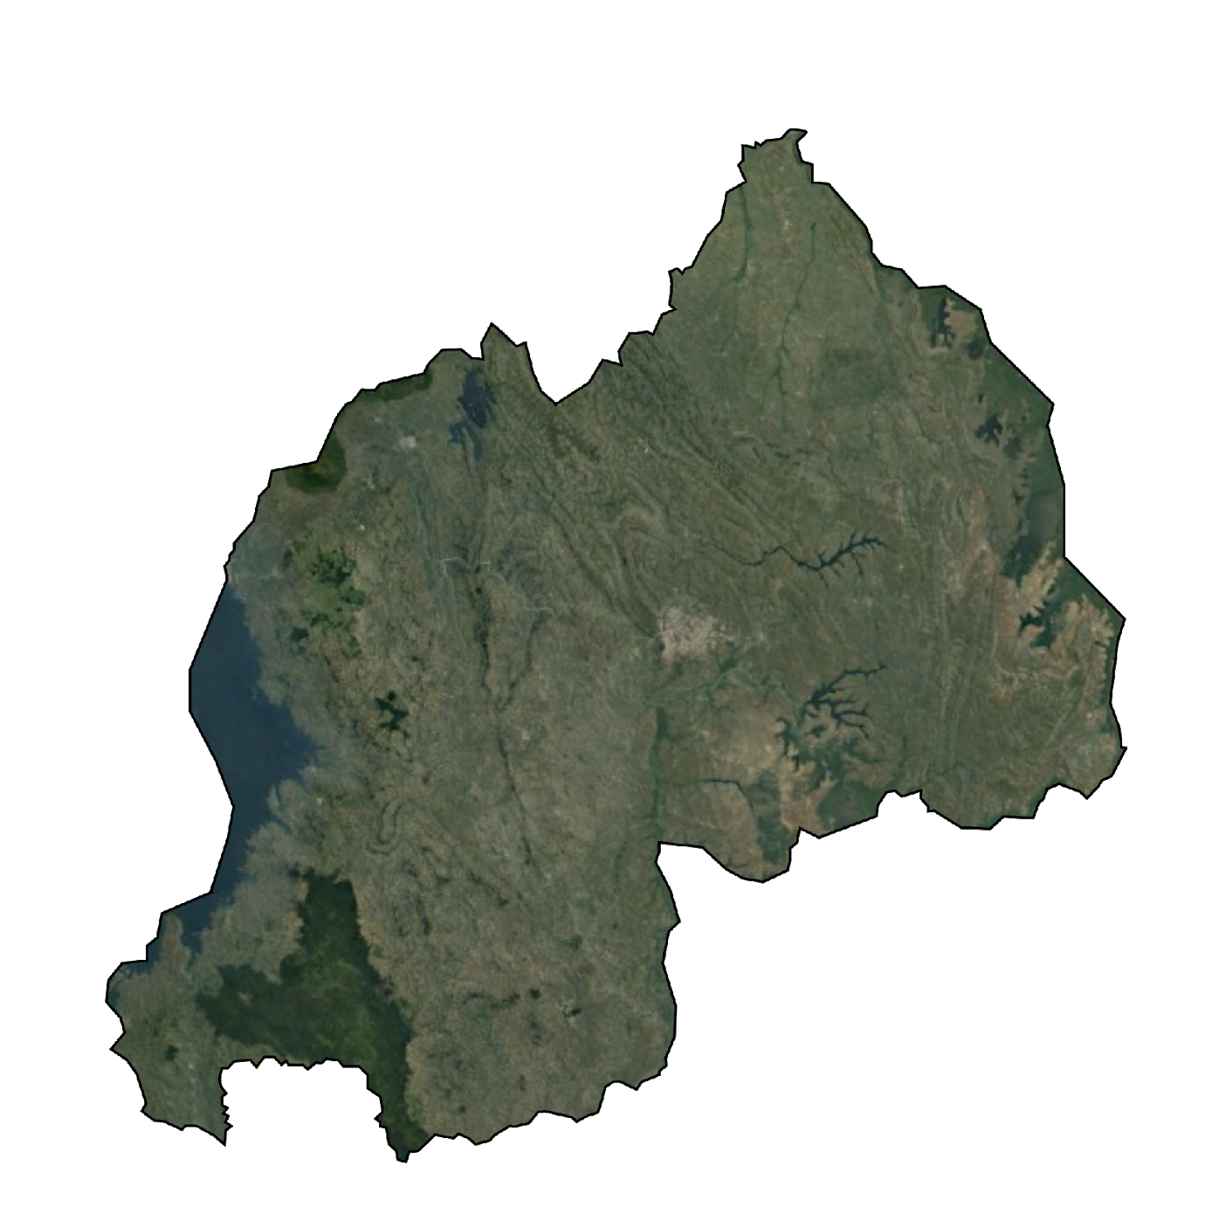
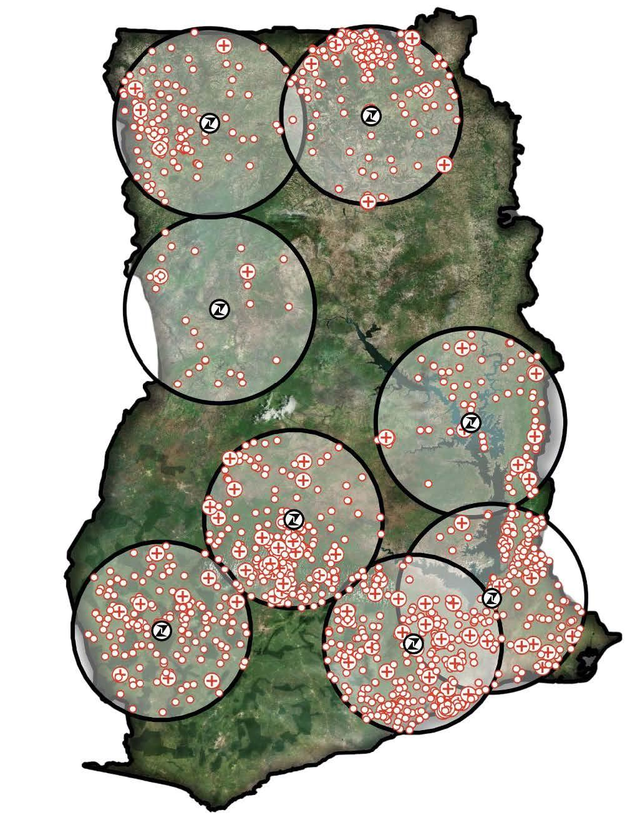
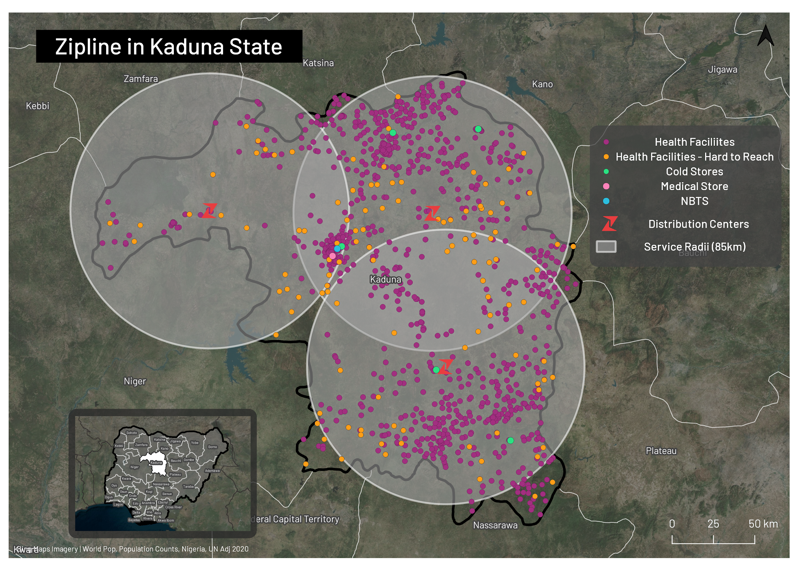
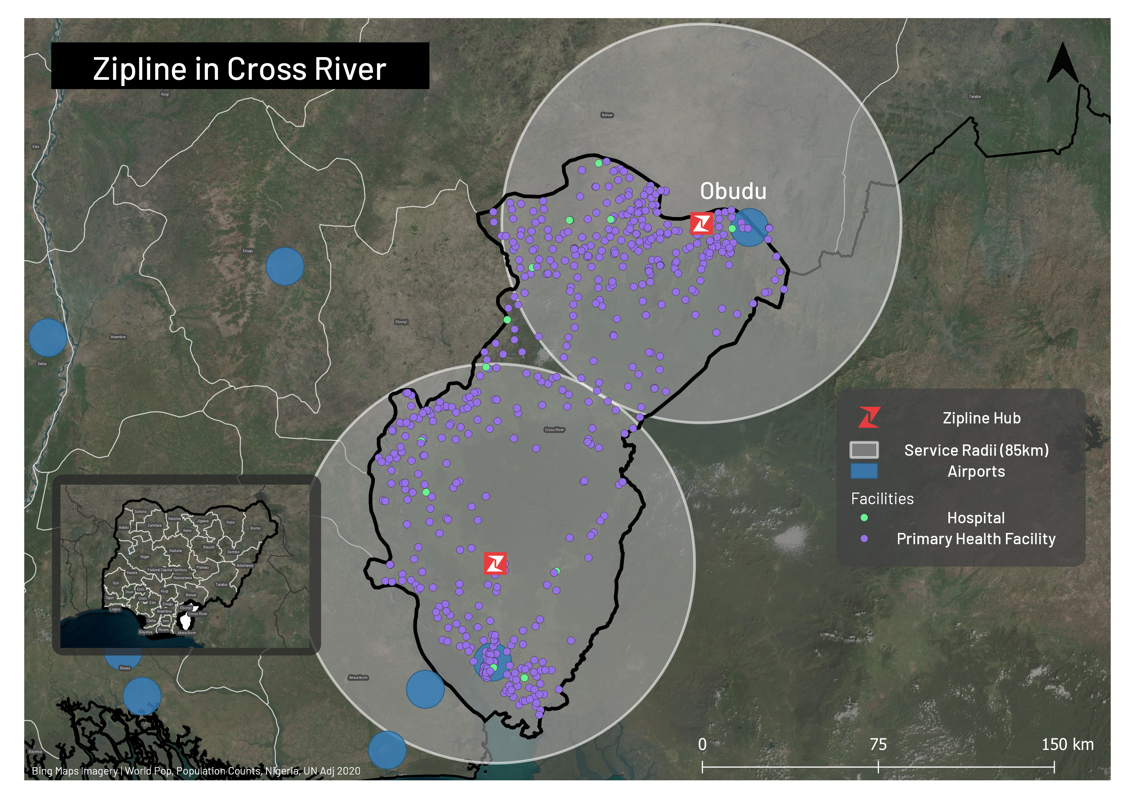
National Scale Drone Delivery in Africa since 2016
Ghana
50 mi
Rwanda
Kaduna & Cross River , Nigeria
in Q4, 2021
13 Zipline ISO-certified hubs
22,500 sq km coverage per hub
~3,600 facilities served; 25 million people covered
2.7 metric tons of freight delivered daily
Notes:
Hubs are GDP-compliant, on-site cold chain
Fleet management capabilities to fly dozens of drones at a time, integrated into national airspace
Thousands of flights per day
2.7 metric tons delivered daily
Someone receives a Zipline delivery in Africa every minute
Started with blood, product mix of 160+ medical products now including essential medicines, emergency and routine vaccines
Rwanda restructured blood supply to be centralized and operate through Zipline
Able to offer rare blood types, platelets and plasma for the first time, as well as cold chain products and anti-venom
Waste reduction from 9% to 0%
Software enabled, full integrated experience
Results to date:
Improved supply chain performance - 100% on time delivery, 100% product availability at every tier
Supply chain improvement - waste reduction, fewer referrals
Health impact - less delayed or avoided care, fewer severe cases, lower cost to the health system

Slide 4
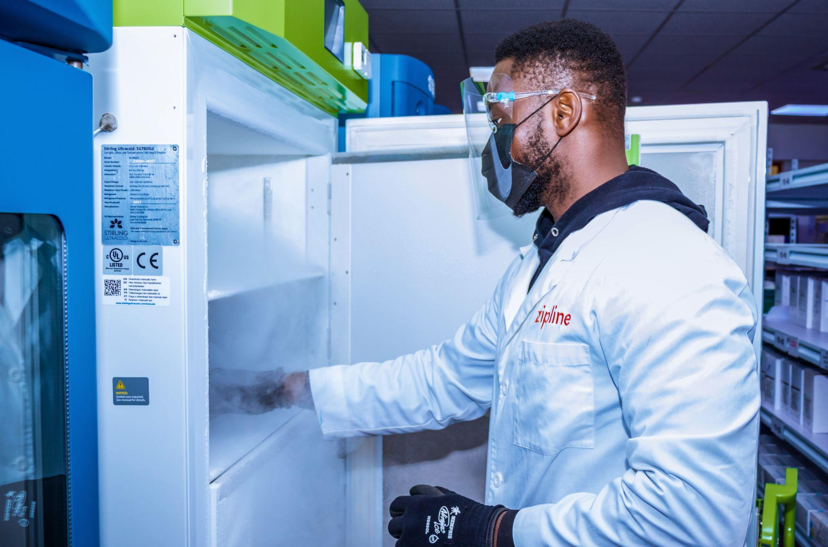
ZIPLINE IS AN END-TO-END SUPPLY CHAIN SOLUTION
WAREHOUSING & FULFILLMENT
ON-DEMAND DELIVERY
DATA & PERFORMANCE MANAGEMENT
Inventory management at GDP-compliant hubs
Best in class SOPs
100% accessible inventory
24/7 delivery operations
100% guaranteed cold chain and product quality
Early warning system
Transparency, planning, preparedness, & quality control
Zipline proprietary & confidential. © 2021 Zipline International Inc. All rights reserved.
Notes:
Embedded capability in national supply chain
Commodities they want us to be the sole distributor of
Commodities that they want us to guarantee availability of
Any commodities that should be available at any facilities that we’re the sole supplier for
Managing the data system to capture demand across the health system
Ongoing technical assistance to help health system administrators manage supply chain performance and understand population health
The longer we operate, the more predictive this becomes

Slide 5
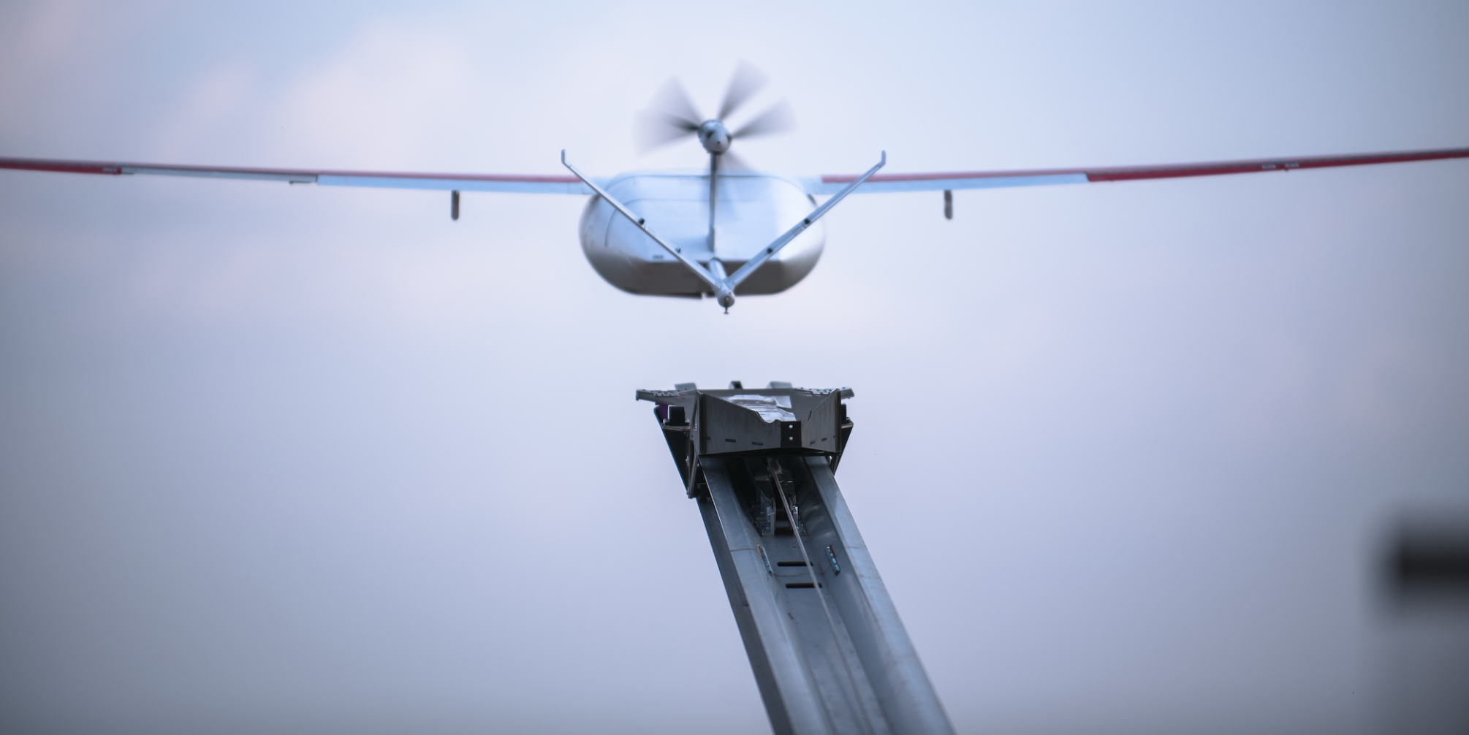
DELIVERY IN <1 HOUR TO ANY FACILITY WITHIN 20,000KM² SERVICE AREA
80 km service radius (one-way) increasing to 100km
110 km/h cruising speed
1.8 kg payload increasing to 3 kg
Dozens of simultaneous flights
100s of flights/day to unlimited sites
Reliable in all weather conditions
Zipline proprietary & confidential. © 2021 Zipline International Inc. All rights reserved.

Slide 6
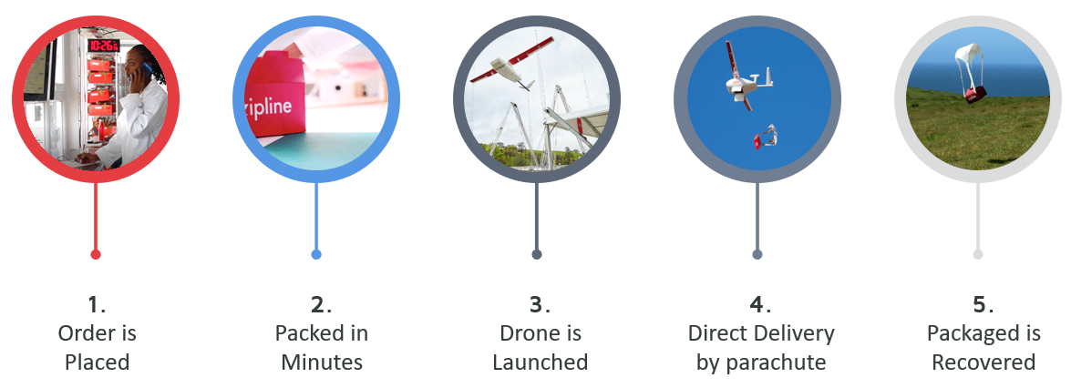
How Does A Health Facility Use Zipline Aerial Logistics?
Order is Placed
Packed in Minutes
Drone is Launched
Direct Delivery by Parachute
Package is Recovered
Notes:
Health practitioners place an order for an essential medical product via phone / SMS / Whatsapp / web form
Zipline pharmacist receives the order and prepares the product for immediate delivery
The product gets placed on an aircraft in as little as 3 minutes
The health facility receives the product in less than one hour

Slide 7
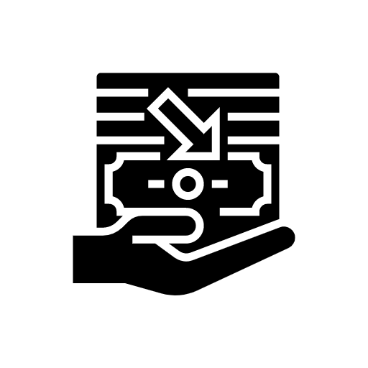
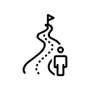
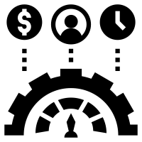
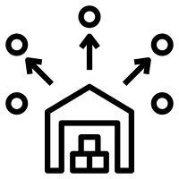
Driving Continuous Improvement Across the Health System
Reduction in overall supply chain expenses
Up to 95% wastage reduction due to reduction in expiries and optimization of safety stock
Service all Hard To Reach facilities with ease
Reliable cold chain infrastructure- ready to use, delivered within an hour without the need for CCE at the health facility
Add new scalable cGDP warehouses (Current Good Distribution Practices)
Empower your supply chain planning by improving forecasting and creating more flexible tolerances

Slide 8
SCALING EXPONENTIALLY IN SERVICE OF EQUITABLE HEALTH ACCESS
175,000
July 2021
Zipline by the numbers
125,000
April 2021
2,500
Healthcare
facilities served
100,000
February 2021
175,000
Commercial deliveries
50,000
September 2020
3.1+ M
Vaccine doses delivered
10,000
March 2019
Number of deliveries
220+
Medical products
in inventory
2017
2018
2019
2020
2021
2022
Zipline proprietary & confidential. © 2021 Zipline International Inc. All rights reserved.
Notes:
T up conversation around how customers are utilizing the system, scale of system and impact

Slide 9
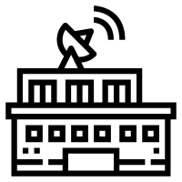
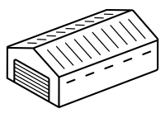
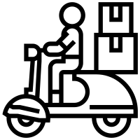
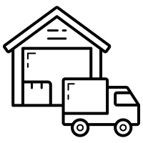
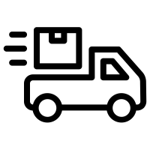
Beyond healthcare, an on-demand multi-purpose aerial logistics system
Live Data
State
3PL
Ward
LGA
Zipline complements your existing supply chain by enabling you to streamline your entire supply chains across numerous industries, from national distribution down to the last mile.
Integrating aerial logistics into your routine ground transport allows for maximum coverage in all areas.
Zipline proprietary & confidential. © 2021 Zipline International Inc. All rights reserved.
Notes:
Zipline can complement your supply chain or implement the entire the supply chain from end-to-end
Modern health systems based on a model that’s over 100 years old
Reliance on ground transportation
Primary care facilities don’t stock many items
On-site storage requires investment - lots of fridges
Unreliable infrastructure and inflexible supply chains lead to waste - power outages
Imperative to solve access challenges more vital than ever

Slide 10
POWERING GHANA’S COVID-19 RESPONSE
Ghana by the Numbers
2,000
Healthcare facilities
3 million
Vaccine doses distributed
9 : 1
Resupply : Emergency
The Ministry of Health leveraged Zipline to respond quickly and efficiently to COVID-19:
10x demand surge in program vaccines
COVID-19 sample transport into Accra & Kumasi
National-scale PPE delivery
Equitable COVAX vaccine delivery at scale
Zipline proprietary & confidential. © 2020 Zipline International Inc. All rights reserved.
Notes:
Ghana as a case study of what’s possible when instant, autonomous delivery is fully integrated with health facilities - system is responsive and resilient
Zipline supported Covid-19 test sample transport during the lockdown period in 2020 - allowed government to react quickly, keep health workers safe, and real-time data created visibility into new clusters that were forming
Zipline also enabled the continuity of routine vaccines during the Covid-19 lockdown - our data shows that when Covid-19 hampered health workers’ movements in 2020, Zipline’s monthly vaccine deliveries rose by >400% from January to December
Then, during the election, Zipline helped deliver PPE so that citizens could safely vote
Covax Facility's historic first shipment of vaccines went to Accra because Ghana scored #1 in vaccine readiness out of all 92 AMC countries - in no small part because Zipline has supported strengthening of the national health system
Zipline delivers the exact number of doses a facility will administer in a given timeframe, reducing waste and saving money
Zipline will enable Ghana to vaccinate 20% of its ex-urban population (2.43 million people) in only six months, without having to buy additional cold chain equipment, taxing its existing supply chain, or incurring new distribution costs

Slide 11
COVID-19 VACCINE DISTRIBUTION IN GHANA
Optimize health system utilization
Maximize adherence
Minimize wastage
Reduce cost and risk
Minimize supply chain disruption
Aerial distribution is critical given the likelihood of emergence and the need to deploy vaccines quickly. With a good coverage of new regions, Zipline would feature heavily in next phases of distribution.
60%
40%
Ghana centralizes COVID-19 vaccines at the cold room facilities at the National Expanded Program on Immunization.
Zipline proprietary & confidential. © 2020 Zipline International Inc. All rights reserved.
Notes:
Softbox-validate cold chain boxes for 2-8, -20, -70

Slide 12
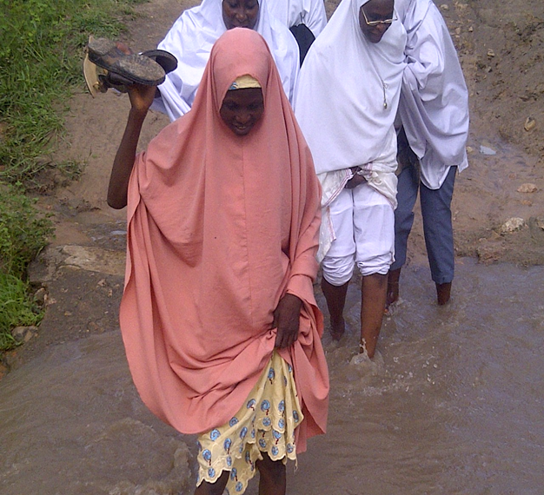
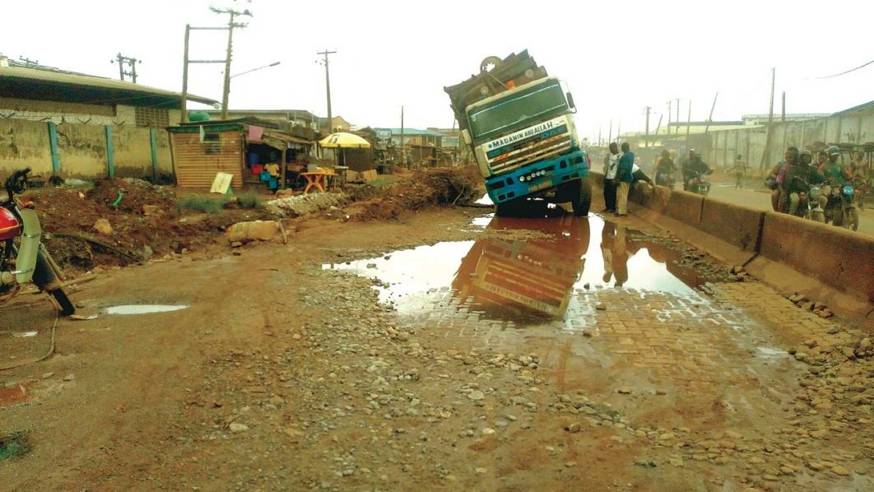
Why is Zipline relevant in Nigeria
Zipline proprietary & confidential. © 2020 Zipline International Inc. All rights reserved.

Slide 13
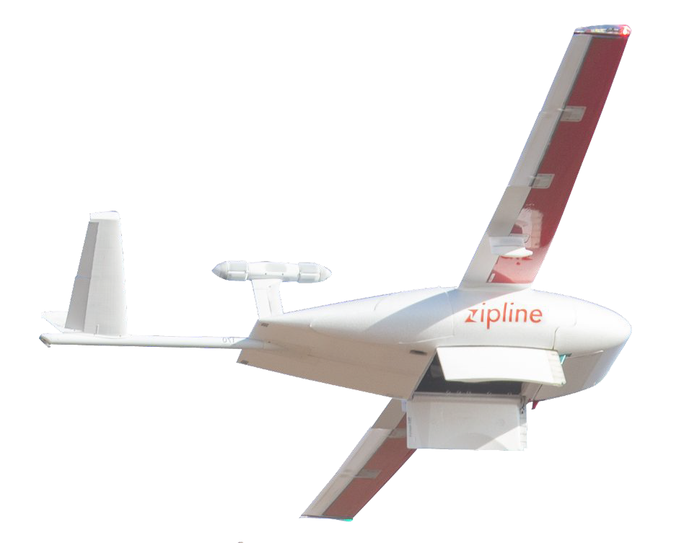
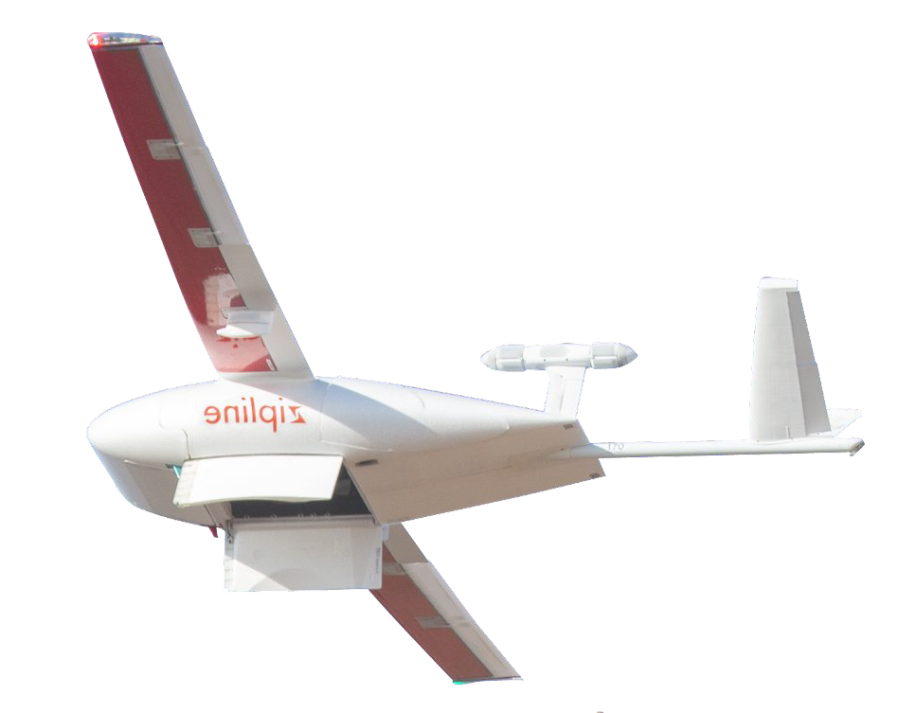
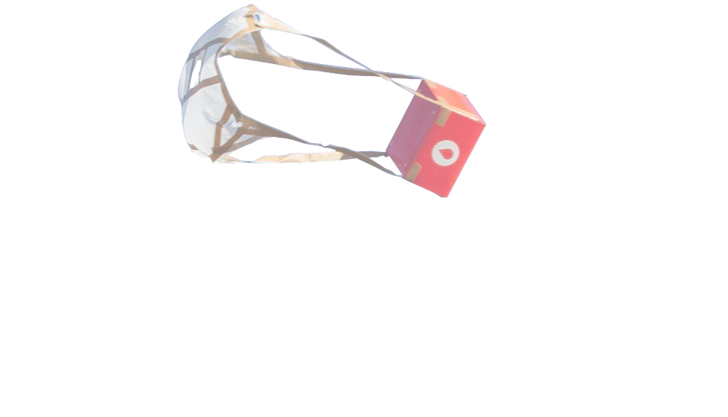
What does Zipline in Nigeria look like
Zipline proprietary & conﬁdential. © 2021 Zipline International Inc. All rights reserved.

Slide 15
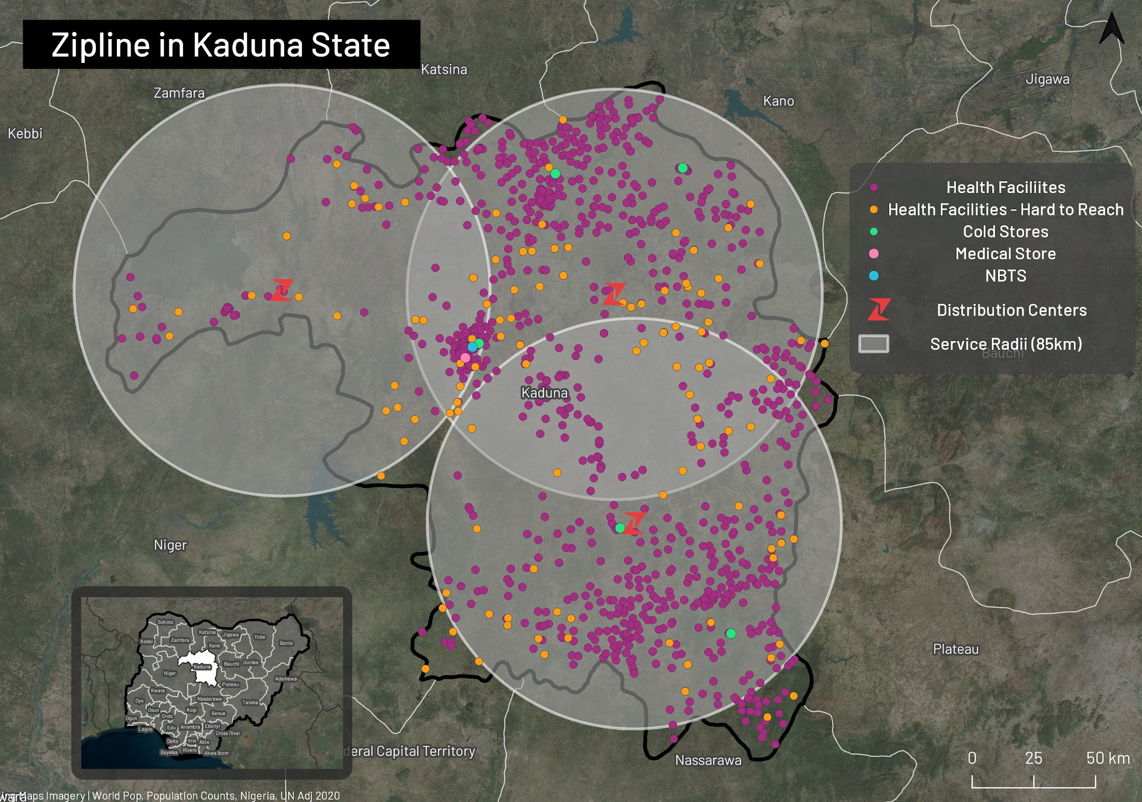
Every medical product is under 60 minutes away for 1100+ health facilities
Pambegua
# of Facilities Reached | 1119 (96.5%)
# of Hard to Reach Facilities | 146
DC Distance from Supplier | <100km
Estimated Supply Chain Eﬃciency Increase | 10x to 20x
Geographic Coverage | 97%
Est. Population Coverage | 98%
Airspace & Safety Risks | Low
Speed to set up | Fast
Raﬁngyeda
Kachia
18
Zipline proprietary & conﬁdential. © 2020 Zipline International Inc. All rights reserved.

Slide 16
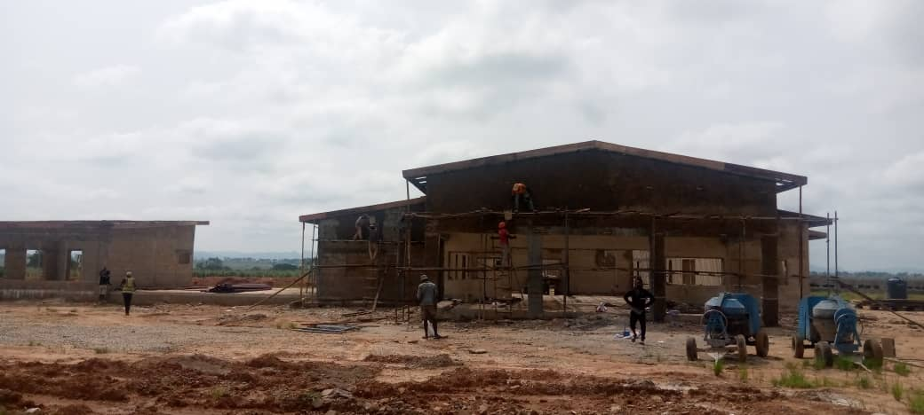

Slide 17
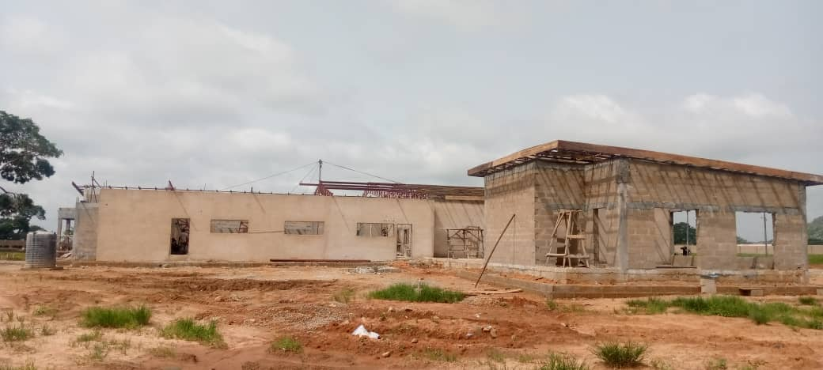

Slide 18
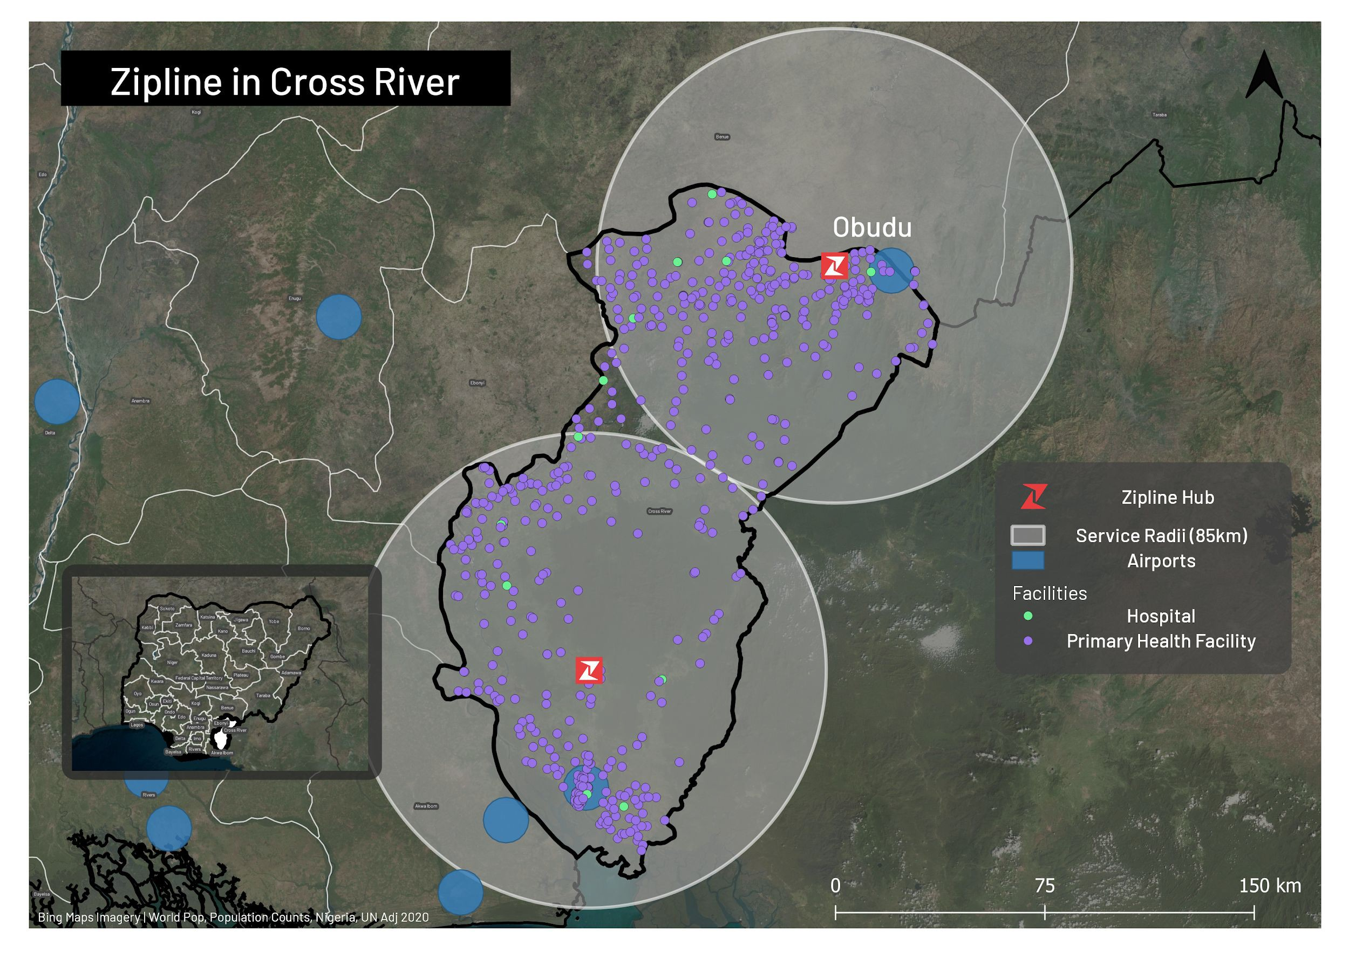
Example of Cross River Distribution
# of Facilities Reached | ~1100
Coverage of Hard to Reach Facilities | ~99%
# of Facilities not Covered | ~15
DC Distance from Supplier | <100km
Estimated Supply Chain Eﬃciency Increase | 5 - 18x
Geographic Coverage | 99%
Est. Population Coverage | 98%
Airspace & Safety Risks | Low
Speed to set up | Fast
20
Assuming a no-ﬂy zone radius of 10km at airports
Zipline proprietary & conﬁdential. © 2021 Zipline International Inc. All rights reserved.

Slide 19
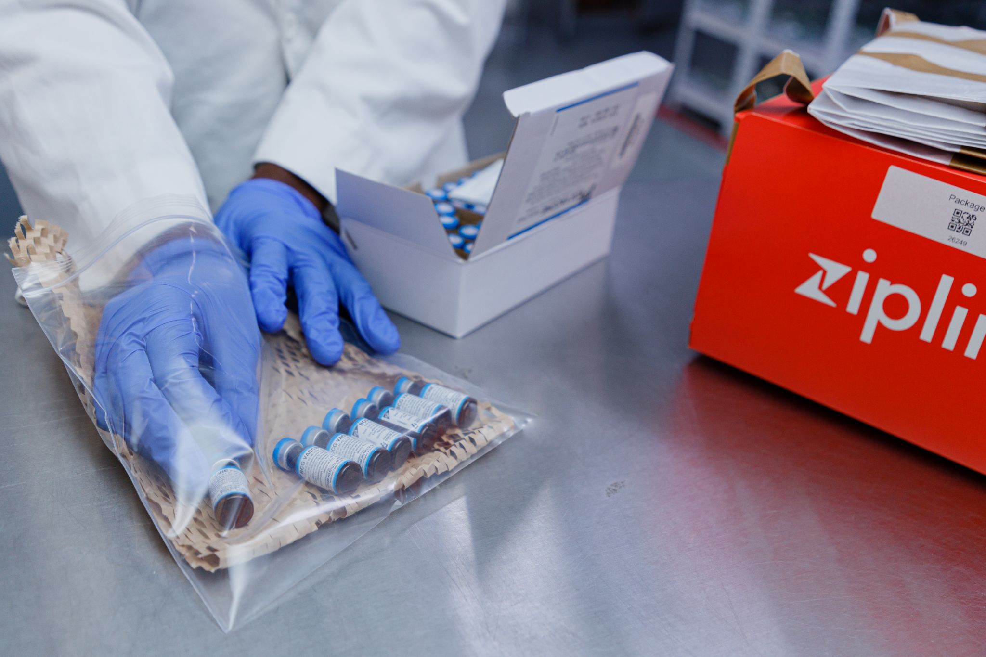
Sample Use Cases: Vaccine Distribution
Up to 20%
Increase in doses administered
Up to 15%
Increase in vaccine availability
> 96%
Reduction in health personnel cost on supply chain activities
> 33.2%
Reduction in CCE costs
Notes:
Sole Supply in Rural Communities: In remote rural areas which are often difficult to reach, Zipline will solely supply vaccines to these areas with drones ensuring the availability of vaccines at every ward.
Vaccine Stock Outs and Exceptions -Studies show a third of missed vaccination opportunities are due to stockout of vaccines at the health facility. Zipline’s just in time delivery will ensure that health facilities always have stock available to serve patients.
Supplement (or Substitute) Cold Chain Infrastructure - Zipline can be a cost efficient alternative for facilities who currently do not have cold chain infrastructure or those that may need replacement by delivery vaccines on-demand.

Slide 20
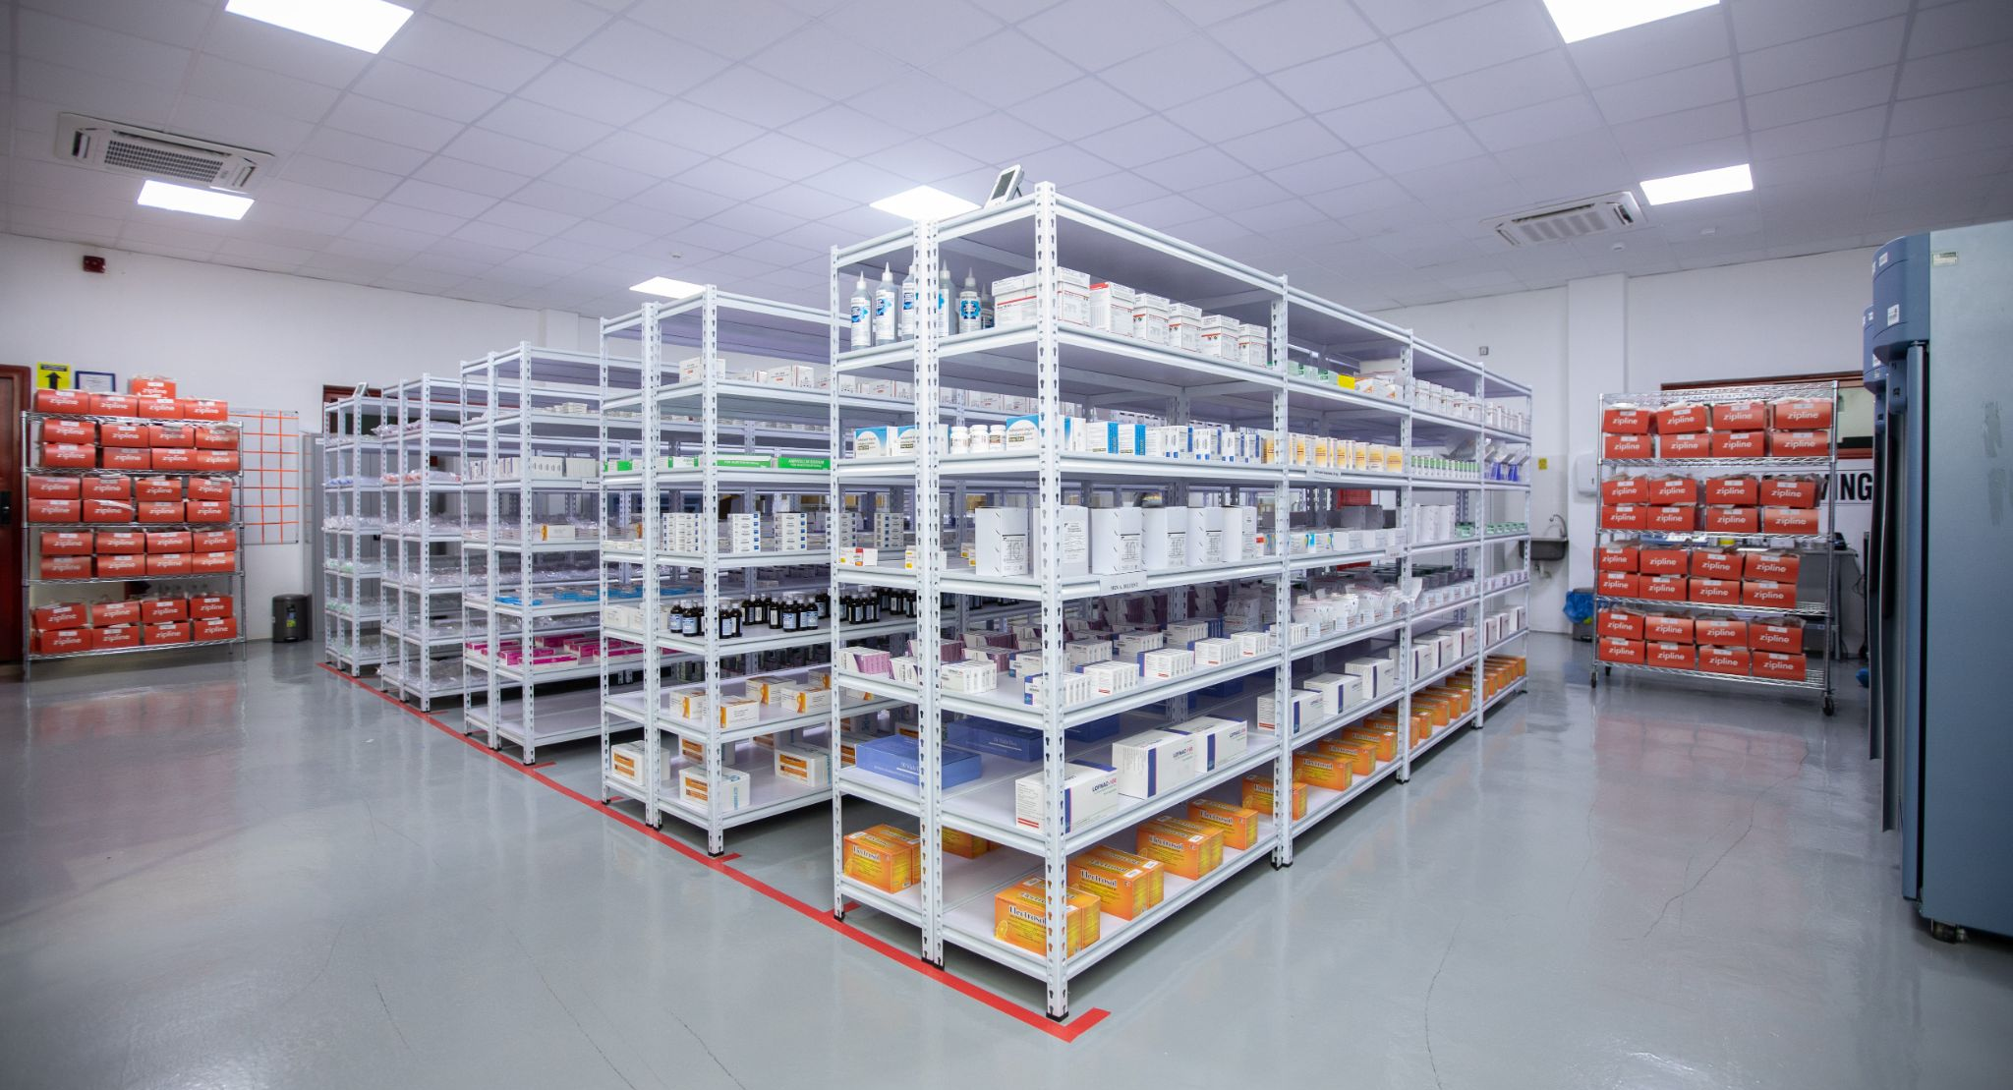
Sample Use Cases:Medical Products
Up to 100%
Reduction in emergency resupply costs
Up to 99%
Increased availability of medicines
> 95%
Increase in patient satisfaction rate
> 90%
Decrease in product wastage
Notes:
Effective and Rapid Distribution of Rare Products - Scarce products which can be challenging to distribute equitably can be centralized at Zipline’s hub and supplied on-demand to health facilities ensuring the availability of the products across different levels and categories of facilities.
Exception Management - Stock-outs can sometimes lead health facilities to overstock an item in the next replenishment, which risks more drugs expiring before they are used. Zipline can support by driving stockouts to <1%, ensuring that products are always available.
Tracking & Traceability - Live Consumption Data -Zipline unit level tracking generate real time consumption data which can improve forecast accuracy.
Chronic Care Management- In chronic patients who are more stable, Zipline can support remote care by delivering products either directly to patients, via churches, community centers or wherever access does not pose a problem to patients.

Slide 21
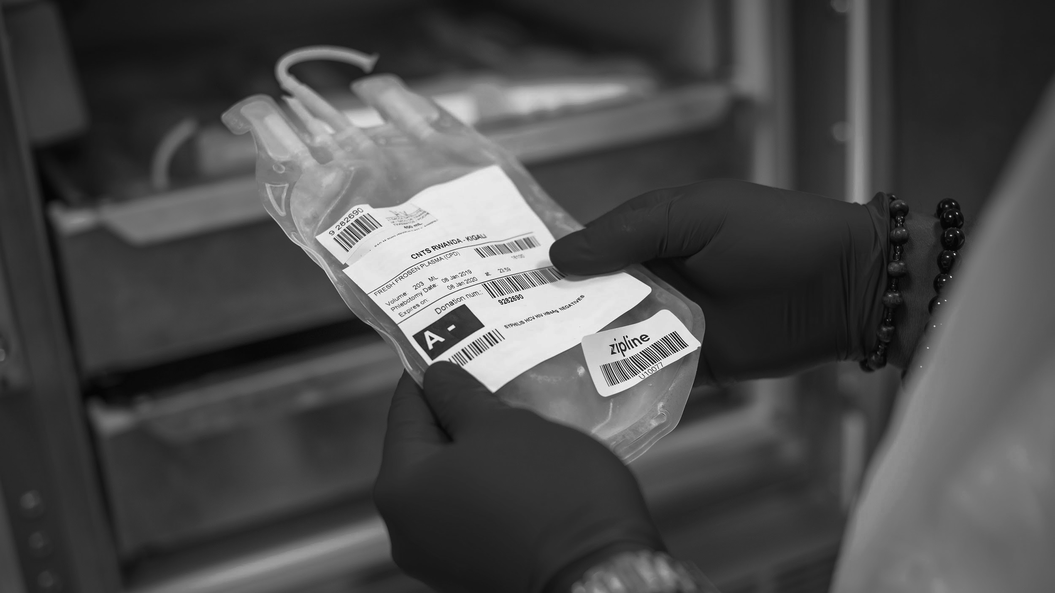
Sample Use Cases:Blood Products
Up to 5%
Efficiency gain in blood inventory allocation
Up to 10x
Expansion of treatment options for hospitals
> 99%
Reduction in expiries
> 99%
Reduction in stockouts
Notes:
Managed, On-Demand Distribution - Safety stocks required at transfusing facilities can be reduced significantly because the just-in-time service ensures that products are delivered just when it is needed. We estimate that this will provide an additional 1-5% efficiency gain in inventory allocation.
Cold Chain Advantage & New Treatment Options - Some blood products require specialized storage, such as freezers, incubators and agitators. Delivering on-demand allows products to be used immediately without storage. This also enables new treatment options for facilities who previously could not order due to lack of storage.
Inventory Management & Efficiency- Centralizing stock allows for application of FEFO (First Expiring, First Out) en masse which will ensure that virtually 0% of products expire while simultaneously increasing satisfaction rates.

Slide 22
What Is Our Health Impact?
Increased Product Availability
Zipline’s on-demand service ensures products are readily available at health facilities.
Improved Service Delivery and Utilization
The increased availability equips healthcare providers to deliver care effectively. It also promotes patient trust in the healthcare system which influences healthcare utilization.
Improved Patient Outcomes
Improved service levels and utilization positively affect patient health outcomes. It increases the health system’s responsiveness to preventable deaths that would have been exacerbated due to low service utilization and limited product availability.

Slide 23
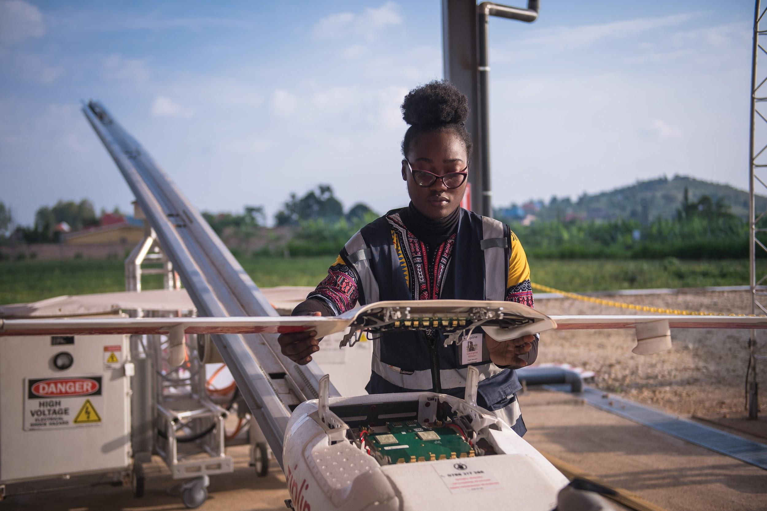
Ecosystem Development: Growing Drone & Supply Chain Expertise
Economic Benefit
100%
Local talent will manage and learn from cutting-edge technology and health system innovation
>$1.5M
Invested in infrastructure and equipment
2x
multiplier effects with its spending on housing, food service vendors, and partnership with local suppliers that creates opportunities to improve the economy.
Technical Knowledge Transfer
Increased collaboration with international partners, donors, and tech companies
Development of specialized skills because drone technology is an emerging field
Zipline proprietary & confidential. © 2021 Zipline International Inc. All rights reserved.

Slide 24
WHAT DOES THE FUTURE LOOK LIKE
USE CASES ACROSS AFRICA

Slide 25
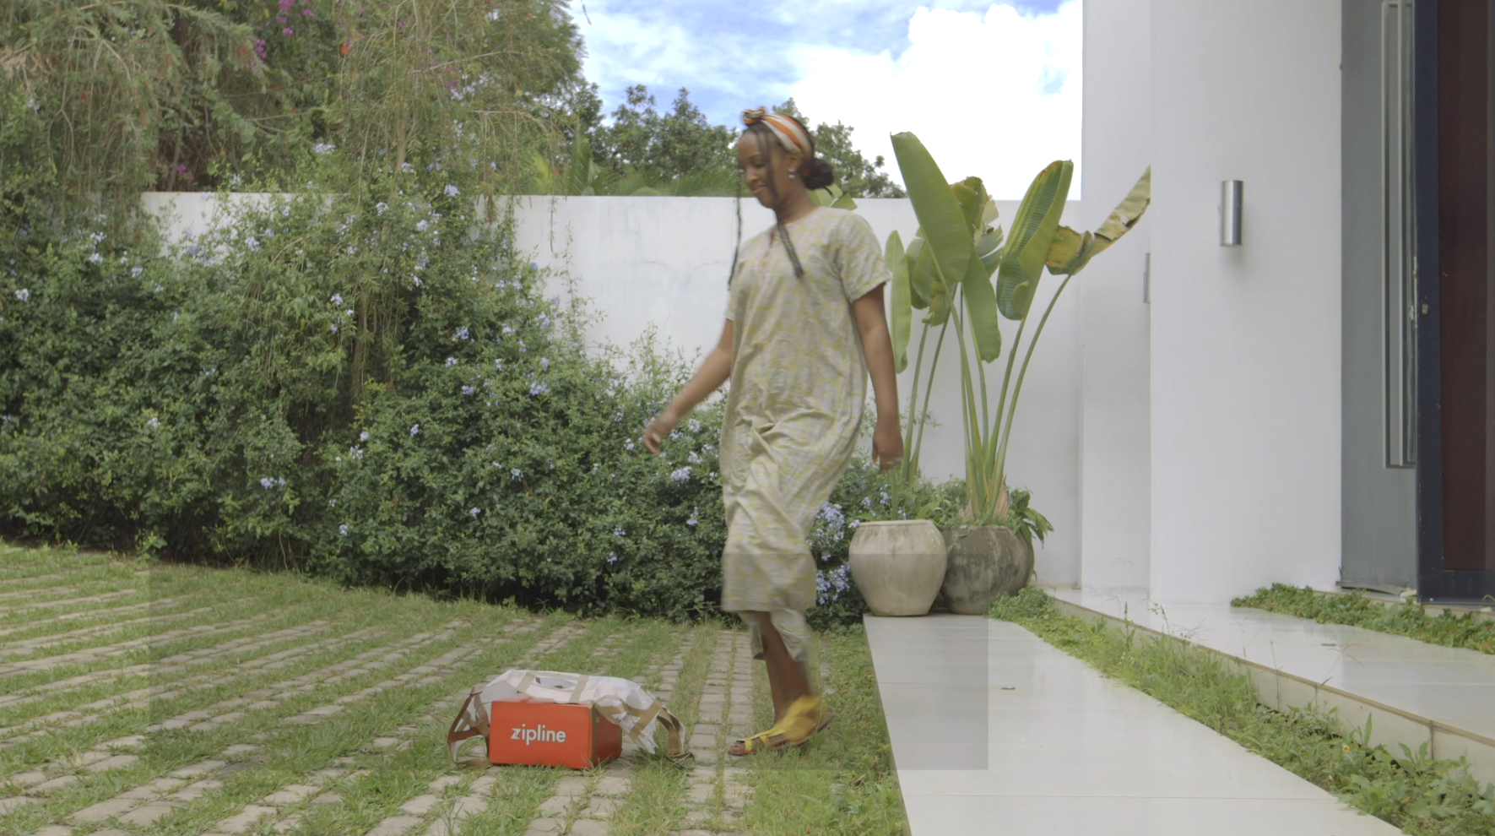
HOME DELIVERY
Getting Care Closer To Home
Recipients where we see high impact:
Patients with long-standing chronic disease (Cancer, Diabetes, Hypertension, etc..)
Mobility challenged patients (Aged, living in the rural area) with difficulty of traveling long distances for medical products refill.
There is a huge time cost to one’s healthcare. Receiving care faster leads to fewer comorbidities that may arise, leading to healthier patients and a more efficient healthcare system.

Slide 26
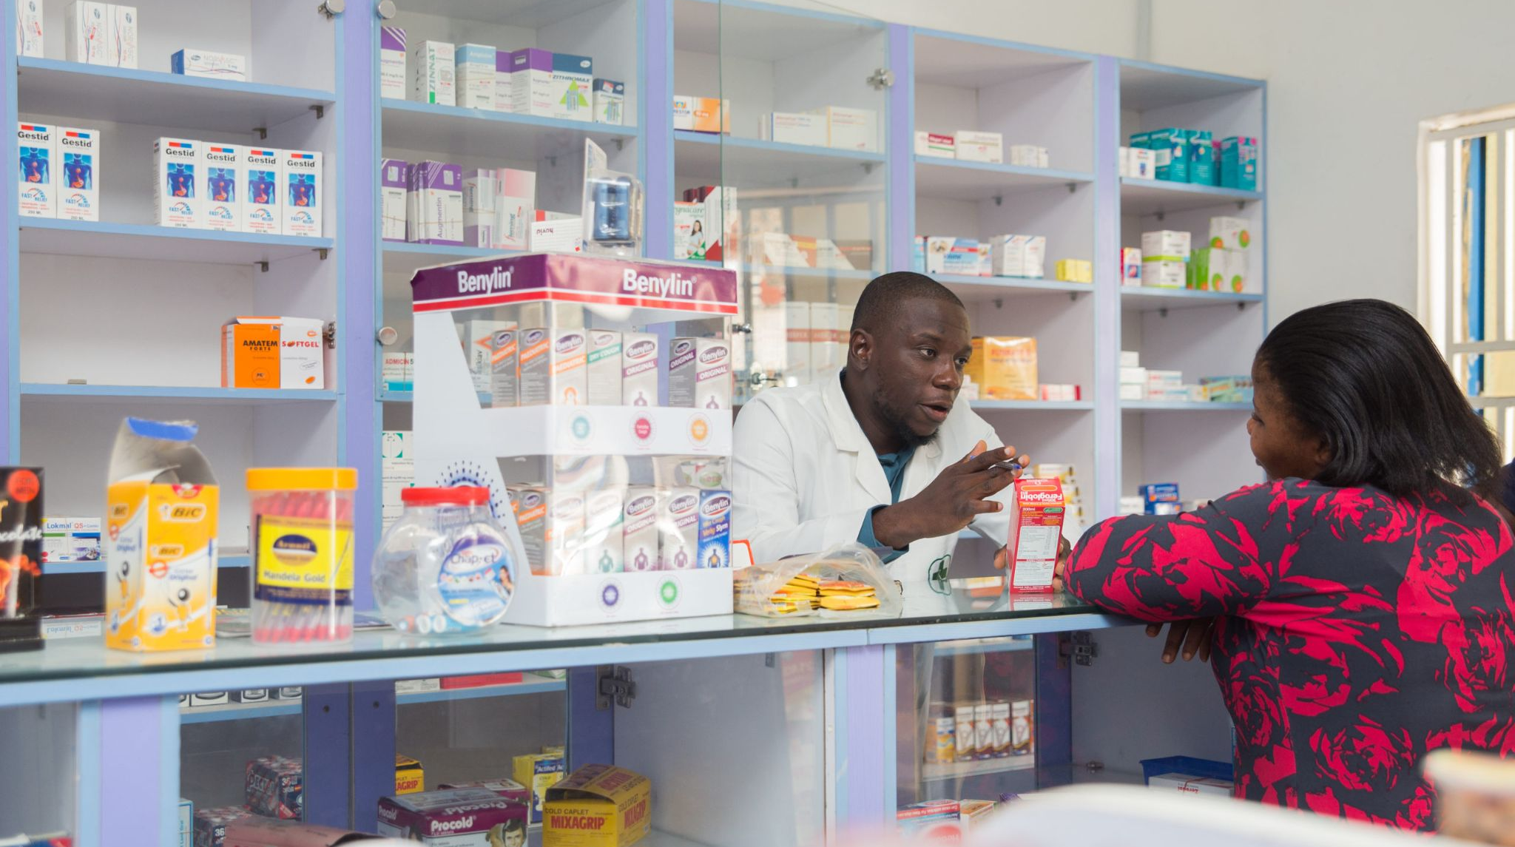
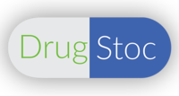
Managed Pharma Supply
Centralized Inventory & Distribution
New players like Drug Stoc are starting to move that pharmacies and be run significantly more efficiently by managing their inventory better. Zipline could partner with these organisations to amplify the effects of centralized inventory to ensure pharmacies always have stock on hand whilst also improving revenue collection and management

Slide 27
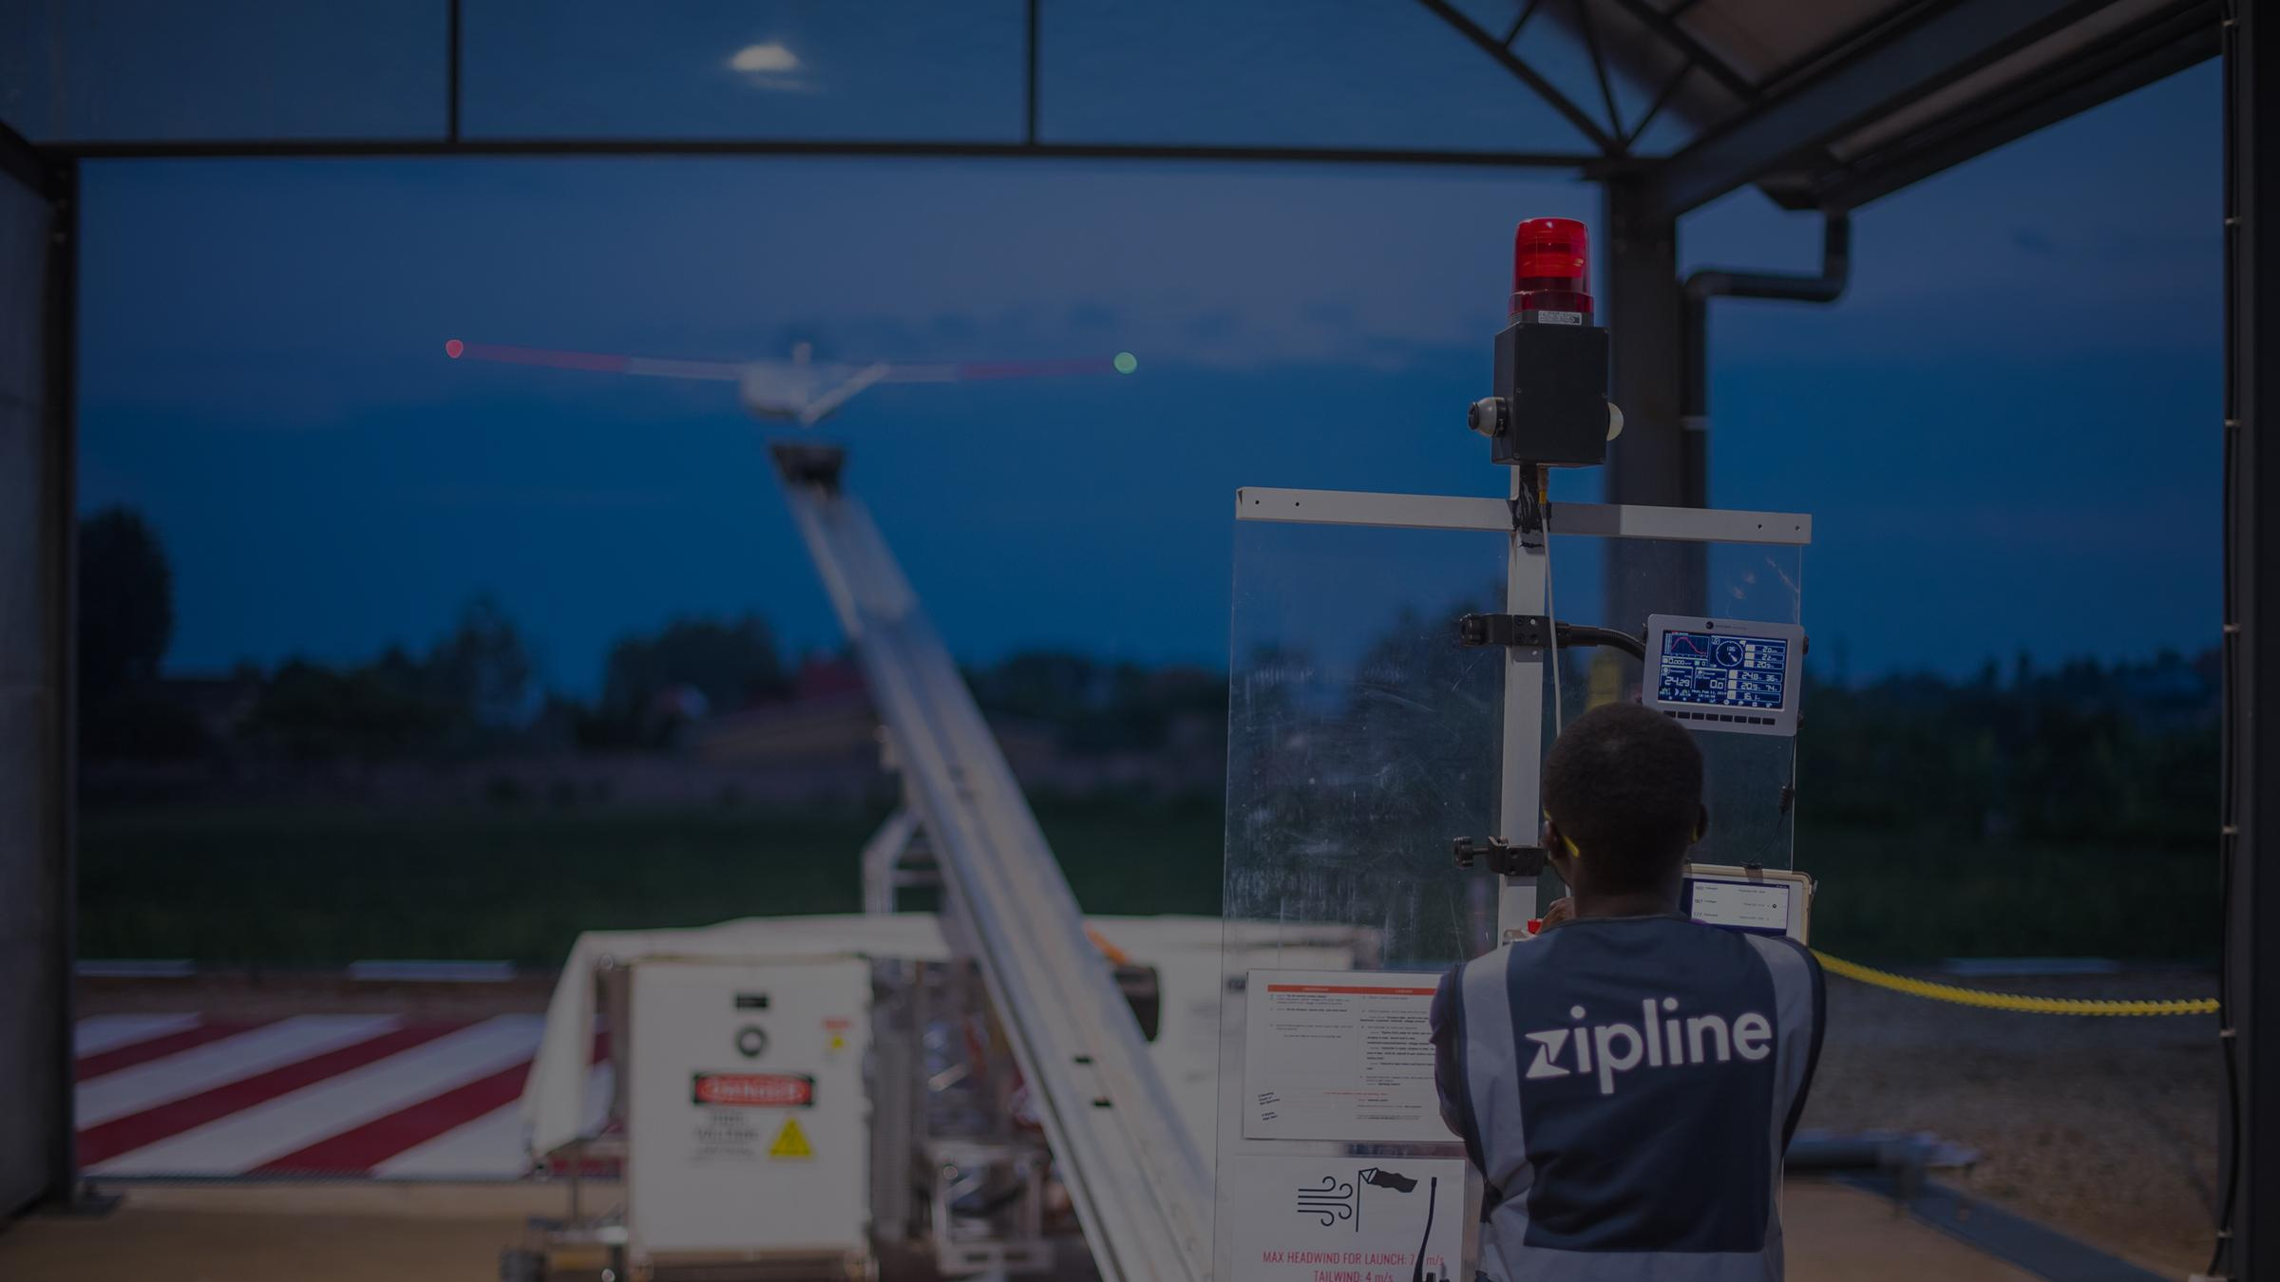
Thank you!
Daniel Marfo
Zipline Nigeria
daniel.marfo@flyzipline.com

Slide 28
Someone gets a Zipline delivery every 4 minutes
Zipline is the world’s only last-mile aerial logistics company delivering medical commodities at national scale, every day.

