Slide 1
Operation Grassroots: Improving Healthcare Access to Local Communities
Uche Udeozo, PhD
CEO, UKC Health
www.ukchealth.com

Slide 2
UKC Health Vision and Mission
Vision: To be an outstanding and trusted entity in the delivery of healthcare to patients
Mission: To use technology and medical innovation to address gaps in the delivery of primary healthcare
www.ukchealth.com

Slide 3
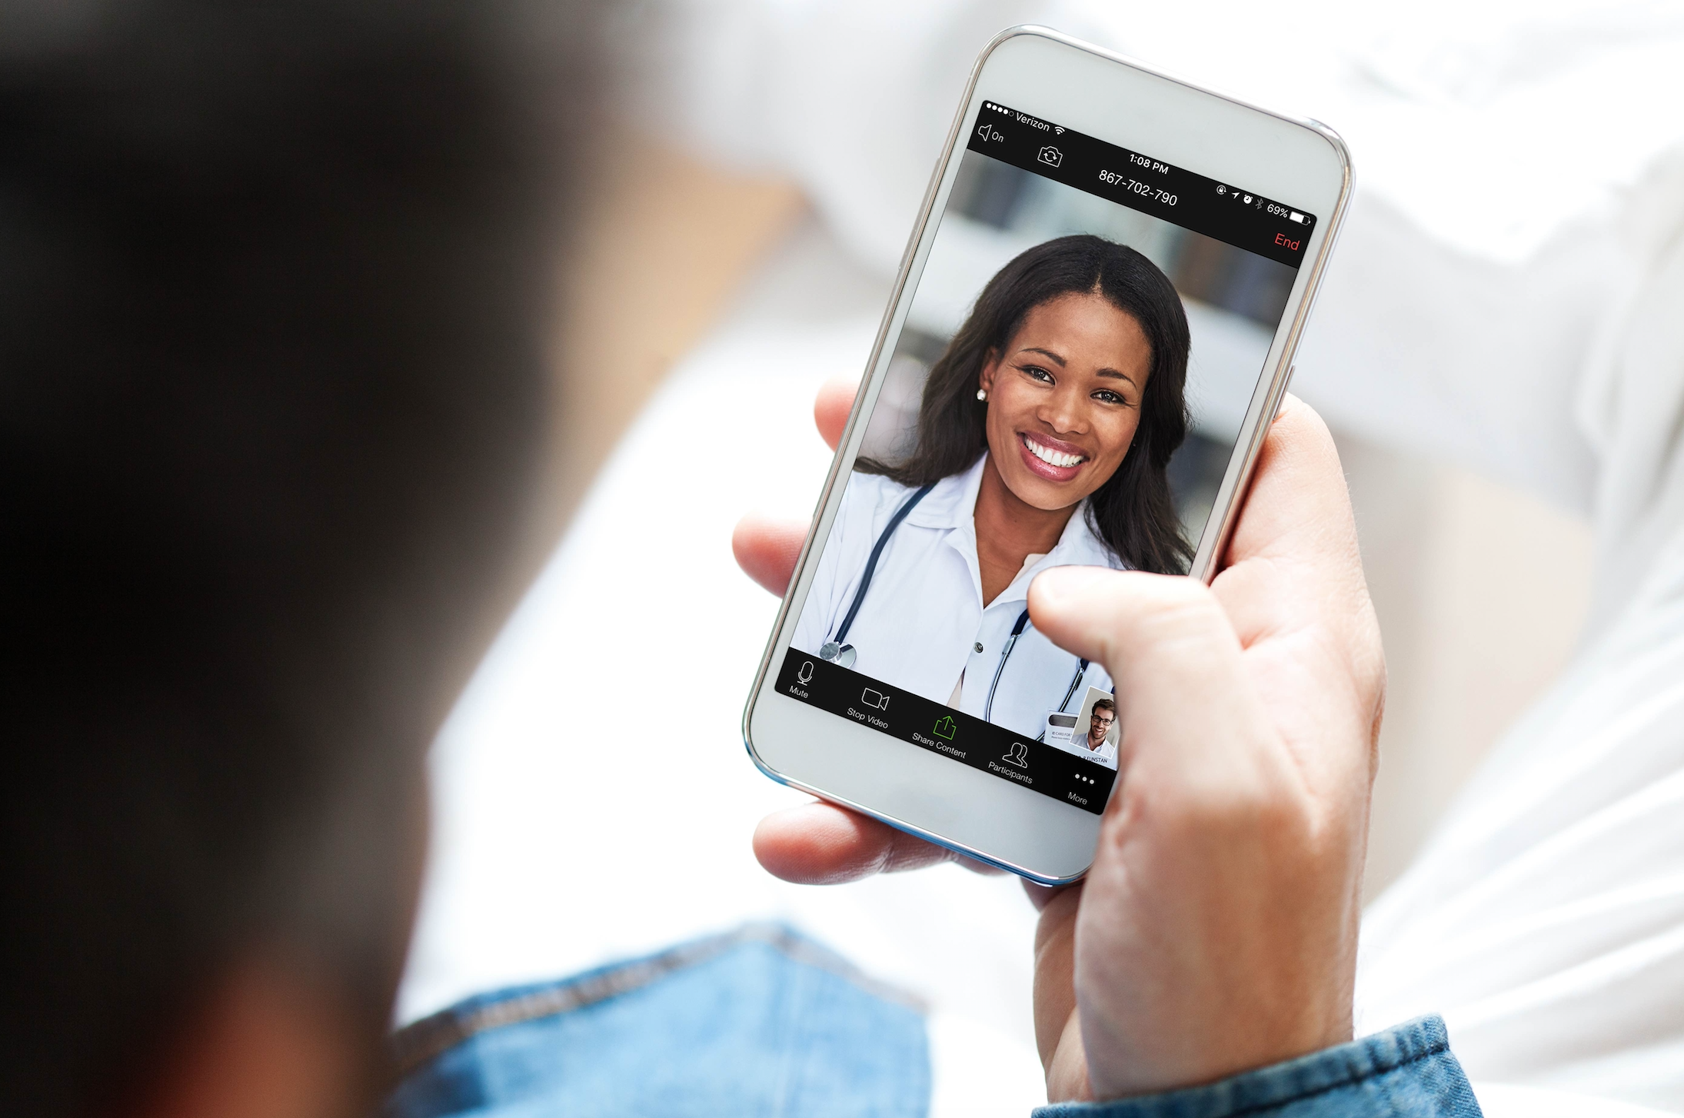
Telemedicine. What is it?
Telemedicine is the diagnosis and treatment of a patient by means of telecommunications technology e.g. a mobile phone or tablet

Slide 4
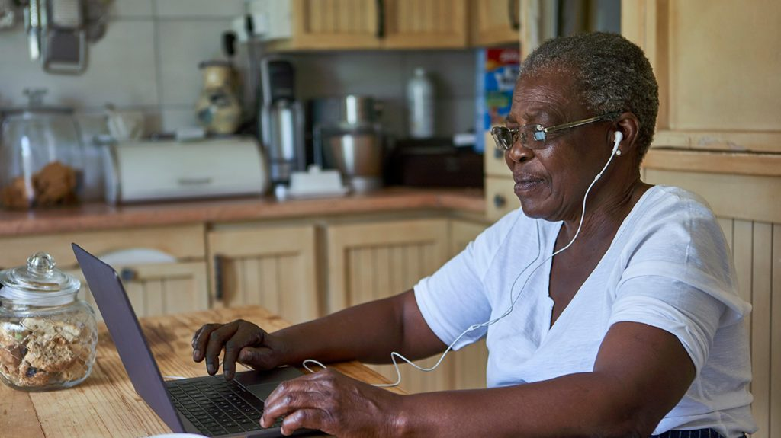
Telepyschology.
What is it?
Telepsychology refers to the
usage of psychology services
delivered via voice or
video conferencing.

Slide 5
“Disruptive technology is the technology that affects the normal operation of a market or an industry. It displaces a well-established product or technology, creating a new industry or market”.
Professor Clayton M. Christensen, Harvard Business School

Slide 6
Disruptive Technology Examples

Slide 7
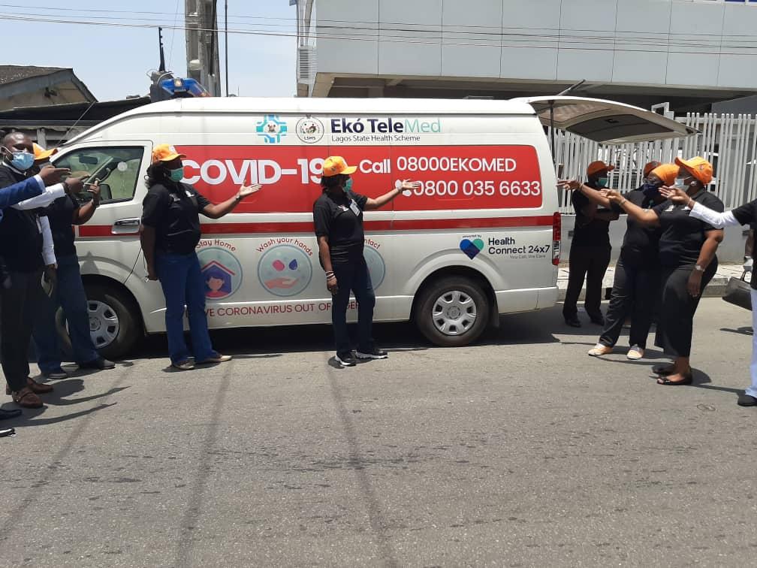

Slide 8
‘Almost 75% of all doctor, urgent care, and ER visits are either unnecessary or could be handled safely and effectively over the phone or video’. American Medical Association
www.ukchealth.com

Slide 9
How Does it Work?
www.ukchealth.com

Slide 10
Key Features to Consider for a Telemedicine Service
08000432584
(08000HEALTH)
Patient toll-free number
24x7
Availability
Local
languages
English, Pigeon English, Yoruba, Hausa, Igbo
Full-time
licensed doctors
In-country and based
at call-centre
Unlimited
No limit of calls to
access service
Voice
Service available for non-smartphone and
smart phone users
Video
Video call service available
High-Quality
Based on the WHO and UK’s NICE telemedicine guidelines
www.ukchealth.com

Slide 11
Conditions That Can Be Manage Telephonically
Malaria
High Fever
Headache
Diarrhea
Digestive
Nausea/Vomiting
Abdominal Pain
Anorectal Problems
Respiratory
Cough/Cold
Sore Throat
Asthma
Musculoskeletal
Back Pain
Joint Pain
Sports Injuries
Wellness
Obesity
Diet Advice
General Health
Chronic Disease
High Blood Pressure
Diabetes
Thyroid
Genitourinary
Sexual Health
Urinary Tract Infection
Thrush
Eye
Conjunctivitis
Allergic Conditions
Eyelid Inflammation
Systemic
Headache
Dizziness/Weakness
Psychiatric Advice
Ear-Nose-Throat
Nose Bleeds
Sinus Problems
Ear Problems
Obstetrics/Gynecology
Pregnancy Advice
Pre & post natal Health
Pelvic Pain
Skin
Cuts and Grazes
Lumps and Bumps
Allergy/Rash
www.ukchealth.com
…...and many more

Slide 12
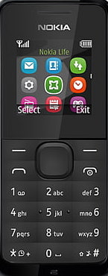
Patient Registration Requirements
Individual to provide personal data information in order to register the identified patients to the telemedicine service
The following data is required:
First name
Middle name
Last name
Date of birth
Mobile number
A welcome message, which includes the telemedicine toll-free number and app download link to access the service, will be sent to the registered user’s mobile via sms
www.ukchealth.com

Slide 13
‘Call-a-Doctor’ Workflow
Virtual Services
(Voice/Video)
Member calls via App/Toll Free No.
Register/Verify Member
Provide Medical, Wellness or Psychology Consult
Healthy
Acute
Develop customized wellness programs
Monitor fitness activity
Recommend OTC medication(s) and deliver, where available
Refer to in-network Specialist
Send sick leave note, where applicable
Follow-up with Member if required
Send KPI/Outcome Reports
www.ukchealth.com

Slide 14
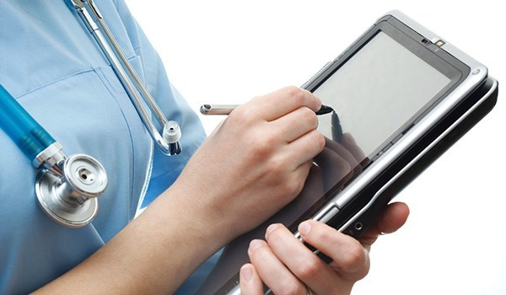
Electronic Medical Records System
Each registered patient must have their own electronic medical record and unique ID number

Slide 15
Telemedicine Service Impact and Benefits
Telemedicine can plug the human resource gap and address any lack of doctors
Telemedicine call centre will increase the patient to doctor ratio and importantly improve health outcomes of patients
High-quality healthcare will be made easily accessible, where a mobile phone or internet is available
Remote access means less chance of a patient catching a new illness due to reduced exposure to other patients (especially COVID-19)
www.ukchealth.com

Slide 16
Telemedicine Service Impact and Benefits
Telemedicine can reduce face-to-face medical consultation, which could subsequently reduce costs
Telemedicine will reduce unnecessary non-urgent ER visits
Patients can communicate with the healthcare team without the need to travel, thereby saving money or taking a day off work
www.ukchealth.com

Slide 17
Our Partnership Will Make a Difference

Slide 18
Thank You

