Slide 1
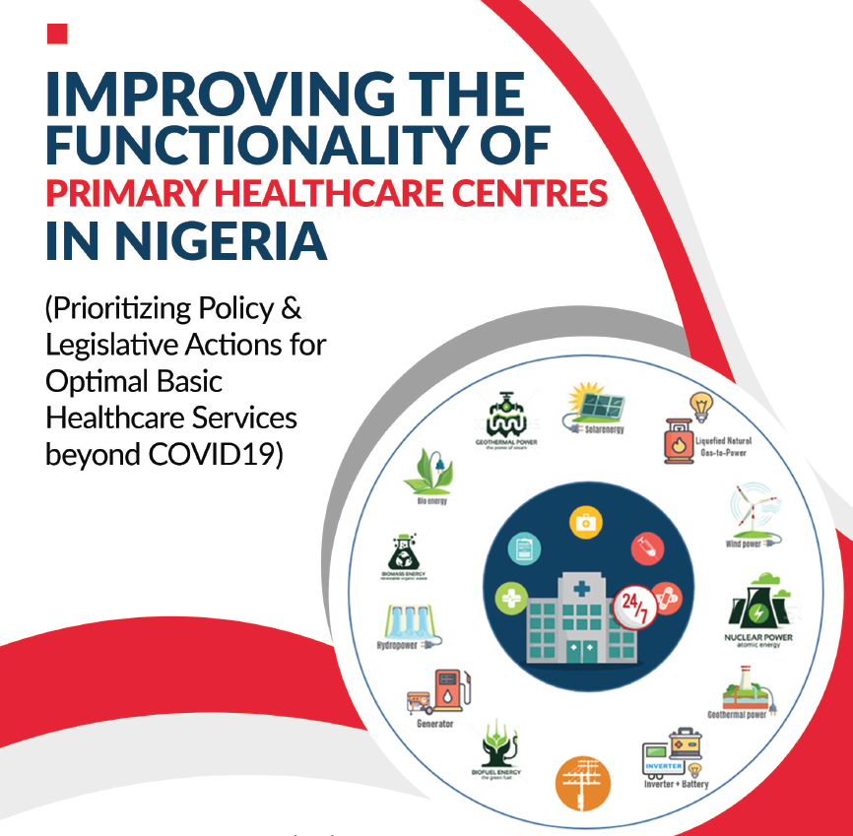
Public Policy and Healthcare Electrification in Nigeria
by

Slide 2
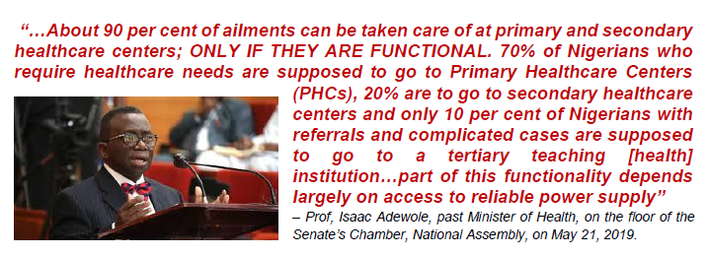
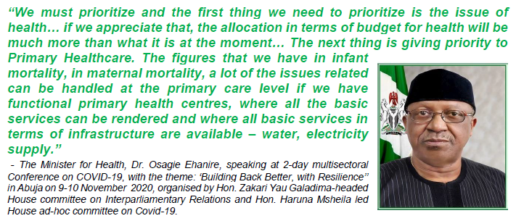

Slide 5
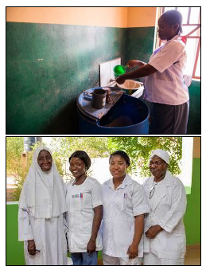
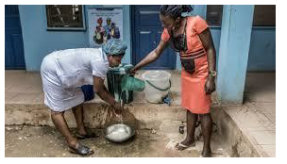
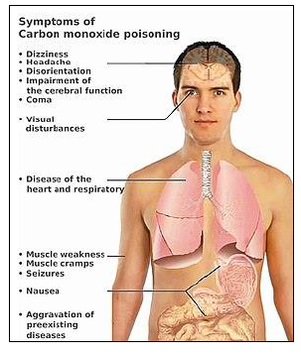
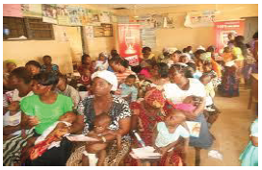

Slide 6
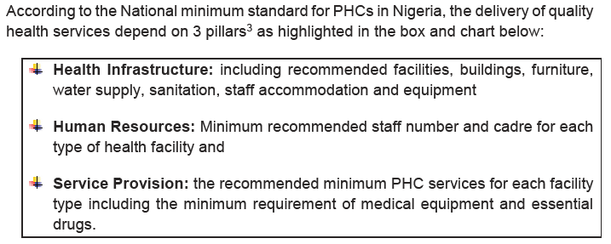
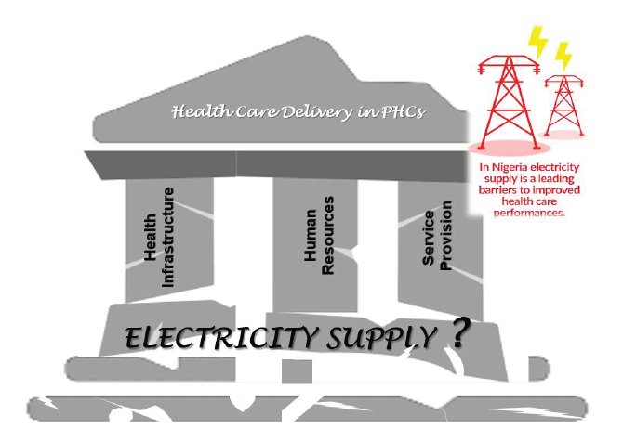

Slide 7
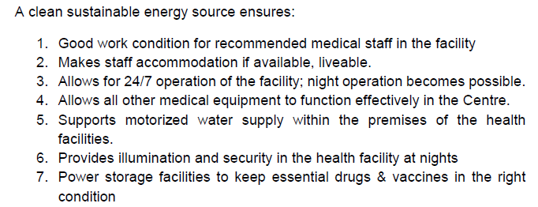
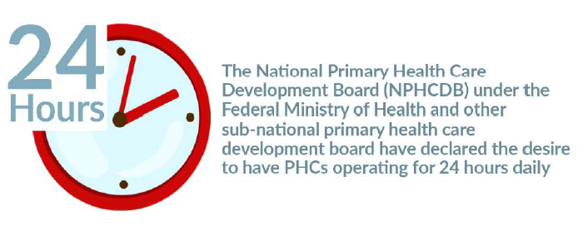
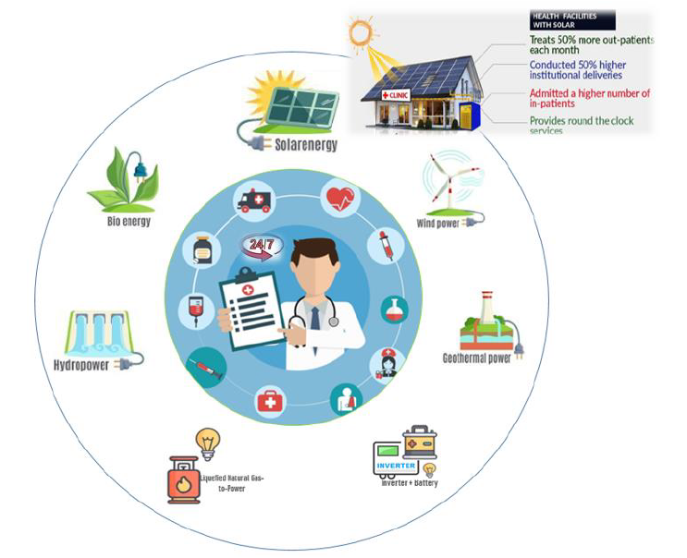
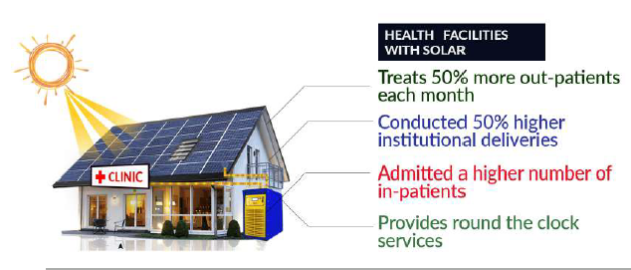

Slide 8
Key health legislation, policies, regulations, and guidelines reviewed
National Health Act 2014 (including Guideline for Administration, Disbursement, Monitoring and Fund Management of Basic Health Care Provision Fund)
National Human Resources for Health Policy 2015
National Health Policy 2016
Second National Strategic Health Development Plan 2018 – 2022
Ward Minimum Healthcare Package 2007 (Minimum Standards for Primary Health Care in Nigeria 2007 – 2012)
National Primary Health Care Development Agency [Cap N69] 2004
Protocol for the Assessment of and Accreditation of COVID-19 Isolation Facilities
National Action Plan for Health Security 2018 – 2022
One Health Strategic Plan 2019 – 2023

Slide 9
The Minimum Standard for PHC in Nigeria Guideline
The National Primary Health Care Development Agency (NPHCDA) developed the Minimum Standards for Primary Health Care in Nigeria 2007–2012 to guide the operation of primary healthcare services in the country. The document prescribes a set of minimum standards for health infrastructure, personnel, drugs and other medical consumables to reflect the WMHCP.
The minimum standards document describes key components of PHC services to include promotion of proper nutrition, adequate supply of safe water, basic sanitation, maternal and childcare, family planning, immunization, prevention and control of locally endemic diseases, education on prevailing health problems and methods of preventing and controlling them, as well as appropriate treatment for common diseases and injuries.
The existing Minimum Standards for PHC is already outdated. It was designed to cover five years - 2007 to 2012. The improved guideline should take cognisance and advantage of new technologies (i.e. energy
21 storage technology, off-grid energy solution, mobile energy solutions, etc.), Multisectoral and community partnership models, existing governance structures, environmental considerations, and other existing PHC challenges. The new minimum standards should also position PHCs to be more than a health centres, but also a major economic catalyst in host communities.
The Minimum Standard Guideline under PHC infrastructure prescribed that the PHC facility - “Be connected to the national grid and other regular alternative power source”. Though the guideline considered the limited and unreliable nature of the national electricity grid, it does not consider the sustainability of the fossil generator (either sourcing fuel, its polluting nature, the cost of financing its fuelling and maintenance), which it technically suggested as the first line alternative power source.
The guideline had very poor compliance rate, as most PHCs were constructed without following the set guideline. This largely explains why only 20% of the over 30,000 PHCs in the country are functional, and the majority dilapidated. The new minimum standards guideline must be enforced when developed.

Slide 10
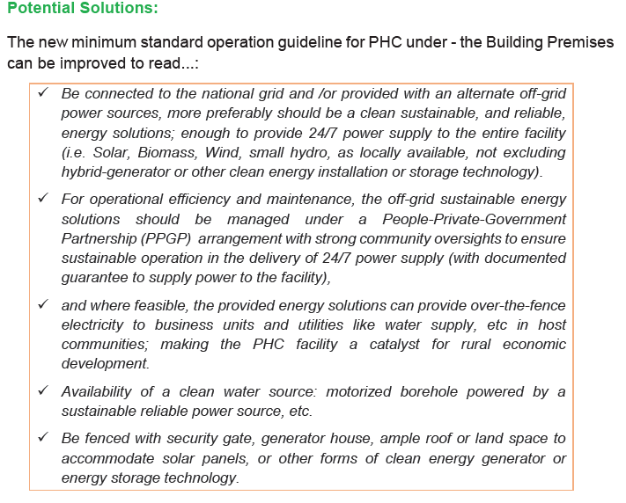

Slide 11
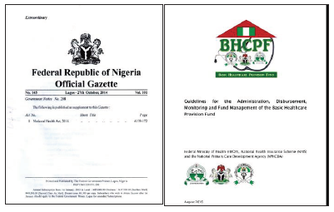
The National Health Act 2014 (NHA, 2014) and its Basic Health Care Provision Fund (BHCPF) Guidelines (2016)
The National Health Act was signed into law on 31st October 2014.
The Act provides a legal framework for the regulation, development and management of a national health system in Nigeria. It sets out a minimum package of essential health services for all citizens in the country.
A key component of the Act was the establishment of the Basic Health Care Provision Fund (BHCPF), which aims to support the attainment of universal healthcare coverage in Nigeria by substantially increasing the level of financial resources through the PHC structures.
The BHCPF is predominantly financed through an annual grant from the Federal Government; an amount not less than 1% of the Consolidated Revenue Fund with additional sources of funding expected through grants from local and international donors and state governments.
To access the BHCPF, eligible states and local governments are expected to contribute 25% as counterpart funds.

Slide 12
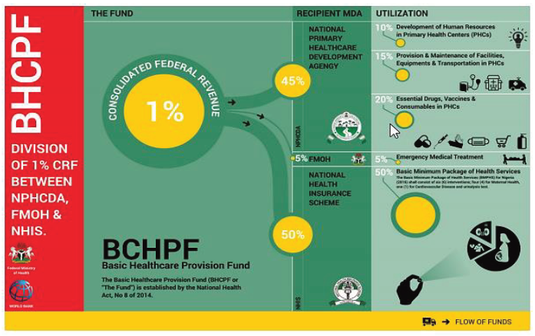
50% used for the provision of basic minimum package of health services to citizens in eligible primary or secondary healthcare facilities through the National Health Insurance Scheme (NHIS).
20% used to provide essential drugs, vaccines and consumables for eligible PHC facilities.
15% used for the provision and maintenance of facilities, equipment and transport for eligible PHC facilities.
10% used for the development of human resources for primary healthcare.
5% used for emergency medical treatment to be administered by a Committee appointed by the National Council on Health.

Slide 13
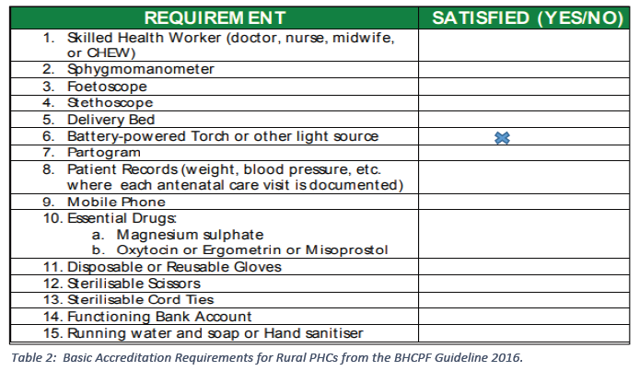
The Gap & Proposed Solutions:
Under the NPHCDA Gateway in Healthcare Provider Rights and Responsibilities, section 3.9.2 [a, b]:
Primary Health care facilities selected based initially on the One Functional PHC per Ward strategy shall be eligible to apply for accreditation and participate in the initiative.
In order to ensure a consistent level of quality, each facility shall meet the minimum criteria of quality standards before it is eligible to be enlisted.

Slide 14
Take note of number 6 under the basic accreditation requirement for Rural PHCs from the BHCPF Guideline 2016 - “Battery powered Torch or other light source”.
The guideline encourages the use of Battery touch lights and other light source (which can be candles, kerosene lanterns, etc.) to provide illumination at night. This is without considering the fact that over 50% of Nigerian communities are not connected to the national grid electricity, and for those connected to the grid, more that 85% of them are largely underserved with irregular electricity.
A guiding document like the BHCPF that hopes to achieve 1 functional PHC per ward strategy fails to make provision for 24/7 uninterrupted electricity supply in each of the PHC per ward.
Even though the BHCPF scheme provides basic minimum package of health services; supplies essential drugs, vaccines and consumables for eligible PHC facilities, provides equipment’s in the eligible (or selected) PHCs per ward and cover salaries of personnel’s in the PHC; without steady reliable electricity in the eligible PHCs these provisions may not provide the desired outcome.

Slide 15
Potential Solutions:
The success of the BHCPF scheme lies in the ability of the selected and eligible PHCs to deliver quality health services as promised. This depends on the sustainability of the pillars of PHCs, and central to their functionality is the availability of clean reliable uninterrupted electricity supply.
The BCPF guideline needs to be reviewed to encourage PPP with strong community oversight to improve infrastructure provision and management; specifically, for electricity supply.
A fraction of the 15% of the BHCPH fund earmarked for the provision and maintenance of facilities, equipment and transport for eligible PHC facilities, can be channelled towards covering the operation and maintenance agreement with a private energy companies and community people to ensure 24/7 supply of electricity to the selected PHC in each ward. This fraction can be augmented with budgetary allocation from Local and State government, as well as grants from local and international organisations and philanthropist.
For a starter, the BHCPF guideline should review the requirement for eligible PHC, specifically the criteria line number 6 - “Battery powered Torch or other light source”. This ridicules the plans to improve the functionality of PHCs in Nigeria and ending the norm of women and nurses giving birth in the dark or PHCs not being able to work at night or attend to night emergencies.

Slide 16
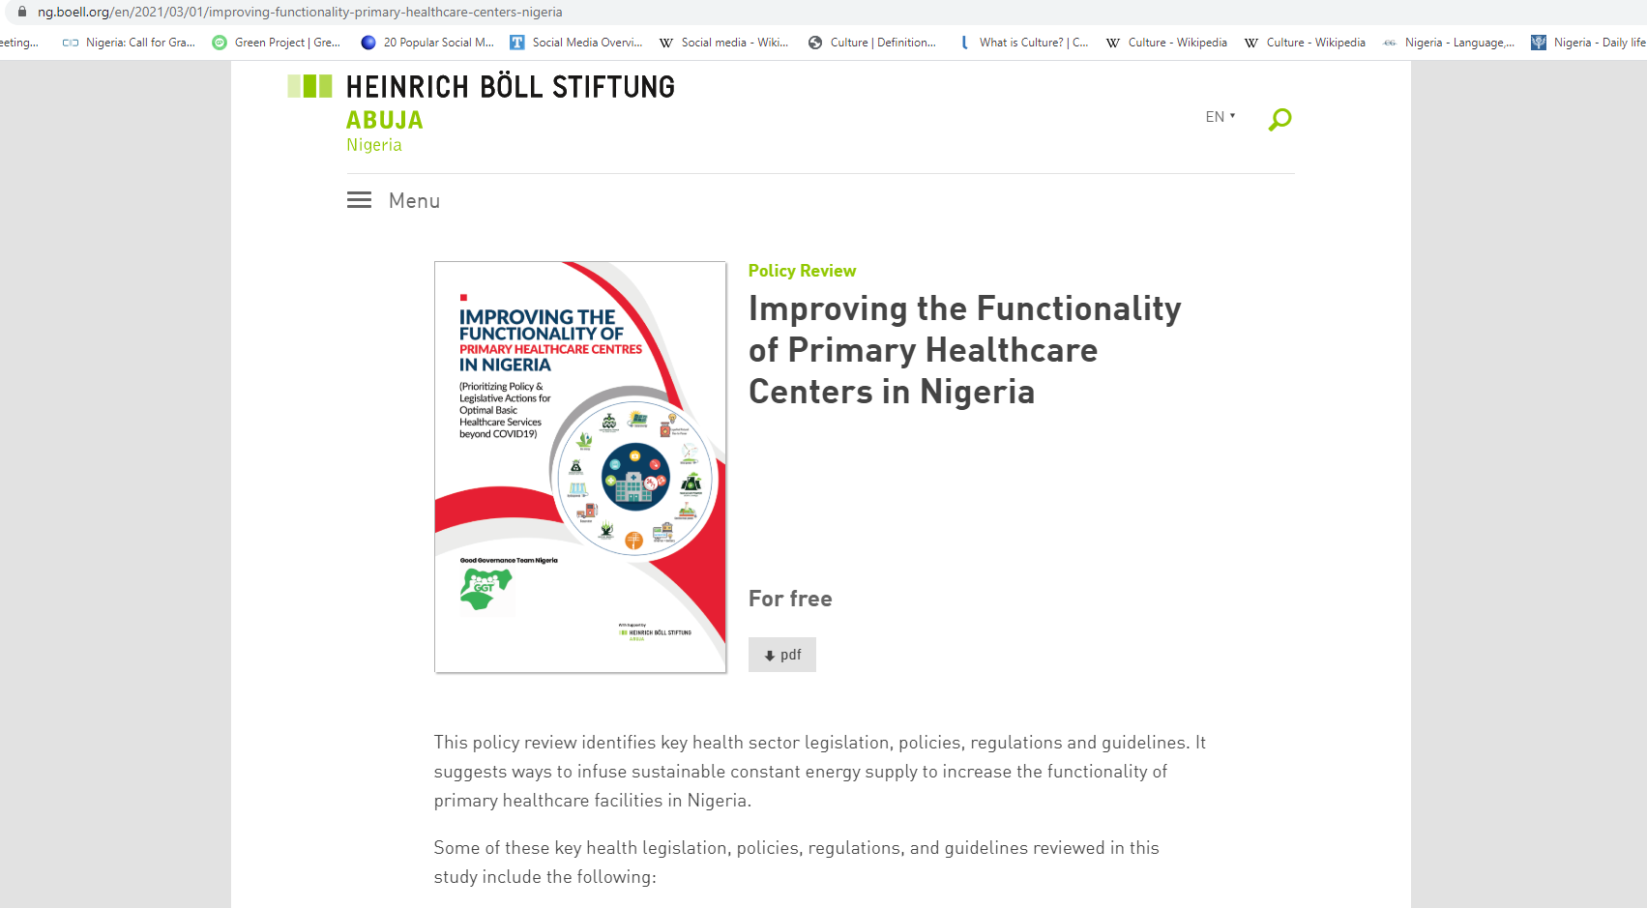
For details on more of the policy gaps and fillers please visit our website:
https://ng.boell.org/en/2021/03/01/improving-functionality-primary-healthcare-centers-nigeria

Slide 19
Thank you!
See next slide for our progress report….

Slide 24
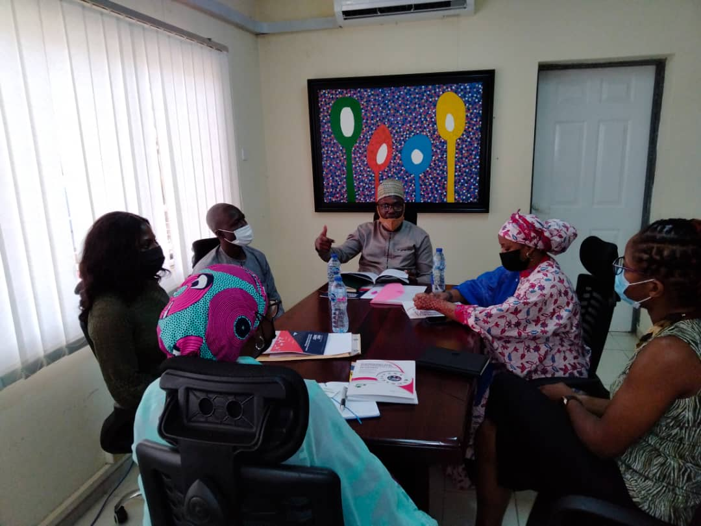
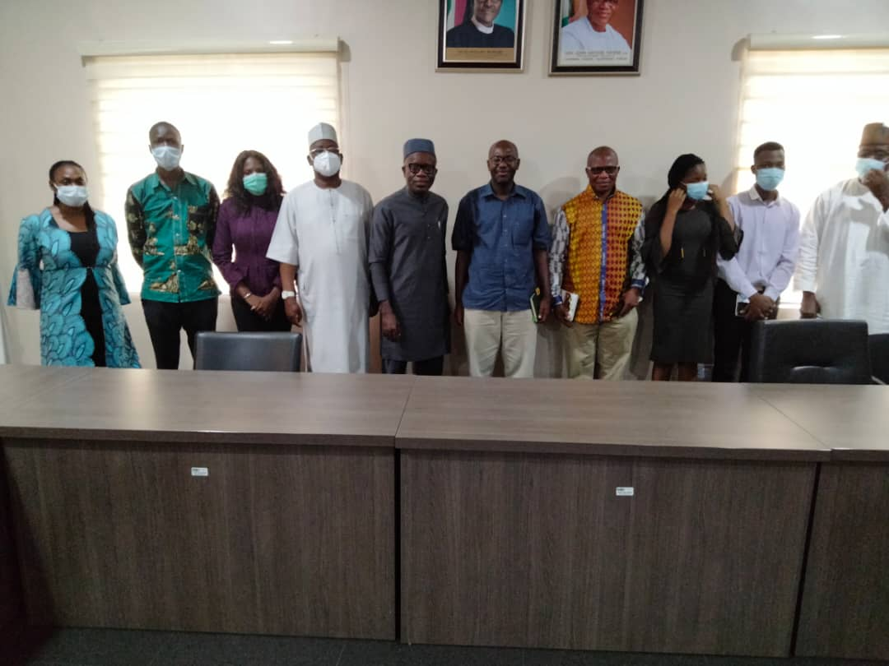

Slide 25
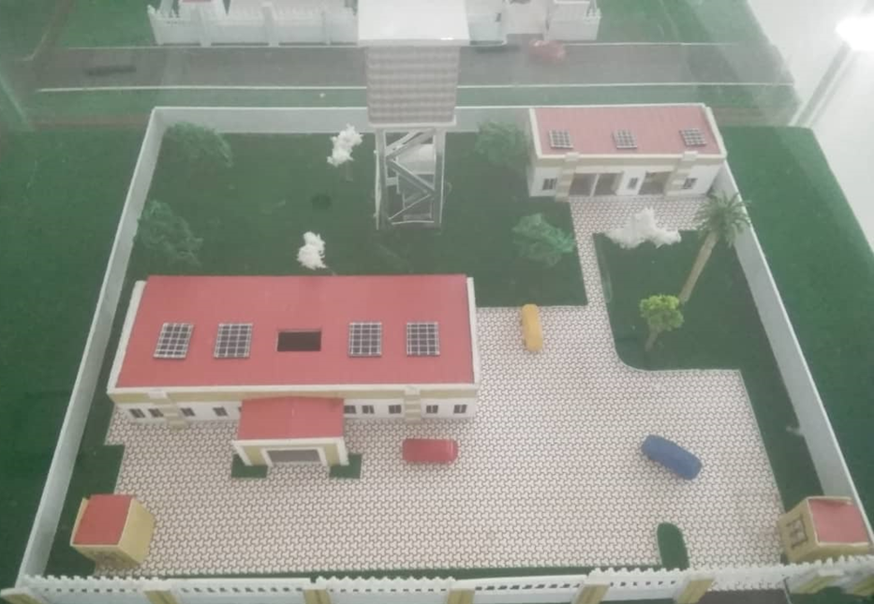

Slide 26
