Slide 1

How Lagos State Managed the COVID-19 Pandemic
Presentation to the Commissioners of Health
Prof. Akin Abayomi, Honourable Commission of Health, Lagos
SEPTEMBER 2021

Slide 2
Our response to the COVID-19 pandemic can be divided into 5 periods
Towards a COVID-19 Free Lagos State
1
2
3
4
5
Pre- Index case
Post Index-Case
First Wave
Second Wave
Third Wave
Learning, Strengthen health system and reduce deaths
Resilience. Pursue Herd Immunity to end 3rd wave and mitigate a 4th wave
Anticipate the pandemic
Mitigate the spread of the virus
Adapt health system to manage the pandemic
Expand testing & isolation capacity
Setup Incident Command System
Robust scenario analysis
Full isolation of all confirmed cases
Increased the number of public labs testing for COVID-19
Inclusion of private sector in testing & isolation strategy
Telemedicine driven Home-based care program
Reduce deaths
Deploy learnings from 1st wave
Publish findings about virus
Introduce oxygen strategy
Ramp up vaccination to achieve herd immunity
Control importation of mutant strains
Build capacity to sequence variants

Slide 3


Activities Leading Up to COVID-19
BSL-3 Lab
Policy
Infrastructure
Invested in a Biosafety Level 3 Laboratory and Biobank in Lagos State
Completed Lagos State’s biosecurity policy and roadmap
Upgraded and expanded Isolation capacity at Lagos Mainland hospital; the infectious diseases hospital.
Convened 5 Biosecurity conferences
2015 –
2017
2016 –
2020
2018
2018
2018
Staff Training
Bio-Governance
Trained key staff in Biosecurity and Biothreat reduction
Established the Biosecurity and Bio-Governance council

Slide 4
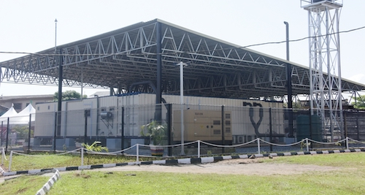
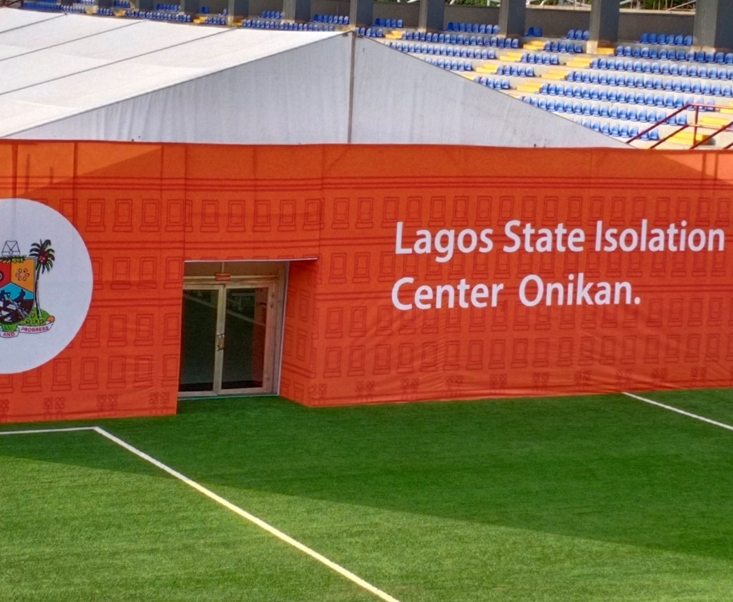
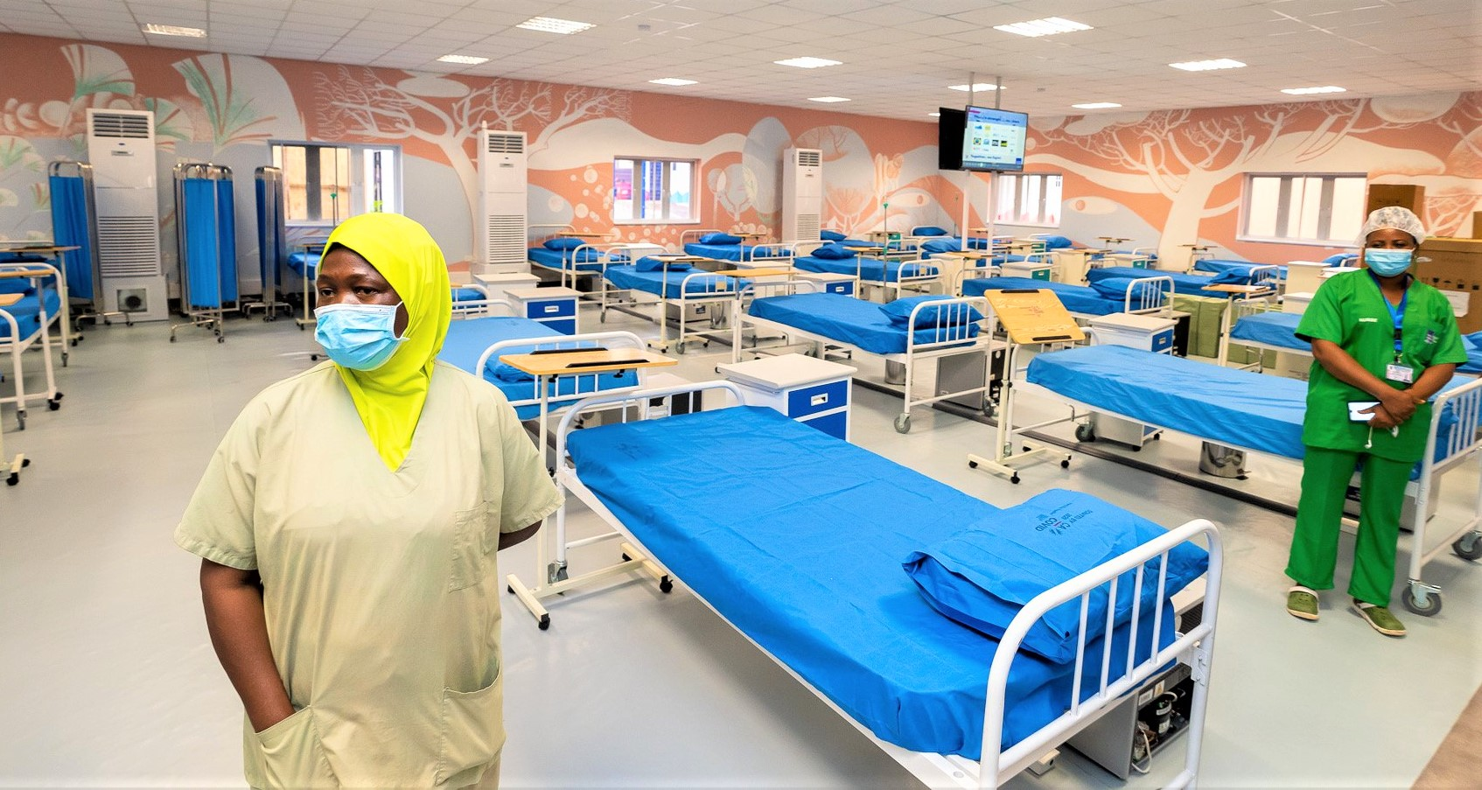
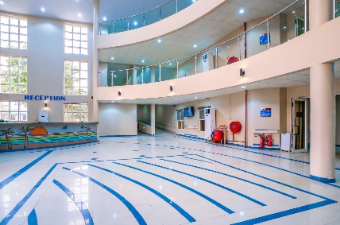
Onikan Isolation Centre
Lagos State BioBank, Yaba
Mainland Hospital Isolation Centre, Yaba
Gbagada Cardio Renal / Isolation Centre

Slide 5
Complexity of the Incident Command System Hierarchy
Incident Commander (MG)
HC’s Support Team
Deputy Incident Commander (HCH)
CABINET
Partner Engagement
MG’s Think Tank
Coordinator
PS Health, PS HSC, PS PHCB
Advocacy & Stakeholder Mgt. (Dr. Lajide)
Research & Manuscripts
(Prof. Osibogun)
Incident Manager
(Dr. Abdusalam)
Strategy & Reporting
(Dr. Zamba)
Supply Chain Mgt.
(Dr. Adejumo)
Operations
Private Sector Engagement
Clinical Trials
Epidemiology & Surveillance
Data Collation
Logistics & Transport
Administration
Regulatory Engagement
Research
Case Mgt.
Connect Centre
Procurement & Storage
Finance
Laboratory
Planning & Budgeting
Manuscripts
Human Resources
IPC
Risk Communications
Analytics & Dashboard
Technology
Point of Entry
Infrastructure

Slide 6
1
We built a biosecurity roadmap
PRE-INDEX CASE
2
Outbreak of COVID in December 2019 in Wuhan draws our attention
Prepare systems for the virus
3
Accelerated preparation in Lagos, observing the pandemic gradually extend itself globally
4
We observed the scientific data emanating from affected regions
5
By the time we got our index case, we were relatively prepared operationally and scientifically

Slide 7
1
Flatten the curve by reducing the rate of spread
POST-INDEX CASE
2
Avoid community transmission
Mitigate the spread of the virus
3
Full containment ad isolation of all positive cases
4
Preliminary engagement with all stakeholders to strengthen health system

Slide 8
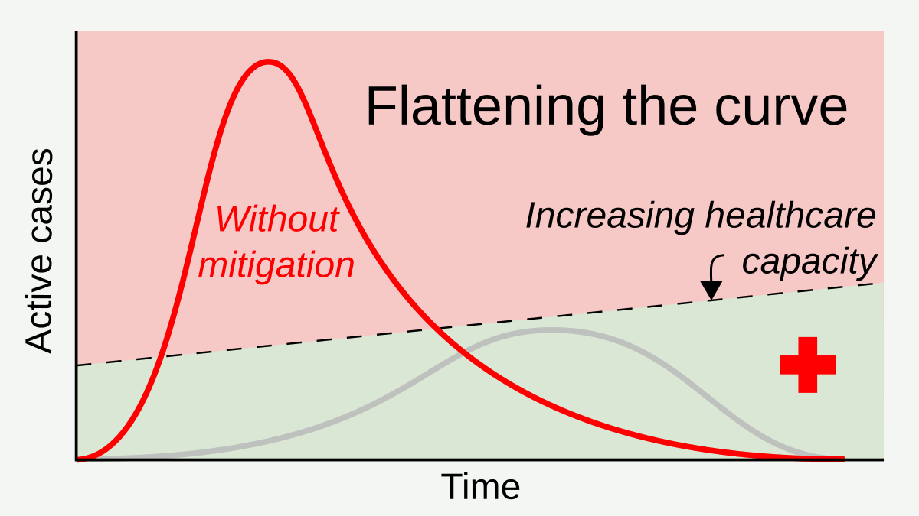
During the First Wave, our Goal was to Flatten the Curve
Flattening the curve involved deploying isolation measures that could keep the daily number of confirmed cases at a manageable level for our health system.
We deployed counter measures while increasing the capacity of our health system

Slide 9
Multiple swift policy decisions based on data helped us better manage the pandemic
Launch of Home-Based Care
Commencement of Vaccination
Ease of Lockdown
Inclusion of private laboratories
Reopening of airports
Lockdown
Gradual reopening of economy
Community Active Case Search
Case definition updated
Inclusion of private hospitals
Index case
Activation of ICS
Feb ‘20
Mar ‘20
Apr ‘20
May ‘20
June ‘20
July ‘20
Aug ‘20
Sept ‘20
Oct ‘20
Nov ‘20
Dec ‘20
Jan ‘21
Feb ‘21
Mar ‘21
Apr
‘21

Slide 10

THE FIRST WAVE

Slide 11
1
Inclusion of private sector in testing & isolation strategy
FIRST WAVE
2
Telemedicine driven Home-based care program
Adapt Health System to Manage the Pandemic
3
Using Data to forecast the peak of the first wave

Slide 12
Inclusion of Private Laboratories in Lagos State’s Testing Strategy

Slide 13
The Private Laboratories have Accounted for over 67% of the samples Tested in Lagos State
Currently, we have 25 accredited private and 4 public health laboratories
Total samples tested: 700,315 Of this amount, 685,036 were valid initial samples
The balance were repeat samples tested
72,673 were diagnosed Positive
Public Laboratories – 191,735 Samples processed (27%)
Private Laboratories – 508,580 Samples processed (73%)
Notes:
Good

Slide 14

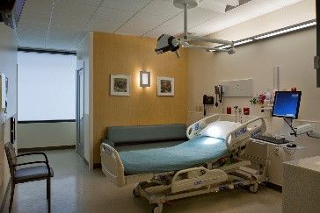

To Better Managed Mild Cases, We Included Home-Based Care
It became clear that we couldn’t isolate all the confirmed cases of COVID-19, so we adapted our isolation strategy to include a telemedicine driven Home Based Care Program
Isolation alone (Full Containment)
Policy Changes
INTEGRATED CARE
Isolation + Private Providers + Home Care
+
+
Leverage a Robust Tele-Medicine Platform

Slide 15
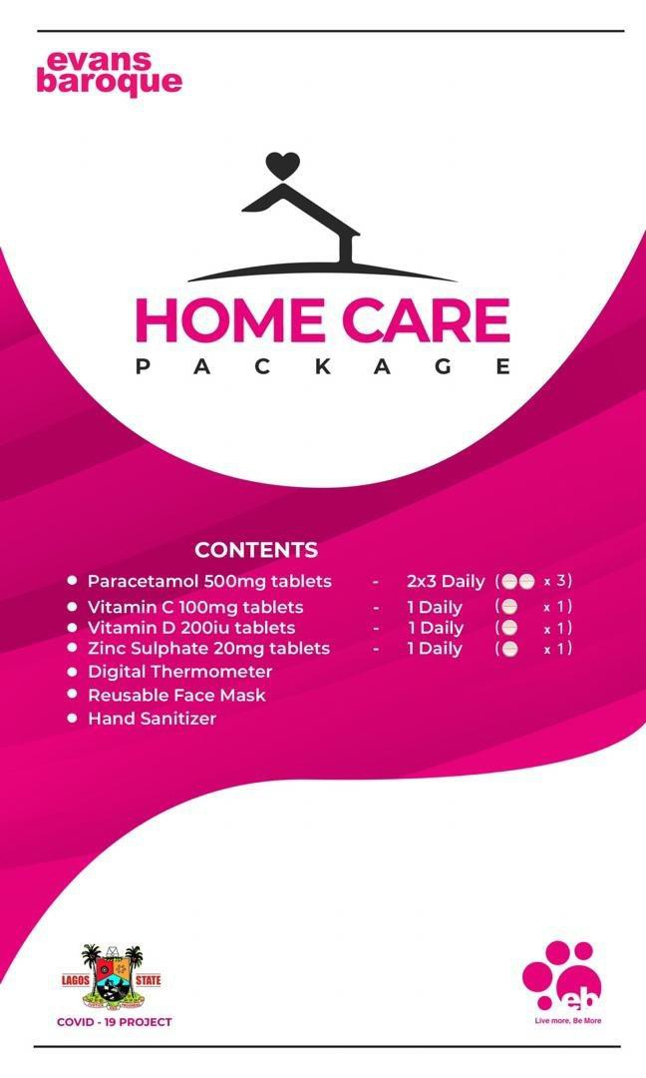
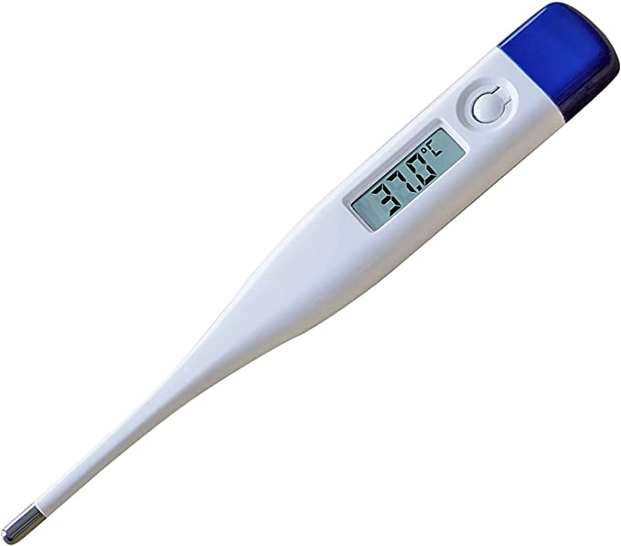
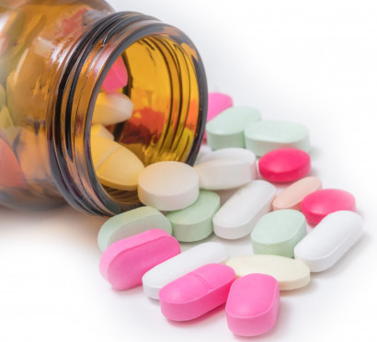
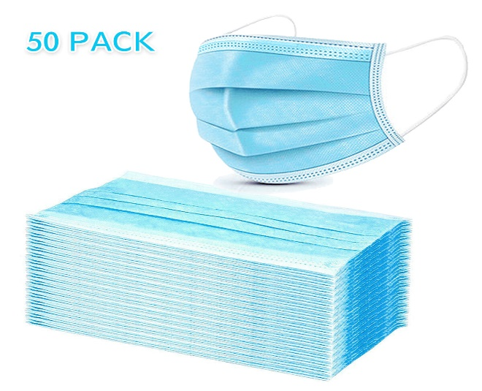
We Introduced Care Packs for the Home Based Care Program
S/N | Item Description
1. | 7 Medical Masks and a digital thermometer
2. | Zinc Tabs
3. | 2 Sachets of Paracetamol
4. | Vitamin C
5. | Vitamin D

Slide 16
Forecasting the Spread of the Virus predicted first wave would peak in August 2020
Our modelling of the pattern of the virus led us to believe that we would reach the peak number of infections between July and August. This is exactly what happened
Notes:
Create a few boxes to the right showing it flattening and going down

Slide 17

THE SECOND WAVE

Slide 18
1
Deploy learnings from 1st wave to reduce deaths
SECOND WAVE
2
Publish research about virus
Strengthen Health System & Reduce Death
3
Introduce oxygen strategy
4
Robust data collection and Interpretation to Support Decision making
5
Keep the economy of Lagos State open

Slide 19
Managing the Second Wave
We carried-over all our successful strategies from the first wave into the second wave
Following the study of regions of the world that were in a second wave, we knew that the availability of oxygen was critical to beating the wave so we introduced a robust oxygen strategy into our response
Expanded Testing Strategy
Oxygen Strategy
Home Based Care Program
Inclusion of more private laboratories
Decentralized oxygen kiosks
Oxygen plants in selected hospitals
Expand State Telemedicine Platform
Out-patient clinic

Slide 20
Early successes created a false sense of security in community which resulted in relaxation of precautionary measures
Failure in Adaptation and increase in vulnerability
Mar ‘20
Apr ‘20
May ‘20
June ‘20
July ‘20
Aug ‘20
Sept ‘20
Oct ‘20
Nov ‘20
Dec ‘01
Jan ‘01

Slide 21
Analysis of Oxygen Usage During 2nd and 3rd Waves of the Pandemic

Slide 22

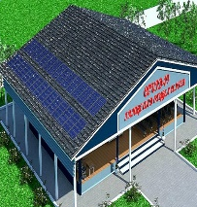
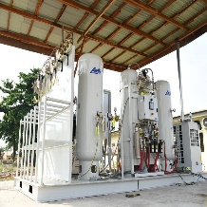
Lagos State’s Oxygen Strategy
We deployed a robust oxygen strategy to meet the increasing need for oxygen therapy at the isolation and treatment centres
1
Outsourcing
2
Outsourcing of oxygen supply at IDH to a 3rd party logistics firm. This has significantly improved the supply of oxygen at the hospital
Oxygen Centres
3
Deployment of oxygen therapy centres in high burden local government areas to meet the increasing demand for oxygen in community
Oxygen Plants
Installation of 2 Oxygen plants at IDH, Yaba and Gbagada
Reactivation of Oxygen Plant in LASUTH

Slide 23
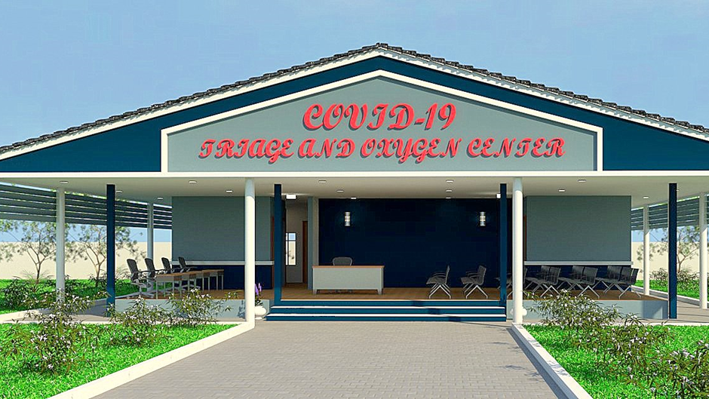
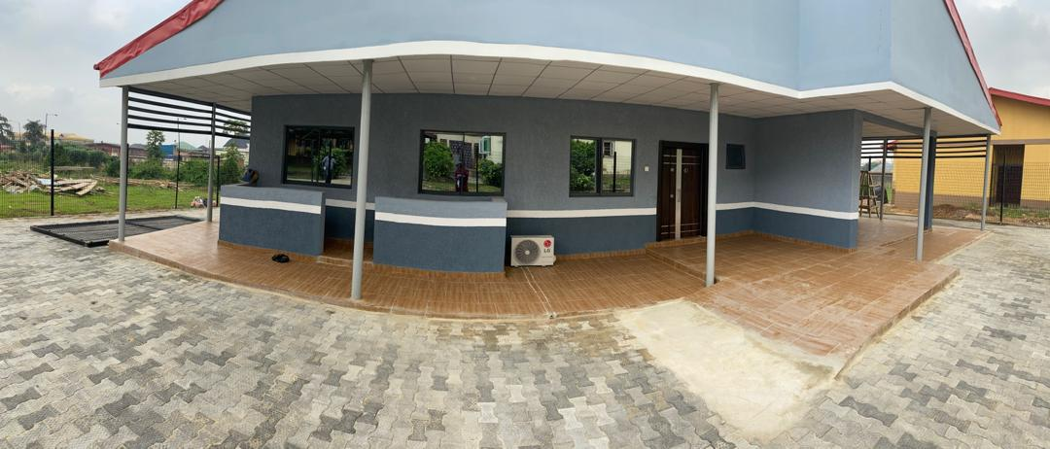
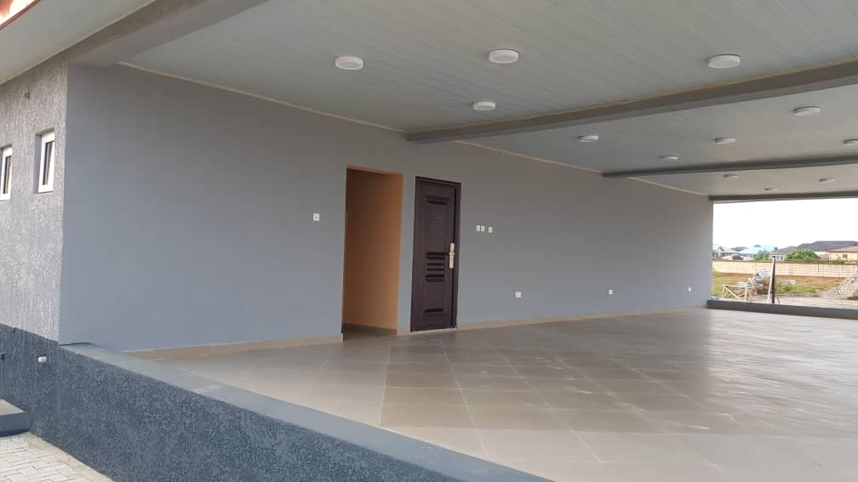
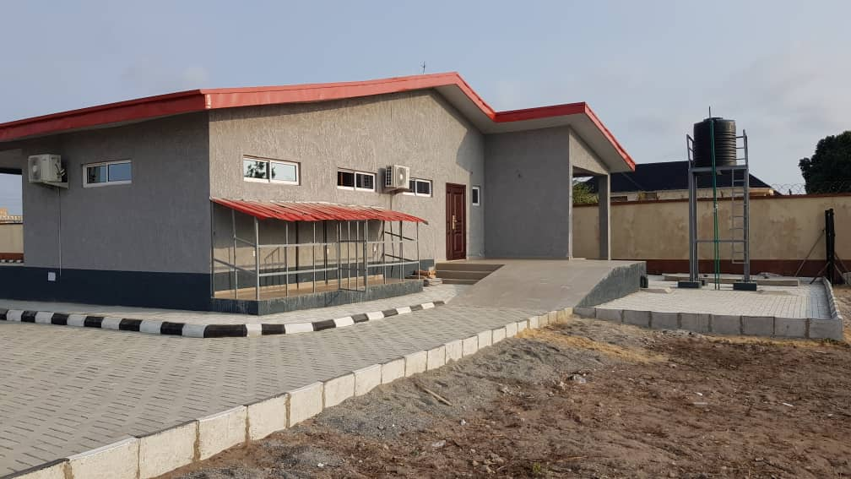
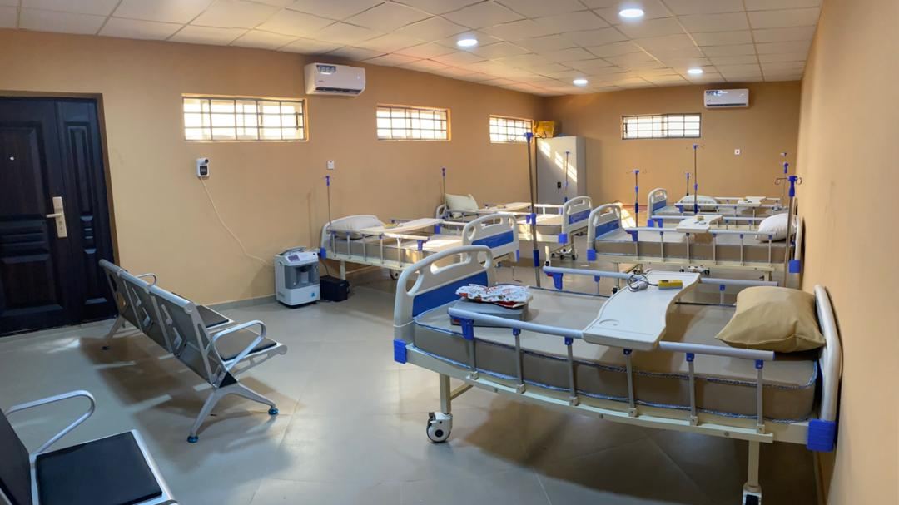
Oxygen Therapy Centres in 10 LGAs
Oxygen therapy and other related services are provided to patients that require them in our excellently designed and fit-for-purpose facilities 10 High-burden LGAs

Slide 24

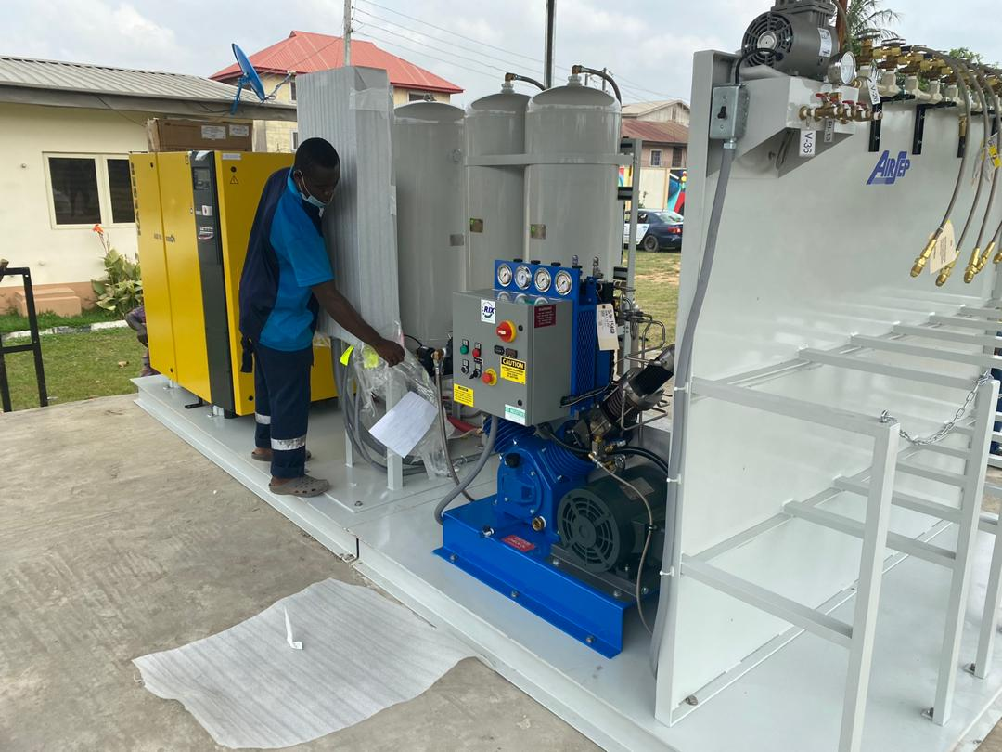
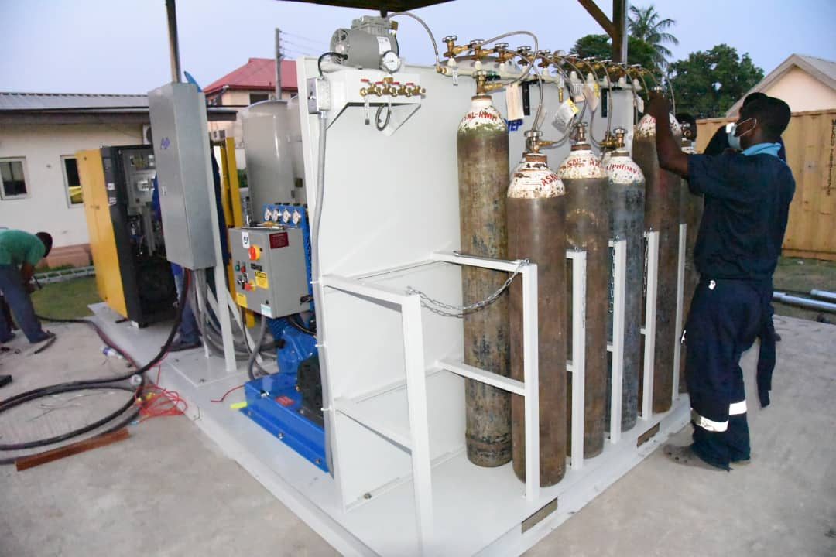
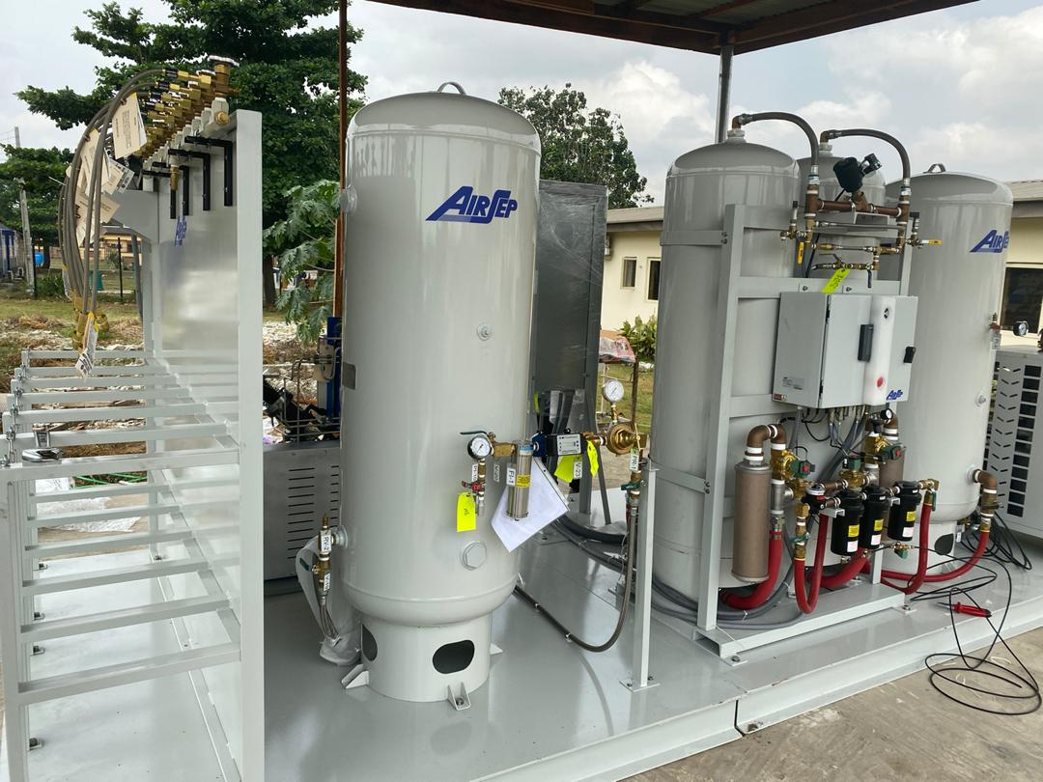
Installation of Oxygen Plant at IDH
Deployment and installation of a 60-cylinder-per-day at the Infectious Diseases Hospital in Yaba
Another oxygen plant has been deployed at Gbagada General Hospital
Dedicated generators were procured to power the plants

Slide 25
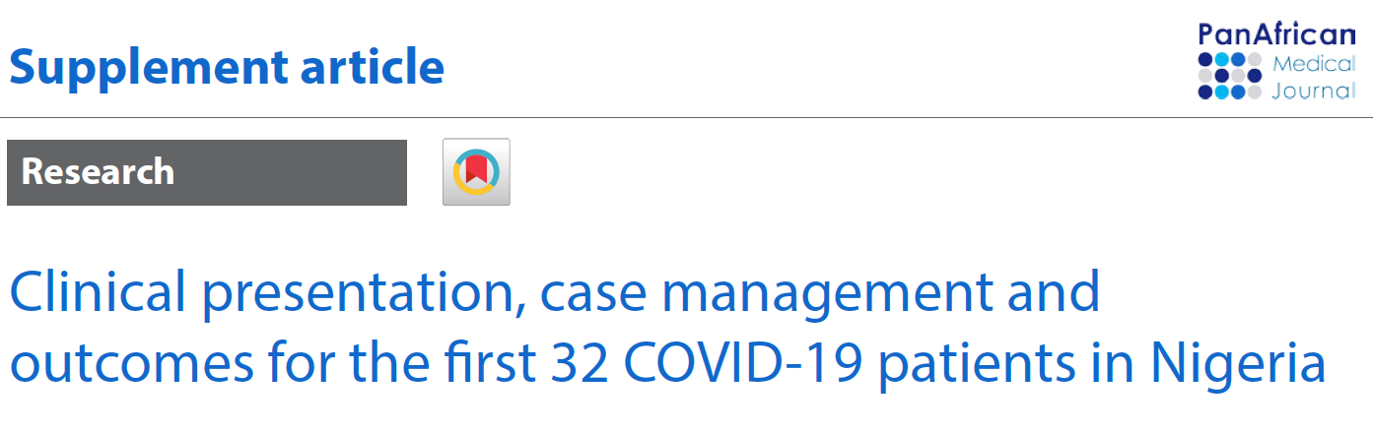
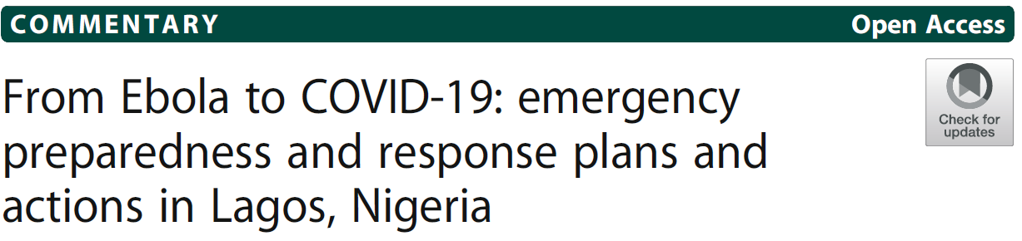
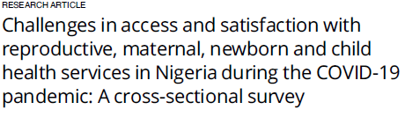
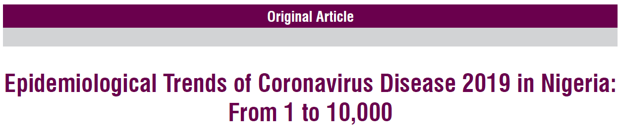
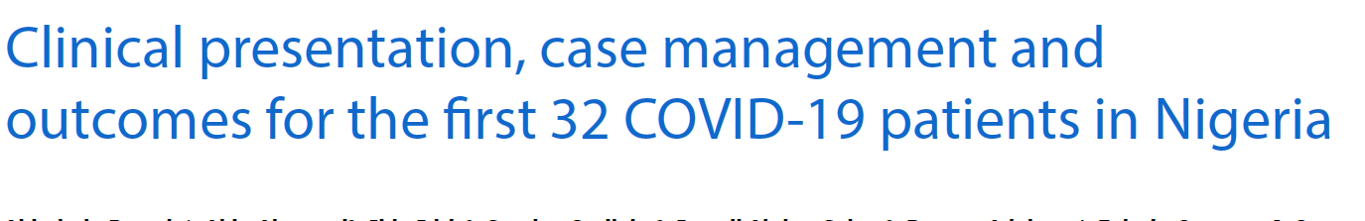
Lagos State has published 21 COVID-19 related research publications

Slide 26
Lagos State has published 21 COVID-19 related research publications…

Slide 27
Robust Data Collection to Support Policy Decision Making
We built a system of data collection, analysis and interpretation along the lines of each pillar of the Emergency Operations Centre (EOC)
We then invested in technology to automate our data collection system through the initiation and implementation of the LAGOS STATE EMERGENCY RESPONSE SYSTEM (LASERS)
This allowed us to get real-time data that we could trust

Slide 28
Strategies we Deployed to keep the Economy of Lagos State open
Enforcing guidelines and Non- Pharmaceutical Interventions
Inclusion of Private Hospitals
6
1
Maintain Capacity to upscale the State Response if required
5
2
Decentralization of Sample Collection Centres
Strengthen Home-Based Care
4
3
Inclusion of Private Laboratories

Slide 29
1
Control importation of mutant strains
THIRD WAVE
2
Build capacity to sequence variants
Pursue Herd Immunity to end 3rd wave and mitigate a 4th wave
3
Ramp up vaccination to achieve herd immunity

Slide 30

THE THIRD WAVE – MANAGING VARIANTS OF THE VIRUS

Slide 31
Philippines
Brazil
South Africa
UK
UK
India

Slide 32
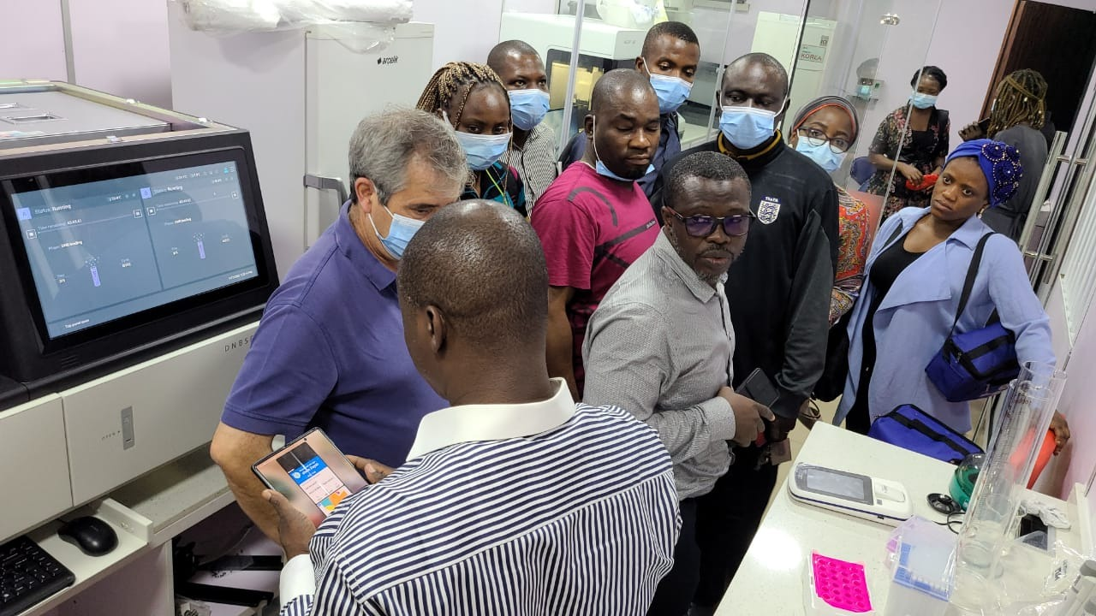
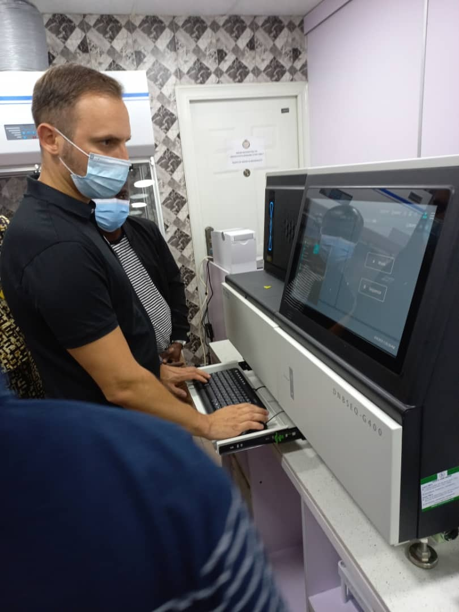
Installation of the Sequencing Machine
Photos showing the installation of Lagos State sequencing machine at the BioBank:

Slide 33
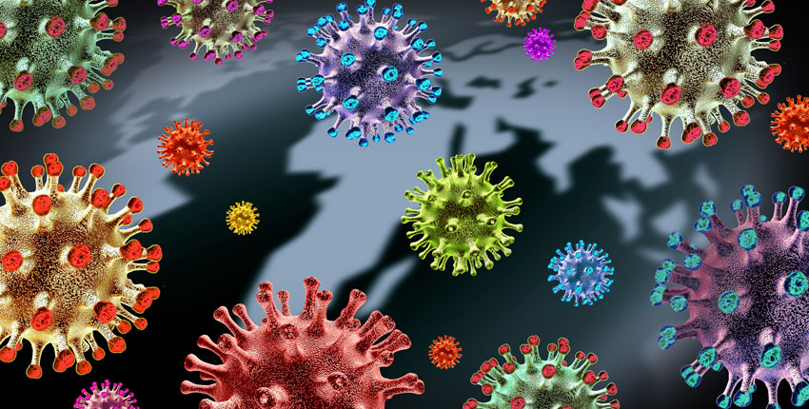
Analysis of Variants in Lagos State
Sequencing for COVID-19 variants has commenced in Lagos State
Of the samples sequenced so far:
  82% were positive with the Delta Variant (from India, now predominant in the UK)
  7% were positive with either Alpha (UK), Beta (South Africa) and Eta (UK) Variants
  The remaining 11% were positive with unclassified variants

Slide 34
Result of Analysis of Variants in Public Laboratories
About 132 samples were sequenced at LSB, LUTH, and NIMR
Of the samples sequenced :
  74% were positive with the Delta Variant (from India, now predominant in the UK)
  8% were positive with the Kappa Variant (First discovered in India),
  The remaining 17% were COVID-19 positive, but did not have any known variant of the virus

Slide 35
Lagos State’s Strategies for Managing the Third Wave
Testing & Isolation
Technology
Enforce Non-Pharmaceutical Interventions
Ramp Up Oxygen Supply
Pharmaceutical Interventions
Ramp up testing and ensure all travellers carry out COVID-19 Tests
Introduce PCR tests to determine variants of the virus for positive cases
Utilize EKOTELEMED to monitor confirmed cases and provide telemedicine services
Hand washing
Social distancing
Thresholds for public gathering
Discourage super spreader events
Two-phased approach
Outsource oxygen plants to private partner
PPP for 700 cylinder/day oxygen plant
Increase number of vaccine doses administered by leveraging the private sector
Lagos State has Ivermectin stock in case of 3rd wave
Positives will be subject to a mandatory 7-day quarantine
EKOTELEMED to become the backbone of the response
Enforcement is key to mitigating the 3rd wave
The Hallmark of our approach to managing the 3rd wave will be oxygen therapy
Requirement for herd immunity is 60% of population

Slide 36

EPIDEMIOLOGY OVERVIEW
LAGOS STATE INCIDENT COMMAND SYSTEM
TESTING
CONFIRMED CASES
AVERAGE CASE POSITIVITY
FATALITY RATE
NUMBER OF
SAMPLES TESTED
72,673
10.6%
0.75%
685,036
COVID-19: DISEASE PROFILE 30/08/2021
Private
Public
Second Wave (Nov – December 2020): Avg. cases per day (213 – 901)
Height of First Wave June – Aug 2020:
Avg. cases per day (225 – 375)
First Wave April 2020:
Avg. cases per day (150 – 175)
Bottom of First Wave (Sept – Oct 2020): Avg. cases per day (25 – 75)
Beginning of Third Wave (Jul 2021)
Feb ‘20
Mar ‘20
Apr ‘20
May ‘20
July ‘20
Aug ‘20
Sept ‘20
Dec ‘20
Jan ‘21
Feb ‘21
Apr
‘21
May
‘21
June
‘21
July
‘21
Aug
‘21
June ‘20
Oct ‘20
Nov ‘20
Mar ‘21
July
‘21

Slide 37
Breakdown of Positive Inbound Passengers by Month of Infection (8th May – 28th August)
Positive Inbound Passengers into Lagos State
Daily Confirmed Cases
Number of Positive Inbound Passengers in August is as at 28th of August 2021

Slide 38
Breakdown of COVID-19 Positive Inbound Travellers by Country of Origin – May 8th – August 14 2021
150 Inbound Travellers were surveyed by EKOTELEMED.
Of this number, India, UK and USA account for about 79% of the Positive POIs that have come into Lagos State

Slide 39
Imperatives for Mitigating a Fourth Wave
We know that all the waves of the pandemic in Lagos State have coincided with increase in inbound flights during holiday seasons
In order to mitigate a potential fourth wave, we have to do the following:
1
2
3
4
Strengthen our filtration SYSTEMS; especially at the ports of entry
Improve our capacity to mine DATA from the other waves for better policy decision making
Deploy an innovative VACCINATION strategy that will cover at least 60% of our population
Enforce adherence to COVID-19 protocols among residents and visitors to Lagos State

Slide 40
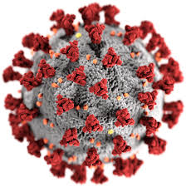
Strategic Priorities for Lagos State – Vaccine Strategy
Our vaccination strategic is driven by the following strategic priorities:
Prevent Economic Harm
Prevent Clinical Harm
Reduce Deaths: Prioritize the vaccination of those groups at highest risk of severe disease and death
Improve System Resilience: Prioritize Health Workers. Vaccination of healthcare workers is beneficial since it improves the resilience of the healthcare system
Prevent Clinical Harm: Regulate the distribution of vaccines though a central planning system that ensures the best clinical outcomes for all residents of Lagos State
Prevent Economic Harm: Target those whose absence will significantly impact the economy in the short run or negatively impact the states response to COVID -19
Improve System Resilience
Reduce Deaths

Slide 41
In Conclusion – The Pillars of Lagos State’s COVID-19 Response
Since the outbreak of COVID-19, Lagos State has significantly strengthened its capacity to contain the virus by applying the following core strategies
1
Robust Preparation Prior to the Pandemic
2
Launch of the Incident Command System (ICS)
Mr. Governor as Incident Commander
3
Leveraged Private Sector Capacity to Expand Testing & Isolation Capacity
Lab Consortium
Increase Isolation Beds
4
Introduced Home Based Care Program
Driven by Telemedicine - EKOTELEMED
5
Robust Oxygen Strategy
Outsource management of oxygen supply
6
Controlling the Importation of Mutant Strains from Inbound Travellers
Mandatory Isolation in Hotel Consortium
7
Build Capacity to Sequence Samples for Mutant Strains
Continuous training at Lagos State BioBank
8
Vaccine Distribution Strategy
Leverage private sector to procure and administer vaccines

Slide 42
Topical Talking Points
HRH and labor laws (40,000)
Donor partner engagement often by passing MOH
PHC platform three levels of govt
Health Financing (demand-supply equation)
PPP (budget deficit), IGR sustainability
Digitalization and data governance
Innovation
Brain gain (20,000)
Collateral damage of COVID vaccination roll out
Twins

Slide 43

THANK YOU
Prof. Akin Abayomi, Honourable Commission of Health, Lagos
SEPTEMBER 2021

