Slide 1
Introduction to U.S. CDC Nigeria Programs and Impact
Dr. Mary A. Boyd
Country Director
U.S. Centers for Disease Control & Prevention, Nigeria
Nigeria Health Commissioners’ Forum
Sept 3rd, 2021
Center for Global Health
CDC Nigeria

Slide 2
Establishment
Established in Nigeria in 2001. CDC works with federal and state ministries of health to address HIV, tuberculosis, malaria, global health security and immunization for vaccine-preventable diseases as well as on strengthening laboratory, surveillance, and workforce capacity to respond to disease outbreaks.
We work directly with federal/national and states governments and implementing partners across the 36 states of Nigeria

Slide 3
Vision and Mission
Vision
Public health excellence for healthy Nigerians
Mission
To support the national health response in the application of health promotion, disease prevention, and control measures to improve the health of people in Nigeria through technical expertise, effective local partnerships, and systems strengthening.

Slide 4
U.S. CDC NG Leadership
Country Director- Dr. Mary A. Boyd
Deputy Country Director- Suzanne Theroux
Division of Global HIV/TB (DGHT)
Dr. Mary A. Boyd
Global Immunization Division (GID)
Dr. Omotayo Bolu
Division of Global Health Protection (DGHP)
Dr. Farah Husain
Division of Parasitic Diseases and Malaria (DPDM)
Dr. John Rogers

Slide 5
U.S. CDC NG focus in Nigeria
HIV and Tuberculosis
Global Health Security
National Public Health Institute
Malaria
Vaccine-Preventable Diseases
Disease Surveillance/Outbreak Response

Slide 6
U.S. CDC NG COVID-19 SUPPORT
Technical assistance to GoN in the following areas:
Surveillance & epidemiology,
Emergency response operations,
Case management,
Laboratory systems,
Risk communications,
Vaccine deployment.

Slide 7
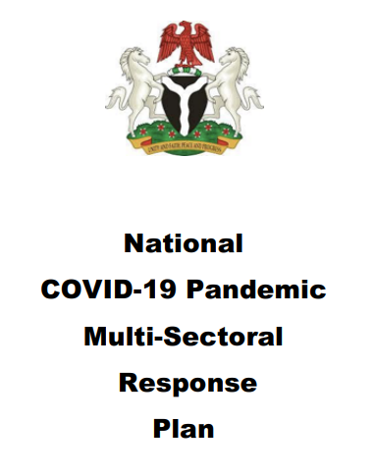
U.S. CDC NG COVID-19 Response Impact
Policy
Response framework and a multi-sectoral national pandemic response plan.
Operational guidelines for the COVID-19 vaccine rollout in Nigeria
COVID-19 Laboratory strategy document

Slide 8
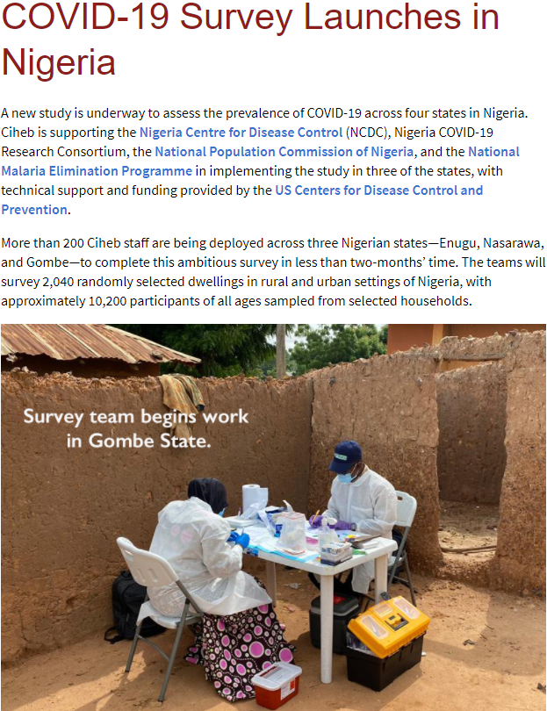
U.S. CDC NG COVID-19 Response Impact
Science
COVID-19 serosurvey in 8 states and the Federal Capital Territory
COVID-19 Vaccine hesitancy study

Slide 9
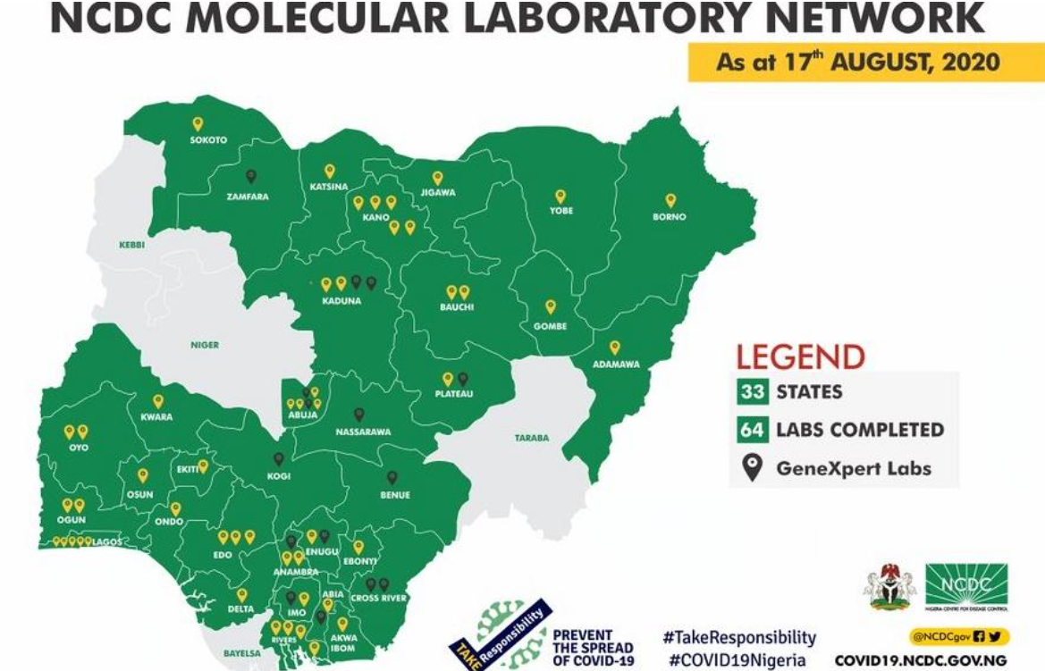
U.S. CDC NG COVID-19 Response Impact
Program
Expansion of the network to over 145 PCR labs
IPC
RRT
Risk communication and community awareness activities across all the 36 states of Nigeria including with Religious & Traditional Leaders

Slide 10
U.S. CDC NG COVID-19 Response Impact
Training
COVID-19 Case Management CoP
COVID-19 Response Community of Practice for Nigeria and the West Africa Region
RRT, IPC

Slide 11
Division of Global HIV/TB
Dr. Mary A. Boyd

Slide 12
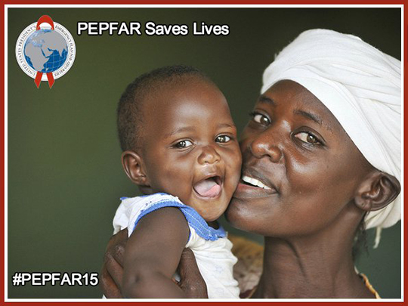
DGHT Implementing Partners
University of Maryland
Institute of Human Virology
APIN Public Health Initiatives
Catholic Caritas Foundation of Nigeria
Centre for Integrated Health Programs
ICAP, Global Health

Slide 13
Division of Global Health Protection
Dr. Farah Husain

Slide 14
GHSA: Prevent, Detect, Respond
Prevent avoidable
catastrophes
Detect threats early
Respond rapidly and effectively
Notes:
The Global Health Security Agenda goes further than any prior global coordination around multiple diseases and conditions. GHSA is not another single-disease initiative; it drives a set of concrete and achievable actions to help actualize the International Health Regulations. It helps us reach public health goals through eleven targets that aim to
PREVENT avoidable catastrophes,
DETECT threats early, and
RESPOND rapidly and effectively.
All of the different aspects of GHSA further these three simple goals.

Slide 15
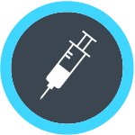
Action Packages to Achieve Targets
Antimicrobial Resistance
National Laboratory Systems
Emergency Operations Centers
Zoonotic Diseases
Surveillance
Public Health and Law Enforcement
Biosafety/Biosecurity
Reporting
Medical Countermeasures
Immunization
Workforce Development
Notes:
There are eleven action packages, or targets, that comprise GHSA. While they may seem like discrete activities, these lanes are overlapping and inter-related.
To meet the objectives for these targets, we will have to combine efforts across sectors. For instance, labs are instrumental in surveillance; surveillance is instrumental in AMR and zoonotic diseases; identifying zoonotic diseases requires strong reporting systems… It’s all cross-cutting.

Slide 16
GHSA Action Packages in Nigeria
Laboratory
Surveillance
Support to the National Reference Laboratory and the public health lab network in capacity and infrastructure development
Capacity to analyze and link data for functional real-time bio surveillance systems
Emergency Operations
Workforce Development
EOC activation when needed
Functional IMS use for preparedness and response
National public health workforce training
Implementation of the three tiers of the field epidemiology training program
Notes:
CDC is working closely with countries to implement the Global Health Security Agenda.
While the agenda requires input and participation from many sectors, we have a deep bench of expertise in the pillars of public health: tracking diseases, building strong laboratory systems, setting up responsive Emergency Operations Centers, and training a public health workforce.
While we participate in all aspects of global health security, these foundational public health capacities provide much of the foundation for our work. In fact, the U.S. has taken the lead on the GHSA laboratory target. Let’s look a little closer at what that means on the ground.

Slide 17
CDC/DGHP Implementing Partners and Activities
Nigeria Center for Disease Control
Technical assistance and funding for:
Center of Excellence Program
Field Epidemiology Training Program (basic, intermediate, advanced)
Surgical Site Infection and Acute Febrile Illness research studies
Public Health Emergency Management Program
Monkey pox human surveillance and animal ecology
Laboratory diagnosis capacity
Infection prevention and control policy development and implementation
Event based surveillance
Medical counter measures readiness and deployment plan
Notes:
none

Slide 18
CDC/DGHP Implementing Partners and Activities
African Field Epidemiology Network
Pro Health International
Research Triangle Institute
Georgetown University
Institute of Human Virology
Notes:
African Field Epidemiology Network: Funding to support the implementation of the Field Epidemiology Training Program
Pro Health International: Funding to support the Federal Ministry of Health’s Port Health Services (PHS) Division to Enhance surveillance in points of entry; Develop and implement the PHS master training program for PHS staff
Research Triangle Institute
Funding for:
International Health Regulations electronic library
Development of a virtual Joint External Evaluation platform
4. Georgetown University
Funding for:
Development and implementation of the public health emergency management trainings
5. Institute of Human Virology
Funding for:
Enhancement and expansion of electronic based reporting across Nigeria (mSERs and SORMAS)
Establishment of an acute febrile illness surveillance system in Nigeria

Slide 19
CDC/DGHP Impact
Establishment of an NPHI Center of Excellence program for the Nigeria Center for Disease Control
The development of NCDC's 5-year National Action Plan for Health Security (NAPHS) strengthened the IHR core capacities by adopting strategies, establishing priorities, and implementing activities intended to close identified gaps to prevent, detect, and detect and respond to public health threats
All 774 local government areas in Nigeria now use an electronic case-based reporting system to detect and track emerging disease threats in real-time

Slide 20
CDC/DGHP Impact
Developing a National Public Health Emergency Contingency Plan for points of entry.
Strengthening diagnostic capacity for genomic sequencing.
The establishment of 36 sub-national public health EOCs across the 6 geo-political zones in Nigeria, all of which are linked to the National EOC.
The development of a Public Health Emergency Management Professional Development Program
Development of core laboratory diagnostic capacity to test for Monkey Pox, Yellow Fever, and Cerebrospinal Meningitis

Slide 21
Division of Parasitic Diseases and Malaria
Dr. John Rogers

Slide 22
U.S. President’s Malaria Initiative (PMI) Nigeria

Slide 23
SCALING INTERVENTIONS THAT WORK
Mosquito Nets
Indoor Spraying
Case Management
Preventive Medicines for Pregnant Women and Children
500M Nets Delivered
310M People Protected
600M Tests
715M Treated
42M Pregnancies Protected
23M Children
Protected
2 Million Trainings for Health Workers
Cross-Cutting Investments
Supply Chain and Health Systems Strengthening
Social and Behavior Change
Surveillance, Monitoring and Evaluation
Operational
Research

Slide 24
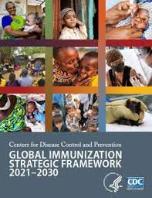
Global immunization division
Dr. Omotayo Bolu

Slide 25
CDC Global Immunization Objectives
Established in Nigeria in 2012
Objectives: To support the polio eradication efforts, improve routine immunization (RI) coverage and respond to vaccine preventable diseases (VPDs) outbreaks including COVID-19 vaccination efforts.
Funding: Over >$158 million on polio eradication efforts in Nigeria with additional funds to WHO and UNICEF
25

Slide 26
CDC/GID Partners and Supported States*
Sokoto
Borno
Funded partners:
WHO and UNICEF
AFENET/ NSTOP
International Federation of Red Cross (IFRC)
IHVN/ UMB
Sydani
Government Agencies:
NCDC, NPHCDA, MoH
CDC HQ Support:
Lab sequencing: all polio samples
Satellite imagery activities
Kebbi
Katsina
Yobe
Zamfara
Jigawa
Kano
Bauchi
Niger
Kaduna
Gombe
Adamawa
Kwara
Plateau
^{FCT}
Taraba
Oyo
Nasarawa
Kogi
Osun
Ekiti
Benue
Ogun
Ondo
Edo
Enugu
Cross
River
Lagos
Anambra
Ebonyi
Delta
Imo
Abia
Rivers
Akwa Ibom
Baye-
lsa
CDC Funded AFENET/NSTOP States
AFENET/NSTOP and IFRC ( IFRC closed out in July, 2021)
* Supported States= where we have partner staff
Notes:
Funded partners:
WHO and UNICEF: Supporting key staff positions working on polio and routine immunization activities across Nigeria
AFENET/NSTOP:
Present in 12 states across Northern Nigeria
12 state field coordinators and 120 NSTOP LGA Officers work with the state and 212 LGA teams to build capacity of LGA staff, improve polio and VPD outbreaks (e.g.measles, COVID19, meningitis) response, surveillance, data management etc.
Mapping of migrant populations for targeting polio and immunization services
International Federation of Red Cross (IFRC):
Use of Red cross volunteers (> 400) for community surveillance to report VPDs and polio cases in Katsina, Jigawa, and Zamfara
IHVN/ UMB / Sydani (more recent with COVID-19 funds)
Government (Indirect funding): NCDC, NPHCDA, NEOC
HQ:
CDC Atlanta Lab: Confirms every polio case
CDC GRASP: Implements satellite imagery activities

Slide 27
INTERVENTIONS | IMPACT (in collaboration with government and GPEI partners)
Over 250 plus AFENET staff initially in 12 northern states 220 LGAs & FCT- surveillance , capacity building, training, RI improvement, OBRs Supported hundreds of polio campaigns & VPDs outbreak response Implement satellite imagery: identify unreached settlements to improve vaccination coverage Rolled out DHIS2 for RI in 36 states & FCT 3 year logistic support to DSNOs, State Epis for polio & VPD surveillance in 12 southern states Interventions to reach nomadic / mobile pop COVID19 vaccination: electronic platform, training, supervision , technical guidance Measles elimination : training, OBR, surveillance system strengthening FELTP trainings and capacity building | Administering ~ 50 million doses of OPV annually Reduction in the # of unreached children in inaccessible areas in NE from 432,345 in September 2016 to 31,188 in February 2020 DHIS2 roll out completed and transitioned to states We all achieved wild polio virus free certification in Nigeria

Slide 28
Remaining challenges & way forward

Slide 29
Remaining Challenges
Ongoing COVID-19 3rd wave surveillance and response
At State & LGA
Response to Emerging Outbreaks
Measles, Cholera, Avian flu
Persistent cVDPV2s. Twenty-two confirmed in 2020 vs 246 (as at Aug. 13, 2021)
nOPV2 introduced, but more support from states to improve the quality of campaigns and sustain polio eradication efforts
Improving routine immunization nationwide

Slide 30
Way Forward
Increased partnership with State Leadership
Continued capacity building at National/State level
Increase resource (human resource/ financial) contribution by states to polio and other outbreak responses/ campaigns
Some states: support full time staff to avoid attrition and reversal in programs at PHC levels especially

Slide 31
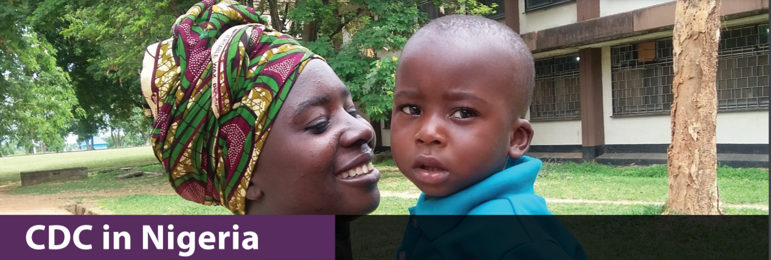
Thank You!
For more information, contact
U.S. Centers for Disease Control and Prevention
U.S. Embassy, Abuja, Nigeria or CDC Nigeria Communications Specialist
08090236011
husman@cdc.gov

