Slide 1
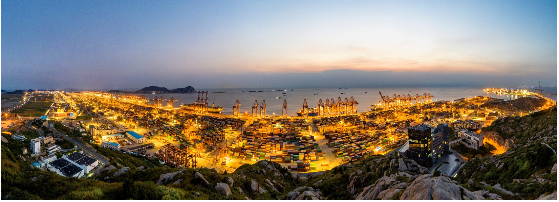
NIGERIA GOVERNORS FORUM
EXECUTIVE BRIEFING
Increase Productivity, Improve Compliance..
Take Control of Your Revenue

Slide 2
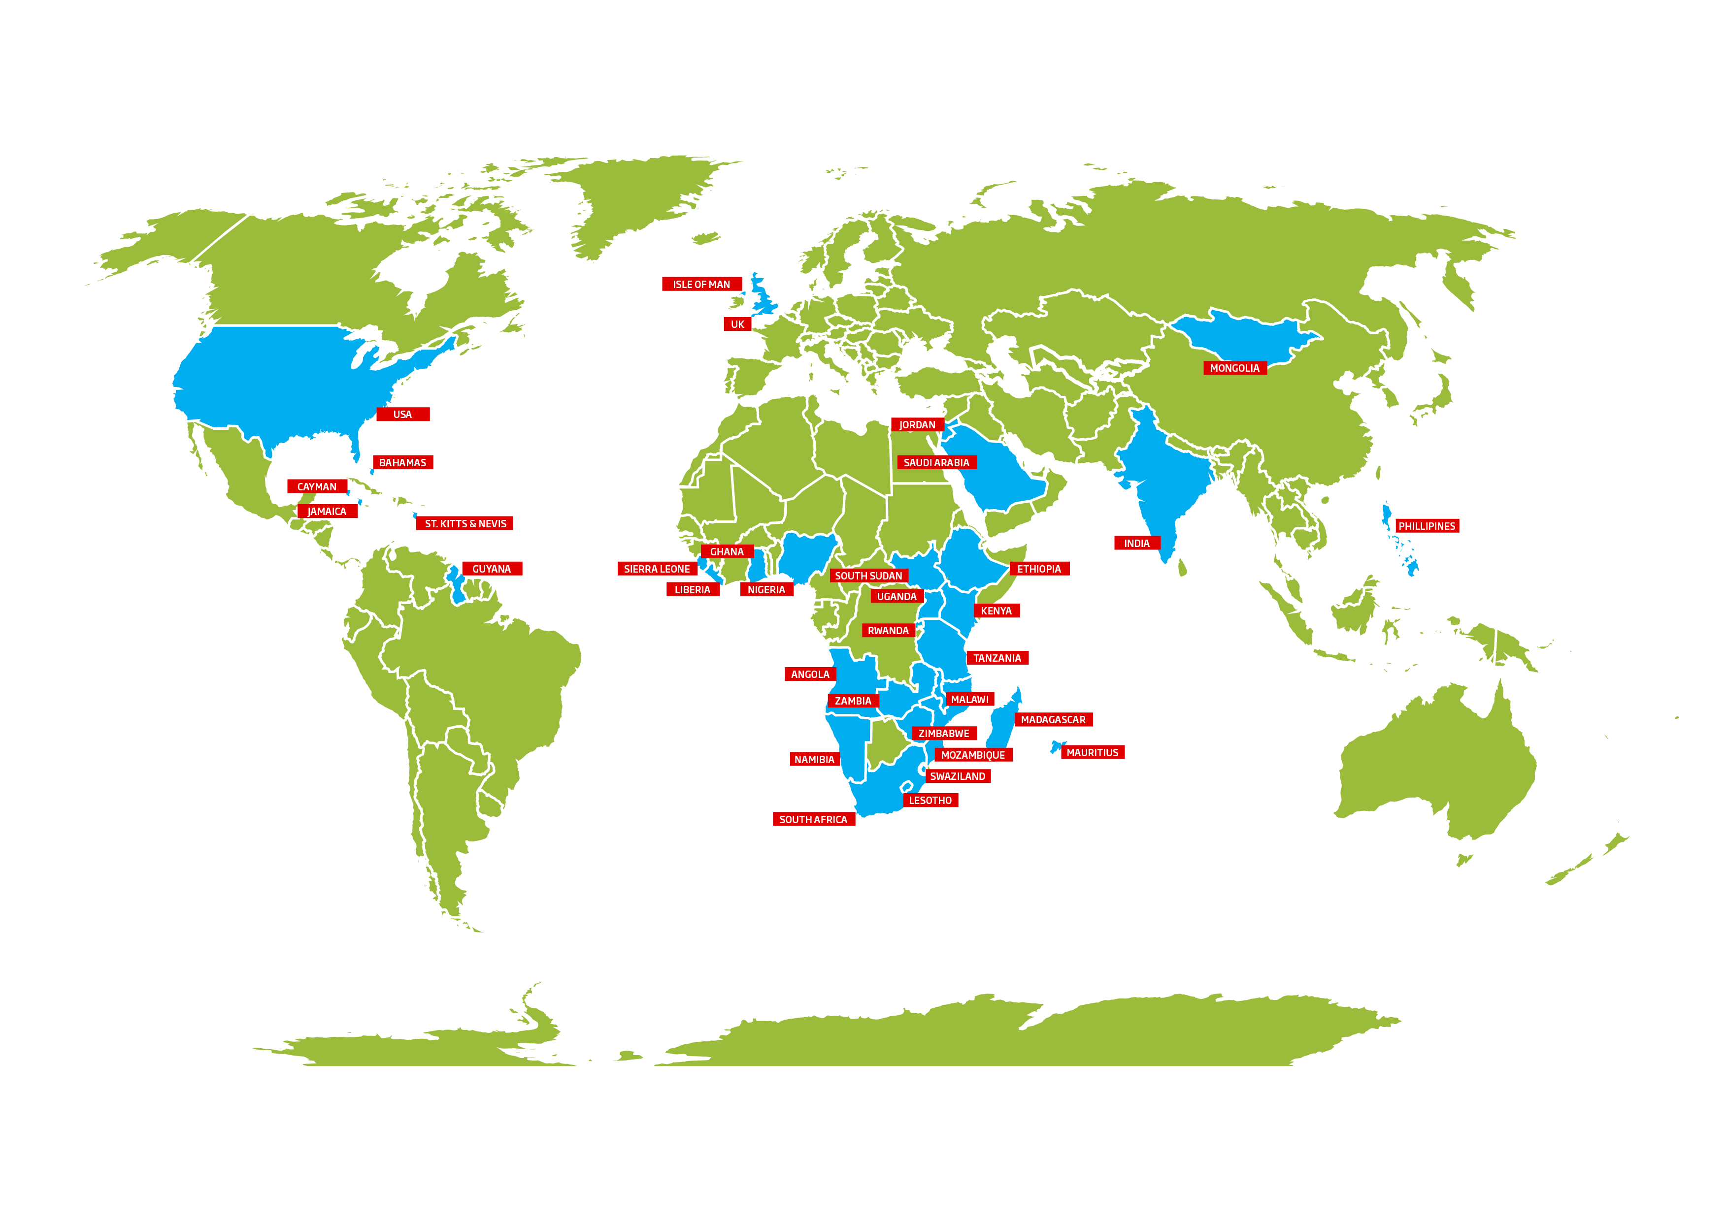
OUR STRENGTH
25
NATIONAL GOVERNMENTS USING OUR PLATFORMS
70⁺
UNIQUE SOLUTIONS
14
PRODUCTS WITH OWN IP
470+
PROJECTS DEPLOYED TO DATE
800⁺
TECHNICAL EXPERTS
50⁺
EXPERIENCED PROJECT LEADERS
CUSTOMERS IN
33
COUNTRIES
800+
STRONG CONSULTANT BASE
5
STATE OF THE ART CONTACT CENTERS IN AFRICA
CMMI L5
ONLY COMPANY IN SUB-SAHARAN
AFRICA
GEO PRESENCE
₁₈ MILLION
SUBSCRIBERS ON OUR PLATFORMS
5
CONTINENTS
16
COUNTRIES IN AFRICA
23
COUNTRIES WORLDWIDE
Pioneering Africa’s Integration
Transformational Award Africa Awards for Entrepreneurship
2nd Fastest Growing Company
in Africa
Winner – East Africa Entrepreneur of the Year

Slide 3
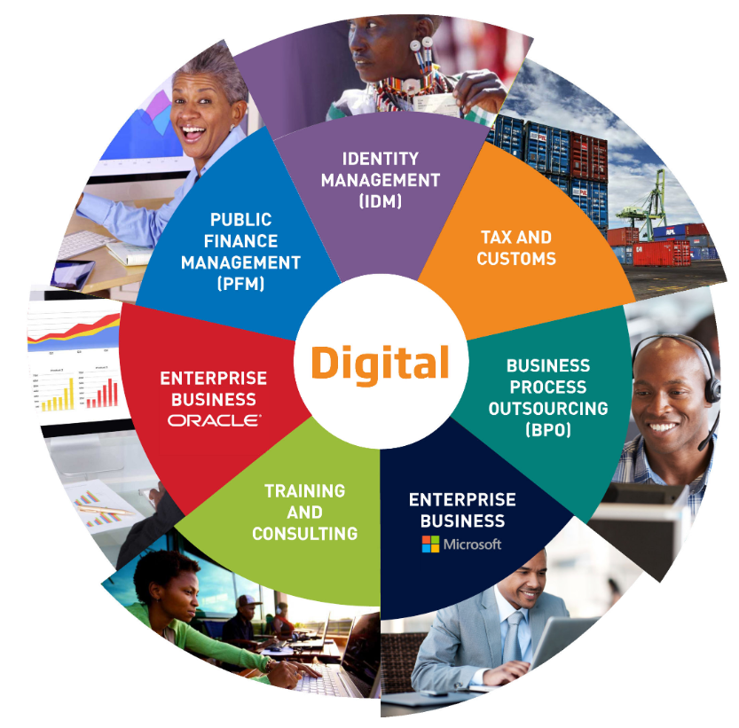
STRATEGIC BUSINESS UNITS
1
ENTERPRISE BUSINESS UNIT Microsoft & Oracle
2
PUBLICE FINANCE MANAGEMENT
Public Finance Management for Govt., Ngo’s & Private Sector
3
TAX & REVENUE BUSINESS
Complete Suite of an Integrated Tax System
4
IDENTITY MANAGEMENT
E-Passport, Border Management, Digital ID, E-visa, NID
5
Business Process Outsourcing
End-End BPO Services
6
DJITAL BUSINESS
Artificial Intelligence & Machine Learning, BlockChain, IOT

Slide 4
OUR PRODUCTS (IP’S)
INTEGRATED FINANCIAL MANAGEMENT SYSTEM
TRIPS+
MAXIMIZING AIRPORT
REVENUES
PBS – PERFOMANCE BUDGETING SYSTEM
REVENUE MANAGEMENT SYSTEM
SAFE SOCIETY ENSURED
PROJECT PERFORMANCE ENHANCED
DISASTER RELIEF MANAGEMENT SYSTEM
MORE THAN JUST TRACKING
PRE-ARRIVAL ASSESSMENT REPORT GENERATION SYSTEM
MOBILE BASED ACCOUNTING SYSTEM
MULTI-MODAL BIOMETRIC SYSTEM
CORE BANKING SECURITY
MOBILE MATERNAL HEALTH

Slide 5
Africa’s 1st Microsoft Testing center, set to provide over 1000 high tech jobs to Kenyan Youth.

Slide 6
Tax & Customs Business
IMPACT
₂ MILLION
SUBSCRIBERS ON OUR PLATFORMS
6
IMPLEMENTED NATIONAL REVENUE AUTHORITIES
25
COUNTRIES BENEFIT FROM T&C SOFTWARE
50⁺
DOMAIN EXPERTS IN TAX
CMMI L5
ONLY COMPANY IN SUB-SAHARAN
AFRICA
GHANA
SIERRA LEONE
Ghana Revenue Authority
Integrated Tax Administration System
National Revenue Authority
Tax Administration System (Ongoing)
MALAWI
ISLE OF MAN
Malawi Revenue Authority
Integrated Tax Administration System
VIPS - VAT Administration & Collection for Government Treasury Department
IDENTITY MANAGEMENT (IDM)
MONGOLIA
TAX AND CUSTOMS
Tax Administration System for General Department of Taxation
BUSINESS PROCESS OUTSOURCING (BPO)
TRAINING AND CONSULTING
PUBLIC FINANCE MANAGEMENT (PFM)
SBUs

Slide 7
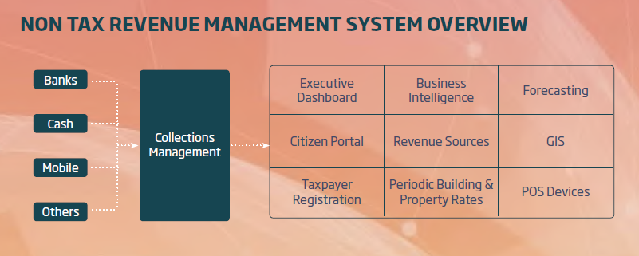
Non-Tax Revenue Management
A cloud based one-stop-shop Government enabler that keep records of all tax registers, obligations and payments; to easily track defaulters and adequately follow-up with enforcement with detailed reports and analyses with GIS embedded for mapping and special analysis of revenue
Governments need more domestic revenue to fund their own development goals. It’s not only about collecting more. It’s about how that revenue is collected (i.e. who pays).
Addis Tax Initiative 2018
World Bank & Oxfam

Slide 8
End-to-end Revenue Management Process
+
+
+
Registration and
GIS mapping
Assessment- Potential to be collected
Comprehensive Tax Register- Single Source of Truth
Proactive Billing and Collection –e-mail, SMS notifications
+
+
Digital services facilitates 24/7 self service payment and interaction
Enforcement and compliance-bridge gap between taxes owed and collected
Leverage data with analytics to improve compliance and taxpayer services

Slide 9
Current Revenue Challenges
MANUAL PROCESSING
DISPERSED SYSTEMS
REVENUE COLLECTION LEAKAGES
OUTDATED VALUATION
MISCATEGORIZATION

Slide 10
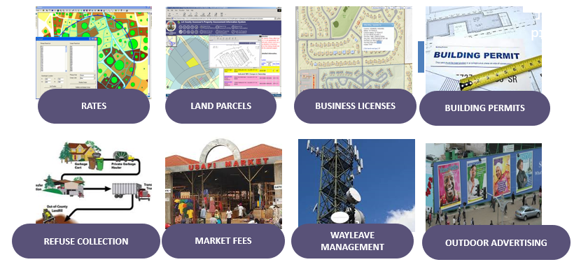
Examples of Major Revenue Sources To Be Collected
Other fees include but not limited to
Parking Fees
Schools
Hospitals
Levies
Tolls
Registration and Civic services

Slide 11
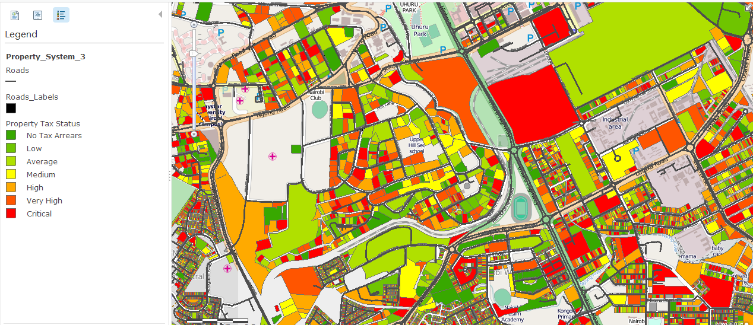
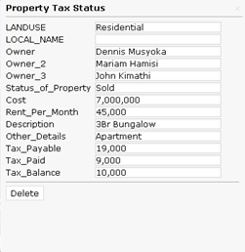
GIS-Increased Land/Property Rates Visibility

Slide 12
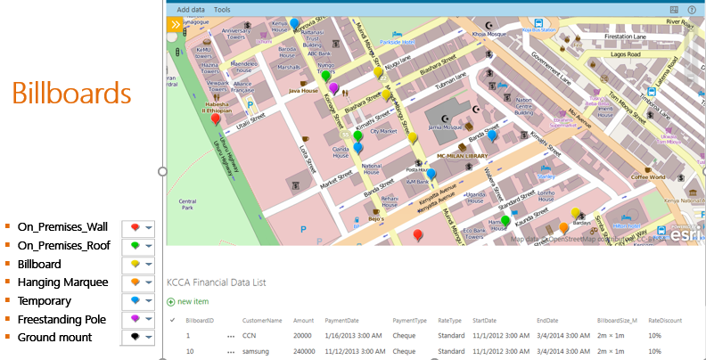

Slide 13
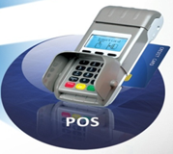
Access and Collection
Support multiple currencies
Ability to plug in multiple collection channels
Ability to cater for futuristic collections channels not available today
Ability to integrate collections from the region
Ability to provide real time reports for agency collections
Seamless Alerts on payments Made
Who made payments? (Payer’s name, ID number, Reference number, etc.)
What the payments were for? (Type of Tax.)
How much was paid?
When the payments were made?
Where the payments were made?
Citizen Self Service Portal
Remote City/State Offices
RMS
MULTIPLE COLLECTION CHANNELS

Slide 14
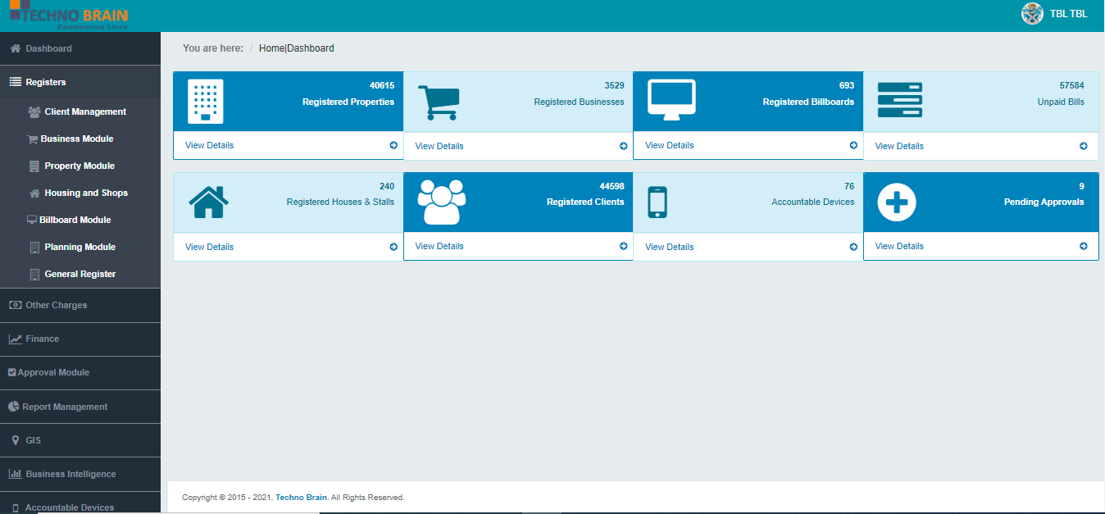
RMS Dashboard

Slide 15
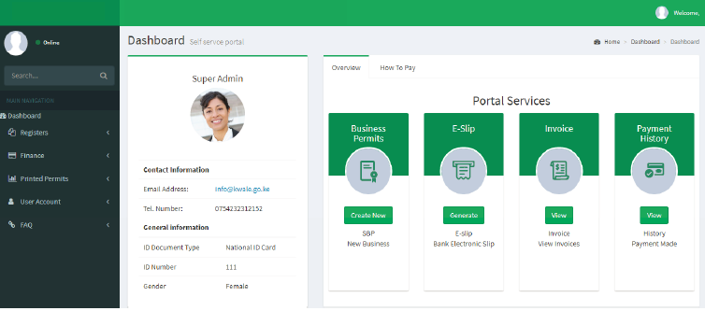
Citizen Self-Service Portal

Slide 16
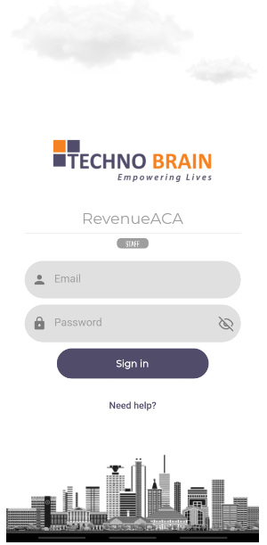
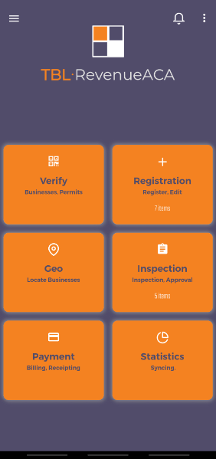
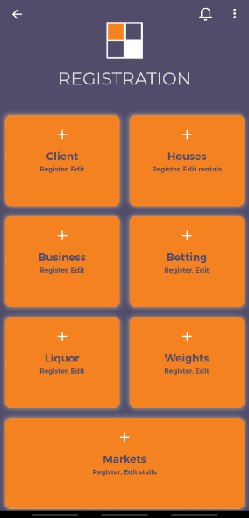
Mobile Application

Slide 17
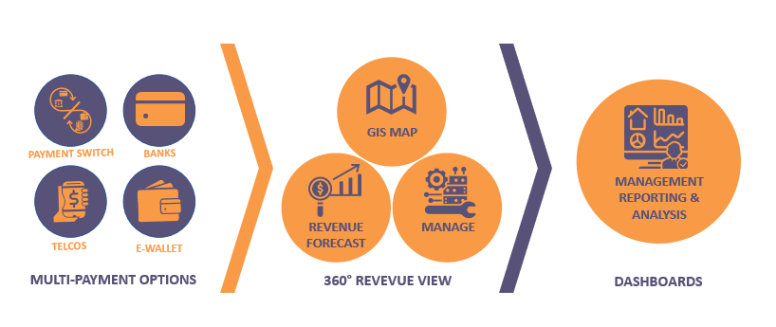
Multiple Payment Channels

Slide 18
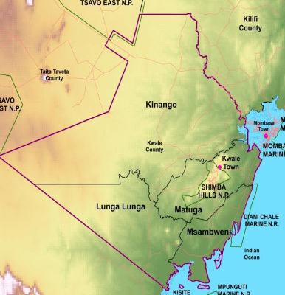
Case Study- Kwale County Government
4 Constituencies – 20 wards
POS revenue collectors - 100 devices
Collection Avenues-Mpesa, Banks (KCB direct debit), cash
County Employees accessing backend solution– 50 users
Citizen Self Service portal users – 500 + * ( new users registering daily)
1,000 + Different Local Generated Tax types
Controller of Budget Reports - https://cob.go.ke/reports
2016/2017-Kwale County revenue collection recorded one of the highest proportion of ORS at 84.7% which accounted for USD 2.2 Million
2017/2018-Nationally, Kwale County revenue collection recorded one of the highest proportion of ORS at 82.3% which accounted for USD 2.26 Million
2018/2019 – Kwale County surpassed its target of Own Source Revenue collecting 103.9% above target collecting USD 3.1 Million
Win Results
Over 40 % increase in Revenues Collected
Automation of revenue collection decreased revenue losses and enhanced enforcement
Compliance increased by over 60 %
Auto reconciliation and generation of periodic SMS and Email reminders increased compliance levels
Visibility of Revenues Collected
Real time visibility of revenues collected leads to quicker policy and decision making process related to revenue collection

Slide 19
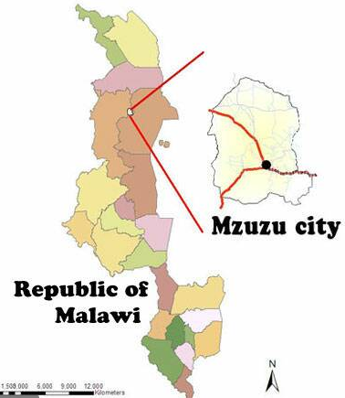
Ongoing Projects
Nairobi City Council Government
Mzuzu City Council
Blantyre City Council
Past Projects
Uganda Local Governments
Malawi Local Governments
TANAPA-Tanzania
Features :
Citizen Portal
Citizen Mobile App
GIS –Google Maps
System Backend
POS revenue collectors - 100 + devices
Collection Avenues-Mobile Money ,Banks
500 + Different Local Generated Tax types

Slide 20
Benefits Of Our Revenue Collection And Management Solution
Improved decision making
Increased Revenue collection
Transparency
& Accountability
Collaboration
Citizen engagement
Location Intelligence

Slide 21
2nd Fastest Growing Technology Company in Africa
Ranked 6th in KPMG Top 100 Mid-Sized Companies in Tanzania
Appraised at CMMI L5. The Only Company in Africa
Winner - East Africa Entrepreneur of the Year

