Slide 1
Business Support Systems for Revenue Cycle Management in GOVERNMENT
Presented By:
Wumi Oghoetuoma
CEO Crown Interactive Limited
April 19th 2021

Slide 2
CONTENT
WHO WE ARE & WHAT WE DO
REVENUE CYCLE MANAGEMENT
BUSINESS TRANSFORMATION IN THE POWER SECTOR
MOVING FROM CASH TO LESS CASH TO CASHLESS
PROTECTING THE REVENUE
PROMOTING A THE COLLABORATION FRAMEWORK
EIRS – AUTOMATION OF DIRECT ASSESSMENT
THE BUSINESS SUPPORT SYSTEM
ENABLING REVENUE ASSURANCE
ENFORCING
AUTOMATE YOUR WORKFLOW FOR MONITORING
CROWN INTERACTIVE

Slide 3
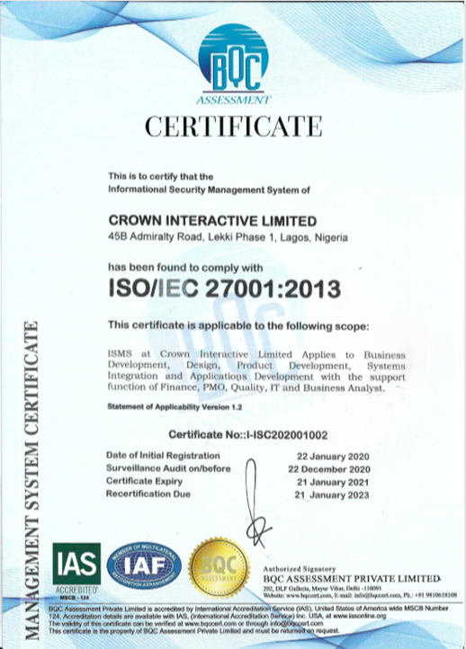
WHO WE ARE & WHAT WE DO
Crown Interactive Limited is an indigenous Software Company with a focus on delivering global best practice and innovative business models for Business Process Automation & Revenue Assurance.
Setup Nigeria Operations in 2012, with an experienced team of 75+ predominantly technology, products and business analysis staff.
Cross Industry experience with Large and Medium sized clientele in Utility, Government, Oil & Gas and Manufacturing.
Crown Interactive provides best of breed Revenue Assurance Business Support Systems (CICOD Enterprise) processing billions of Naira monthly for Eko Electricity Distribution Plc using all CBN Approved Payment Partners.
Crown Interactive was responsible for the Direct Assessment Revenue Billing Platform for the Edo State Inland Revenue Service.
CROWN INTERACTIVE

Slide 4
REVENUE CYCLE MANAGEMENT
Revenue Cycle Management is the ability to follow the flow of money in your business from order to cash.
….”Wumi Oghoetuoma”
DIFFERENT PRODUCT BUT SIMILAR CHALLENGE
ELECTRICITY
TAXES, LEVIES & PENALTIES
Residential – Low Demand Customers
Residential – High Demand Customers
Commercial Low Demand
Commercial High – Demand
Industrial Customers
Self Employed
High Net-worth Individuals
Small Enterprise
Medium Size Enterprise
Large Enterprise
Problem Statement:
Perception of not receiving service so do not want to pay
Want to consume electricity with paying.
Paying customers want to pay for less than they have consumed.
Not all payments make it to the coffers.
Problem Statement:
Perception of not receiving service so do not want to pay
Want to earn money with paying.
Paying citizens want to pay for less than they have earned.
Not all payments make it to the coffers.
CROWN INTERACTIVE

Slide 5
BUSINESS TRANSFORMATION IN POWER SECTOR
Enumerations: Reconfirm the customer base. What data should be removed and where are the consumers we are losing money from.
Assessment: Discover and agree on the category the customer should be billed on.
Billing: Bill efficiently, accurately and timely.
Collections: Collect efficiently, timely and completely.
Receipting: Receipt on all collections. Invalidate all receipts not traced to collections.
Reconciliation: Ensure all collections are traceable to the bank.
SLA Reporting: Ensure all communications internally and externally are responded to timely.
Enforcement: Enforce transparently and monitor the result.
CROWN INTERACTIVE

Slide 6
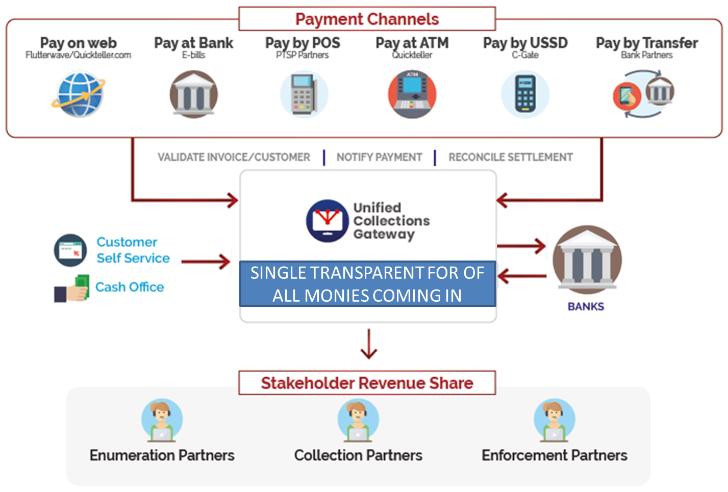
MOVING FROM CASH TO LESS CASH TO CASHLESS
CROWN INTERACTIVE

Slide 7
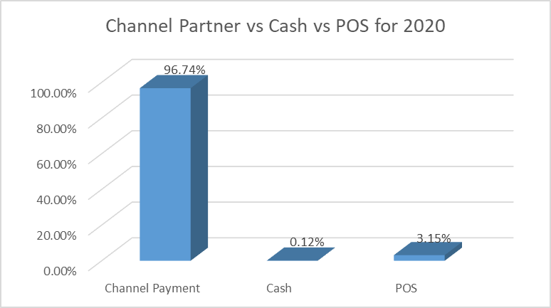
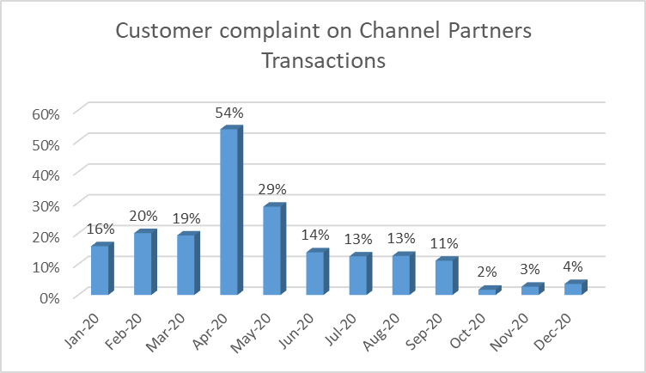
PROTECTING THE REVENUE
Over a 2 year period, we gradually moved to cashless collections via collection partners and as at December 2020 had achieved 97% of the revenue coming in through the cashless channels.
Revenue had also grown due to many factors including the fact that we had gone cashless.
Going Cashless birth a new challenge to ensure that all customer payments were reflected properly on customers accounts and also in the bank account of the DISCO.
This necessitated the need for automation of the help desk for customers to report their concerns on improper receipting, monies not reflecting on bills as well as whistleblowing on extortion.
CROWN INTERACTIVE

Slide 8
PROMOTING A COLLABORATION FRAMEWORK IN IRS
STATE GOVERNMENT
Revenue Generating Entities
LOCAL GOVERNMENT
AGENCIES
INSTITUTIONS
Technology
TECHNOLOGY BUSINESS SUPPORT SYSTEMS
Partners
SERVICE PROVIDERS & ENFORCEMENT PARTNERS
Citizens
THE PEOPLE OF THE STATE – Pay Taxes, Levies & Penalties
CROWN INTERACTIVE

Slide 9
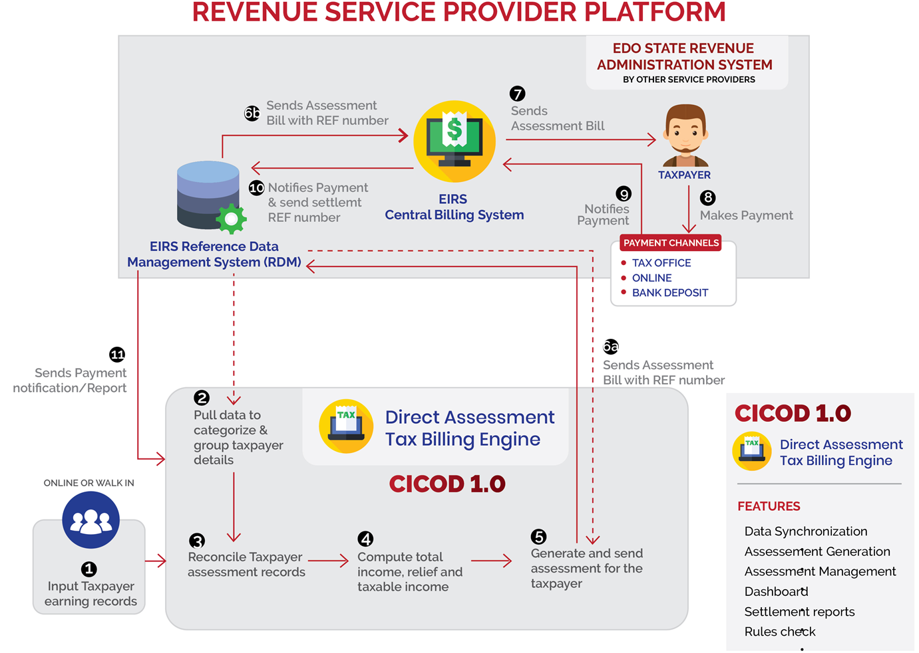
EIRS – AUTOMATION OF DIRECT ASSESSMENT
EDO STATE INLAND REVENUE have implemented a world class service-oriented architecture for their tax management systems using multiple Revenue Service Provides and a collaboration approach.
CROWN INTERACTIVE

Slide 10
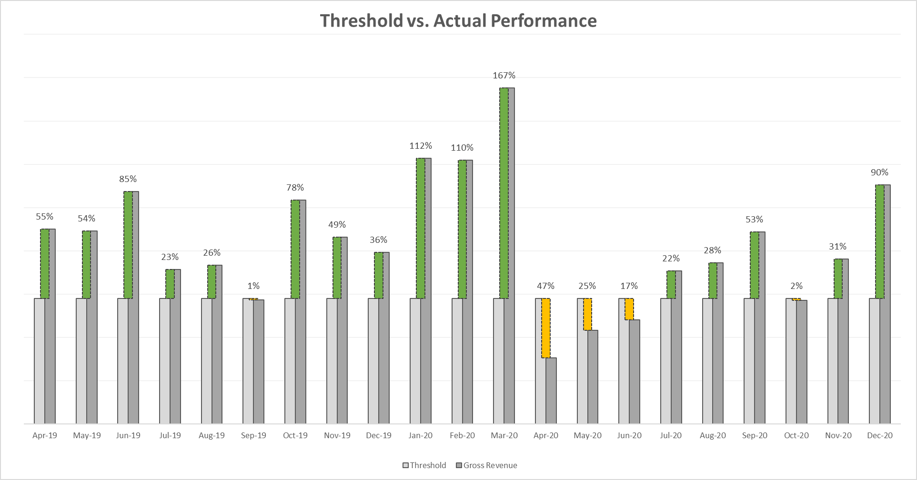
EIRS GROWTH ON TRANSFORMATION IN DIRECT ASSESSMENT
Exact numbers undisclosed but the month-on-month growth above the threshold set is clear
CROWN INTERACTIVE

Slide 11
LESSONS LEARNED
The project was implemented as a shared risk shared reward where the Revenue Service Providers where paid purely on increased revenue. We group the lessons learnt into 3 high-level categories.
COLLABORATE
Feedback from EIRS to the Revenue Service Providers (RSPs) was that they definitely thought both the Inland Revenue and the RSPs could do much better across the revenue streams based on the amount of work that had been done if there is:
Increased in collaboration between the RSPs and the IRS.
Increased collaboration between government agencies and the IRS.
Increased collaboration between large utilities and the IRS
INCREASE TRANSPARENCY
There was the general wrong perception of inadequate transparency as what was truly happening in the response of citizens to some of the initiatives.
EIRS resolved to have better and more frequent engagements with the RSP in order to build trust and resolve any issues of concern at any time.
The involvement of the Executive Governor of the State Mr Godwin Obaseki boosted the confidence of the RSPs.
REWARD
Nothing motivates partners to help achieve more than when they are rewarded timely for their efforts.
CROWN INTERACTIVE

Slide 12
EXPANDING THE TAX NET
CROWN INTERACTIVE

Slide 13
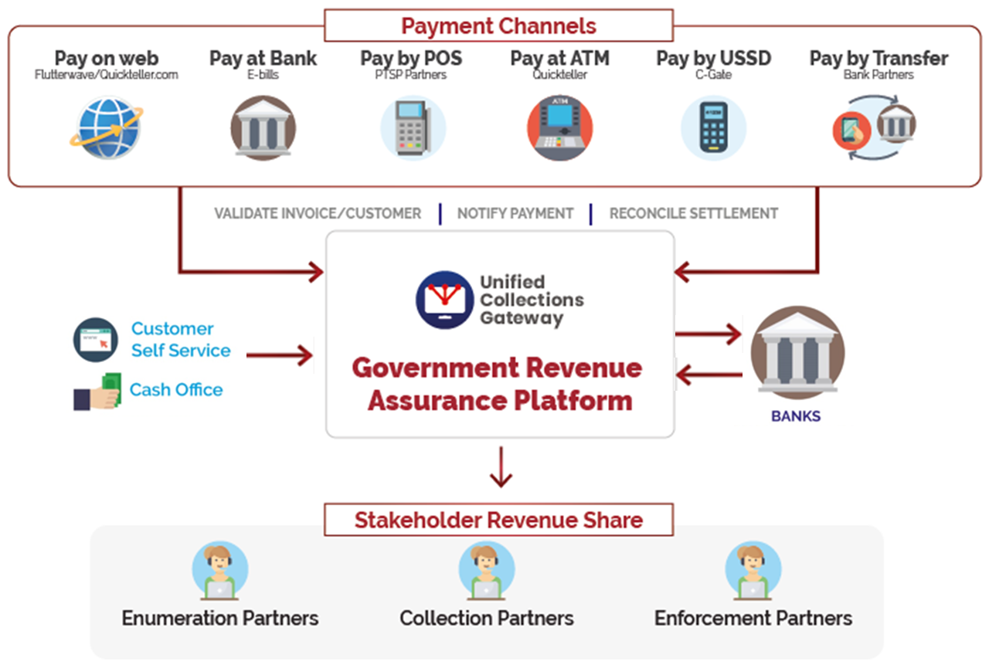
ENABLING REVENUE ASSURANCE IN COLLECTIONS
CROWN INTERACTIVE

Slide 14
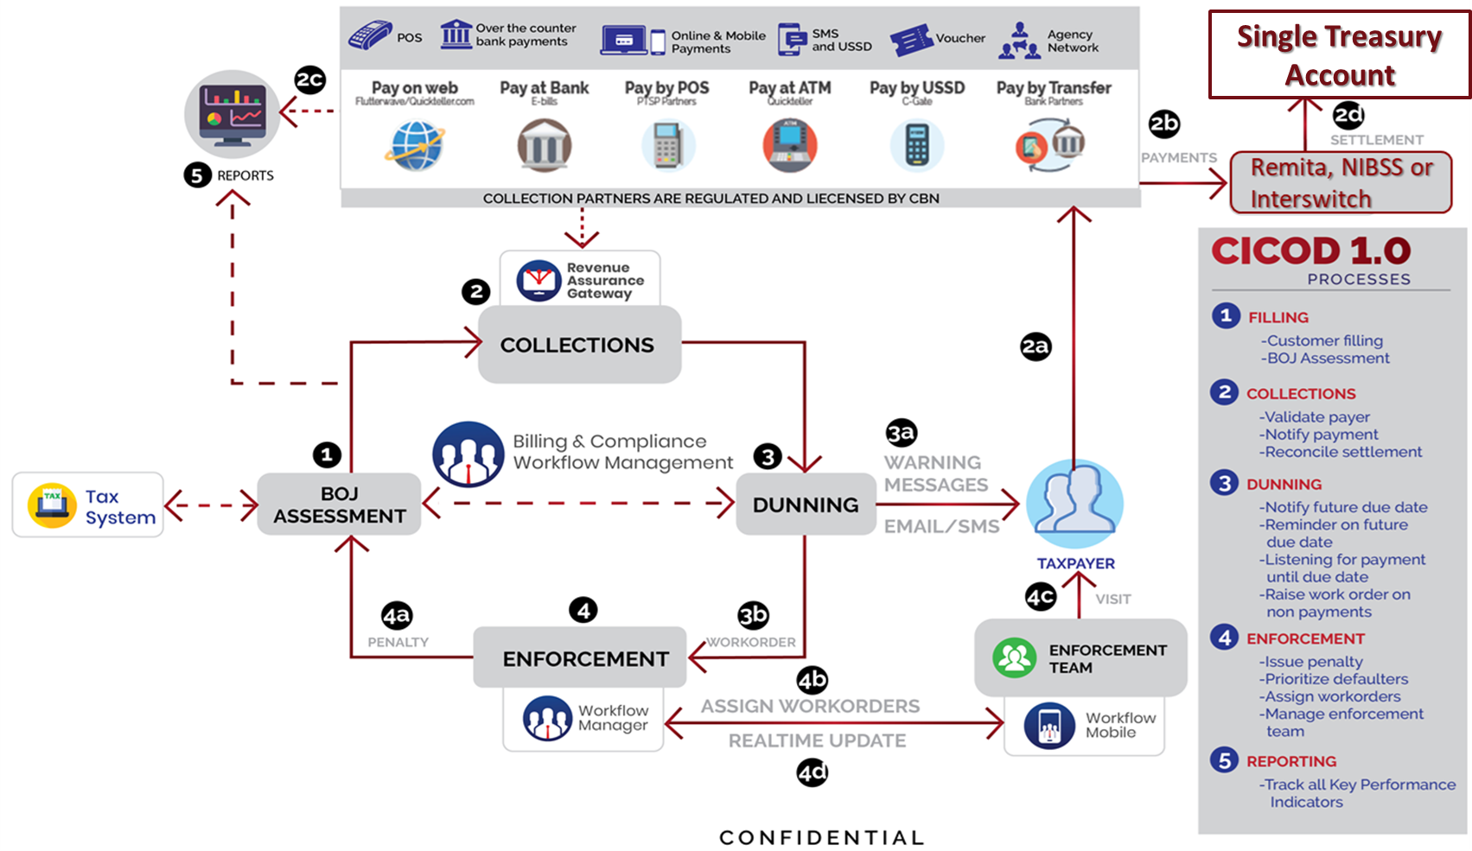
ENFORCING
CROWN INTERACTIVE

Slide 15
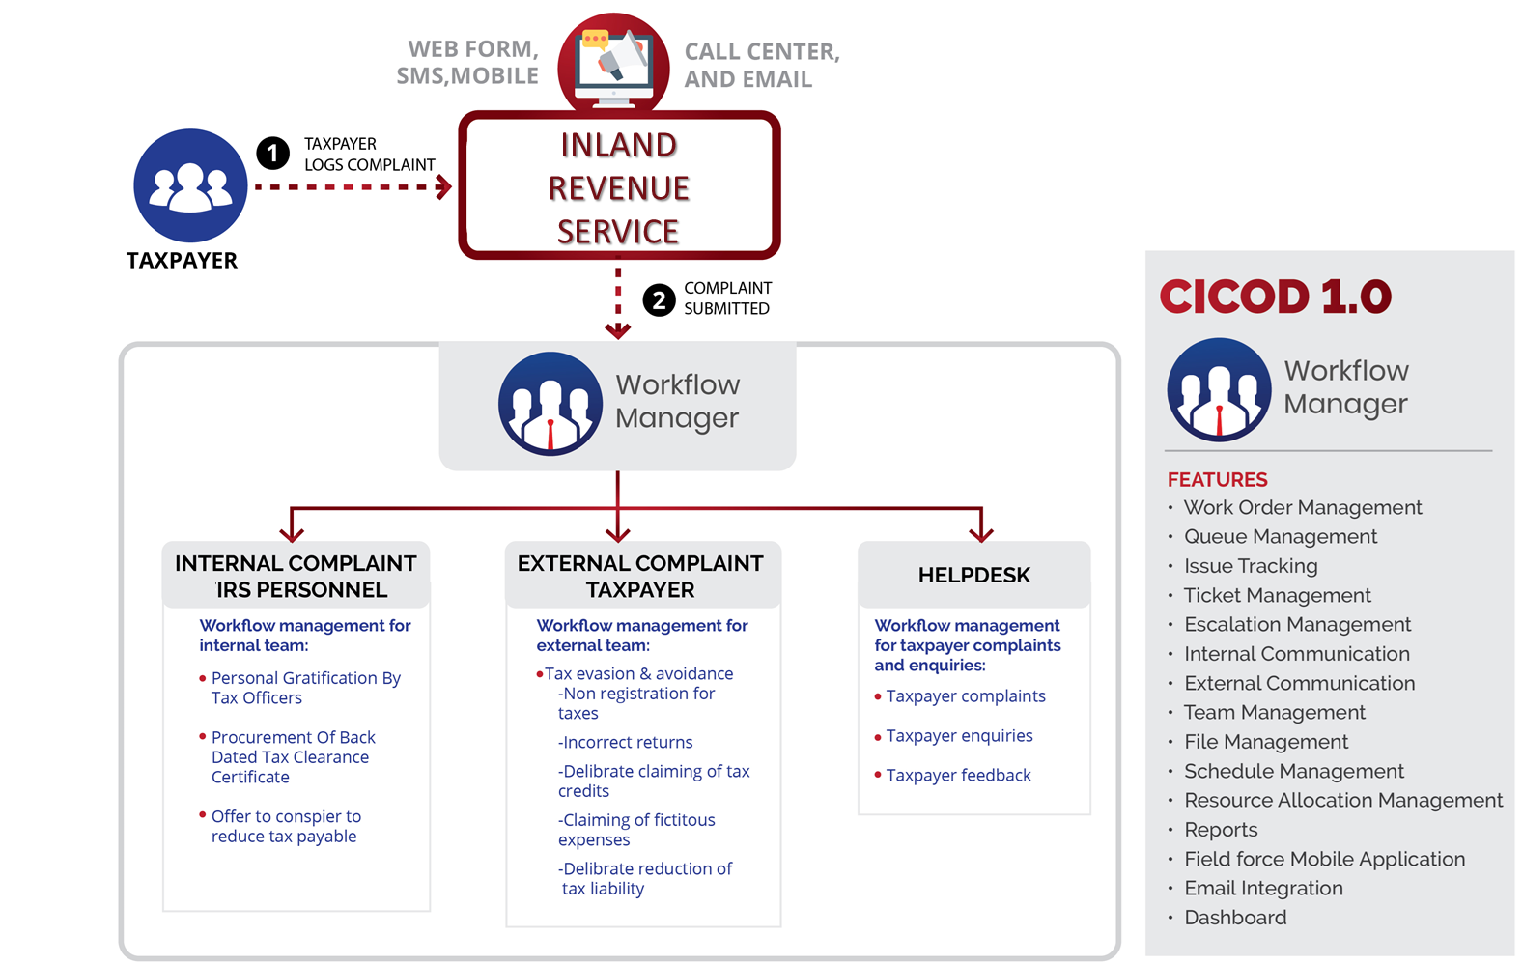
AUTOMATE YOUR WORKFLOW FOR MONITORING
CROWN INTERACTIVE

Slide 16
QUESTIONS ?
For Questions & Feedback:
Email: wumi.oghoetuoma@crowninterative.com
Tel: 0815 268 6610
Corporate website:
www.crowninterative.com
CROWN INTERACTIVE

