Slide 1
STRUCTURAL TRANSFORMATION OF THE NIGERIAN ECONOMY: ANALYSIS OF PATTERNS AND TREND
PROF. OLU AJAKAIYE
EXECUTIVE CHAIRMAN
AFRICAN CENTRE FOR SHARED DEVELOPMENT CAPAICTY BUILDING
IBADAN
A PRESENTATION AT THE 15TH MEETING OF THE 2016 JPD&NCDP, AUGUST 23-25, 2016
AT TAHIR GUEST PALACE, NASARAWA GRA, KANO, KANO STATE

Slide 2
OUTLINE
Introduction
Diagnostic Tools for Structural Transformation
Insights from Diagnosis of Structural Transformation of Nigerian Economy
Pattern and Trend of Structural Transformation of Typical Economies
Pattern and Trend of Structural Transformation of Nigerian and Comparator Economies
Insights from Comparative Analysis of Patterns and Trends of Structural Transformation
Lessons of Experience of Comparator Countries
Planning for Achieving Structural Transformation of Nigerian Economy
Contents of a Typical Participatory MTP
International Partnership in Support of Structural Transformation of Nigerian Economy
Other imperatives

Slide 3
Introduction
Economic development is growth plus structural change and technological sophistication
Economic growth is a necessary condition but not sufficient for structural transformation
Economic growth unaccompanied by structural transformation is recipe for excessive concentration of the economy, non-inclusive growth, jobless growth and paradoxical growth and rising poverty.
Structural transformation of an economy is the reallocation of economic activities away from low productivity to high productivity activities necessitated by the need to move the economy from the present state to a desired specified state.
Structural transformation can also be presumed to have occurred if the contributions of the various economic activities to the total is not too large – i.e., the economy is diversified.
Structural transformation of an economy is best achieved in an environment of deliberate, judicious, dynamic, pragmatic and contextually relevant combinations and coordination of public and private sector institutions and instruments by Government in order to achieve a specified desired development goals. See Ajakaiye (2014 and 2015) further details
Put simply, structural transformation is unlikely to occur in an unplanned economy

Slide 4
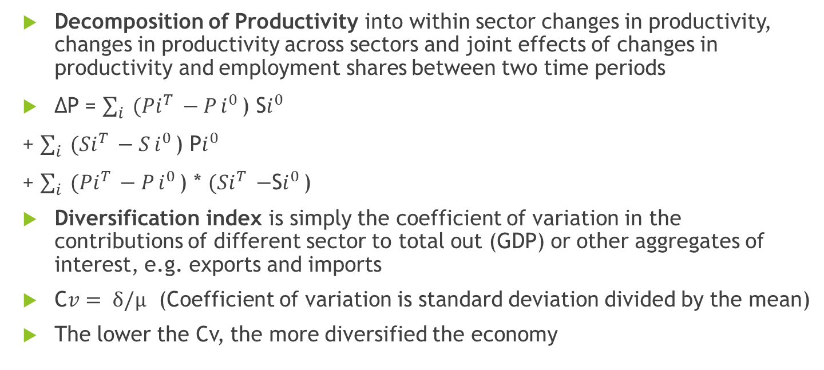
Diagnostic Tools for Structural Transformation
Decomposition of Productivity into within sector changes in productivity, changes in productivity across sectors and joint effects of changes in productivity and employment shares between two time periods
ΔP = $\sum_{i}{(Pi^{T }−P}i^{0 }$)S$i^{0 }$
+ $\sum_{i}{(Si^{T }−S}i^{0 }$) P$i^{0 }$
+ $\sum_{i}{(Pi^{T }−P}i^{0 }$) * $(Si^{T }−$S$i^{0 }$)
Diversification index is simply the coefficient of variation in the contributions of different sector to total out (GDP) or other aggregates of interest, e.g. exports and imports
C${v= δ/µ}^{ }$(Coefficient of variation is standard deviation divided by the mean)
The lower the Cv, the more diversified the economy

Slide 5
Insights from Diagnosis of Structural Transformation of Nigerian Economy
Economic activities have been reallocated away from low productivity agric to low productivity services
The Nigerian economy has been undiversified
These are all contrary the aspirations of NV2020 where the objective was to reallocate economic activities from Agric to manufacturing and modern services
Failure to achieve structural transformation is a consequence of abandoning planning during the most auspicious time in Nigerian economic history (2000-2014)
It is imperative to quickly return to rigorous planning at Federal and State levels

Slide 6
Pattern and Trend of Structural Transformation of Typical Economies
The literature suggests that a rapid increase in the share of industry and a decline of the agricultural share, i.e., industrialization initially plays a key role in catapulting the economy onto a higher growth path
Typically most attention is paid to the size of the manufacturing sector as economic development is often thought to be closely associated with industrialization.
Therefore as the economy grows, the contribution of agriculture should decline while that of manufacturing should rise and as the economy advances towards knowledge economy, the share of services should increase

Slide 7
Pattern and Trend of Structural Transformation of Typical Economies ctd
In essence at early stages of development, agriculture or primary production tends to dominate
As development progresses, manufacturing becomes dominant
At the advanced stage, modern sophisticated services dominate
We compare the growth and pattern of structural transformation in Nigeria with those of comparator countries - China, Indonesia, Malaysia and South Korea

Slide 8
Average Annual Growth Rates, 2000-2014
Clearly, Nigeria and the comparator countries met the growth imperative for Structural Transformation
Indeed Nigeria out-performed all but China
However, Figures (a-f) indicate that it is only in Nigeria that the decent growth of the period under consideration was not accompanied by significant structural transformation!!!.

Slide 9
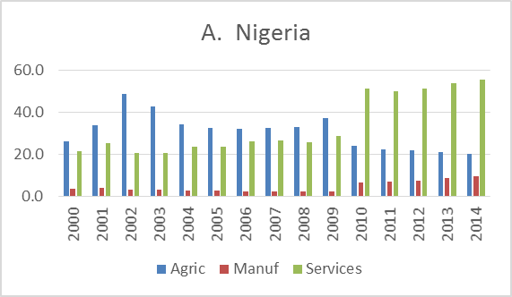
Pattern and Trend of Structural Transformation in Nigeria

Slide 10
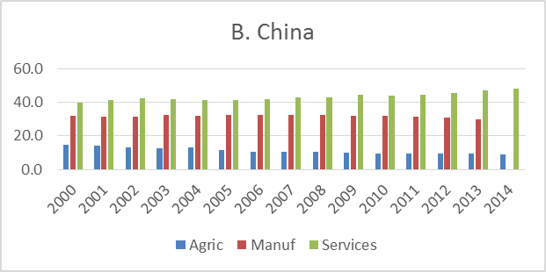
Pattern and Trend of Structural Transformation - China

Slide 11
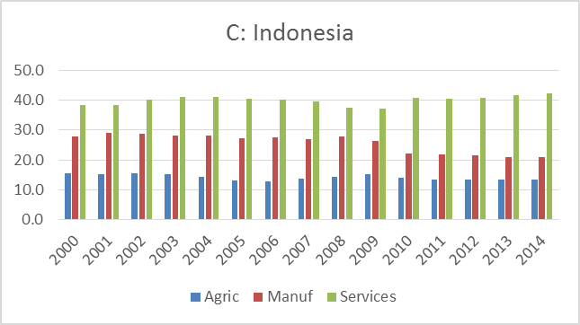
Pattern and Trend of Structural Transformation - Indonesia

Slide 12
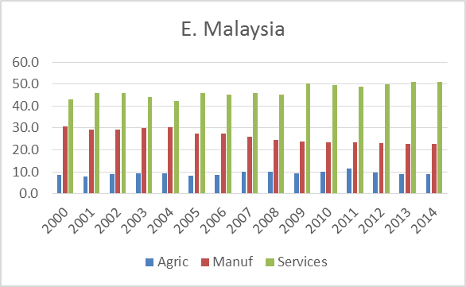
Pattern and Trend of Structural Transformation - Malaysia

Slide 13
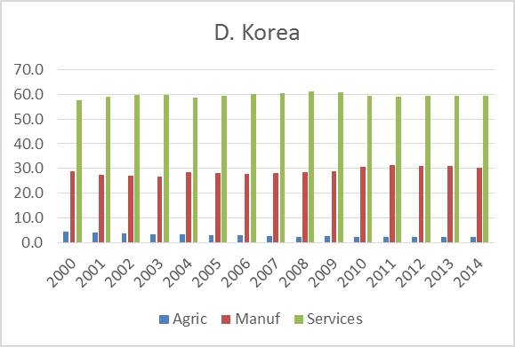
Pattern and Trend of Structural Transformation – South Korea

Slide 14
Insights from Comparative Analysis of Patterns and Trends of Structural Transformation
The pattern of structural transformation in Nigeria has been from primary production (oil and agric) to services sector dominated by informal rudimentary and low productivity distributive trade – premature tertiarization of the economy
The trend has been systematic consolidation of the premature tertiarization syndrome and the associated continuing disarticulation of the economy resulting in weakening inter-industry linkages, rising unemployment, poverty, inequality and stagflation
These are contrary to the aspirations of NV20:2020 which specified that the contribution of manufacturing to GDP should be at least 25% by 2020 whereas as at 2015, it is only 9.5%.
Also, the Global Competitiveness Index (GCI) of the World Economic Forum(WEF), 2014-2015 still classifies Nigeria as a factor driven economy – the lowest stage of development despite its impressive average annual growth of around 8 per cent between 2000 and 2014. (WEF, 2015: 282)).
By contrast, China, Indonesia, Malaysia and South Africa are at efficiency driven stage of development while South Korea is already at the innovation driven stage of development (the highest stage of development).

Slide 15
Insights from Comparative Analysis of Patterns and Trends of Structural Transformation
The upshot of the foregoing is that while Nigeria performed well in terms of growth profile between 2000 and 20014, the growth was factor (crude oil and primary agriculture ) driven and was not accompanied by significant structural change.
When the factor that drove the growth started to falter from June 2014, the growth process was terminated and we are now in recession!!!
Again, the abandonment of rigorous participatory medium term planning (the veritable bridge between NV20:2020 and the annual budgets) during the most auspicious time has resulted in a disarticulated economy characterized by the paradox of growth accompanied by intensifying misery featuring rising poverty, inequality, unemployment and inflation!!!

Slide 16
Lessons of Experience of Comparator Countries
Development experiences of the comparator (Asian) countries where growth has been accompanied by structural transformation suggests that their success rests squarely on:
Political commitment of the leadership to maximizing welfare of the people;
Creation and maintenance of a competent and highly motivated largely meritocratic bureaucracy with appropriate autonomy and embeddedness
Strategic and pragmatic state intervention aimed at
investing in people, science and technology;
investing in social, institutional and economic infrastructure and
efficiently and effectively nurturing, supporting and promoting development of world class indigenous private sector operators, organizations and institutions able and ready to partner with their foreign counterparts to their mutual benefits and complementary to national development agenda articulated in a participatory development plan

Slide 17
Lessons of Experience of Comparator Countries ctd
A cooperative, complementary and collaborative public-private interface and avoidance of adversarial relationship among public and private agents
A realization that the pragmatic choice is not between the state and market but between different combinations of public and private institutions by the state in delivering sustainable growth and structural transformation.
Avoidance of capture and rent seeking behavior as well as readiness to adjust policies quickly once credible and convincing evidence shows that certain strategies and policies are no longer applicable in light of emerging circumstances.

Slide 18
Planning for Achieving Structural Transformation of Nigerian Economy
The initiative of re-creating Ministry of Budget and National Planning at the Federal level should be replicated at the State level – States that are yet to create such a ministry should .do so
The Federal Ministry of Budget and National Planning should organize a National Development Summit to be attended by the national leadership of all stakeholder groups, including those of
Federal MDAs,
Committees of National Assembly on Planning and Economic Development,
State Government Planning Agencies,
State Assembly Committee on Planning and Economic Development,
the political parties,
private sector organizations, labour union organizations, professional organizations and major civil society organizations.

Slide 19
Planning for Achieving Structural Transformation of Nigerian Economy
The purpose of this Summit is to build consensus on the objectives of the medium-term plan and agree on key priority actions to be taken by each of the stakeholder groups working in concert to achieve the plan objectives.
State Ministries of Budget and Planning should also organize a State Development Summit to be attended by the leadership of
Federal Ministry of Budget and National Planning,
State Government MDAs, State Assembly Committee on Planning and Economic Development,
Chairmen of all Local Government Councils,
the State Leadership of all stakeholder groups, including political parties, private sector organizations, labour organizations, professional organizations and major civil society organizations such as State Council of Women Societies.

Slide 20
Planning for Achieving Structural Transformation of Nigerian Economy ctd
The objective of the Summit is to build consensus on the objectives and targets of the state medium term plan and agree on key priority actions to be taken by each stakeholder groups working in concert to achieve the plan objectives.
Federal Ministry of Budget and National Planning and the State Planning Agencies should prepare their respective Federal and State Medium term Rolling Development Plan based on the outcome of the respective National and State Development Summits for consideration and approval by the Federal and State Executive Councils and subsequent transmission to the National and State Assemblies for adoption by resolution the way they do with MTEF/MTSS.
Copies of the Plan should be made available to all participants at the National Development Summit and to the general public.

Slide 21
Contents of a Typical Participatory MTP
The Federal and State Plans should contain:
a precise statement of the development objectives based on the outcome of the National and State Development Summits
Federal and State Government investment programmes required for the achievement of the medium term development goals agreed upon at the Development Summits;
estimates of private sector investment profile necessary to secure the contributions of the private sector to the achievement of the agreed development objectives.
broad directions of monetary, fiscal, trade, exchange rate, incomes, sectoral and other development policies that are compatible with the enabler roles and constitutional responsibilities of Federal and State Governments and also complementary to the achievement of the development objectives during the plan period; and

Slide 22
Contents of a Typical Participatory MTP Ctd
A macroeconomic framework including the basic macroeconomic projections and sectoral development targets all of which are conditional on the public investment programmes, estimates of private sector investment profile and the complementary monetary, fiscal, trade and other structural and social development policy directions.
Articulation of the human resources required for the plan and the employment implications of the plan
Articulated/Institutionalized of collaborative monitoring, evaluation and impact assessment framework to be coordinated by the Ministries of Budget and Planning
Articulated Institutionalized framework for effective periodic (half yearly) deliberations by relevant stakeholder groups at Federal, State an Local Government levels where the monitoring reports will be considered for validation and subsequent presentation to the Federal and State Executive Councils for approval and eventual transmission to the National and State Assemblies for adoption by resolution

Slide 23
International Partnership in Support of Structural Transformation of Nigerian Economy
In this regard, development partners should:
channel their development assistance to projects that will increase competitiveness of recipient nations;
encourage their MNCs to actively seek out and support local industrialists to become part of regional production networks;
supplement diversification efforts of the Nigerian Government by providing financial assistance through preferential export financing and similar options

Slide 24
Other imperatives
NBS should be empowered and supported to produce regular, comprehensive, integrated data on all aspects of the economy and society necessary to guide and gauge national development including structural transformation of the economy.
The initiative to produce State GDP should be sustained and finalized
MNBP should originate an executive bill making participatory development planning mandatory and not optional – MTEF and MTSS are insufficient
MNBP should rebuild capacity of PRS at Federal level and JPB should mandate MBNP to incorporate State Govts in the capacity building process
MBNP should pursue the possibility of pooling and professionalizing planning officer cadre at the Federal and state Levels without prejudice to their prospects of rising to the top of their careers in the civil service

Slide 25
THANK YOU FOR YOUR KIND ATTENTION

